Slide 1
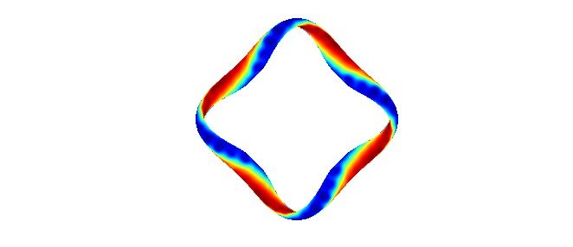
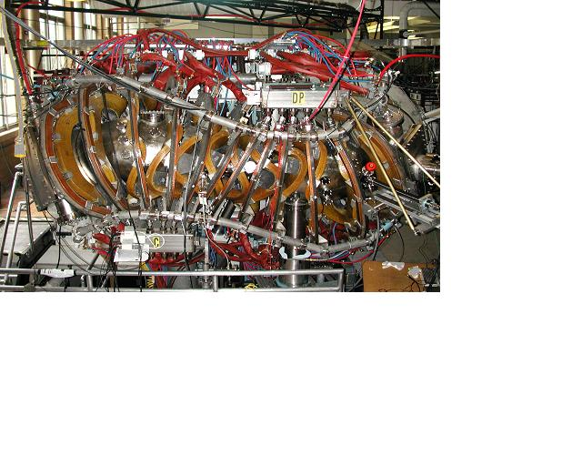
Measurements of the contribution of Reynolds stress to momentum balance in the HSX stellarator
Bob Wilcox
D.T. Anderson, J.N. Talmadge, F.S.B. Anderson
HSX Plasma Laboratory
University of Wisconsin, Madison
Thanks to the rest of the HSX team for their contributions to this work
Joint ISHW and IEA-RFP Workshop
Padua, Italy
September 17, 2013

Slide 2
Outline
The HSX stellarator
  Quasi-symmetric optimization
  Experimental setup: Langmuir probes
Measurements of Reynolds stress and E_{r}
  Gradient in time-averaged Reynolds stress profile implies relevant macroscopic flow drive
  Region of measured flow drive corresponds to measured deviation in E_{r} from neoclassical ambipolarity calculations
  Fluctuation measurements from multiple probe installations show that Reynolds stress drive changes depending on the local magnetic geometry

Slide 3
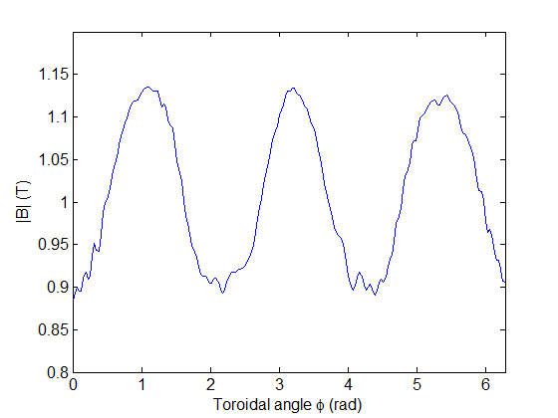


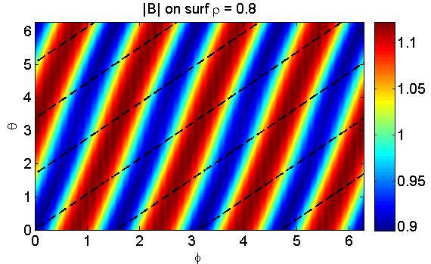
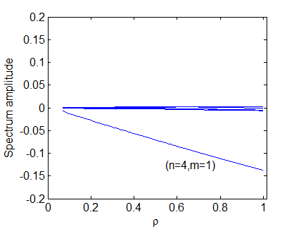
HSX is the first stellarator optimized for quasi-symmetry, designed to minimize neoclassical transport and flow damping
HSX is optimized for quasi-helical symmetry: |B| is symmetric in the helical direction (n=4, m=1)
This is designed to give tokamak-like viscosity and neoclassical transport properties
|B| along field line
Tokamak:
QHS:
|B| Spectrum
Notes:
HSX major radius is ~1.2m, minor radius ~12 cm

Slide 4
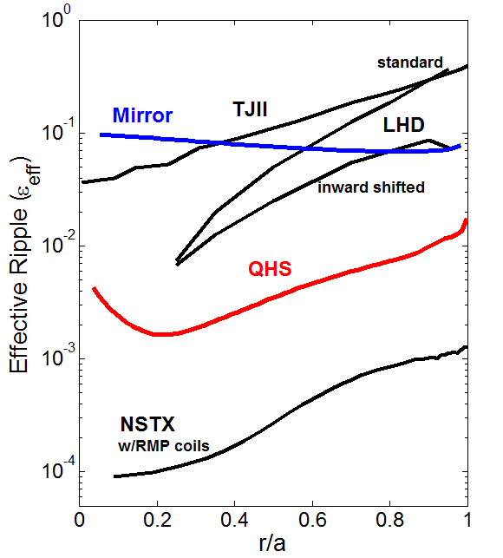

The level of symmetry breaking in HSX is somewhere between that of a conventional stellarator and a tokamak
Effective ripple is a measure of the neoclassical thermal particle losses at low collisionality, and is finite in all real magnetic confinement devices
  Sources like RMP coils, TF ripple, field errors in tokamaks
Particle transport in the low collisionality regime scales like ~
Viscosity is similarly in between that of a tokamak and a conventional stellarator
TJII: Seiwald et. Al., JCP 2008
LHD: Okimara, EPS 2012
NSTX calculations courtesy of John Canik, ORNL
Notes:
Although it has been optimized to be quasi-symmetric, this optimization is not perfect. As with all real devices, including tokamaks, there is some finite amount of magnetic ripple that leads to neoclassical viscosity as well as collisionless particle losses in the low collisionality regime.

Slide 5
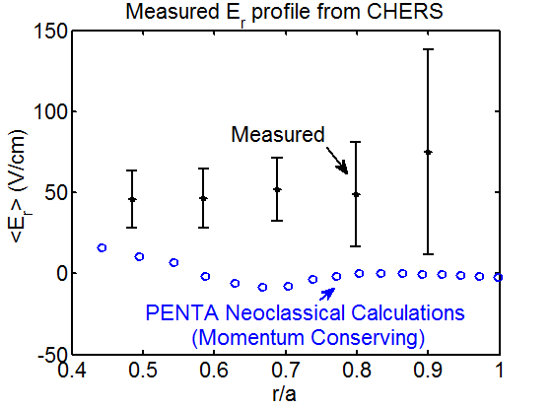

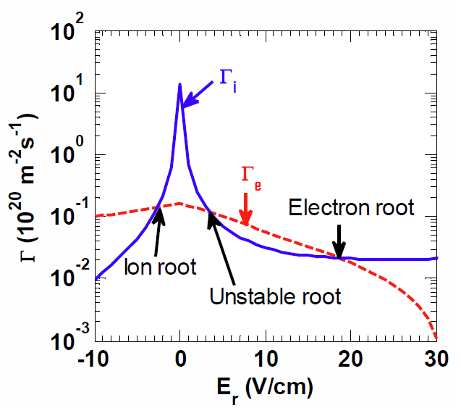
E_{r} measured in HSX using CHERS does not generally agree well with the values calculated by PENTA
DKES and PENTA determine E_{r} by calculating non-ambipolar particle fluxes as a function of E_{r} and imposing the ambipolarity condition
CHERS measurements made in similar 50 kW ECRH plasmas doped with CH4 show that E_{r} differs from neoclassical calculations →
[J. Lore et. al., PoP 2010]
[A. Briesemeister et al, PPCF 2013]
Investigate turbulent sources for determining E_{r}
Notes:
So now when we calculate the flows using neoclassical transport codes, do the measurements match neoclassical predictions? We calculate the neoclassical transport of each particle species as a function of the radial electric field. The radial electric field is calculated as the solution to the ambipolaroty condition. We do this using the PENTA code, which takes the DKES transport coefficients and corrects for momentum conservation, although the change to the neoclassical ambipolar solution is small due to this correction.
Comparing CHERS measurements to these neoclassical calculations shows that the radial electric field deviates significantly from the calculated prediction. These measurements are made in plasmas doped with carbon to get enough emission for the CHERS diagnostic, but they are similar plasmas to what I will be showing measurements for. These are steady-state measurements, and there is no external momentum injection in these ECRH-heated HSX plasmas.

Slide 6
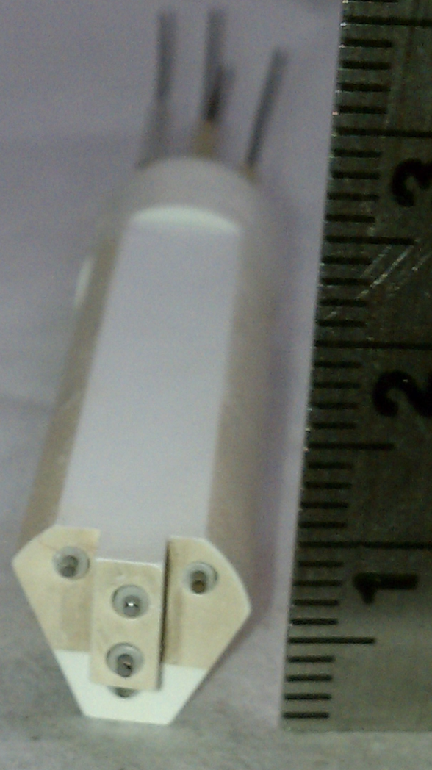
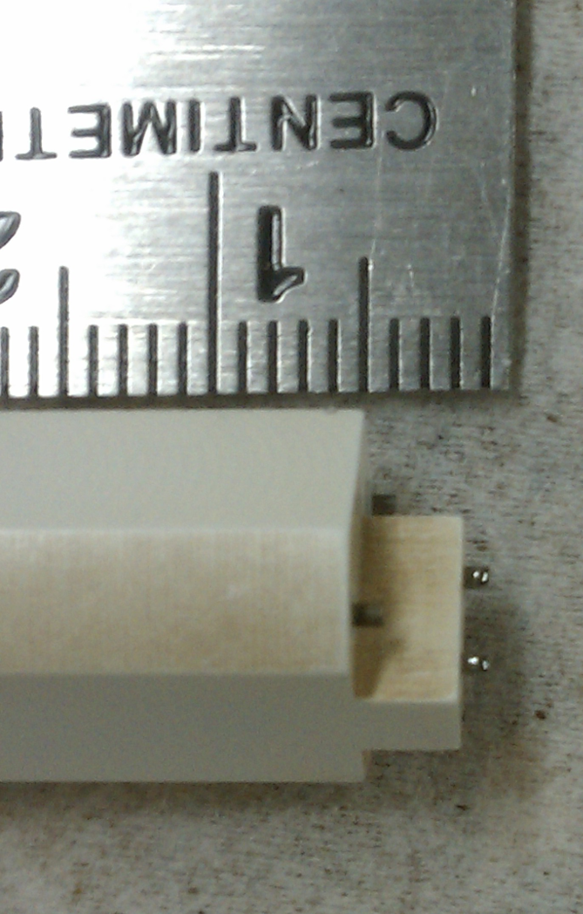


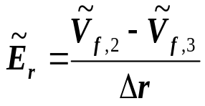
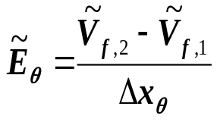
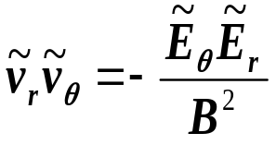
Langmuir probes installed to measure local fluctuating plasma parameters for Reynolds stress studies
Tungsten tips shielded by bulk BN, V_{f} and I_{sat} signals digitized at 2.5 MHz
Radial profiles taken on a shot-by-shot basis
  Discharges are very repeatable
Differential V_{f} fluctuations are assumed to be potential fluctuations
  Fluctuating T_{e} not accounted for
  Fluctuating v_{r} and v_{θ} quantities for Reynolds stress assumed from measured E_{r} and E_{θ} fluctuations, respectively
E_{r}
B
E_{θ}
I_{sat}
V||
V_{f}
I_{sat}
V_{f}
V_{f}
Notes:
If we assume electrostatic fluctuations and steady state plasmas, which should be the case in the ECRH-heated HSX plasmas we have, then the Reynolds stress is the most likely candidate for a momentum source in the momentum balance equation

Slide 7
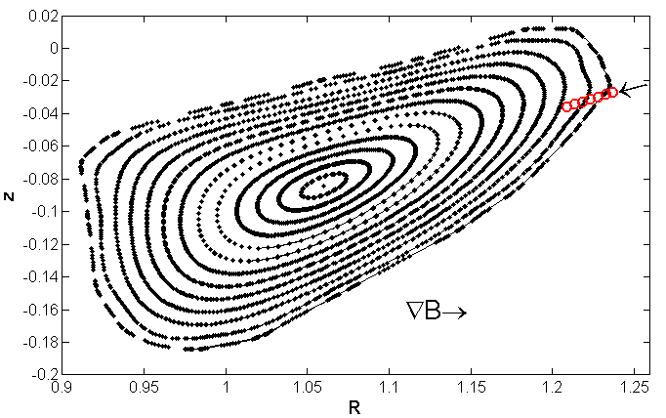
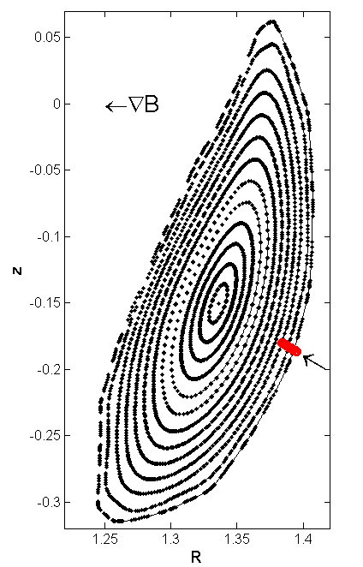
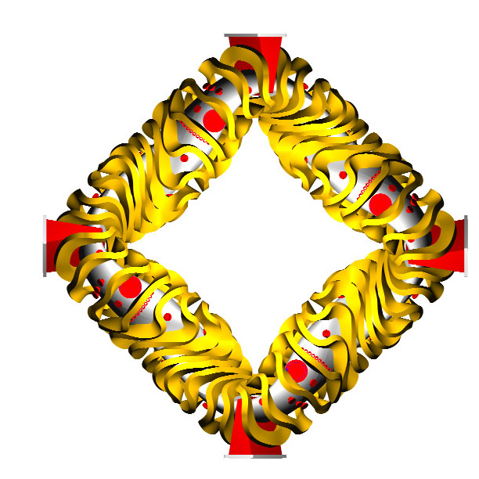
Two probe installations to provide better estimate of flux-surface averaged Reynolds stress from local measurements
High-field side probe
Probes located in regions near limits of magnetic field strength, curvature, and flux expansion on a flux surface
Compare measurements at two locations with different local magnetic geometries
Low-field side probe
Notes:
One probe is in a region of a flux surface with high magnetic field, good curvature, and high flux expansion, while the other probe is located on the low field side of a toroidal cross section in a region with bad curvature and small flux expansion

Slide 8
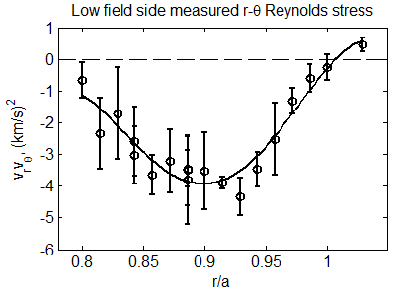
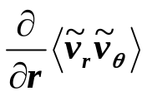
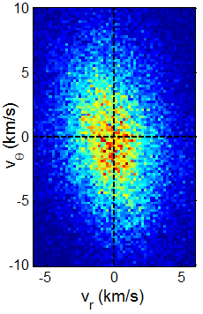
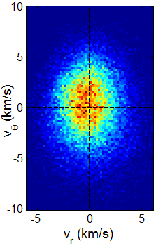
Clear radial gradient exists in time-averaged Reynolds stress profiles
Reynolds stress flow drive is proportional to
PDF of velocity fluctuations (inferred from V_{f} measurements) show negative correlation between instantaneous v_{r} and v_{θ} fluctuations inside the confined plasma
  Fluctuations are more isotropic near the last closed flux surface
Measurement needs to be compared to some estimate of the poloidal viscosity to calculate resulting poloidal rotation and E_{r}
Notes:
This profile is from the low-field side probe, which shows a larger Reynolds stress gradient

Slide 9

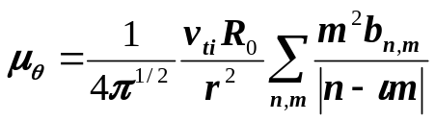
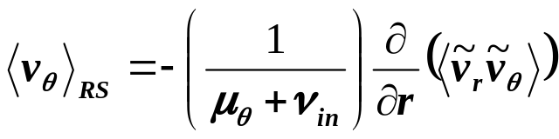
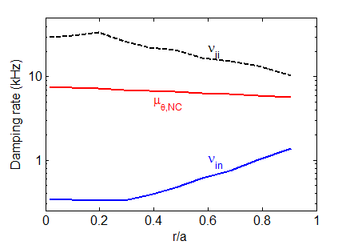

Estimate of neoclassical poloidal viscosity is calculated to find contribution of measured Reynolds stress to flows and E_{r}
[M. Coronado and H. Wobig, Phys. Fluids B 29 (1986) 527]
Estimate the purely poloidal component of neoclassical viscosity for poloidal momentum balance
Neutral density based on measurements from H-alpha arrays and calculations from DEGAS neutral gas code
Neutral damping is small but non-negligible at the edge where probe measurements are made
Notes:
This is an initial estimate that ignores the coupling in a stellarator between parallel and perpendicular flows, so this estimate will be improved going forward with PENTA.

Slide 10
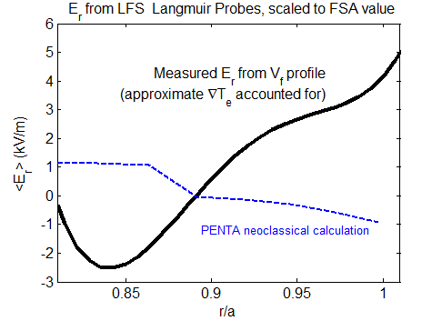
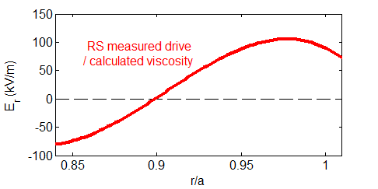
Measured Reynolds stress flow drive agrees qualitatively with deviation of E_{r} from neoclassical ambipolarity calculation
E_{r} calculated from shot-by-shot floating potential profiles
T_{e} gradient is estimated from Thomson scattering and accounted for
  T_{e}(ρ=0.9) ≈ 60 eV
Based on sensitivity studies, neoclassical calculations have small errorbars relative to measured deviations
Reynolds stress measurements imply unphysically large flow drive
  Single point measurement where microinstabilities are expected to be most unstable (low field, bad curvature)
  T_{e} fluctuations observed through V_{f} may lead to over-estimation of fluctuating φ [Gennrich & Kendl, PPCF 2012]
  Viscosity may be underestimated

Slide 11
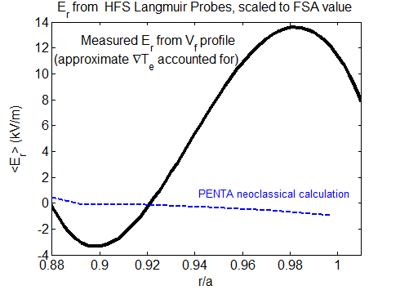
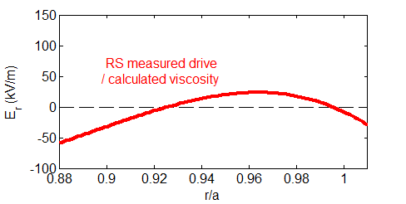
High field side probe measures qualitatively similar E_{r} profile, with lower-amplitude Reynolds stress drive than low-field side
E_{r} profile at HFS probe is similar
Reynolds stress drive measured on high-field side is generally smaller magnitude, but still larger than the observed deviation from the neoclassical calculation
How to interpolate the flux surface average Reynolds stress from 2 measured locations on a surface remains an open question

Slide 12
Summary and future work
Reynolds stress flow drive is measured to be large in the same radial regions where E_{r} deviates significantly from the predicted ambipolar value calculated by PENTA
Locally measured Reynolds stress drive can change depending on local magnetic geometry
  No clear way to extract a flux surface averaged value of the Reynolds stress from 2 spatial locations
Upcoming measurements in configuration with the symmetry intentionally spoiled will hopefully shed light on the dependence of intrinsic flows on quasisymmetry
Notes:
Improvement of the viscosity model will hopefully also help improve the modeling, although

Slide 13
Extra Slides

Slide 14
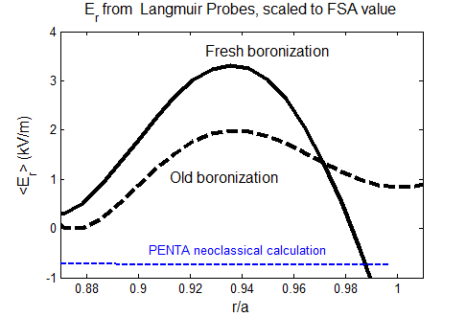
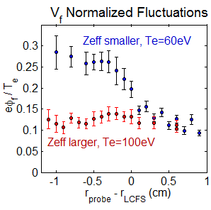
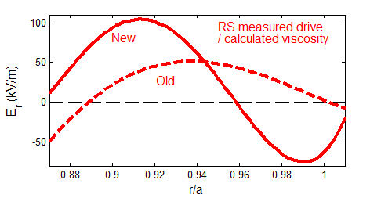
Additional datasets show positive definite Er even before compensating for the temperature gradient
When wall conditioning changes (fresh boronization), edge T_{e} is reduced, and fluctuation levels are increased, along with the measured deviation from neoclassical E_{r} prediction
E_{r} deviation from neoclassical prediction and Reynolds stress measurements qualitatively scale together in amplitude and radial location

Slide 15
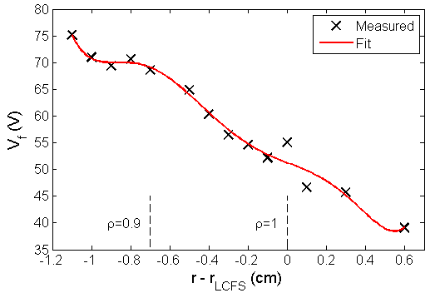

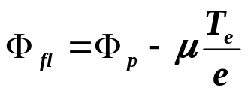
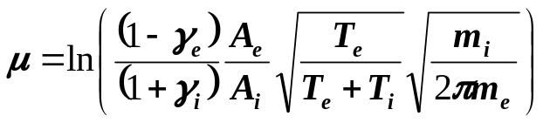
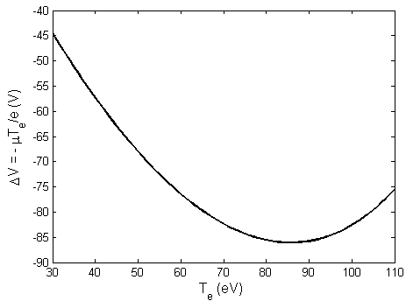
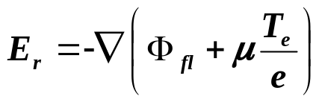
E_{r} measured by radial scan of floating potential signal, which also has electron temperature dependence
E_{r} measured using fit of shot-by-shot Langmuir probe V_{fl} profile
  Attempt to account for local T_{e} gradient in measured E_{r} plots
For low T_{e}, physical T_{e} results in more-positive E_{r}, larger deviation from NC ambipolarity
Non-linearity above ~80 eV due to secondary electron emission, γ_{e}
E_{r} measurements from probe may not be reliable above T_{e}~100 eV without local T_{e} measurements
Contribution of T_{e} to V_{fl} measurement
From ~70-100 eV, offset has small effect on E_{r} measurement (gradient small)

