Slide 1
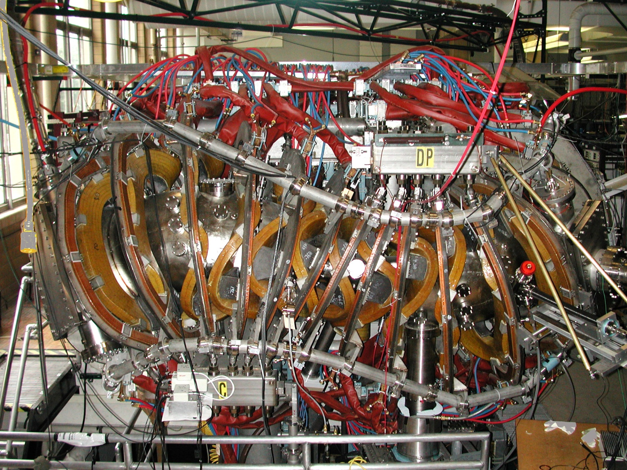
Measurement, Reconstruction and Modeling of Equilibrium Currents in the HSX Stellarator
J.C. Schmitt, J.N.Talmadge, J.Lore
15TH WORKSHOP ON MHD STABILITY CONTROL
15-17 November, 2010 Madison, WI

Slide 2
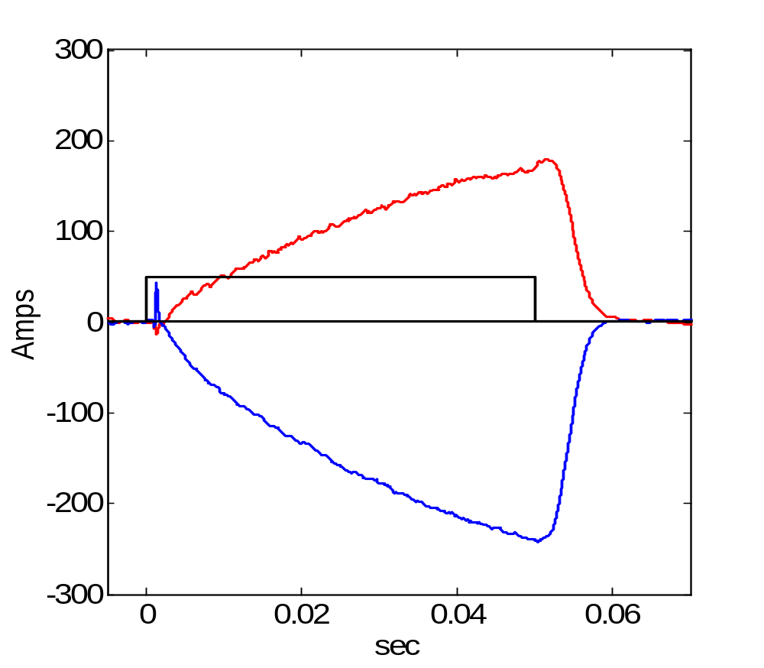
Toroidal current is predominantly bootstrap-driven
Electron Cyclotron Resonance Heating
  1st Harmonic Ordinary-mode
  Perpendicular launch
No ohmic drive
Toroidal current reverses with B-field direction
Bootstrap current induces toroidal current with long decay times: τ_{η||/μ0} ≥ τ_{EXP}
Net Toroidal Plasma Current
N_{e} = 3
ρ_{ECRH} = +0.18 (OB)
B_{CCW}
50 kW ECH
B_{CW}

Slide 3
Equilibrium Currents with Quasi-Helical Symmetry
Pfirsch-Schlüter current rotates with the |B| contours.
Bootstrap current is in the opposite direction and reduced compared to a tokamak.
The evolving current profile is modeled with a diffusion equation using a 3D susceptance matrix.
V3FIT calculates the expected signal response for an array of magnetic diagnostics.
V3FIT reconstructs the pressure and current profiles based on the magnetic diagnostics signals.

Slide 4
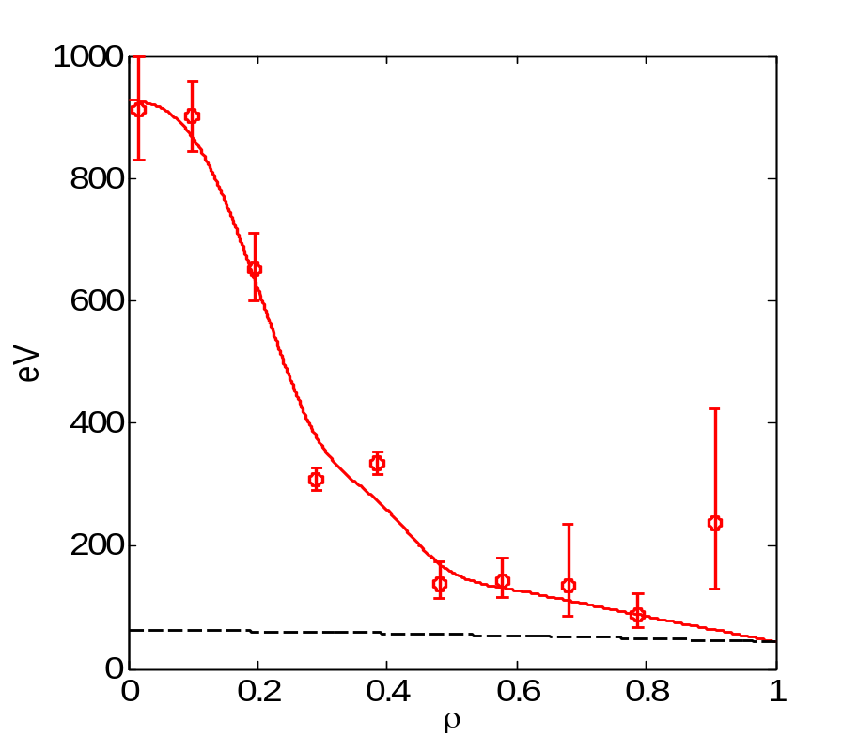
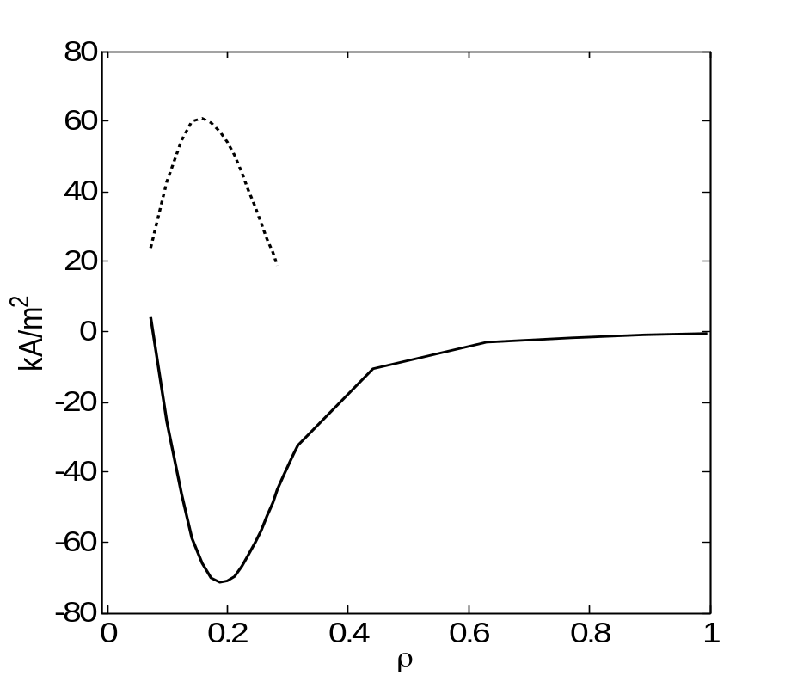
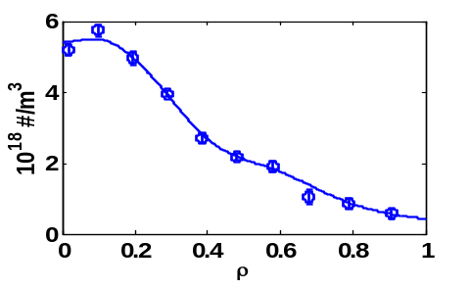
Bootstrap current depends on E_{r}
T_{e}
N_{e}
J_{BS e-root}
Multiple ambipolar solutions
J_{BS i-root}
T_{i}
T_{e}, N_{e} from Thomson Scattering.
T_{i} from ChERS. Z_{eff} ≈ 1 from Bremsstrahlung radiation (ChERS optics).
PENTA¹ calculates the fluxes. E_{r} is determined by ambipolarity.
The electron-root reverses the direction of the bootstrap current.
¹ D.A. Spong, Phys. Plasmas 12, 056114 (2005).

Slide 5
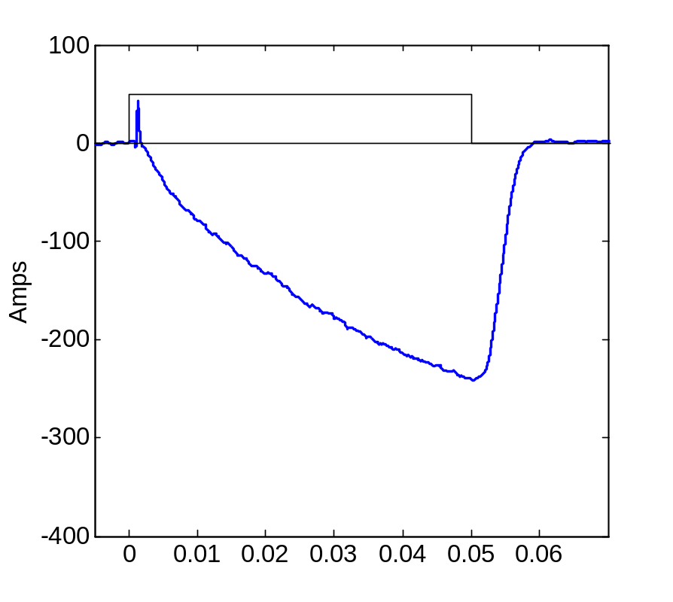
Toroidal current evolves during shot
50 kW ECH
J_{BS e-root}
-60 A
∆I_{BS} = 304 Amps
J_{BS i-root}
-364 A
If electron-root dominates: I_{BS} = -60 A If ion-root dominates: I_{BS} = -364 A
The measured net current is between the predicted limits of the ion- and e-roots.
The extrapolated steady state value is -345 A. τ_{L/R} ~ 40ms.

Slide 6
Modeling the Evolution of the Toroidal Current
3D susceptance matrix links toroidal and poloidal currents and magnetic fluxes²
  S₁₂ = S₂₁ = 0 for Tokamaks
  S₁₁ ≈ S₁₂ ≈ S₂₁ for HSX
1-D diffusion equation for rotational transform
Boundary conditions
  Finite current density on axis:
  iota @ LCFS set by measurement:
Any non-inductive source
  ² P. I. Strand and W. A. Houlberg, Phys. Plasmas 8, 2782 (2001).

Slide 7
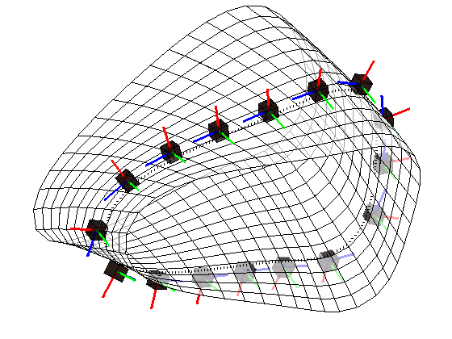
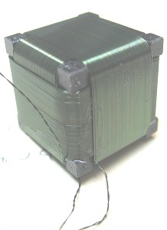
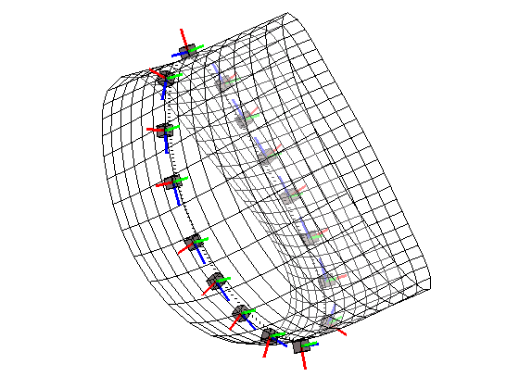
V3FIT³ Calculates the Magnetic Diagnostics Signals
Diagnostic set includes two Rogowski coils, two flux loops , 32 dB/dt sensors and the limiter location.
VMEC is the equilibrium solver. The plasma pressure, toroidal current profile and net toroidal flux are specified with up to 9 free parameters.
For reconstruction, V3FIT adjusts the parameters to minimize the difference between the measured and modeled signals.
Thanks to James Hanson and Steve Knowlton for the assistance in using V3FIT
³ Nucl. Fusion 49 (2009) 075031.
Φ=1/2 Field Period
Φ=0 (symmetry plane)

Slide 8
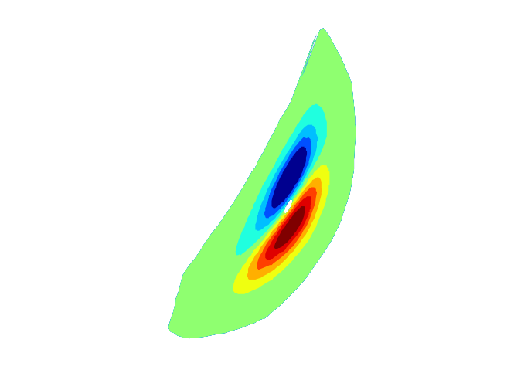
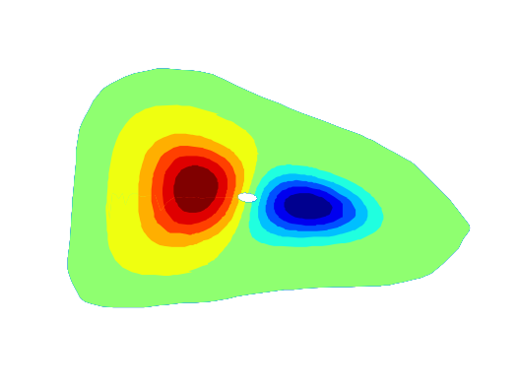
The Pfirsch-Schlüter current rotates helically
B_{r}
32
12
Poloidal Index
B_{θ}
17
Red Contours: J_{PS} OUT OF PLANE
Blue Contours: J_{PS} IN TO PLANE
26
8
16
25
18
1
4
Φ≈ 1/6 Field Period
Φ≈1/2 Field Period
The plasma pressure profile is calculated and used in V3FIT to find the magnetic response due to the Pfirsch-Schlüter current.
The net toroidal current is set to 0.

Slide 9
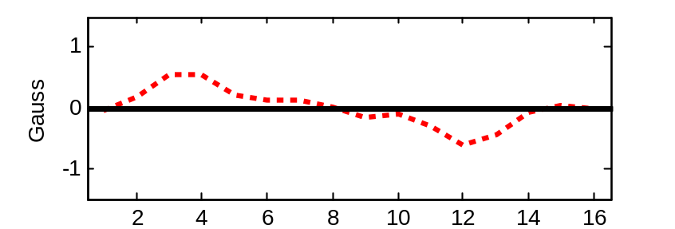
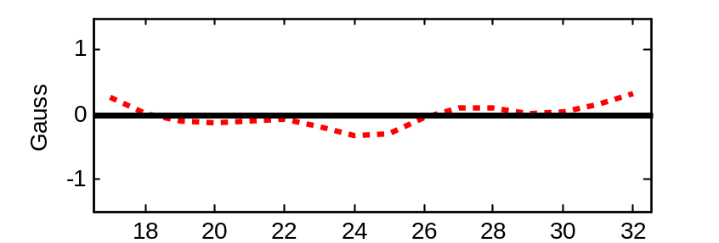
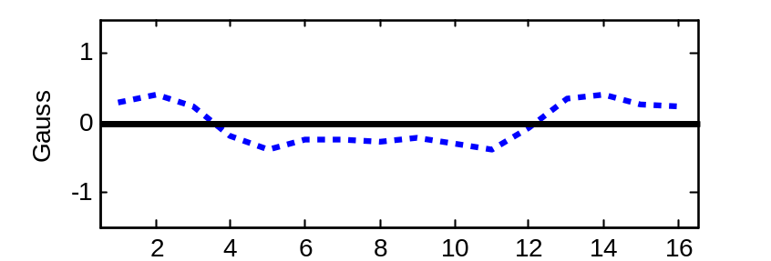
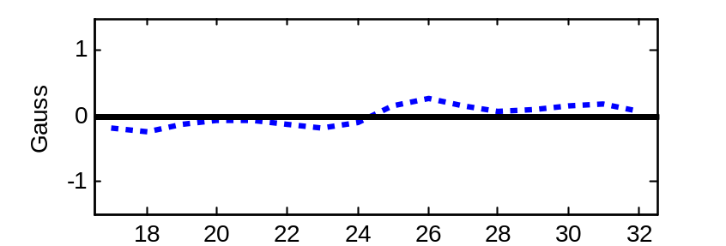
A ‘dipole-like’ response is predicted for the case of no net toroidal current
B_{r}
32
12
Poloidal Index
B_{θ}
17
The sign of the signals at the two toroidal locations demonstrate a phase shift showing the helical rotation.
8
26
16
25
18
1
4
Φ≈ 1/6 Field Period
Φ≈1/2 Field Period
B_{r}
≈ 1/2 FP
B_{r}
≈ 1/6 FP
B_{θ}
B_{θ}
Poloidal Index
Poloidal Index

Slide 10
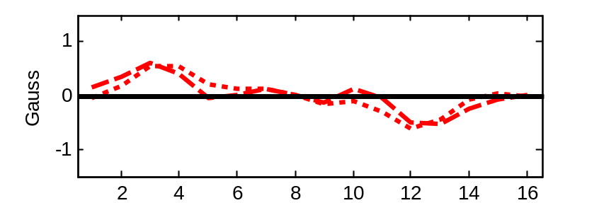
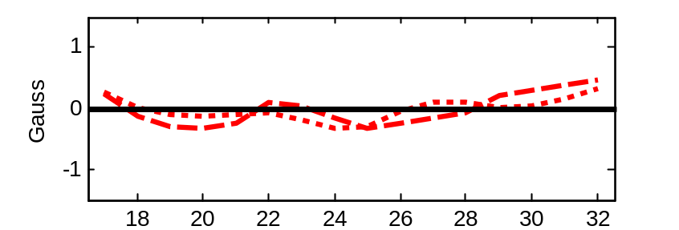
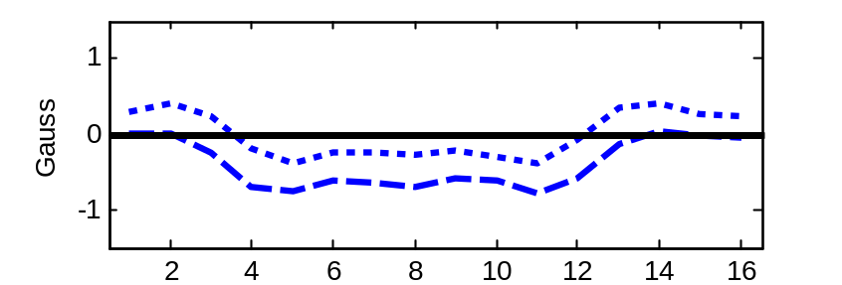
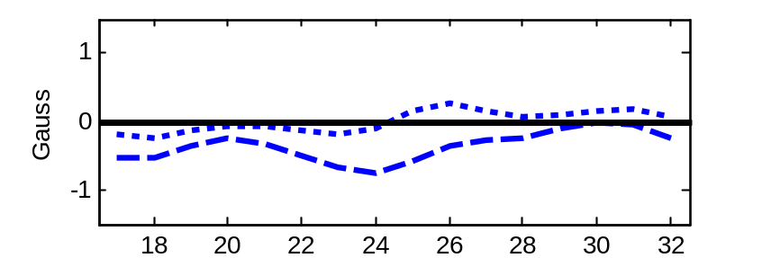
Bootstrap Current Contributes Little to B_{r} Early in Shot
The toroidal current profile is simulated in time and the diagnostic response is predicted with V3FIT.
A small net toroidal current (40 A) contributes to the B_{θ} component.
B_{r}
≈ 1/2 FP
B_{r}
≈ 1/6 FP
B_{θ}
P.S. only
B_{θ}
t_{sim}=8 ms
Poloidal Index
Poloidal Index

Slide 11
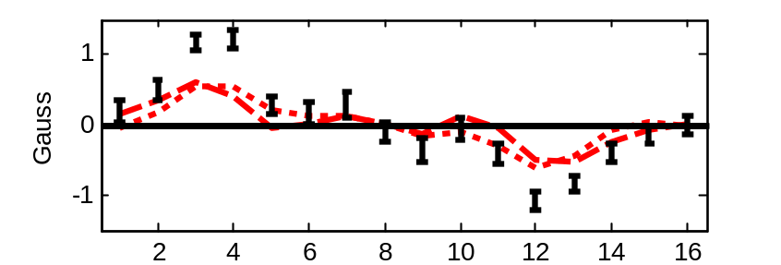
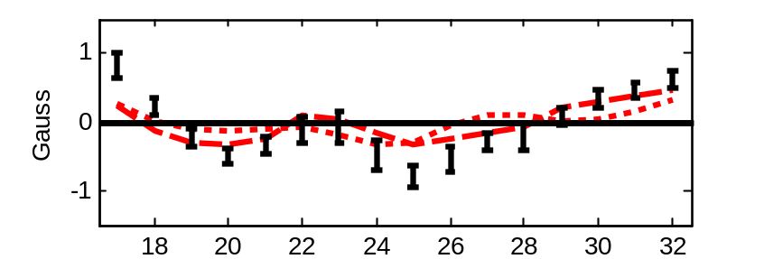
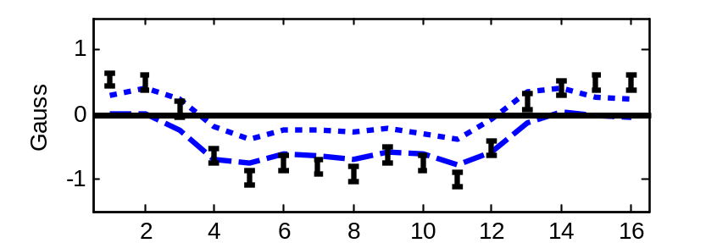
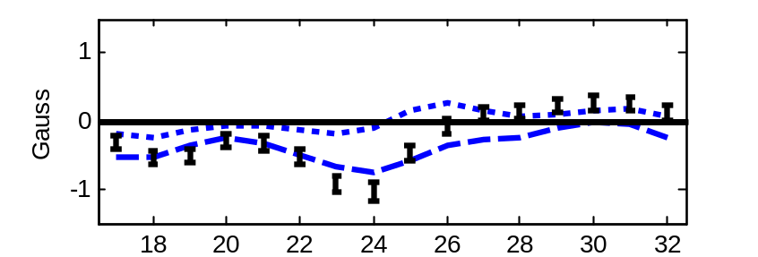
Confirmation of the Helical Rotation of the
Pfirsch-Schlüter Current
The experimental signals at t=8ms agree well with theory in terms of the sign and phase.
Good agreement in magnitude. Reconstruction with V3FIT may resolve the differences.
B_{r}
≈ 1/2 FP
B_{r}
≈ 1/6 FP
B_{θ}
P.S. only
t_{sim}=8 ms
B_{θ}
P.S. only
t_{sim}=8 ms
Poloidal Index
Poloidal Index

Slide 12
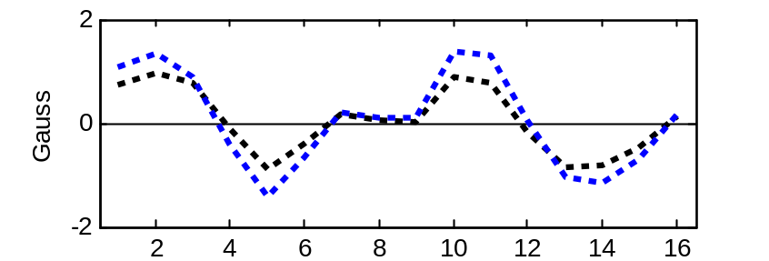
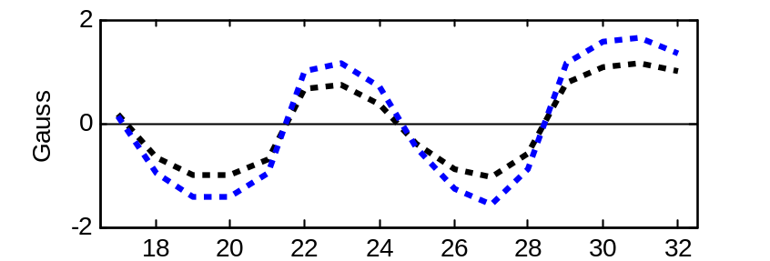
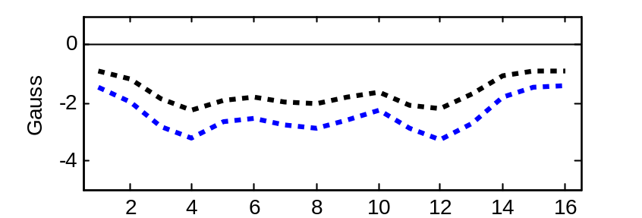
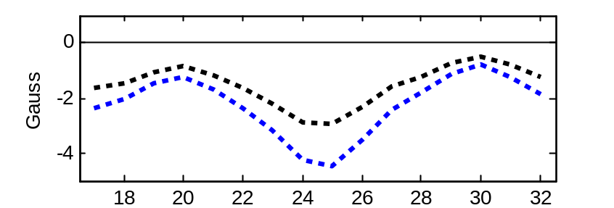
Later in Time, the Largest Signals are from Bootstrap Current
Simulated profiles at 25ms and 50ms.
B_{θ} has large unidirectional contribution from <J∙B>.
B_{r} is dominated by the m=2 structure of the vacuum vessel.
B_{r}
B_{r}
25 ms
B_{θ}
B_{θ}
50 ms
Poloidal Index
Poloidal Index

Slide 13
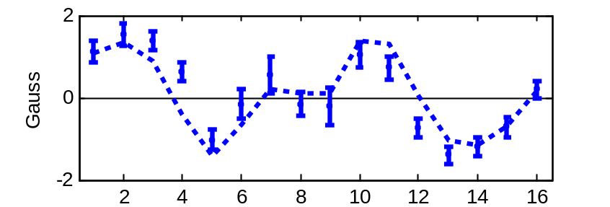
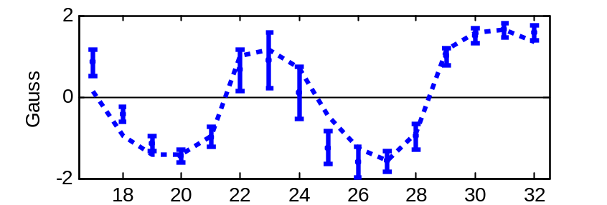
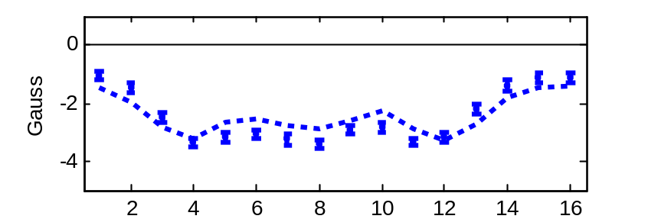
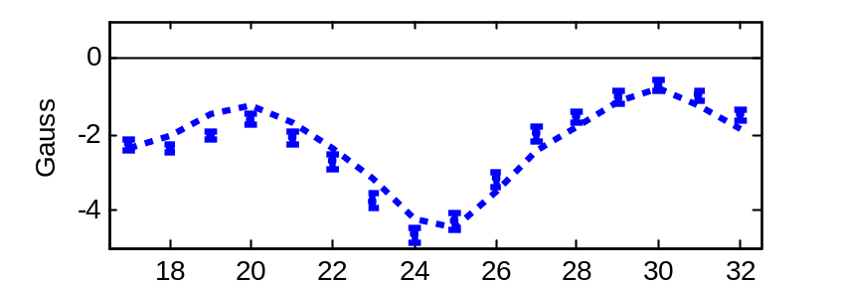
Measured signals are close to the simulated ones
Measurement evolves slightly faster than simulated values.
Possible sources of error: Z_{eff}, initial plasma profiles, neoclassical calculation of bootstrap current.
The pressure profile and evolved current profile serve as an ‘initial guess’ in the V3FIT reconstruction attempt.
B_{r}
B_{r}
50 ms
50 ms
B_{θ}
B_{θ}
Poloidal Index
Poloidal Index

Slide 14
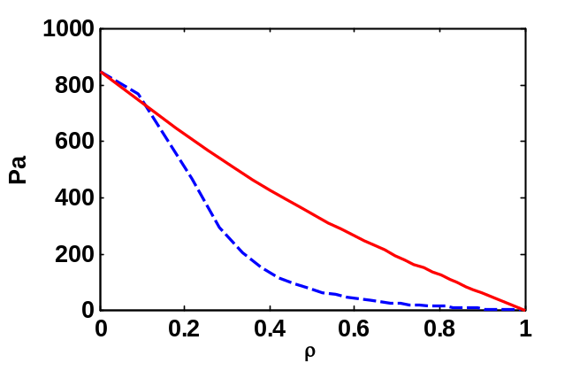
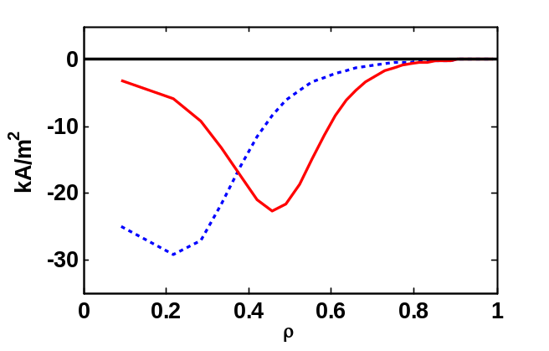
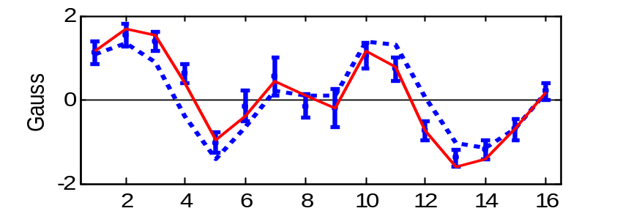
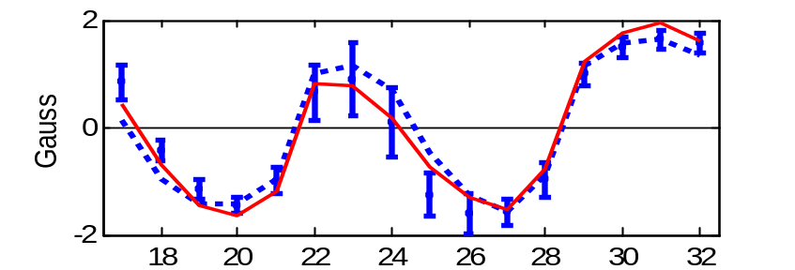
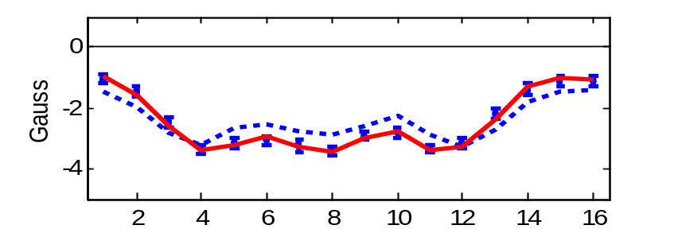
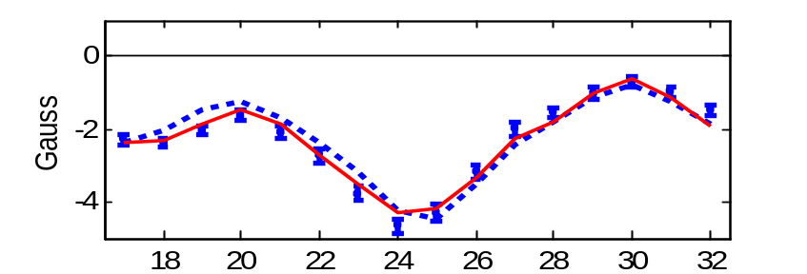
The reconstruction minimizes the mismatch between the measured and modeled signals
Pressure profile becomes wider; Current density is shifted radially outward.
Posterior sigmas are large: Need to reduce the # of free parameters in the model.
Initial guess in blue
Reconstruction in red
B_{r}
B_{r}
50 ms
50 ms
B_{θ}
B_{θ}
Poloidal Index
Poloidal Index

Slide 15
Toroidal Currents with Quasi-Helical Symmetry
The direction of the bootstrap current is reversed and reduced by ~1/3 compared to an equivalent tokamak (same iota, R_{major}, r_{minor}). This results in a reduction in rotational transform.
The Pfirsch-Schlüter current rotates with |B| contours and is reduced by ~1/3 compared to a tokamak, demonstrating the lack of toroidal curvature.
The evolving current profile is modeled with a diffusion equation using a 3D susceptance matrix. Expected magnetic diagnostic signal are calculated with V3FIT.
Continue to improve the V3FIT reconstruction. e.g., Reduce the # of free parameters in the reconstruction to achieve reasonable uncertainties in the profiles.

