Slide 1
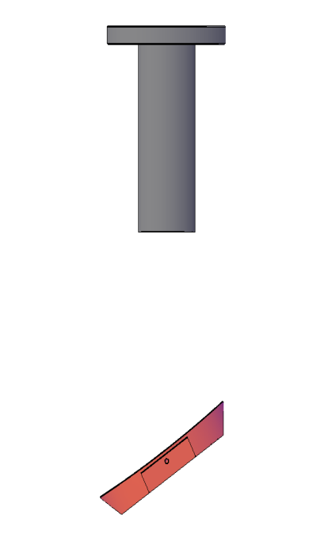
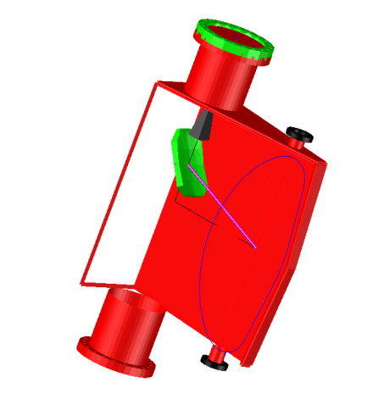
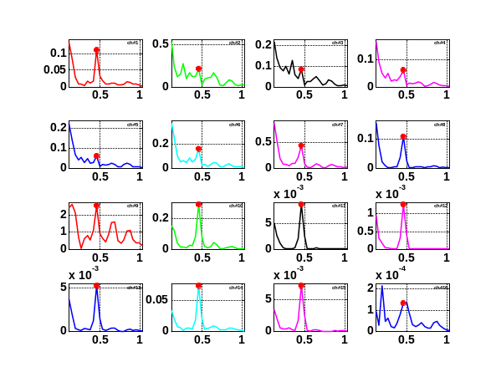
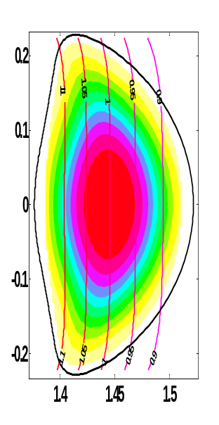
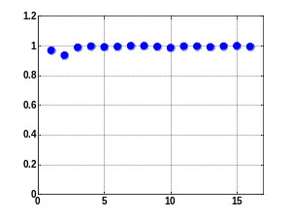
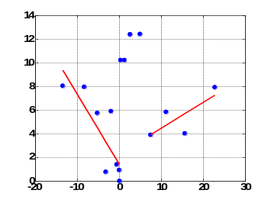
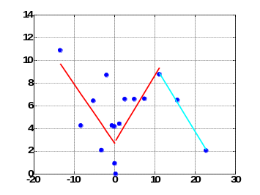
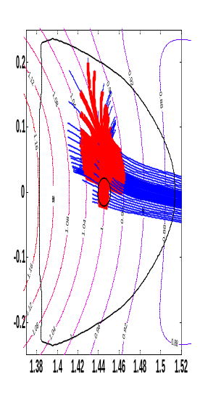
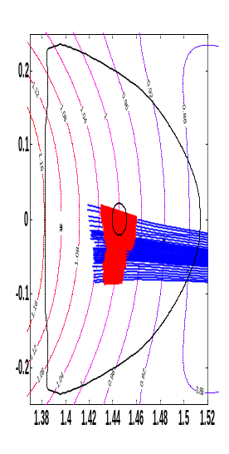
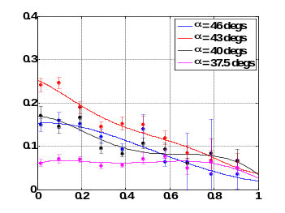
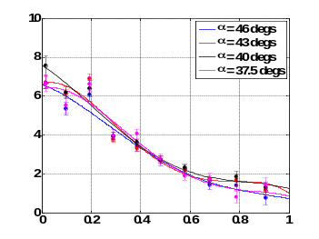
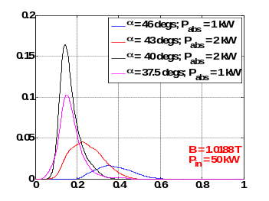
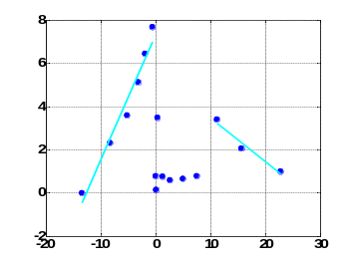
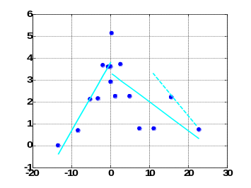
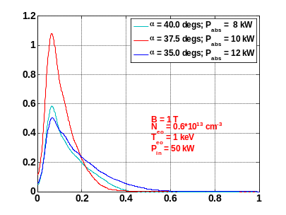
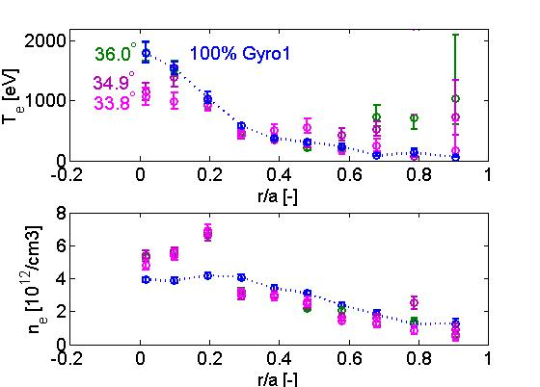
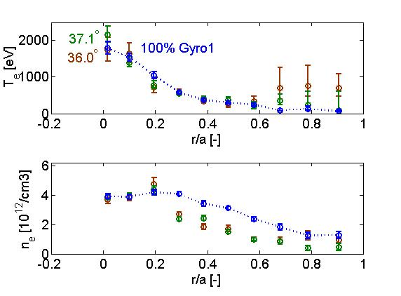
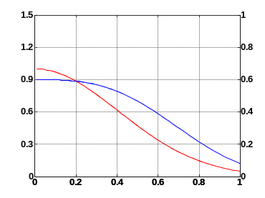
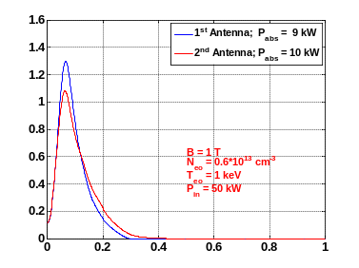
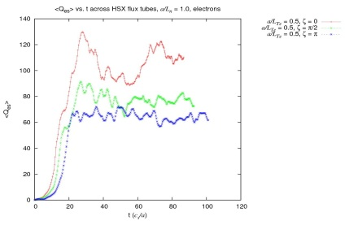

Plasma Heating with Upgraded ECRH System on the HSX stellarator
K.M.Likin, G.M.Weir, F.S.B.Anderson, D.T.Anderson, C.Deng¹, J.N.Talmadge, K.Zhai
HSX Plasma Laboratory, Univ. of Wisconsin, Madison, USA; ¹University of California, Los Angeles, CA, USA
Overview
Optimizing ECRH with
Second Launcher
Electron Thermal Diffusivity from Modulation Experiments
ECRH experiments on the HSX stellarator are carried out with two gyrotrons now
Plasma heating as a function of power density is studied using the steerable mirror of the second launcher. Absorption is estimated with the ray tracing code
Electron thermal diffusivity is measured in the plasmas with modulated heating power and impulse gas puffing
Scans of Magnetic Field and Launching Angle Have Been Made to Maximize T_{e} in the Plasma Core
Heat Pulse Propagation From ECRH Region Is Measured By 16 Channel ECE Radiometer
Second ECRH Launcher
Results presented below have been obtained in the experiments with 50 kW from each 28 GHz gyrotron at the fundamental resonance (1 T / O-wave)
Steerable mirror of the second launcher is used to scan the wave beam across the plasma in a poloidal plane in order to study plasma heating as a function of microwave power density as well as to broaden T_{e} profile
Second wave beam is launched below the mid-plane of the box port; deviation of the beam axis from the plasma core is compensated in the experiments by adjusting the mirror angle
ECE Antenna
FFT of ECE signals
Modulation of second gyrotron power is made in 40 msec window by a square waveform
Spectral amplitude and phase of each signal are retrieved by FFT
HSX Box Port
Helical Cut
PSD (a.u.)
Modeling of Energy Deposition
Y (m)
2θ_{launch}
Frequency (kHz)
Coherence of ECE signals
Time Delay of Heat Pulse
κ_{e}=0.06 m²/sec
κ_{e}=0.17 m²/sec
κ_{e}=0.07 m²/sec
κ_{e}=0.06 m²/sec
ECRH Power Density strongly depends on the launching angle of the second beam
Steerable Mirror
Magnitude
time (msec)
time (msec)
κ_{e}=0.07 m²/sec
HSX Vertical Cut
Ray traces at 35º and 40º
X (m)
ECE Channel
d² (cm²)
d² (cm²)
Launching angle can be vary between 35 and 50 degs that corresponds to the variation of energy deposition in the range of (0 – 0.5)*r/a_{p}
Second beam can deviate from the plasma core due to the grad(n_{e}) while the first beam always propagates towards the plasma axis
To get a maximum power density in the plasma core the second beam should be launched at an optimum angle
Broadening of energy deposition and reduced power density in plasma core are due to strong refraction of the second beam
Electron Temperature, Plasma Density and Absorbed Power Profiles
Most coherent results have been obtained at modulation frequency of 500 Hz and modulation depth of 10% of total input power
Electron thermal diffusivity estimated from these experiments is ~ 0.2 m²/sec ( )
Measured thermal diffusivity is in reasonable agreement with that obtained from power balance by W.Guttenfelder (PRL 2008)
T_{e} (keV)
n_{e} (10¹² cm⁻³)
P_{abs} (W/cm³)
$k_{e}=3/8∙d^{2}/t_{d}$
Z (m)
r/a_{p}
r/a_{p}
r/a_{p}
At the same line averaged plasma density the more peaked N_{e} profile has been obtained with the second launcher as compared to that from the first one; the fueling is possible explanation for such difference: the gas puff is located far away from the second launcher (about one field period) while it is next to the first antenna
Due to the strong wave refraction the energy deposition is low in the plasma core that results in the low values of central T_{e}
Cold Gas Propagation from Impulse Puff Is Detected In Plasma Core
Time Delay of the Cold Pulse
Impulse (700 Hz) puff makes a cold gas that propagates into HSX plasma core; κ_{e} from this perturbation is found to be close to that from the heat pulse propagation
R (m)
R (m)
κ_{e}=0.07 m²/sec
κ_{e}=0.1 m²/sec
κ_{e}=0.3 m²/sec
Absorbed Power Profile
vs. Launching Angle
time (msec)
κ_{e}=0.2 m²/sec
time (msec)
κ_{e}=0.2 m²/sec
Plasma Profiles with Two 50 kW Sources are Slightly Different from Profiles with Single 100 kW First Gyrotron
d² (cm²)
d² (cm²)
P_{abs} (W/cm³)
TS Profiles at 100 kW of Launched Power
Ongoing Gyro-Kinetic Modeling
r/a_{p}
With the dual system we get almost the same central T_{e} (~ 2 keV) at the higher N_{e} as compared to that from the first gyrotron and above 2 keV at the same N_{e} in the core; again the neutral gas fueling can make a difference
Electrostatic heat flux is Estimated for HSX Plasma with GENE Code with Kinetic Electrons
Model Plasma Density and
Electron Temperature Profiles
Deposition Profiles
from each Antenna
For optimum launching angle the absorbed power profile from the second antenna is close to that of the first antenna
Work performed by B.Faber and H.Mynick
κ_{hp}/κ_{pb} >> 1 in tokamaks and ~ 1 in stellarators; Why?
Next step is examine the dependence of fluxes on gradients to simulate ECRH modulation
T_{e} (keV)
P_{abs} (W/cm³)
n_{e} (10¹³ cm⁻³)
r/a_{p}
r/a_{p}

