Slide 1
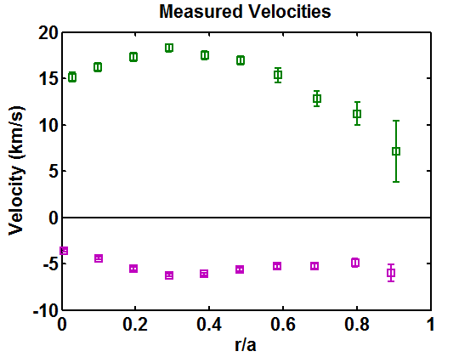
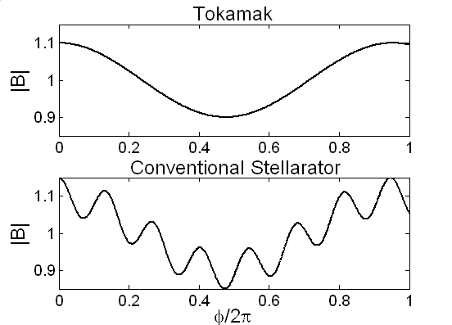
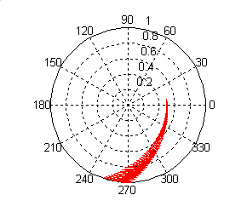
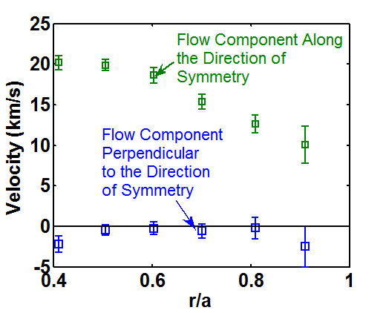
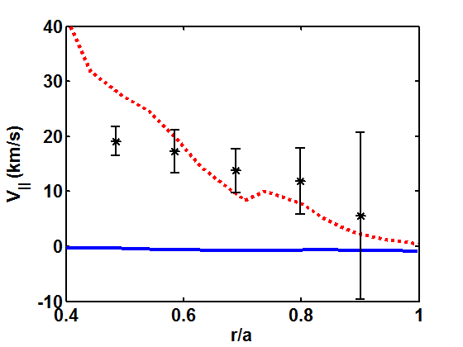
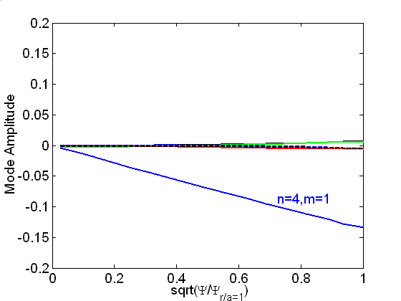
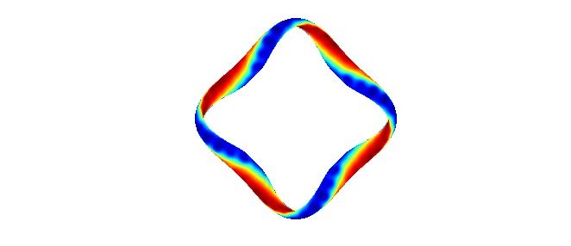
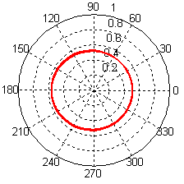
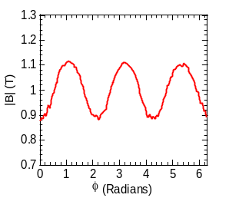
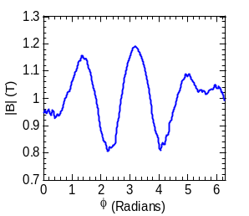
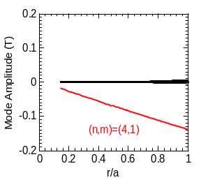
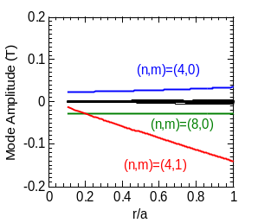
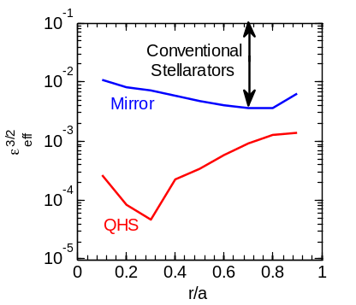
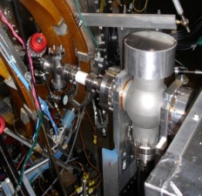
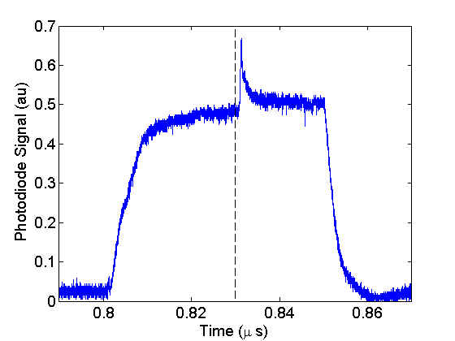
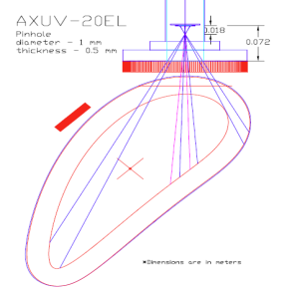
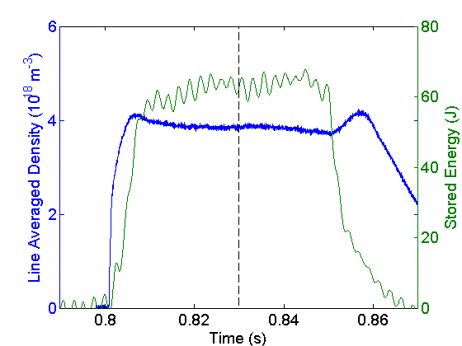
Recent Results and New Directions of the HSX Program
F.S.B. Anderson, D.T. Anderson, A.R. Briesemeister, D.L. Brower¹, E. Chlechowitz, C.A. Clark, C.R. Cook, C. Deng¹, L. Hurd, K. M. Likin, J.W. Radder, J. C. Schmitt, L. Stephey, J.N. Talmadge, G.M. Weir, R.S. Wilcox, K. Zhai
HSX Plasma Laboratory, Univ. of Wisconsin, Madison, USA; ¹University of California, Los Angeles, CA, USA
The HSX Device
Plasma Flows
(Talk by Briesemeister Monday)
2 Gyrotrons Now Operational
(See Poster by Likin for Heat Pulse Propagation)
Conventional Stellarators can have “Bad” Trapped Particle Orbits
Measured flows are predominantly in the direction of symmetry
A tokamak only has a toroidal modulation in the magnetic field strength
    Trapped particles make closed orbits -> no net radial drift
A conventional stellarator also has helical modulation in |B|
  Particles trapped in the helical ripple do not generally have closed orbits => radial drift
Intrinsic rotation velocities of up to 20 km/s in the symmetry direction have been measured with the ChERS system and compared to the PENTA code
Speed increases with increasing ECH power
Heating power doubled to potentially 200kW into torus (need to connect more capacitor bank sections into power supply)
2nd source steerable and can be modulated – first results Likin Poster
Profile differences observed dependent on heating vs fueling locations
“Toroidal” Views
“Poloidal” Views
V|| Calculated by PENTA Agrees With the Measured V|| For r/a>0.5
Equilibrium Reconstruction with V3FIT
(Talk by Schmitt (Anderson) Thursday)
“Quasisymmetry” can restore good orbits
PENTA
Drifts off magnetic surfaces are only dependent upon the spectrum of |B| in flux coordinates, not symmetry in the vector components
Symmetry in |B| insures good confinement
-quasi-axisymmetry
-quasi-helical symmetry (HSX)
-quasi-poloidal symmetry
True symmetry is a subset of quasisymmetry
QHS Magnetic Spectrum
Data
DKES
QHS
DKES under-predicts V|| by more than an order of magnitude
Flows predicted by PENTA with momentum conservation show better agreement
Synthetic diagnostic shows poor E_{r} resolution and comparison in core due to geometrical factors and large flow speeds relative to thermal velocity
HSX can operate with QHS or as a conventional stellarator
Impurity Transport
QHS
Mirror
The quasi-helical symmetry (QHS) of HSX can be spoiled by a set of (48) auxiliary coils
“Mirror” changes the transport properties towards the level of a classical stellarator
Effective ripple larger than QHS, still small compared to many conventional stellarators
|B| along field line
|B| along field line
Impurity control and effective helium exhaust are open areas of research for the stellarator reactor concept
  The expected “Ion Root” operating point of a stellarator reactor is predicted to enhance impurity confinement
  Some stellarators have seen unexpected, and unexplained increase in impurity transport under specific operating conditions
    W7-AS had an “High Density H-mode”[Grigull, ’01]; LHD has an impurity “hole” [Ida, ‘09]
We have undertaken an experimental program to measure the impurity transport properties of the HSX stellarator. Our goals are to:
  Inject aluminum neutrals into HSX plasmas using a laser blow-off technique
  Measure the resulting radiation using AXUV photodiode arrays
  Determine the impurity diffusivity and convective velocity using the STRAHL code
  Compare these findings with the neoclassical model using the PENTA code
|B| Spectrum
|B| Spectrum
  Aluminum has been injected into HSX discharges
    The injection was visible on a photodiode
    The injection did not perturbing the background plasma parameters
  Two photodiode pinhole cameras have been installed on HSX, and five more are under construction.
Targeted Optimization of Stellarators
The HSX Device
  AXUV-20EL Chip
Major Radius | 1.2 m
Minor Radius | 0.12 m
Number of Field Periods | 4
Coils per Field Period | 12
Rotational Transform Effective transform ( N- mι ) | 1.05 →1.12 ~ 3
Magnetic Field | 1.0T
ECH Power (75 ms) | 2 x 100kW 28 GHz
Pinhole
Separatrix
Vessel
Diagnostic Improvements
Other Posters at Workshop
ECE system has been upgraded to 16 channels with improved detectors and amplifiers for heat pulse propagation studies
Thomson scattering is now two pulse system and scattered pulses are being digitized for improved measurement accuracy and better signal to noise
The reflectometer has been upgraded to a doppler system to augment flow measurements
Two toroidally separated additional H-alpha arrays have been added to look at profile differences observed with different fueling locations.
Upgrades to the CXRS beam are under investigation for improved E_{r} measurements
This session:
  Likin: Power Balance vs Heat Pulse Thermal Conductivity
  Cook: Stability Analysis using SIESTA
Next Session:
  Wilcox: Measurement of Reynolds Stress Flow Drive in HSX

