Slide 1
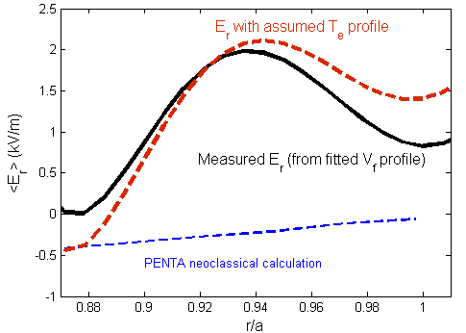
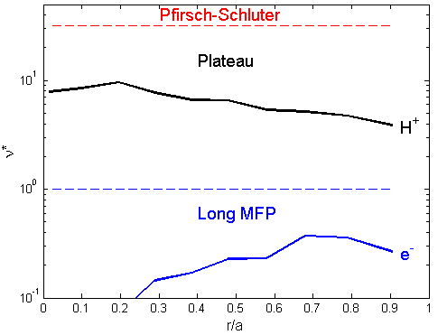
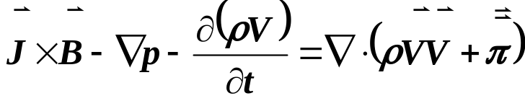
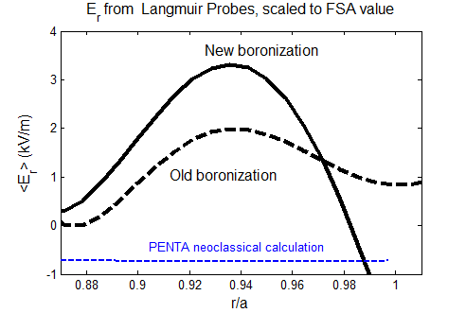
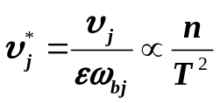
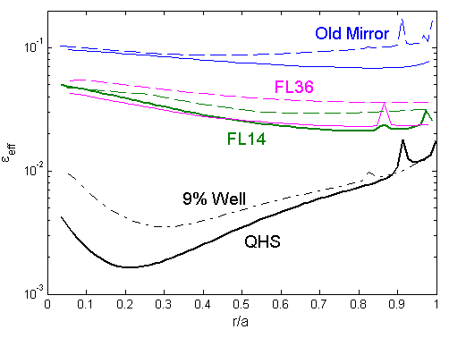
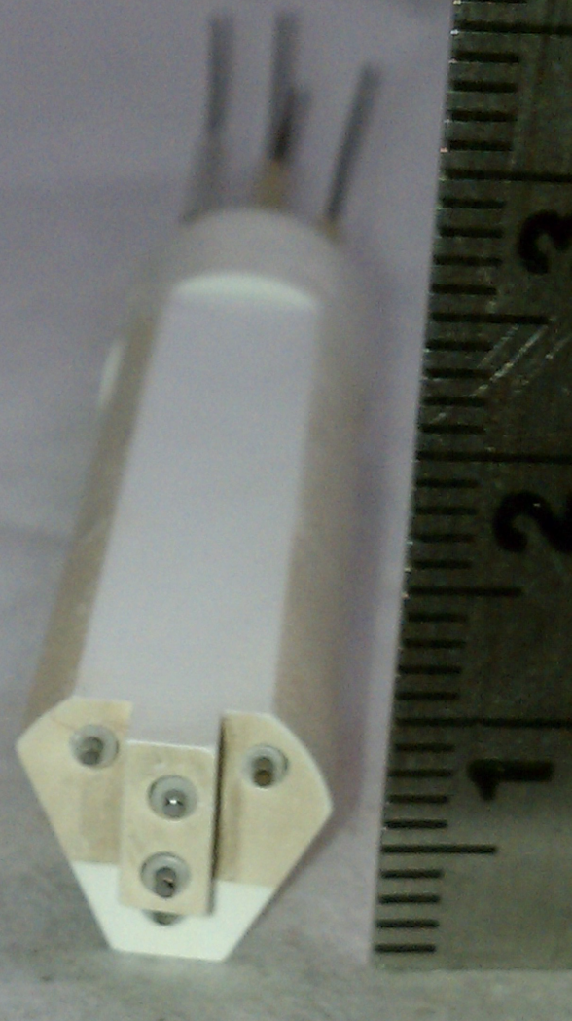
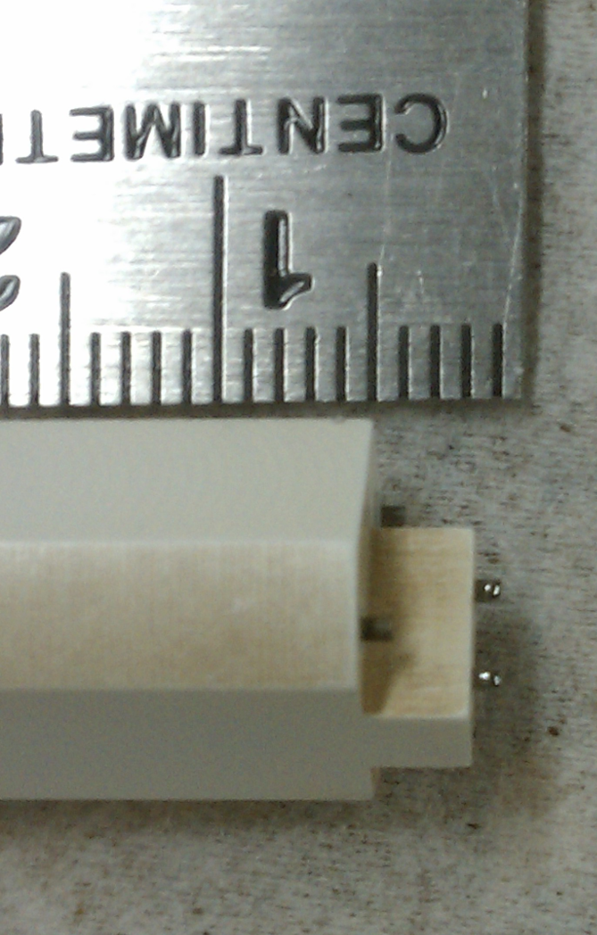
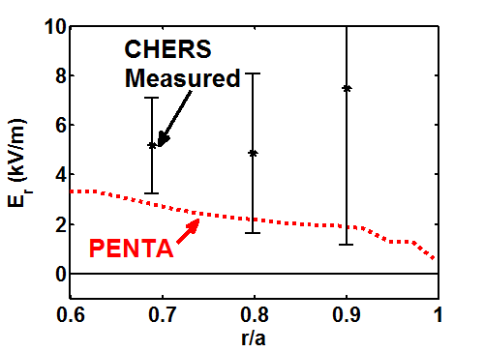
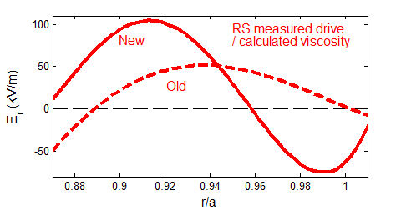


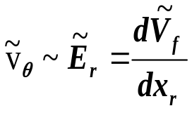
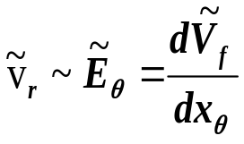

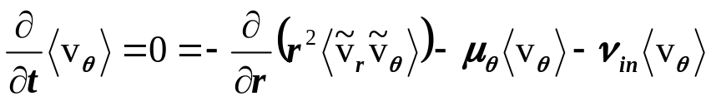
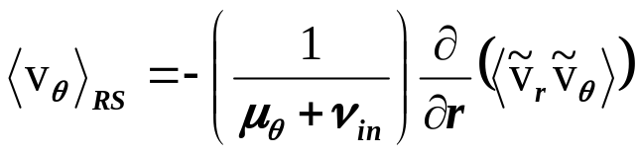
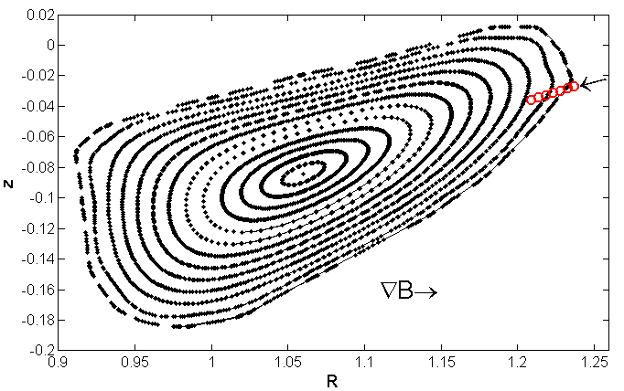
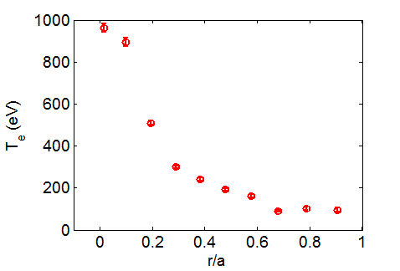
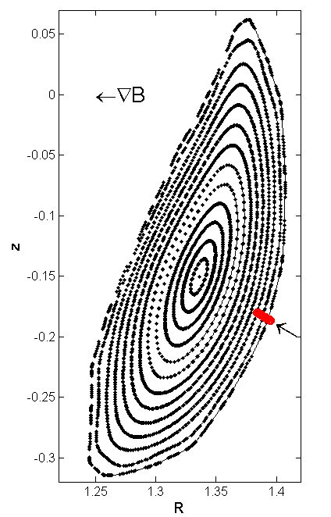
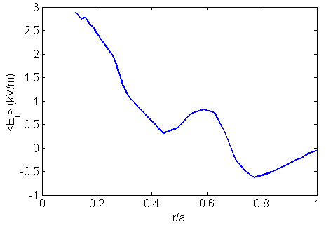
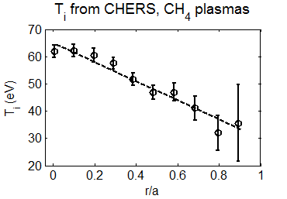
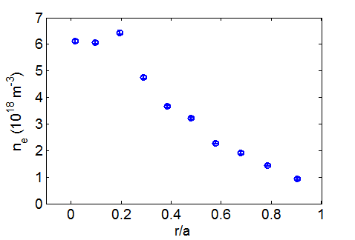
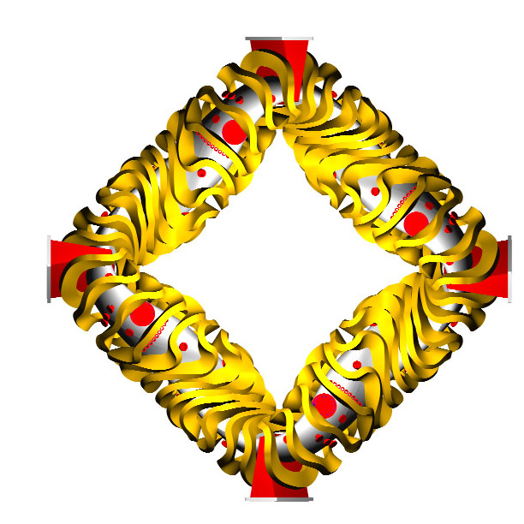
Effect of Reynolds stress on momentum balance and flows in HSX
R.S. Wilcox, A. Briesemeister, J.N. Talmadge, D.T. Anderson, F.S.B. Anderson
HSX Plasma Laboratory, University of Wisconsin, Madison, USA
Overview
Deviation of E_{r} from Neoclassical Prediction
Planned Experiments
How optimized must a magnetic configuration be for E_{r} to be determined through non-neoclassical processes?
Measurements with both Langmuir probes and CHERS indicate that E_{r} can deviate from neoclassical calculations which calculate particle flux and enforce the ambipolarity condition
Local measurements of Reynolds stress indicate a flow drive corresponding qualitatively to the deviation in the measured radial electric field
For a sufficiently quasi-symmetric magnetic configuration, the neoclassical viscosity can be compensated for by the Reynolds stress (or Maxwell stress) due to turbulence
Future plans: New probe installation to get a better estimate of flux surface average value of Reynolds stress term in the momentum balance
Neoclassical transport to be scaled by varying magnetic configuration and collisionality to test when non-ambipolar particle transport and neoclassical viscosity dominate the Reynolds stress term in the momentum balance to determine the radial electric field
Using Langmuir probes to measure the radial floating potential profile on a shot-by-shot basis, E_{r} was found to deviate from the neoclassical calculations made using the PENTA code [1,2]
No T_{e} gradient information available, but based on edge Thomson scattering measurements and a reasonable assumption of temperature gradient, this affect should not greatly affect interpretation of E_{r} from floating potential signals
Given a small enough non-ambipolar neoclassical particle flux, other effects can compete to determine the radial electric field [3,4]
Collisionality scan
Neoclassical 1/ν transport occurs only in the long mean free path collisional regime
Ions are solidly in the plateau regime and no direct ion heating is available, so ion particle transport is relatively fixed experimentally
Electron collisionality will be scanned to test scaling of deviation of E_{r} and V|| from neoclassical calculations
Expectation is that less collisional electrons will lead to larger deviation from neocassical, and vice-versa
Reynolds stress
Viscosity (NC + turbulent)
Deviation of E_{r} from neoclassical prediction corresponds qualitatively to large measured Reynolds stress flow drive
Measured Reynolds stress drive and deviation from neoclassical E_{r} calculation both increase with changing impurity content (wall conditioning)
Neoclassical calculations are relatively insensitive to expected experimental changes
Locally measured Reynolds stress and modeled neoclassical viscosity greatly over-predict rotation and resultant Er
  May be due to location of measurement on a flux surface (new probe should help)
  T_{e} fluctuations may also be playing a role
Reynolds stress flow drive estimated from poloidal momentum balance [4] and a rough estimate of neoclassical plus neutral viscosity:
CHERS also measures possible deviation from neoclassical predictions in CH4 plasmas (different plasma parameters)
Alternate Magnetic Configuration
Compare neoclassical particle transport in different magnetic configurations
Effective ripple is a measure of particle loss in collisionless regime for E_{r}=0 [5]
For a given percentage of auxiliary coil current, pick configuration with most effective ripple to compare to optimized QHS configuration
Expectation would be for E_{r} measurements to more closely match the neoclassical calculation in configuration with designed symmetry broken
Langmuir Probe Setup
5-pin Langmuir probe measures floating potential to infer E_{r} and E_{θ}, and differential ion saturation current pins are configured as a mach probe for V||
Fluctuating velocity components obtained from measured fluctuating ExB velocities, assuming T_{e} fluctuations are negligible:
E_{r}
B
E_{θ}
[A. Briesemeister et. al., PPCF 2012 (pending)]
Summary
Fluctuating v_{r}v _{θ} profile taken on shot-by-shot basis from single port location, radial derivative taken to estimate Reynolds stress flow drive
I_{sat}
I_{sat}
V||
For a sufficiently optimized magnetic configuration, Reynolds stress can contribute to or even dominate neoclassical non-ambipolar transport in the determination of the radial electric field and rotation
E_{r} measured in HSX is different than what is calculated from the ambipolarity condition of neoclassical transport calculations in the edge
Additional Reynolds stress probe is planned to get a better estimate of the flux surface average value of the Reynolds stress flow drive
Proposed experiments will explore the scaling of deviation from neoclassical calculations with breaking of the designed symmetry, as well as the scaling with electron collisionality and neoclassical electron particle transport
V_{f,1}
V_{f,2}
V_{f,3}
PENTA Neoclassical E_{r} Predictions
Additional Langmuir probe installation
Need the flux surface average value of Reynolds stress to properly account for it in momentum balance
Current probe location is in region of low field and bad curvature, where trapped particle and resistive ballooning instabilities are expected to be destabilized
Additional probe installation on high-field side of magnetic surface should provide better estimate of flux-surface average value of the Reynolds stress
PENTA code [1,2] calculates the neoclassical particle fluxes for a set of plasma parameters in a given magnetic configuration, then finds the ambipolar radial electric field
PENTA uses monoenergetic DKES transport coeffecients, corrects for momentum conservation
T_{i} from CHERS measurement in a methane discharge
T_{i} input into calculations is scaled down to account for removal of C ion species from plasma
Neoclassical calculations relatively insensitive to changes in T_{i}
References
Planned high-field side probe
“Ion root” solution exists at all positions across the minor radius, so “electron root” solutions in the core are not plotted here
D.A. Spong, Phys. Plasmas 12 (2005) 056114.
J. Lore at al., Phys. Plasmas 17 (2010) 056101.
P. Helander and A.N. Simakov, Phys. Rev. Lett. 101 (2008) 145003.
P. Helander and A.N. Simakov, Contrib. Plasma Phys. 50 (2010) 695.
V.V. Nemov et al., Phys. Plasmas 6 (1999) 4622.
Existing low-field side probe

