Slide 1
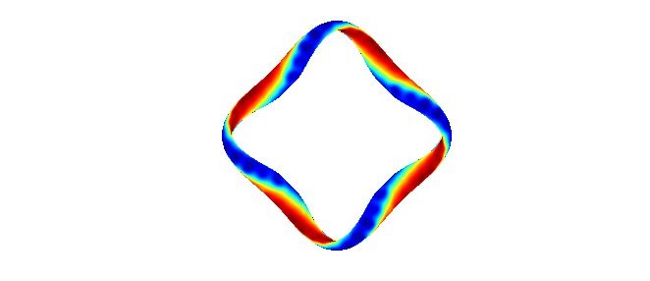
Measurements of Reynolds stress flow drive and radial electric fields in the edge of HSX
Bob Wilcox
HSX Plasma Laboratory
University of Wisconsin, Madison
Thanks to the HSX team for their contributions to this work
Coordinated Working Group Meeting
Greifswald, Germany, June 6-8, 2012

Slide 2
Outline
The HSX stellarator
  Quasi-symmetric optimization
  Experimental setup: Langmuir probes
Measurements of Reynolds stress
  Gradient in time-averaged Reynolds stress profile implies relevant macroscopic flow drive
  Region of measured flow drive corresponds to measured deviation in E_{r} from neoclassical ambipolarity calculations
Comparison to theory
  Scalings based on work by Helander and Simakov
Planned future experiments
  Additional Reynolds stress probe installation
  Effective ripple and collisionality scaling

Slide 3
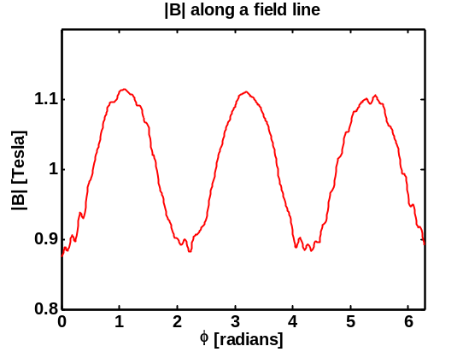
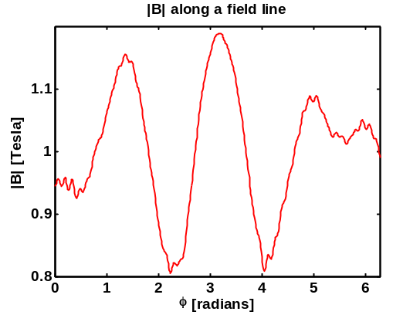
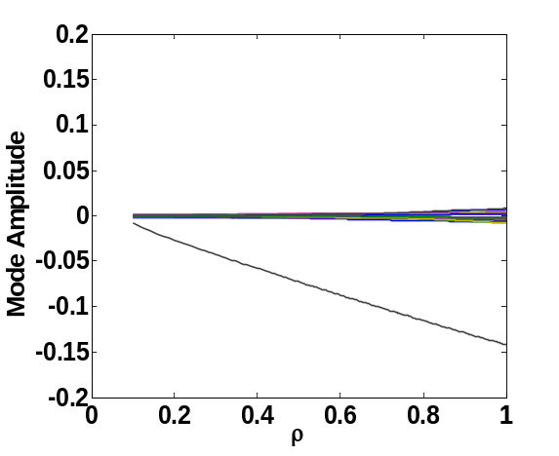
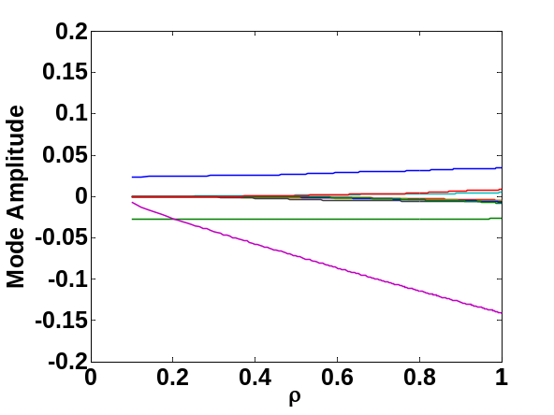
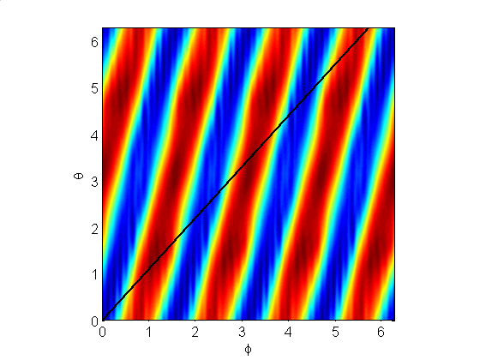
HSX is the first stellarator optimized for quasi-symmetry
HSX is optimized for quasi-helical symmetry: |B| is symmetric in the helical direction (n=4, m=1)
This gives tokamak-like neoclassical transport properties
QHS
Mirror
|B| along field line
|B| along field line
Tokamak:
QHS:
ι_{eff} ~ 3
|B| Spectrum
|B| Spectrum
n=4,m=0
n=8,m=0
n=4,m=1
n=4,m=1
Neoclassical transport can be varied with auxiliary coils
Notes:
Energizing set of planar auxiliary coils spoils the quasi-helical symmetry
Other properties are similar (ι profile, well depth, plasma volume)
Direct comparisons can be made between a quasi-helically symmetric and conventional stellarator
HSX major radius is ~1.2m, minor radius ~12 cm
All data taken here in plasmas heated with 50 kW fundamental O-mode ECRH
Turbulent transport in HSX is predicted to be dominated by the trapped electron mode

Slide 4
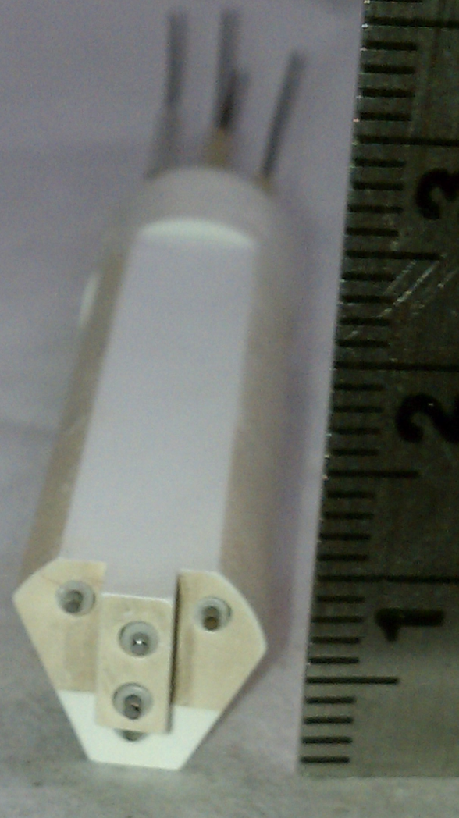
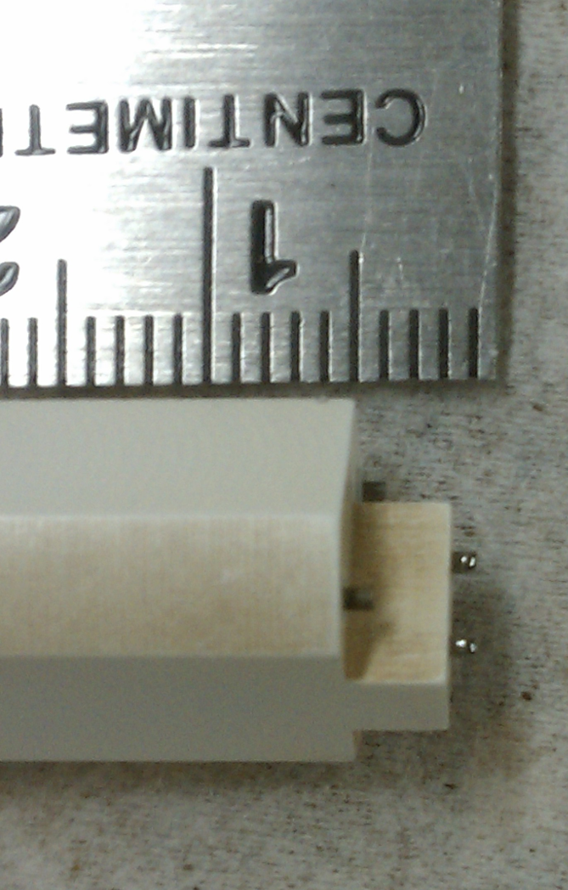
Langmuir probes installed to measure local fluctuating plasma parameters for Reynolds stress studies
Tungsten tips shielded by bulk BN, V_{f} and I_{sat} signals digitized at 5 MHz
Radial profiles taken on a shot-by-shot basis
Discharges are very repeatable: n_{e} consistent to within 1%, probe measurements consistent to within the noise
For the data shown here, differential V_{f} fluctuations are assumed to be potential fluctuations
  Mean T_{e} difference between pins is accounted for, fluctuating T_{e} would not be
  Fluctuating v_{r} and v_{θ} quantities for Reynolds stress assumed from measured E_{r} and E_{θ} fluctuations, respectively
E_{r}
B
E_{θ}
I_{sat}
V||
V_{f}
I_{sat}
V_{f}
V_{f}

Slide 5
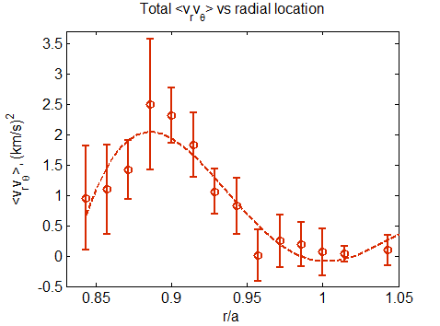
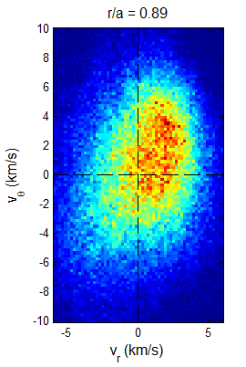
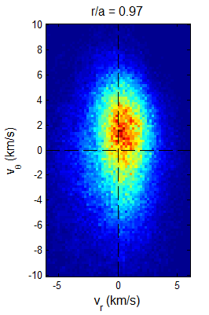
Clear radial gradient exists in time-averaged Reynolds stress profile
Reynolds stress flow drive is proportional to
PDF of velocity fluctuations (inferred from V_{f} measurements) show positive correlation between instantaneous v_{r} and v_{θ} fluctuations
Measurement needs to be compared to some rough estimate of the poloidal viscosity to calculate resulting poloidal rotation and E_{r}

Slide 6
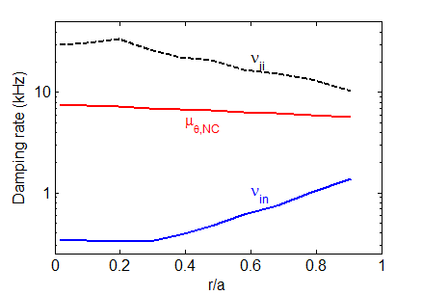
Neoclassical poloidal viscosity is calculated roughly to find contribution of measured Reynolds stress to flows and E_{r}
[M. Coronado and H. Wobig, Phys. Fluids B 29 (1986) 527]
Crudely estimate the purely poloidal component of neoclassical viscosity for poloidal momentum balance
Neutral density based on measurements from H-alpha arrays and calculations from DEGAS neutral gas code
Neutral damping is small but non-negligible at the edge where probe measurements are made

Slide 7
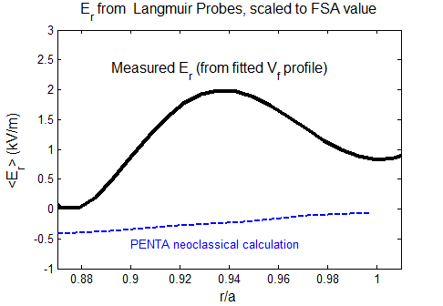
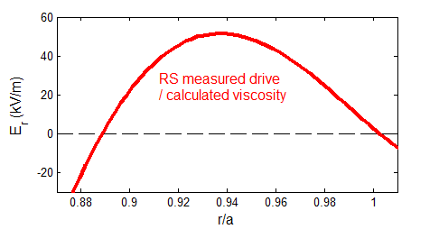
Measured Reynolds stress flow drive agrees qualitatively with deviation of E_{r} from neoclassical ambipolarity calculation
PENTA code calculates neoclassical ambipolarity condition based on non-ambipolar particle fluxes as a function of E_{r}
  Neoclassical particle transport is small for optimized QHS configuration
  More on PENTA calculations from A. Briesemeister tomorrow
Unknown T_{e} gradient is ignored, but would make E_{r} more positive if present
  Anywhere between ~0-5 kV/m, depending on where local T_{e} drops off beyond the last Thomson scattering point
Reynolds stress measurements imply extremely large flow drive, but this is a single point measurement in a region where fluctuations are expected to be large (low field, bad curvature)

Slide 8
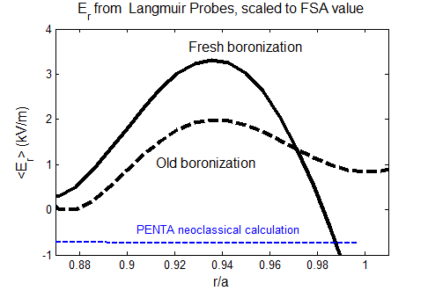
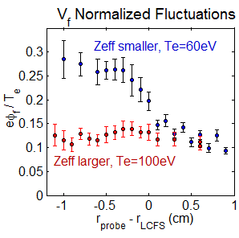
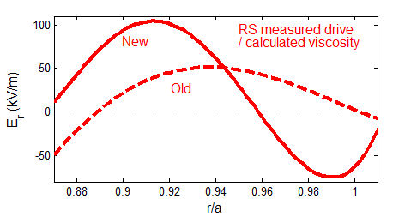
Measured deviation from neoclassical E_{r} prediction scales with Reynolds stress flow drive measurements when conditions change
When wall conditioning changes (fresh boronization), edge T_{e} is reduced, and fluctuation levels are increased, along with the measured deviation from neoclassical E_{r} prediction
E_{r} deviation from neoclassical prediction and Reynolds stress measurements qualitatively scale together in amplitude and radial location

Slide 9
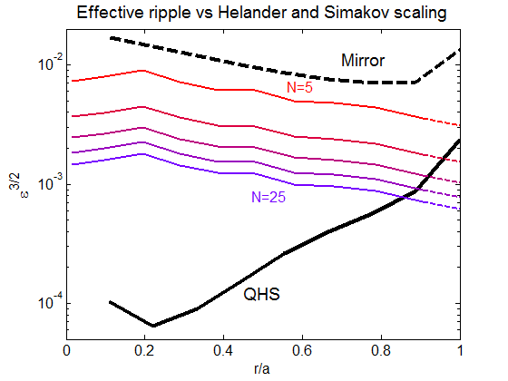
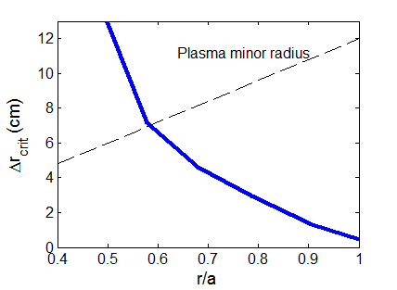
Helander and Simakov scaling finds that collisionless HSX should be free to rotate in core, constrained to neoclassical value at edge
How much symmetry breaking is tolerable before neoclassical non-ambipolar transport dominates turbulence-driven Reynolds stress?
For collisionless plasma with ions in 1/ν regime, a deviation from neoclassical ambipolarity can be maintained over a radial distance of N ion gyroradii if
This prediction finds that HSX should be “free to rotate” at inner radii, constrained to neoclassical rotation at edge
Assumes 1/ν ions, which doesn’t apply to these HSX plasmas (measured ion temperatures put H ions squarely in plateau regime)
  Model represents an upper bound on allowable ripple for HSX
[P. Helander and A.N. Simakov, Phys. Rev. Lett. 101 (2008) 145003]

Slide 10
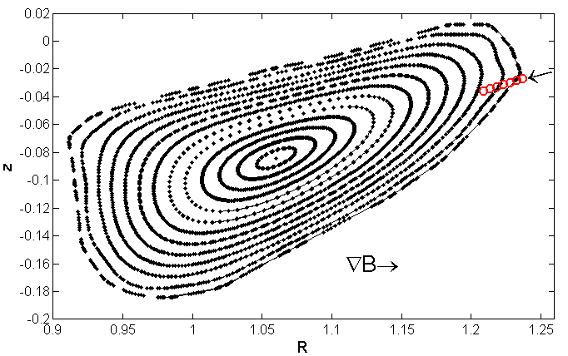
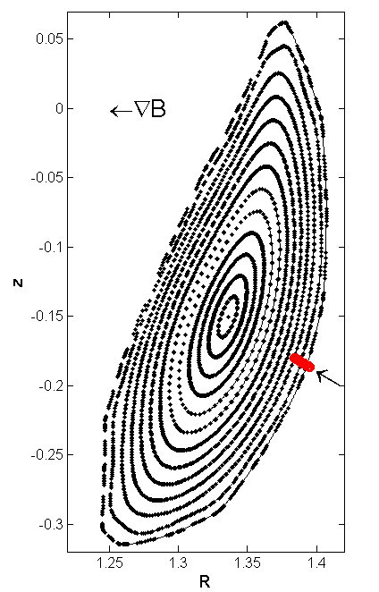
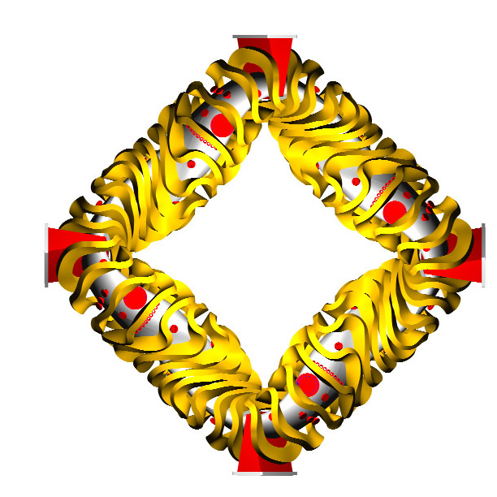
Second probe installation planned in high-field region for better estimate of flux-surface averaged Reynolds stress
Planned high-field side probe
Existing probe is in region of low field, bad curvature
Additional probe will be in region of high field, good curvature (still on outboard side)
Approximate limits of RS value on a flux surface
Possibly interpolate to find flux surface average value
Existing low-field side probe

Slide 11
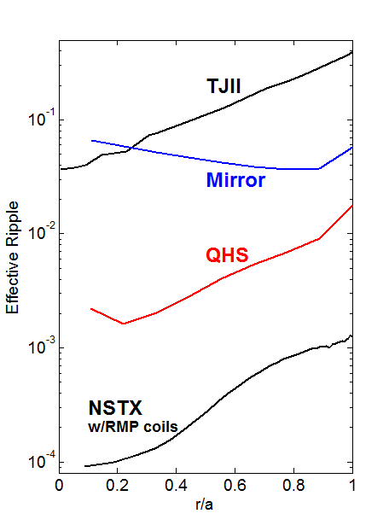
Effective ripple can be changed to examine the role of symmetry breaking in E_{r} determination
Effective ripple ( ) is a measure of the neoclassical optimization, and is finite in all real magnetic confinement devices
  Sources like RMP coils, TF ripple, field errors in tokamaks
Experiments planned for Mirror configuration to find scaling of E_{r} deviation from neoclassical calculation with increased ripple
  at the edge where probes measure can be increased by a factor of ~5
Collisionality scan can also be performed by adjusting heating power, line-averaged density
TJII ε_{eff}: Seiwald et. al, JCP 2008
NSTX ε_{eff} calculations courtesy of John Canik, ORNL
Notes:
This 1/nu transport is traditionally associated with stellarators, but exists for any device with non-symmetric components of the magnetic field spectrum. Beyond stellarators, this has obvious implications to RMPs.
John Canik performed these NSTX calculations, TJ-II calculations from a 2008 Journal of Computational Phyics paper by Seiwald
A machine like ITER is another two orders of magnitude lower than NSTX w/RMP coils here, as calculated by Don Spong at ORNL.

Slide 12
Summary
Regions where the Reynolds stress flow drive is measured to be large correspond to regions where E_{r} deviates significantly from the predicted ambipolar value calculated by PENTA
Scalings suggest that quasi-symmetric configuration may be close to critical value of where neoclassical non-ambipolar transport processes dominate to determine E_{r}
Future experimental plans to test scaling
  Additional probe installation to more accurately measure flux-surface average value of Reynolds stress
  Scan edge effective ripple by breaking optimization
  Scan collisionality by adjusting ECH heating power, density

