Slide 1
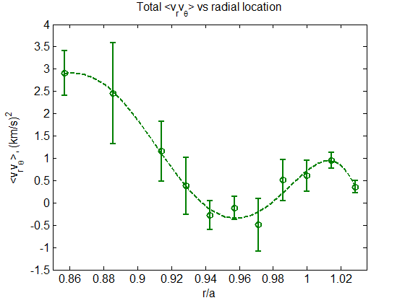
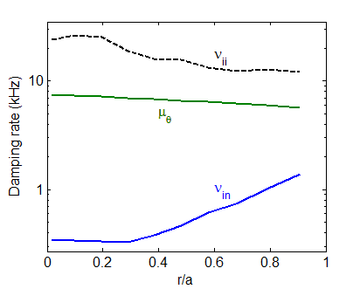
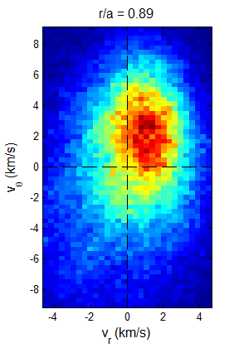
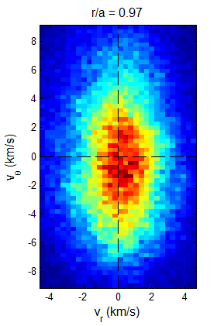
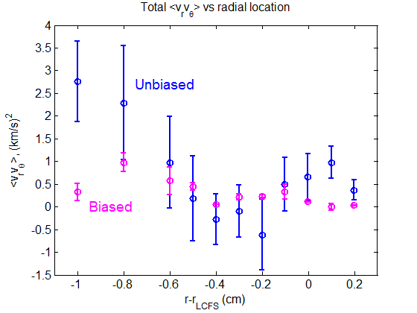
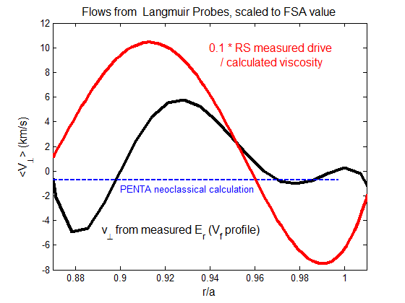
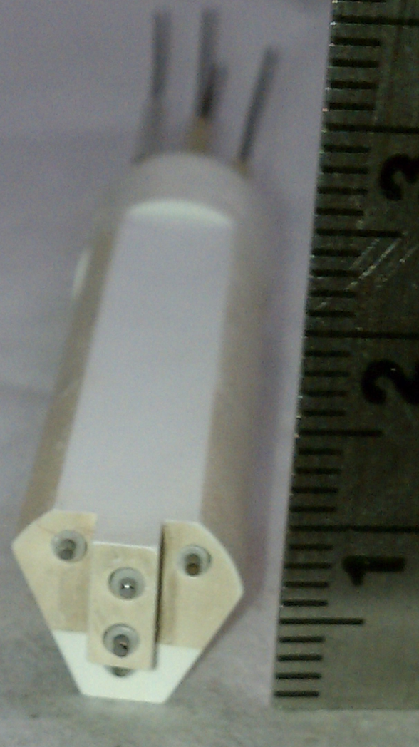
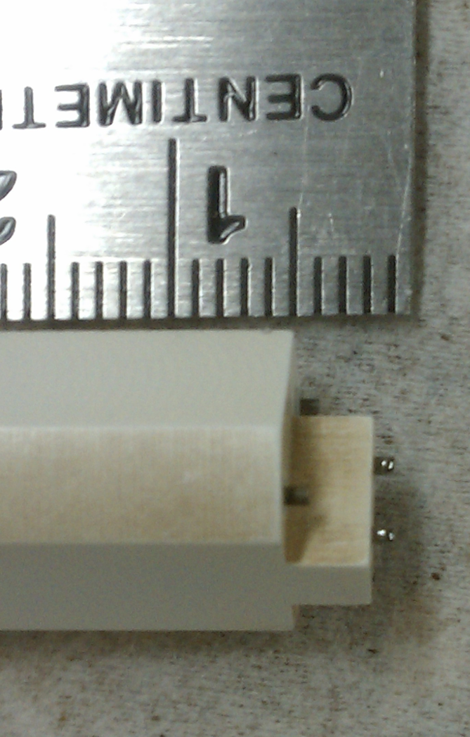
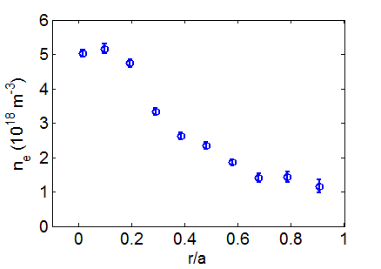
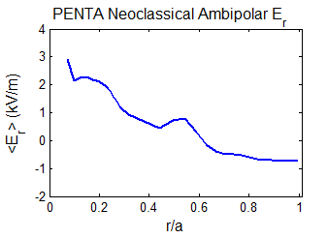
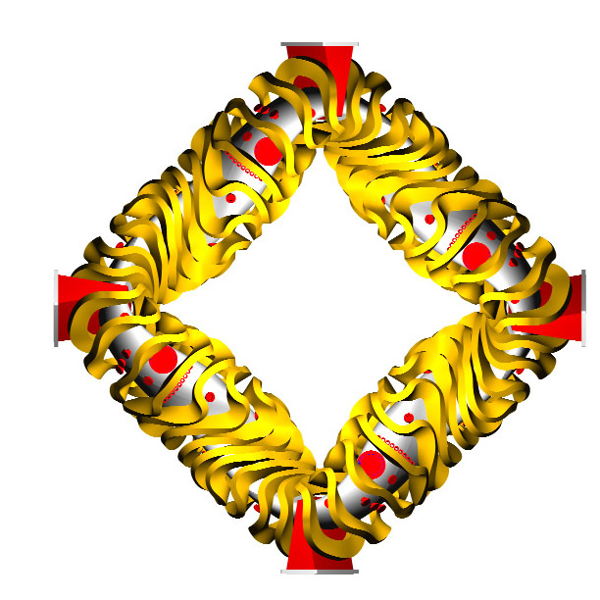
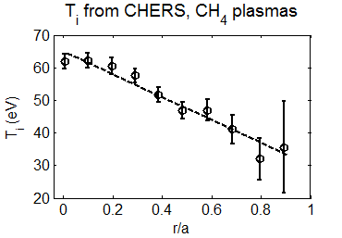
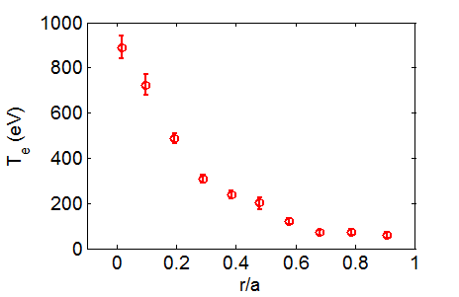
Measurements of Reynolds stress flow drive using Langmuir probes in HSX
R.S. Wilcox¹, J.A. Alonso², D. Carralero², J.N. Talmadge¹, D.T. Anderson¹, F.S.B. Anderson¹
1 HSX Plasma Laboratory, University of Wisconsin, Madison, USA
2 Asociación EURATOM-CIEMAT, Madrid, Spain
Overview
Reynolds Stress and Flow Measurements
Viscosity calculations
Indications of zonal flows have been observed in HSX during biasing in previous experiments [1]
A Langmuir probe configuration designed to measure the Reynolds stress has been designed and implemented to measure the mean and fluctuating values of E_{r}, E_{θ}, and v||.
A radial Reynolds stress profile is measured on a shot-to-shot basis using similar discharges
Neoclassical poloidal viscosity is calculated to estimate the poloidal flow expected from the measured Reynolds stress gradient, and this is compared to the actual measured E_{r} profile
The flow drive calculated this way is large enough to drive significant flows, and radial regions of large flow drive correspond with regions where the measured radial electric field deviates significantly from the neoclassically predicted value given by the PENTA code [2].
When a bias is applied, the fluctuations are reduced by the shearing of the radial electric field and the poloidal flow is simultaneously increased, diminishing the contribution of the Reynolds stress drive to the total poloidal momentum balance relative to the viscous terms
  No bicoherence above the noise level was observed in any of the discharges studied here
Using a cylindrical approximation, the poloidal momentum evolution equation is given by: [3]
  at steady state before a bias is applied, Reynolds stress term is balanced by poloidal viscosity (μ_{θ}) and neutral damping (ν_{in})
A polynomial fit is applied to the shot-by-shot Reynolds stress profile, shown in green on the right, and the appropriate spatial derivative is taken to determine the approximate flow drive
This flow drive is divided by the total damping (μ_{θ}+ν_{in}) to get an estimate of the expected poloidal flow due to the RS if it were constant everywhere on the flux surface
A fit of the shot-by-shot V_{f} profile is used to estimate the local E_{r} profile, plotted below in black
  T_{e} gradient in this region is unknown, but will lead to small changes in E_{r}
The regions where there is significant deviation of the measured E_{r} from the value predicted neoclassically from PENTA correspond to the regions of high measured Reynolds stress flow drive
Neoclassical poloidal viscosity (μ_{θ}) is calculated approximately by using the purely poloidal term of the expression for an arbitrary stellarator configuration [4]
Same experimental profiles used here as for neoclassical E_{r} predictions
Neutral density profile from DEGAS neutral gas code
Neutral damping is small compared to neoclassical term, but not negligible at the edge where probe measurements are taken
Biased discharges
PDF of velocity fluctuations
No bicoherence was detected above the noise level on any fluctuating signals during this set of experiments, including when a bias was applied
When a large bias is applied, E_{r} shear may reduce turbulence to a level too low to drive zonal flows
External torque applied by the bias probe becomes the dominant forcing term in the momentum balance equation rather than Reynolds stress
Langmuir Probe Configuration
The Reynolds stress flow drive is measured where fluctuations and spatial gradients of fluctuations should be highest
Local RS flow drive measurements are scaled down to compare to characteristics of the measured perpendicular flow profile
Proper flux surface average of the Reynolds stress profile is impractical to measure in complex geometry
  Probability density functions of the fluctuating portions of v_{r} and v_{θ} demonstrate how anisotropy changes with minor radius
5-pin Langmuir probe configured to measure the Reynolds stress using local floating potential and ion saturation current measurements
Tungsten probe tips insulated by boron nitride
Signals sampled at 5 MHz
Probes scanned radially on a shot-by-shot basis
Three pins measure floating potential to infer E_{r} and E_{θ} for calculation of local plasma ExB velocities
Two pins measuring ion saturation current are configured as a mach probe and aligned on a field line to measure V||.
E_{r}
Summary
Reynolds stress flow drive measured with the probe is large compared to the calculated neoclassical poloidal viscosity and measured E_{r} profile
Radial regions of large flow drive correspond to regions where the measured E_{r} deviates significantly from neoclassical predictions
Future work will investigate the relationship between the Reynolds stress flow drive, edge radial electric field, and parallel flows
Reduce levels of biasing to re-introduce low frequency zonal flow signatures and measure the corresponding Reynolds stress
I_{sat}
V_{f}
I_{sat}
E_{θ}
PENTA Neoclassical E_{r} Predictions
B
V_{f}
V||
PENTA code [2] calculates the neoclassical particle fluxes for a set of plasma parameters in a given magnetic configuration, then finds the ambipolar radial electric field
These calculations do not account for ECRH driven flux, but this is expected to be small towards the edge
V_{f}
Probe is located at the outboard midplane of the device, in a region of both low |B| on a magnetic flux surface and “bad” curvature, where fluctuations are expected to be largest
Flux surfaces are most compressed where probe is scanned, so that the radial derivative of the Reynolds stress may be larger here than at other poloidal locations
Flow drive calculated here will almost certainly be higher than the flux surface average
Ion temperature from CHERS measurements in a methane discharge
T_{i} input into calculations is scaled down to account for removal of C ion species from plasma
References
“Ion root” solution exists at all positions across the minor radius, so “electron root” solutions in the core are not plotted here
R. S. Wilcox et al., Nucl. Fusion 51 (2011) 083048.
D.A. Spong, Phys. Plasmas 12 (2005) 056114.
G. Tynan et al., Plasma Phys. Control. Fusion 48 (2006) S51.
M. Coronado and H. Wobig, Phys. Fluids B 29 (1986) 527.
Reynolds stress probe

