Slide 1
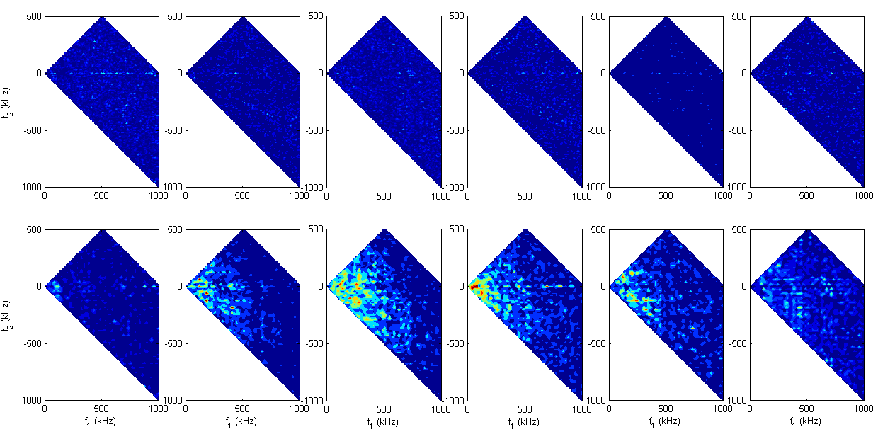
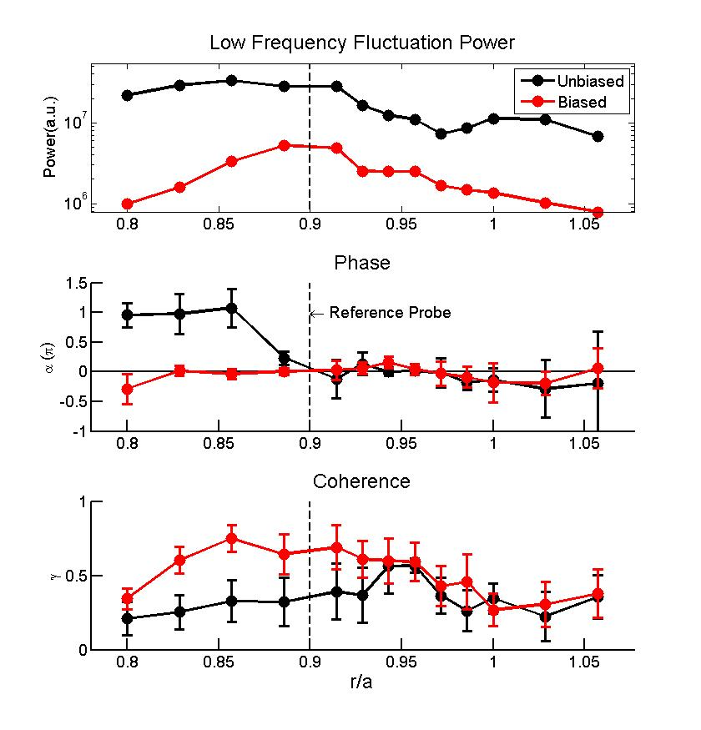

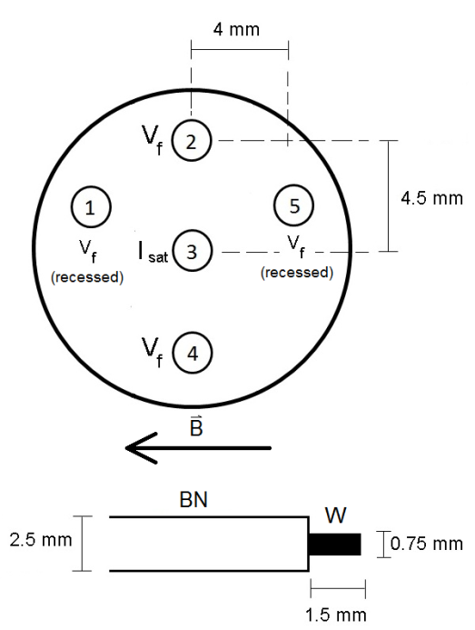
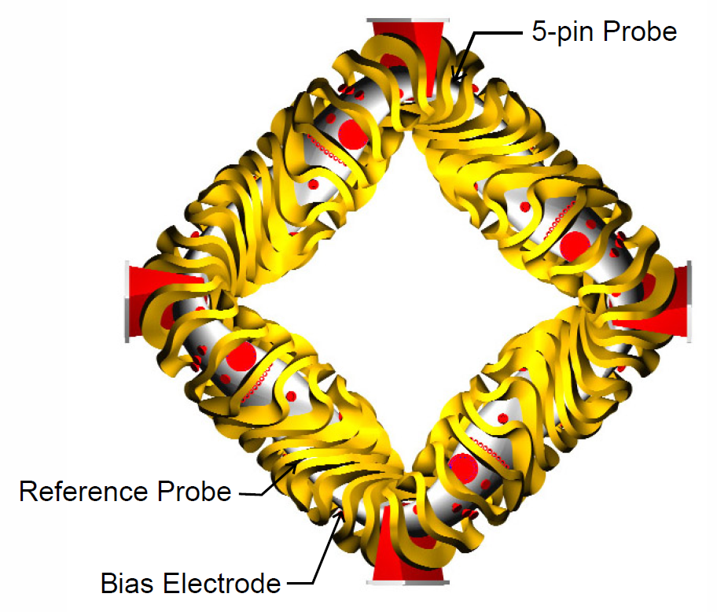
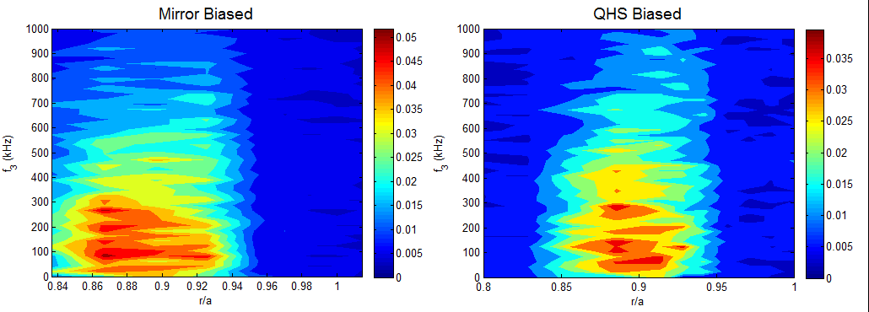
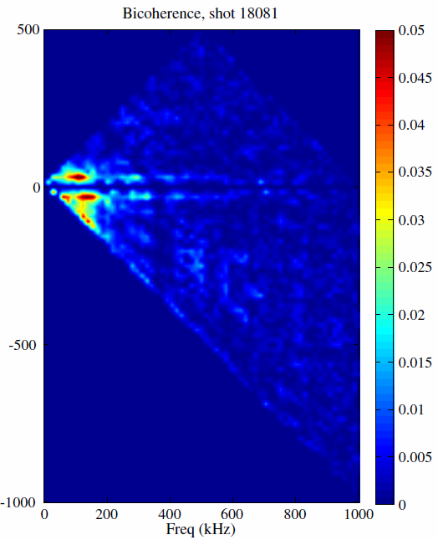
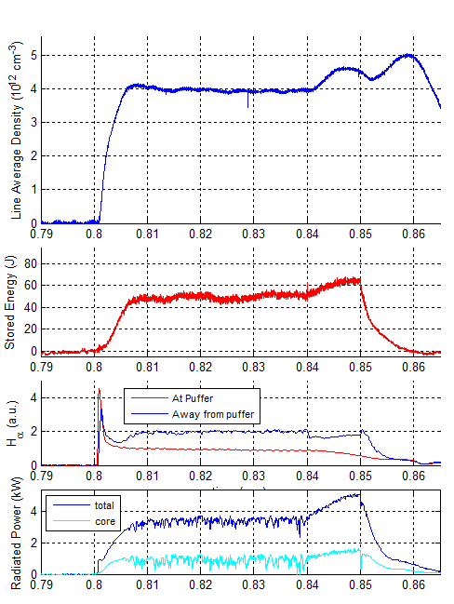
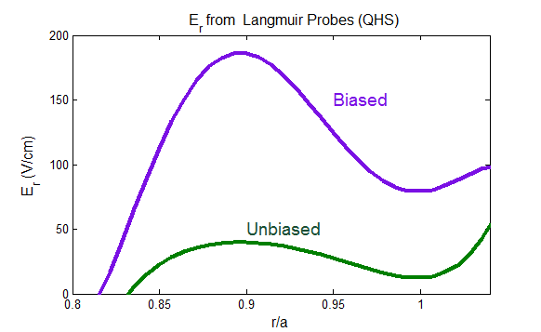
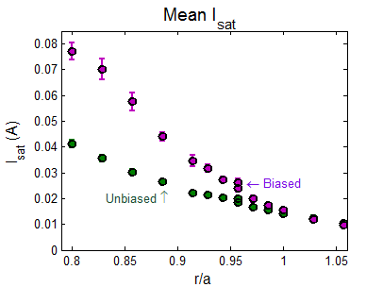
Measurements of Long-range Correlations and Bicoherence during Biasing in HSX
R. Wilcox¹, B.Ph. van Milligen², C. Hidalgo², J.N. Talmadge¹, D.T. Anderson¹, F.S.B. Anderson¹
1 HSX Plasma Laboratory, University of Wisconsin, Madison, USA
2 Asociación EURATOM-CIEMAT, Madrid, Spain
Overview
E_{θ} Bicoherence
Long-range Correlations
This work is part of a collaboration with the TJ-II group in Madrid regarding zonal flows in stellarators
Our goal is to find differences in zonal flow formation in HSX between a configuration optimized for neoclassical transport and one with the optimization intentionally broken
Using Langmuir probes at the edge, an increase in the bicoherence of E_{θ} fluctuations was measured during biasing in the region of strong induced E_{r}
Long-range correlations are also observed in the potential fluctuations of spatially separated probes while biasing, but not between density fluctuations
These observations are consistent with those in other devices, especially during confinement transitions, and are generally seen as indications of zonal flow formation
Changing the degree of quasi-symmetry has no significant effect on these results
Bicoherence measures 3-wave coupling between single or multiple signals, and is used as a tool to analyze zonal flow drives [1]
Often measured during transitions to improved confinement regimes
Plots indicate amount of coupling between fluctuations of frequencies f₁, f₂, and f₃=f₁+f₂
Plots are bounded by the Nyquist frequency on top, left and right, and by symmetry where f₁=f₂ and f₁=-f₂
Unbiased
Zonal flows are expected to be electric field perturbations with zero frequency and a finite spectral width (δf), determined by collisional damping
Low-frequency (<10kHz) potential fluctuations are measured by 2 spatially separated probes, one stationary and one scanning across the minor radius
When a bias is applied, correlations between the two fluctuation measurements become in-phase and have higher coherence across a large radial region
The radial extent of the long-range correlations is similar to that of the bicoherence
Biased
Langmuir Probes and Biasing
5-pin Langmuir probe configured to measure floating potential and ion saturation current
Tungsten probe tips insulated by boron nitride tubes extend from bulk BN to minimize perturbations
Signals passed through optically isolated amplifiers, sampled at 2MHz
Probes scanned radially on a shot-by-shot basis
Bicoherence measured using the floating potential of 2 pins of the 5-pin scanning probe
Long-range correlations measured with respect to a fixed reference probe located ϕ≈3π/4 toroidally from 5-pin probe
Here f=E_{θ} → auto-bicoherence of E_{θ} is plotted
Probe r/a = 0.83
0.86
0.89
0.91
0.93
0.94
Summed Bicoherence
Long-range correlations are not observed in ion saturation signals
This is consistent with results from TJ-II in both biased and spontaneous L-H transitions, both of which were attributed to zonal flows [4]
Increase in auto-bicoherence of E_{θ} fluctuations well above the noise level is measured when bias is applied
Broadband coupling is consistent with results from biased discharges in other devices, TJ-II [2] and CCT [3]
Coupling to zonal flows is predicted to be stronger in neoclassically optimized configurations like QHS [5]
LHD has simulated and measured reduced anomalous transport in their inward-shifted configuration designed to reduce neoclassical transport [6]
TJ-II
Summary
Biased discharge Characteristics
noise
Measurements during spontaneous, unbiased L-H transitions in TJ-II showed more preferential coupling of like frequencies to near-zero frequency modes (more clearly indicative of zonal flows)
Bicoherence of E_{θ} and long-range correlations of low-frequency potential fluctuations are measured in the region of strong radial electric field during biasing in the HSX stellarator
This is consistent with previous experiments, in both tokamaks and stellarators, and is generally interpreted as an indication of zonal flows
Little difference is seen between a configuration with the quasi-symmetry intact and one with it intentionally broken
Future work will be performed to investigate radial electric field threshold for these observations
noise
Bias probe inserted to r/a = 0.75, biased at 260V relative to a carbon limiter placed just outside the last closed flux surface
Gas puffing stopped during bias
Radial electric field is set by bias, probe floating potentials and ion saturation current reach a steady state in <100μs
Particle transport barrier created by induced flows, as measured by Thomson scattering and Langmuir probes
Bias
On
Breaking the Quasi-symmetry
HSX has a direction of symmetry in the magnetic field strength, |B|
Auxiliary coils can be energized to introduce additional terms into the |B| spectrum, without significantly changing the mean field strength, well depth, or rotational transform
Results in this configuration (Mirror) were qualitatively similar to those in the symmetric configuration (QHS)
Small quantitative differences are assumed to be due to experimental differences between the two configurations when biasing is applied
50 kW ECRH
References
Density and stored energy rise during bias
H_{α} signals drop
Radiated power increases as impurities accumulate
Core temperature increases gradually, possibly due to impurities
[2]
Radial electric field found by fitting a curve of the shot-by-shot floating potential profile
Measured bicoherence is highest in the region where the induced radial electric field is the largest
This is consistent with results from other devices that measure bicoherence when biasing
Suggests a link between mean radial electric fields and zonal flow drive
C. P. Ritz et al., Physics of Fluids B 1 (1989) 153.
B. P. van Milligen et al., Nuclear Fusion 48 (2008) 115003.
G. R. Tynan et al., Physics of Plasmas 8 (2001) 2691.
M.A. Pedrosa et al, Physical Review Letters 100 (2008) 215003.
H. Sugama et al., Physical Review Letters 94 (2005) 115001.
T.-H. Watanabe et al., Physical Review Letters 100 (2008) 195002.

