Slide 1
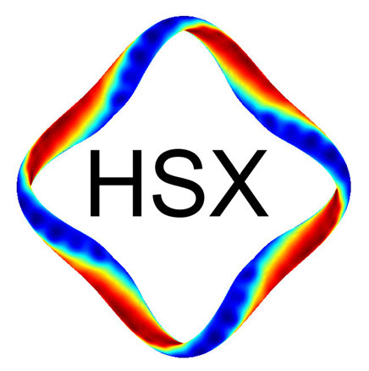

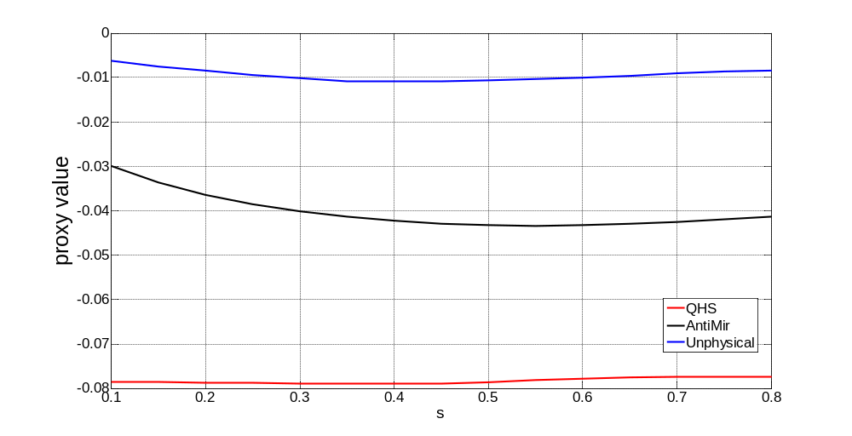
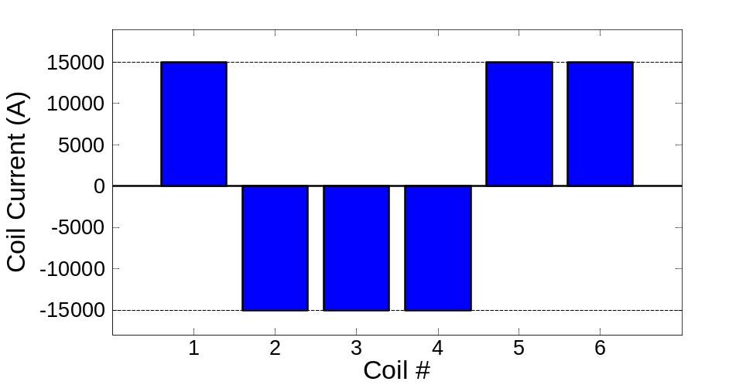
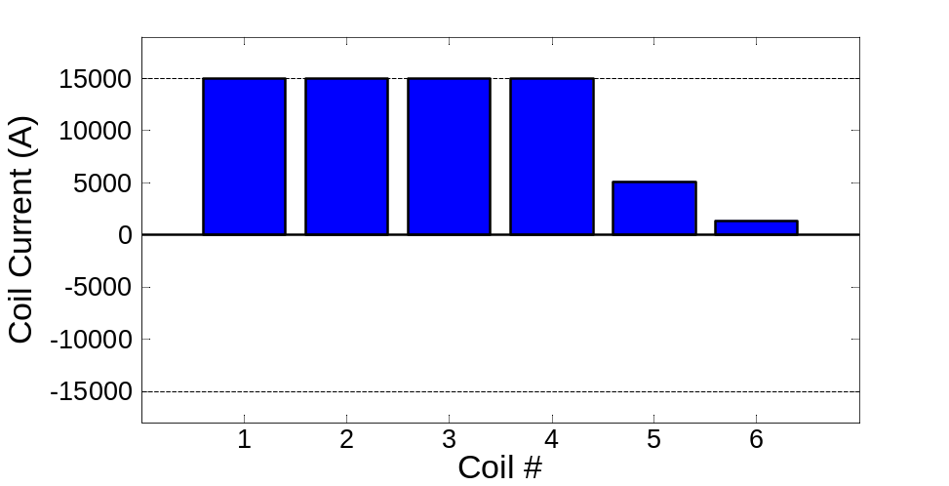
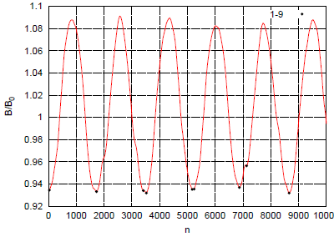
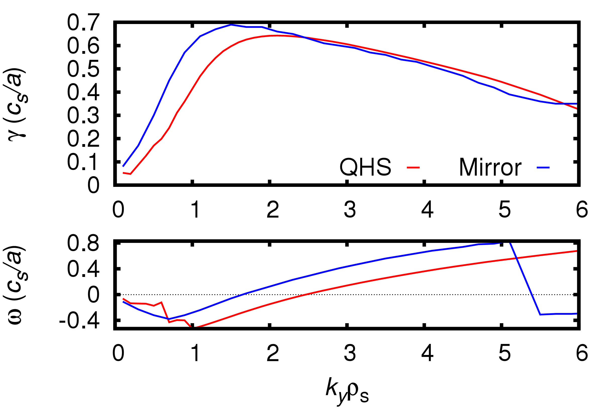
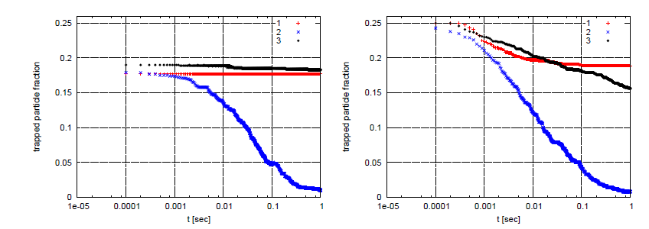
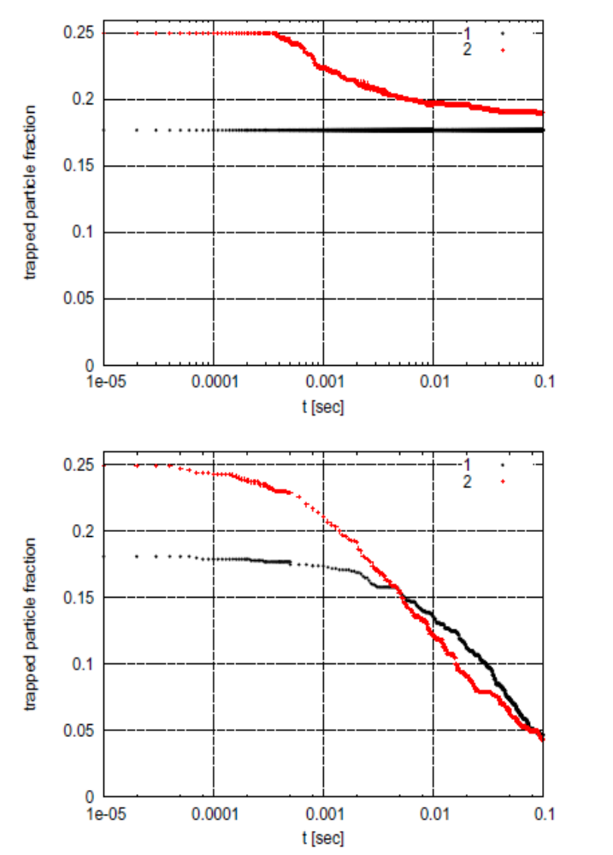
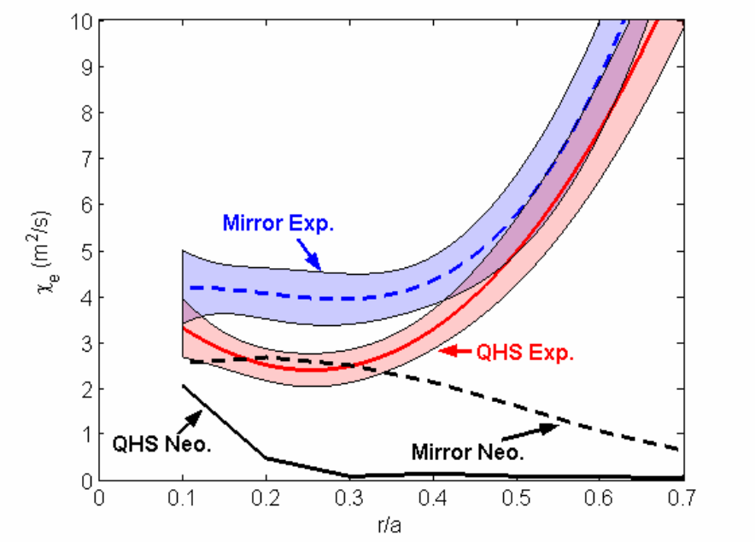
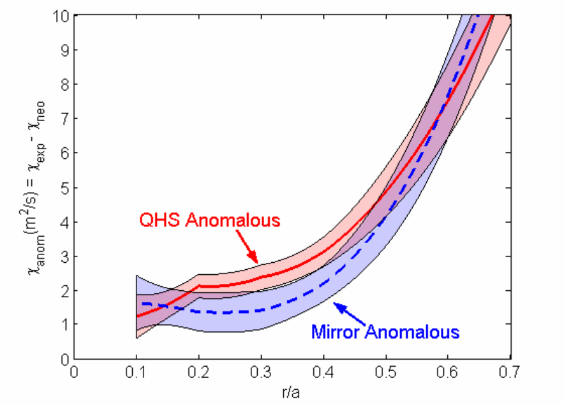
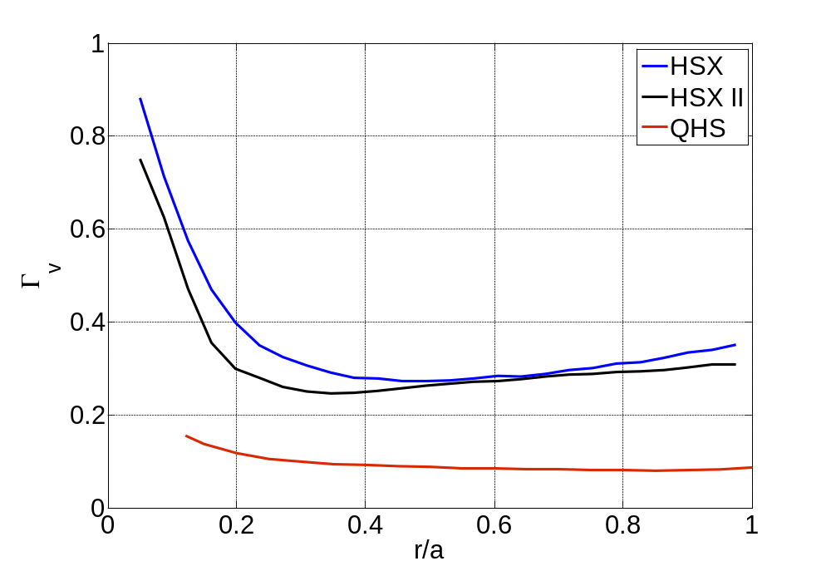
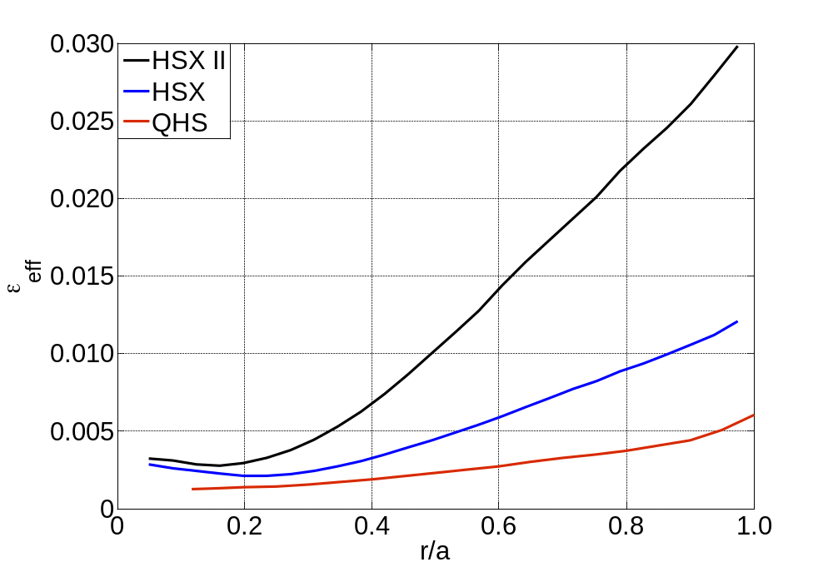
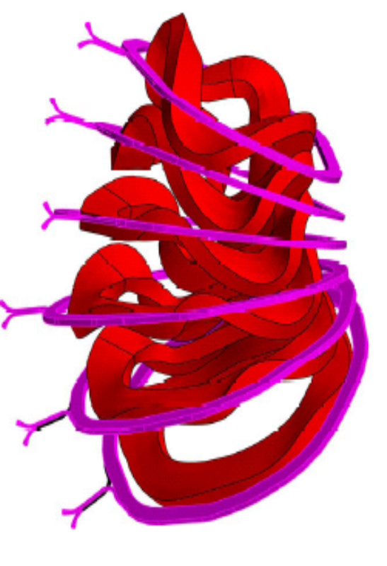
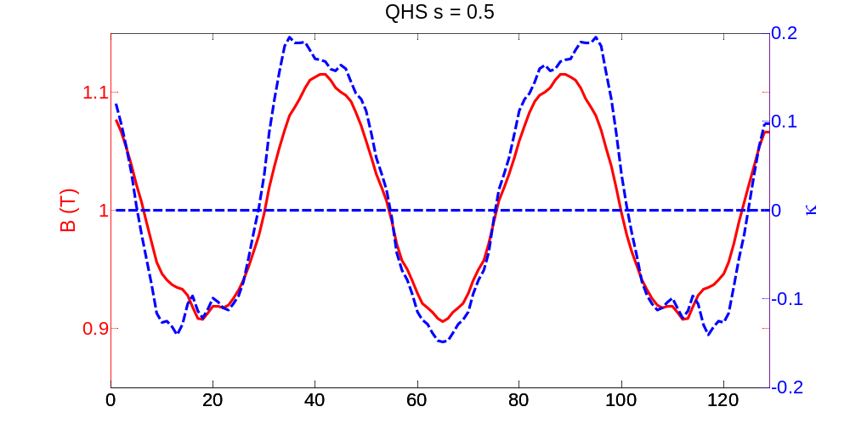
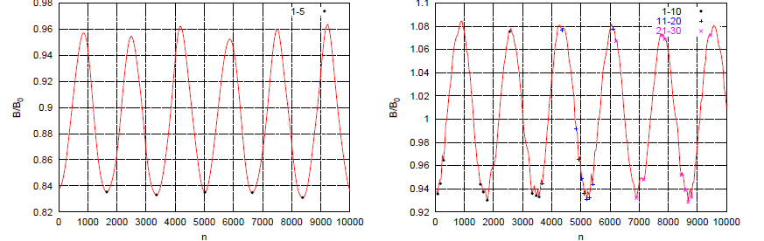
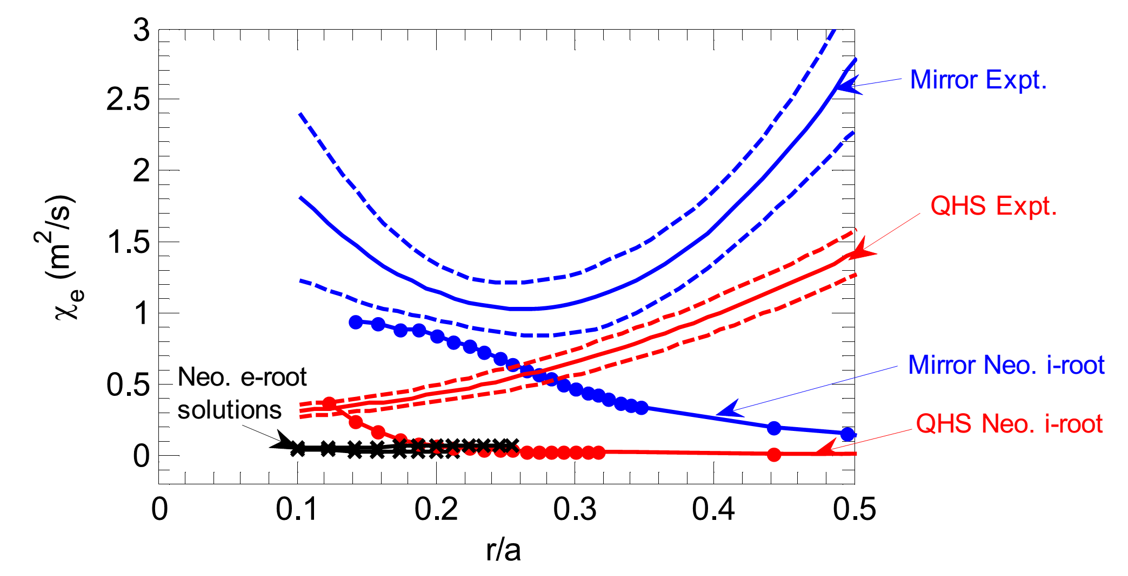
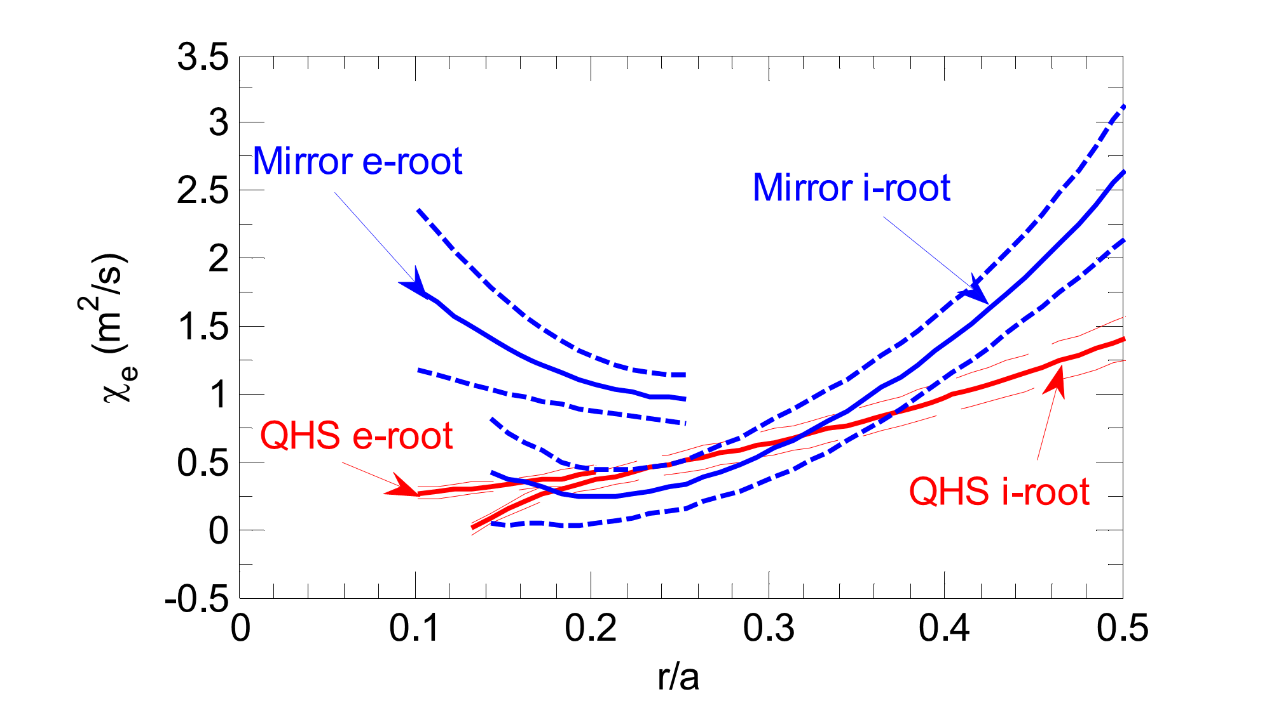
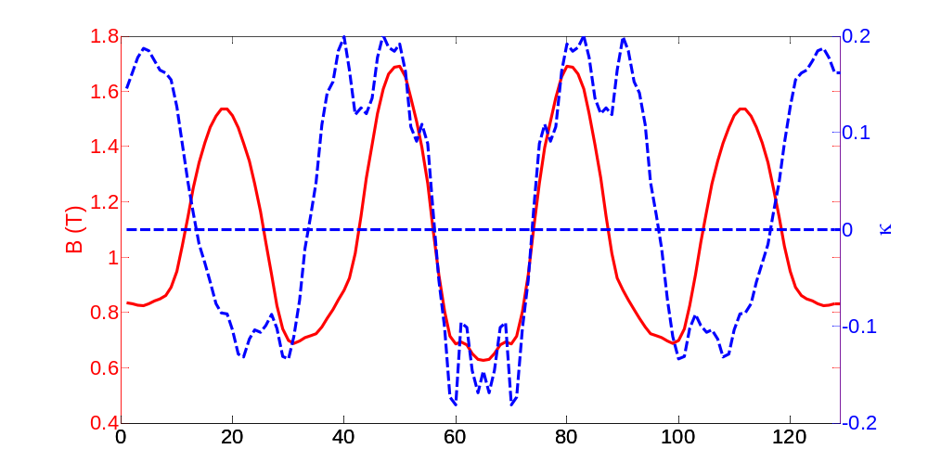
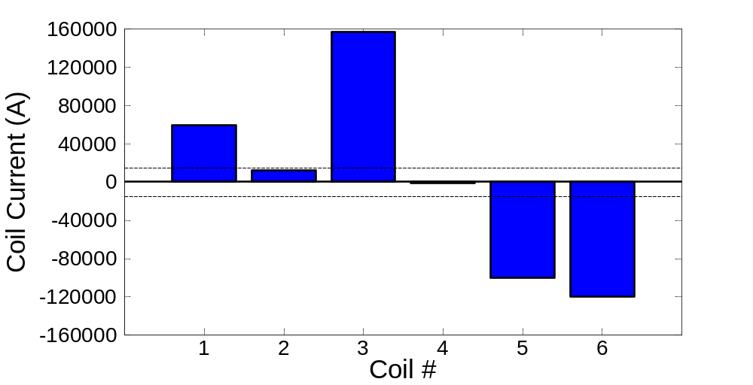
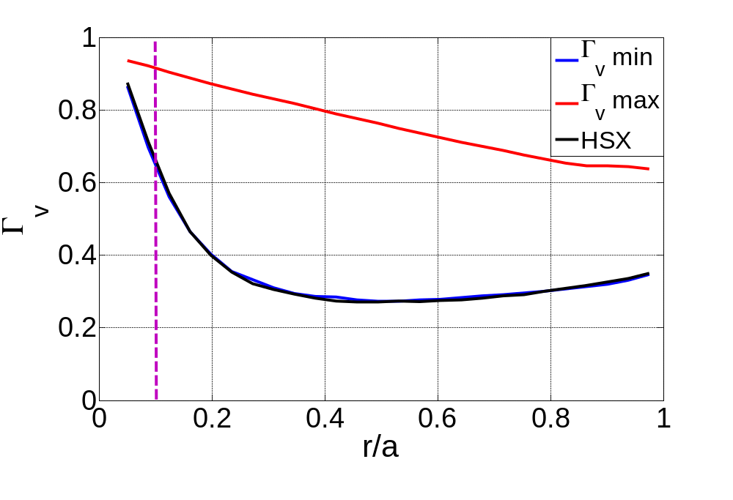
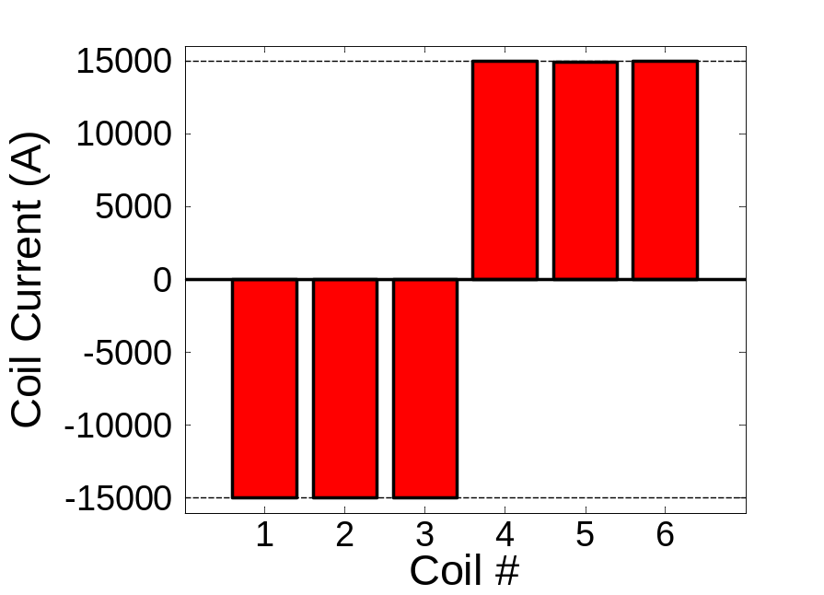
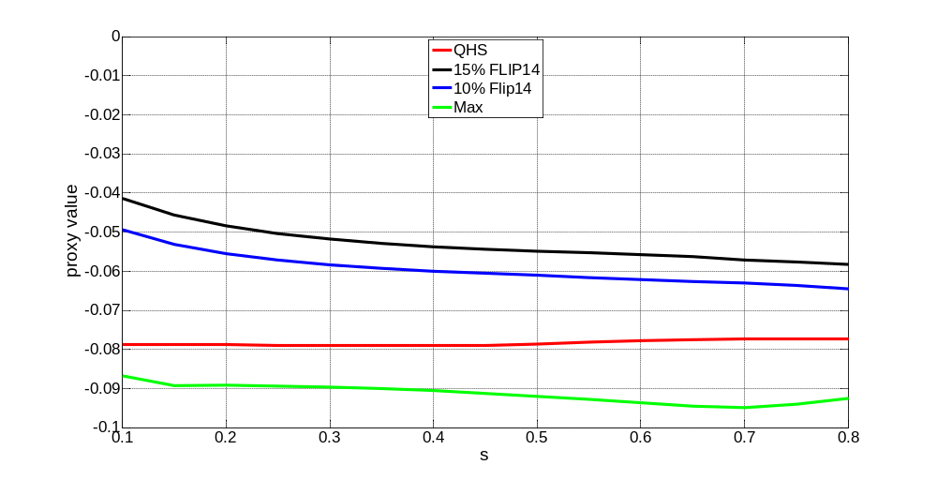
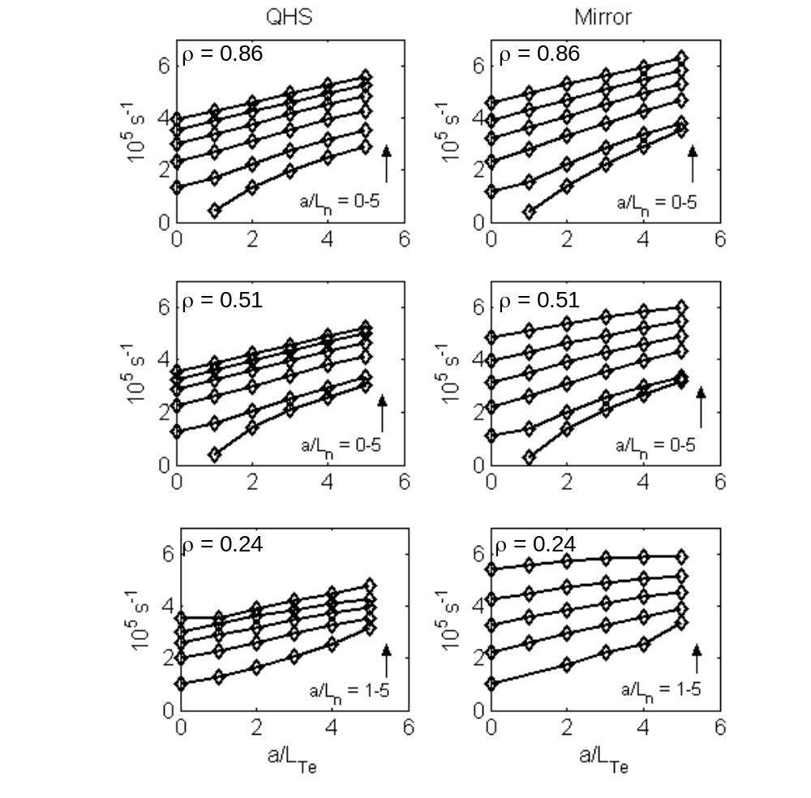
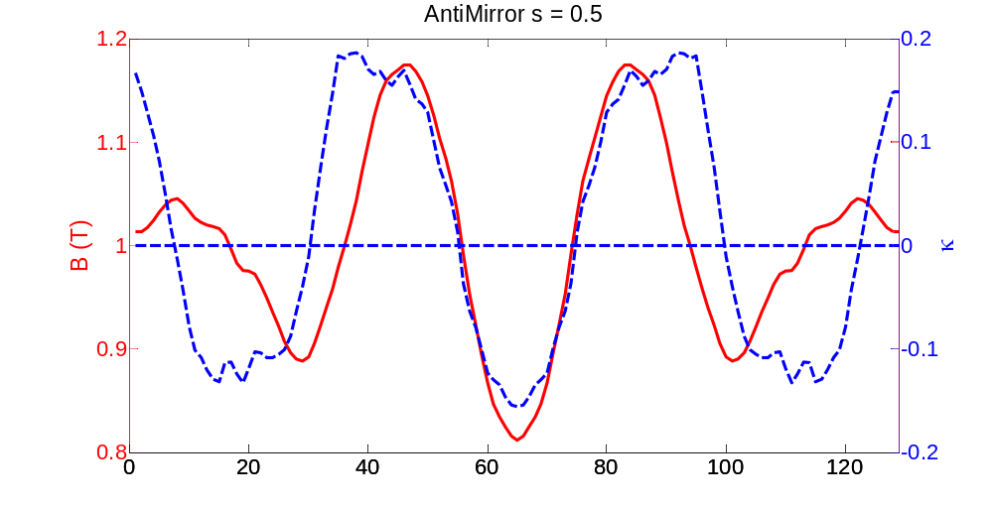
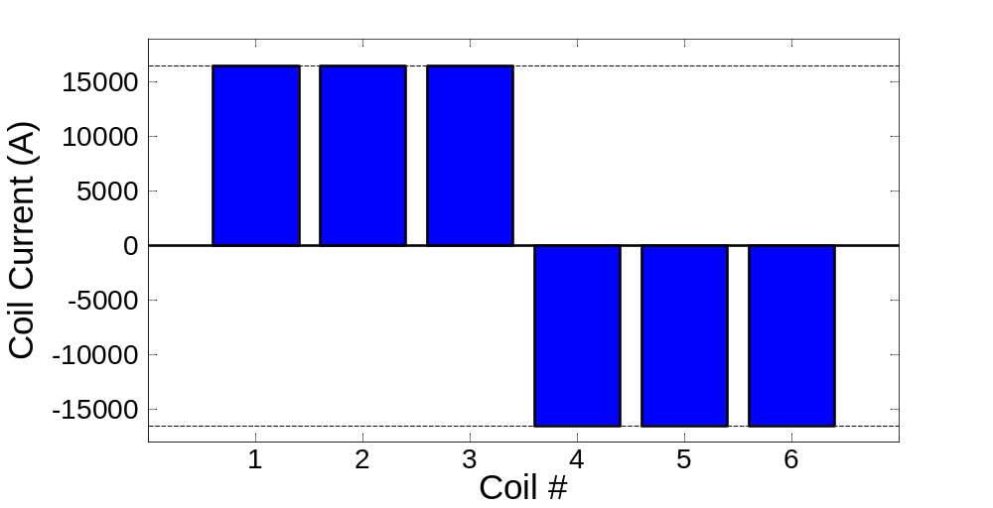
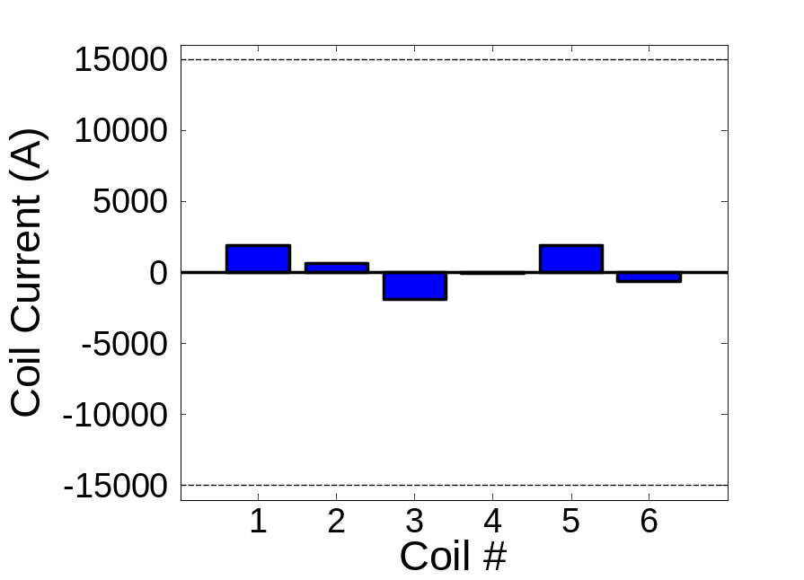
Targeted Physics Optimization in HSX
J.N. Talmadge, B. Faber, A. Bader, S. Lazerson², J.H.E. Proll³,
H.E. Mynick², V.V. Nemov⁴
HSX Plasma Laboratory, Univ. of Wisconsin; ²PPPL;³IPP, Greifswald; ⁴IPP, Kharkov, Ukraine
Overview
One way to improve alpha particle confinement in an HSX reactor is to double the number of modular coils ➔ HSX II
Physics & engineering issues need to be resolved for stellarators: turbulent transport, energetic ion confinement, impurity confinement, divertor, coil complexity.
Explore flexibility in HSX to address some of these issues by varying auxiliary coil currents to optimize for specific physics targets using free boundary VMEC.
Two issues addressed in this poster:
  Can one use 3-D shaping to reduce turbulent transport? Using a simple first generation proxy provided by Josefine Proll, adjust currents in 6 auxiliary coils to shift trapped particle population out of bad curvature region.
  Modular coil ripple degrades energetic particle confinement. Energetic particle confinement cannot be improved with auxiliary coils. Solution is to increase # coils to reduce modular ripple.
  The effective ripple is NOT a good proxy for energetic particle confinement.
Proxy values show improvement of Antimirror configuration over QHS.
48 additional coils are added to HSX by averaging the coordinates of the neighboring coils.
Number of local minima in |B| decrease.
B/B₀
Flip14 (10%) is the normal configuration we use to degrade the quasisymmetry (left). Coil configuration on right is result of trying to maximize the proxy function.
B/B₀
QHS AntiMirror
Energetic Particles
r/a = 0.25
r/a = 0.5
Alpha particle confinement in HSX reactor is degraded compared to original QHS concept: Nemov EPS 2012.
HSX II
HSX
QHS
Turbulent Transport
r/a = 0.5
r/a = 0.5
Stellarators routinely optimized for neoclassical transport
  For QHS configuration, turbulent transport dominates throughout plasma (Canik PRL 2007, Lore PoP 2010)
  The trapped particles for the QHS configuration lie in the bad curvature region, just as in a tokamak.
  STELLOPT uses a proxy function to shift the trapped particles out of the bad curvature region
Linear GENE calculation shows that growth rate in AntiMirror configuration is worse than QHS, contrary to simple proxy result: a/L_{Te} = 1, a/L_{n} = 2, a/L_{Ti} = 0, T_{e}=T_{i}
r/a = 0.25
r/a = 0.25
Past experiments have attempted to determine how turbulent transport is affected by auxiliary coil currents
QHS
HSX
Bounce-averaged radial drift
Effective Ripple
QHS is the original Nührenberg & Zille (1988). HSX is described by finite coils, which introduce additional minima in |B|. QHS & HSX both scaled to B = 5T, a = 1.6 m.
HSX
HSX II
HSX
Vary currents in 6 auxiliary coils using free boundary VMEC.
QHS
HSX II
QHS
Canik 2007 ECRH at B = 0.5 T: Subtract calculated neoclassical thermal diffusivity from experimental value to get turbulent diffusivity
Some indication that turbulent transport is reduced for r/a ~ 0.2 – 0.45 Mirror configuration ~ 15% Flip14
QHS
HSX
HSX II has lower Γ_{v} but higher ε_{eff} compared to HSX.
Effective ripple is not an adequate figure of merit for energetic particles.
Zero currents in auxiliary coils corresponds to quasihelically symmetric configuration
Remarks
Trapped particles for quasihelical configuration are in the bad curvature region. Large bad curvature and short connection length leads to largest growth rate of stellarators studied in Rewoldt (2005).
The curvature in HSX is fixed, but the trapped particle population can be shifted slightly with the auxiliary coils.
Despite the intriguing experimental result of Canik 2007 which suggests that the Flip14 configuration has lower turbulent transport, GS2 and GENE calculations are at odds with the simple proxy formulation.
Future work will test optimization with more advanced proxy (see Proll NO3.00004 Wednesday).
The modular coil ripple in HSX leads to poor confinement of energetic particles. The effective ripple is not a good indicator of energetic particle confinement.
Nemov PoP 2005, 2008 developed target functions for energetic particle confinement ➔ Γ_{v} Γ_{p} Γ_{c} corresponding to bounce-average drift, poloidal drift velocity, angle between J and magnetic surface.
Lore 2010 ECRH at B = 1.0 T: Ambiguous whether QHS or Mirror configuration has lower turbulent transport. Mirror configuration = 10% Flip14
Unbounded optimization attempts to create wells in good curvature region
Optimization using proxy suggests transport in Flip14 configuration is better than in QHS
Guttenfelder 2008 Growth rates calculated with GS2 shows QHS and 10% Flip14 configuration are similar, with larger growth rates for Flip14 in the core.
Bounded optimization turns out to be antiMirror configuration
Optimization of auxiliary coil currents to minimize Γ_{v} at r/a = 0.1 has little effect.
This work is supported by US DOE Grant DE-FG02-93ER54222 and DOE-SC0006103
56th Annual Meeting of the Division of Plasma Physics, Oct 27-31, 2014, New Orleans, LA

