Slide 1
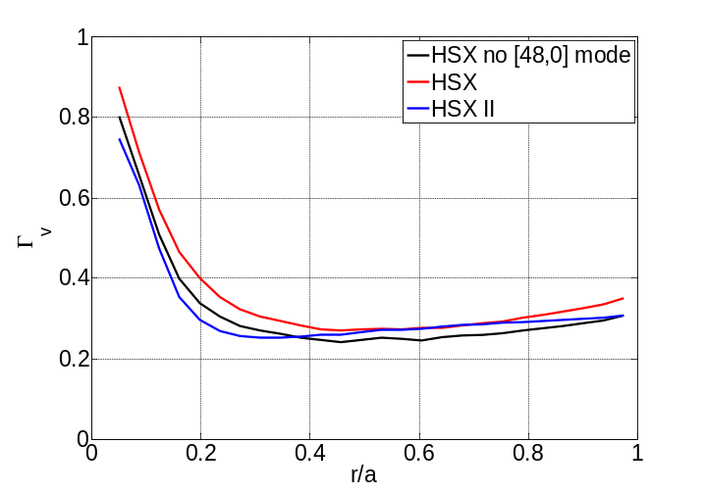
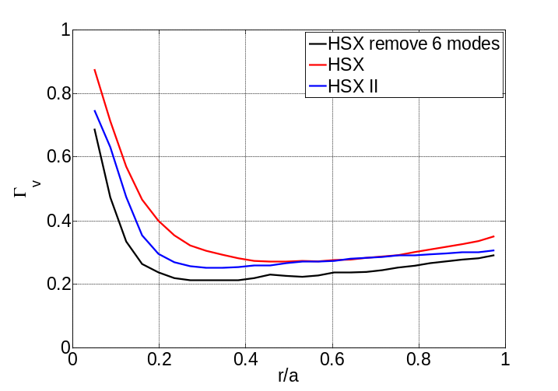
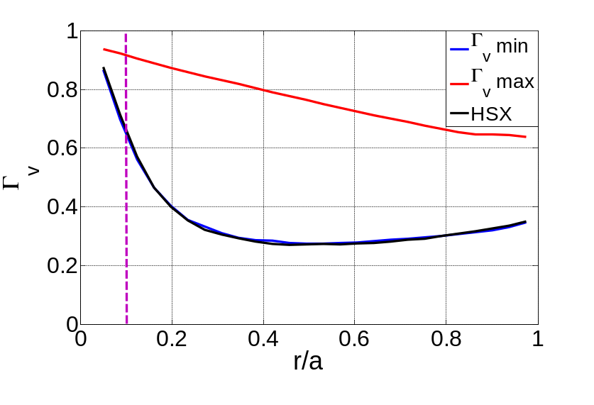
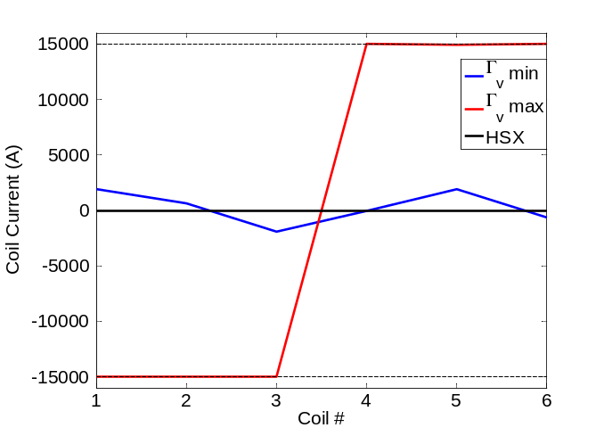
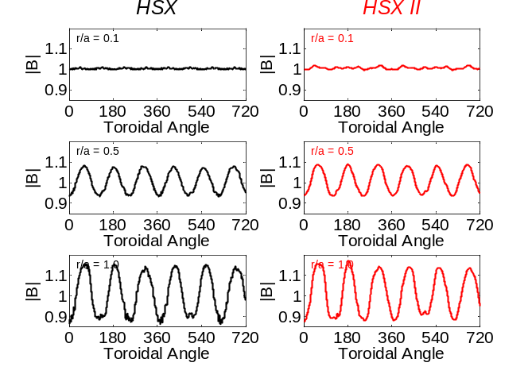
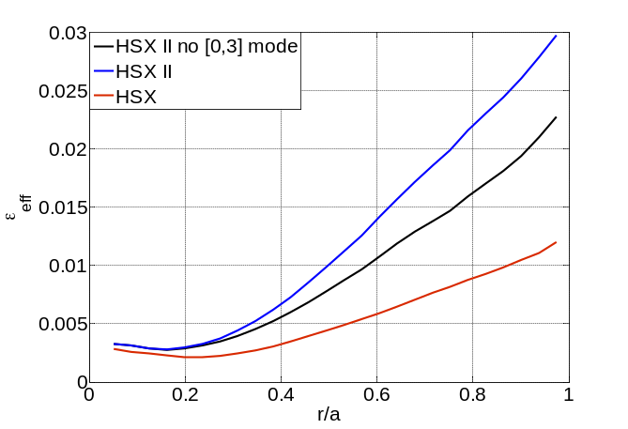
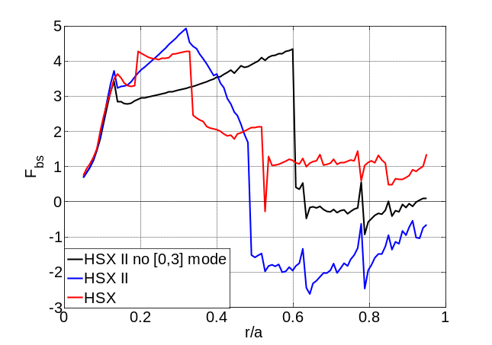
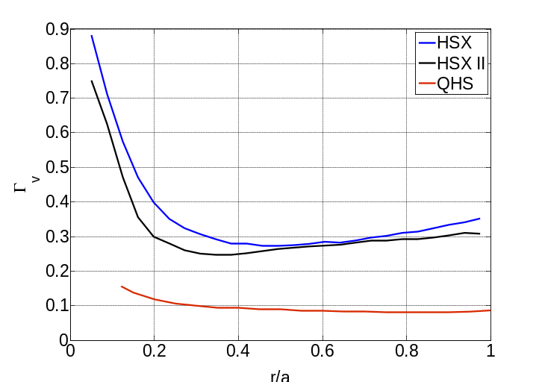
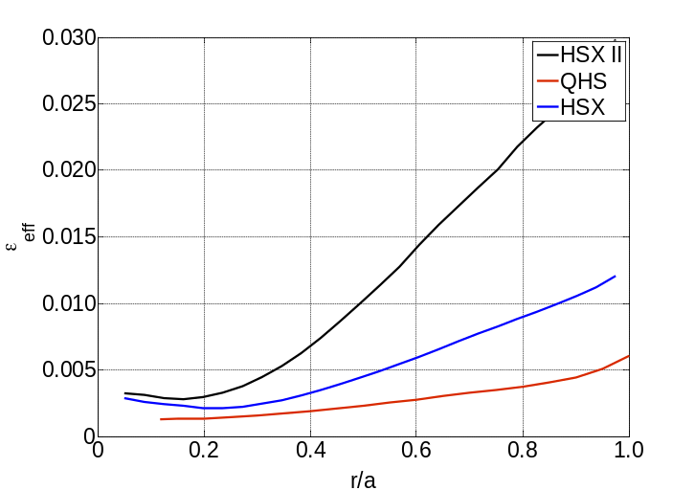
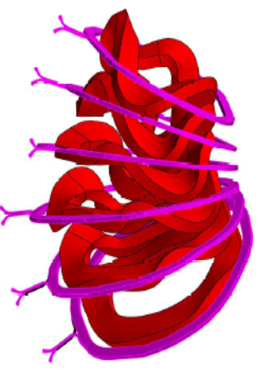
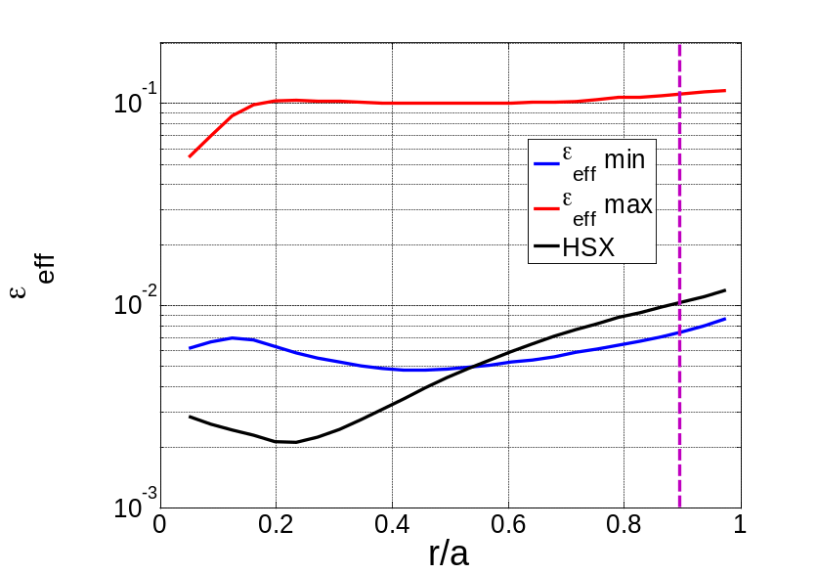
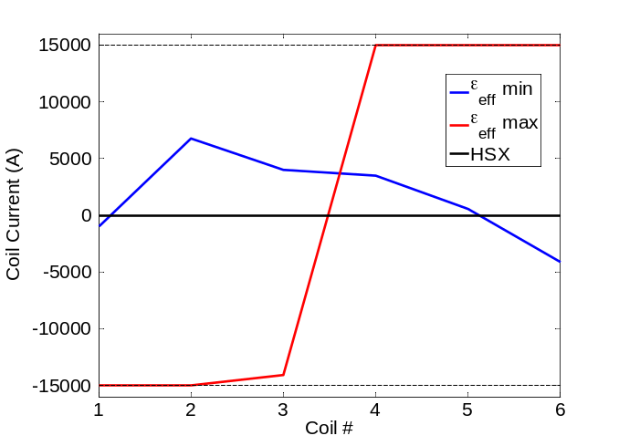
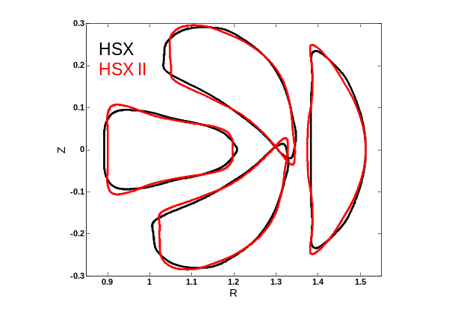
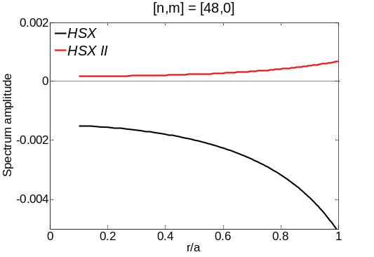
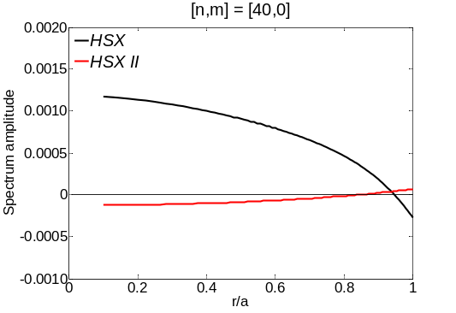
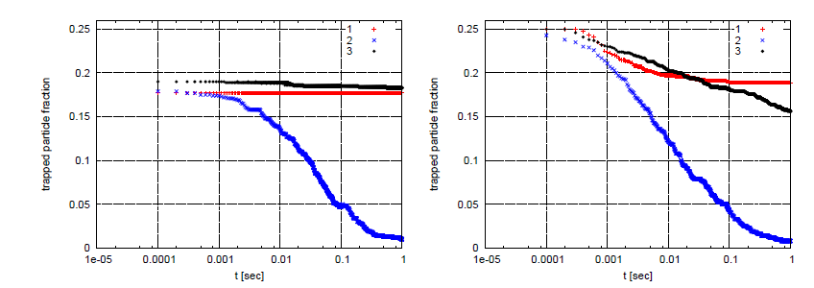
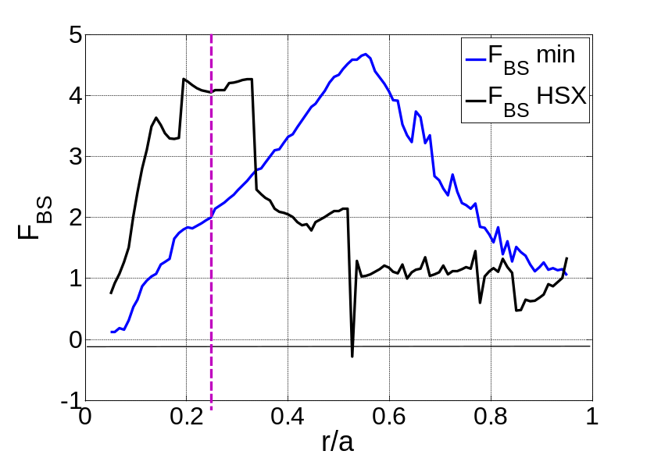
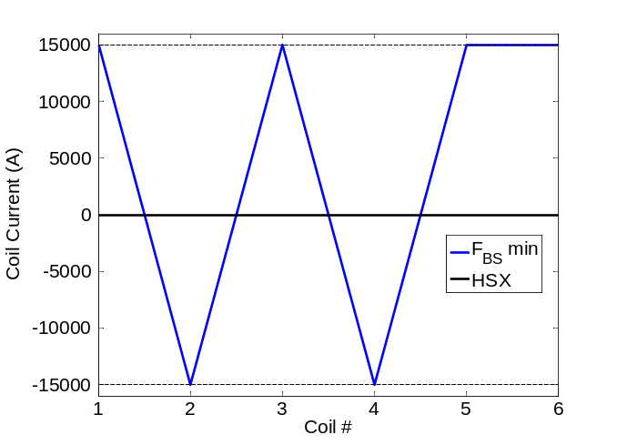
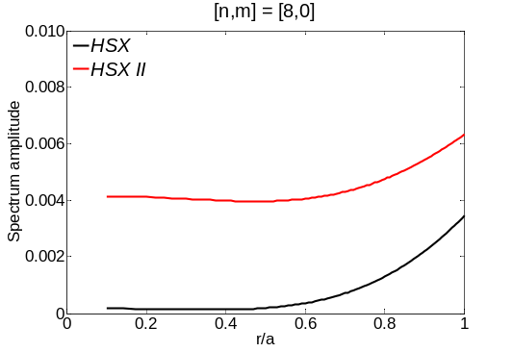
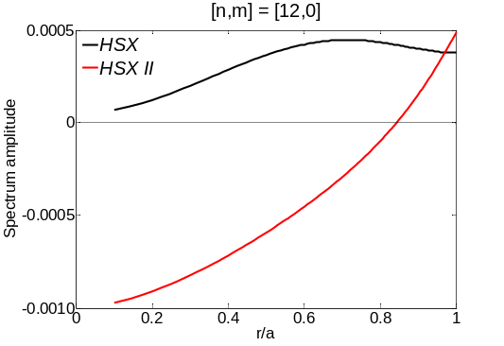
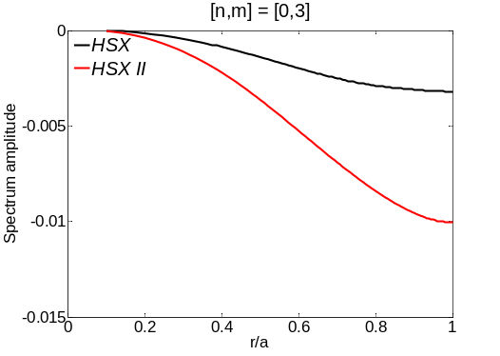
Targeted Physics Optimization in HSX
J.N. Talmadge, K.M. Likin, V.V. Nemov¹, Y. Turkin², W. Kernbichler³
HSX Plasma Laboratory, Univ. of Wisconsin, Madison, USA;
¹Institute of Plasma Physics, Kharkov, Ukraine; ²Max Planck Institut für Plasmaphysik, Greifswald, Germany; ³Institut für Theoretische Physik, Graz, Austria
Overview
Optimization of Γ_{v} at r/a = 0.1
HSX II: a reduced ripple stellarator
Goal is to vary magnetic configuration using auxiliary coils and minimize or maximize target physics parameters: effective ripple, energetic particle confinement or bootstrap current. Then, test this capability experimentally.
Initial optimization runs show that the effective ripple can be decreased with the auxiliary coils, but difficult to decrease energetic trapped particle losses at plasma core or bootstrap current coefficient.
The [n,m] = [48,0] component of the magnetic field spectrum, due to the 48 modular coils in HSX, leads to large trapped alpha particle losses in an HSX reactor. Doubling the number of coils reduces this loss.
Minimization of effective ripple does not lead to optimized alpha particle confinement.
An obvious feature of the HSX magnetic field spectrum is the n = 48, m= 0 ripple due to the finite number of coils.
HSX II is a variant of HSX with twice the number of coils, obtained by averaging neighboring coils.
HSX and HSX II are compared to the original QHS configuration developed by Nührenberg & Zille [3]
Removal of the large [48,0] term in HSX reduces Γ_{v} to level of HSX II. However, additional removal of mirror terms [16,0], [20,0], [28,0], [40,0], [52,0] from HSX underestimates Γ_{v} in HSX II.
Auxiliary coils have little effect on improving energetic particle confinement in core ➔ Optimization of Γ_{v} at r/a = 0.1 only decreased the value from 0.659 to 0.646.
Energetic particle confinement can be degraded by running first 3 coils in opposite direction to last 3.
Targeted Optimization
Γ_{v} is reduced in HSX II but ε_{eff} is higher
Optimization of ε_{eff} at r/a = 0.9
One term which increases effective ripple in HSX II is the toroidal curvature harmonic [0,3]. This component also reverses the direction of the boostrap current at the half-radius.
Main field coils and auxiliary coils in ½ field period in HSX.
The original QHS configuration had better energetic particle confinement and lower effective ripple.
Alpha Particle Confinement in an HSX, HSX II & QHS reactor
Optimization code varies current in 6 auxiliary coils using free boundary VMEC .
Design experiments to test predicted performance for different auxiliary current profiles to minimize or maximize:
  Γ_{v}: Surface average of collisionless bounce-averaged ∇B drift velocity for trapped particles. [1]
    Energetic particle confinement in core driven by ICRF ➔ see poster by Likin.
  ε_{eff}: Effective ripple in low collisionality, E_{r} = 0,1/ν regime [2].
    Competition between Reynolds stress and neoclassical poloidal flow drive at plasma edge ➔ see poster by Wilcox.
  F_{bs}: Bootstrap current geometric factor in low collisionality regime.
    Vary current profile for plasma reconstruction ➔ see poster by Chlechowitz.
The effective ripple at the plasma edge can be reduced from the base configuration with the current profile shown above.
The ripple can be increased by 1-2 orders of magnitude in a similar configuration that increased Γ_{v} .
Surface shape is different in HSX II: modular ripple is reduced
Optimization of F_{BS} at r/a = 0.25
Γ_{v} for HSX is large towards plasma core. How does this compare to alpha particle confinement in an HSX reactor?
Collisionless evolution of trapped alpha particles compared above for original QHS (red), HSX (blue) and HSX II (black) [4]
  Scaled to a = 1.6 m, B = 5 T; 3.5 Mev α-particles launched at r/a = 0.25 (left) and r/a = 0.5 (right)
Alpha particle confinement in HSX II is comparable to the original QHS configuration.
References
1. V.V. Nemov et al., PoP 12, 112507 (2005).
2. V.V. Nemov et al., PoP 6, 4622 (1999).
3. J. Nührenberg and R. Zille, Phys. Lett. A 129, 113 (1988).
4. V.V. Nemov et al., 39th EPS Conference on Plasma Physics, Stockholm, 2012.
By alternating the current in the auxiliary coils the geometric factor for the bootstrap current can be decreased by a factor of two in the region where there is a steep temperature gradient.
Initial results indicate it is difficult to increase F_{BS}.
[n,m] = [48,0], [40,0], [28,0], [20,0],[16,0], [52,0] are smaller in HSX II.
[8,0], [12,0] and [0,3] term are larger in HSX II.

