Slide 1

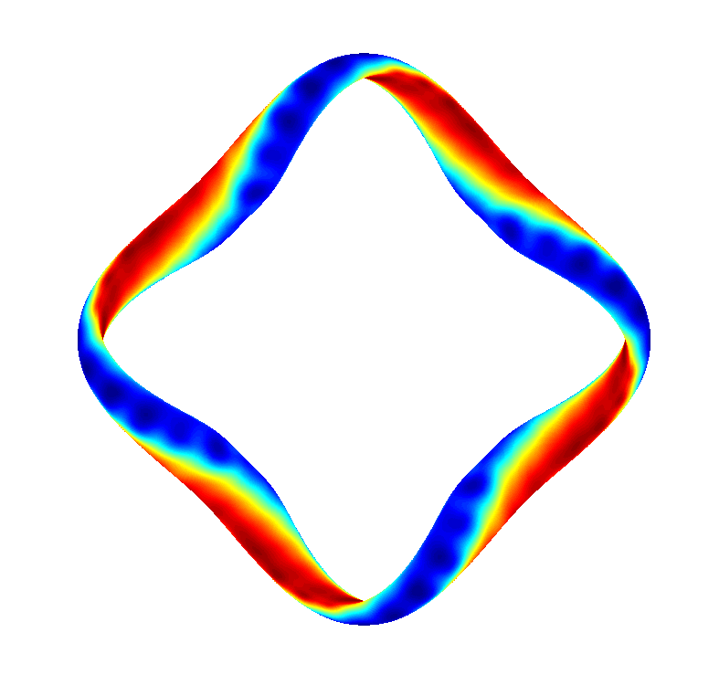
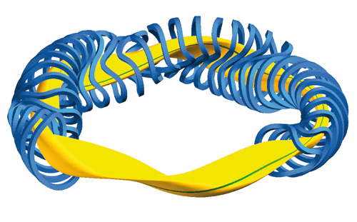



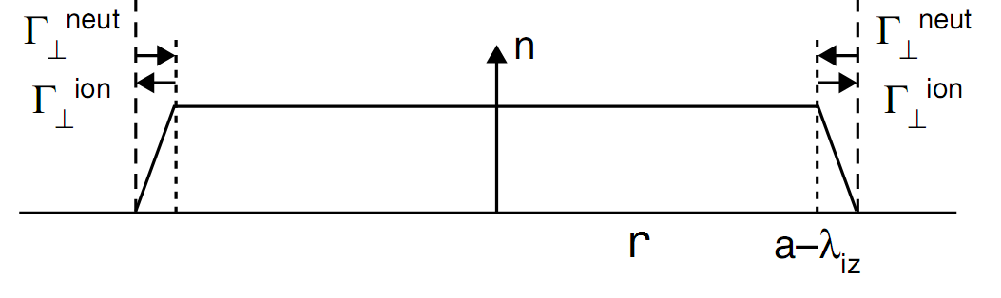
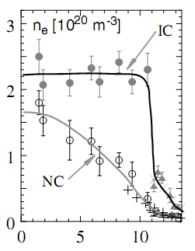
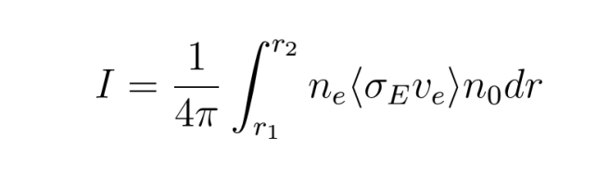
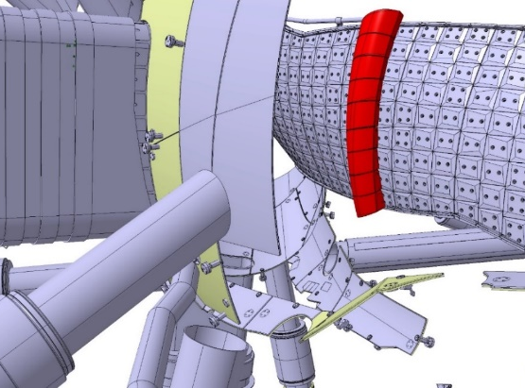
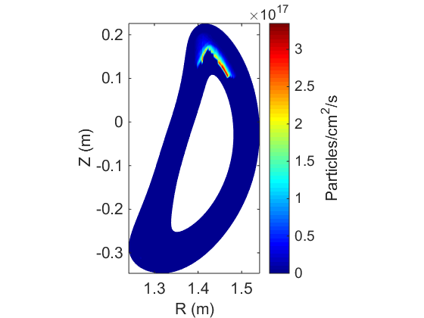
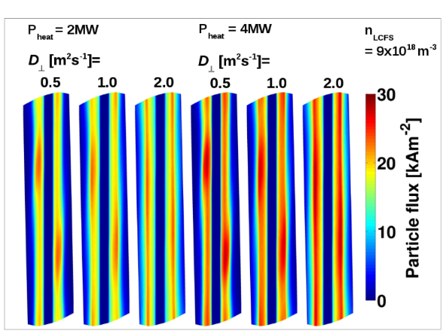
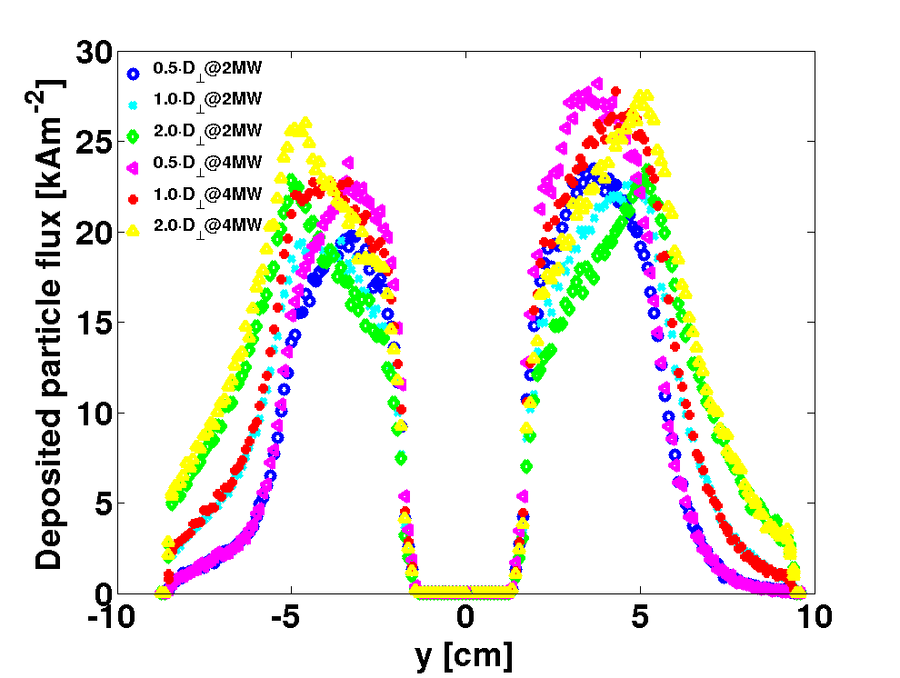
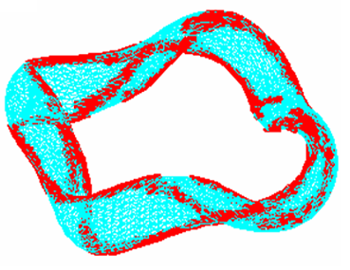
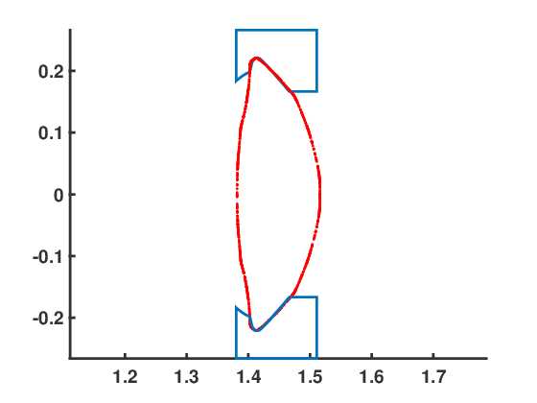
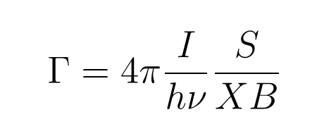
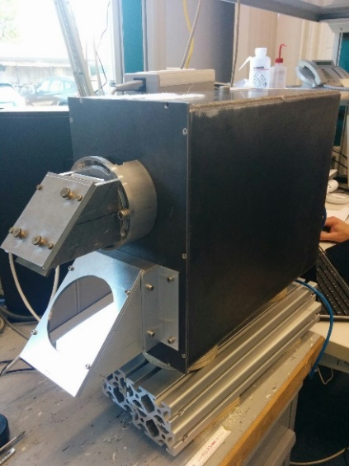
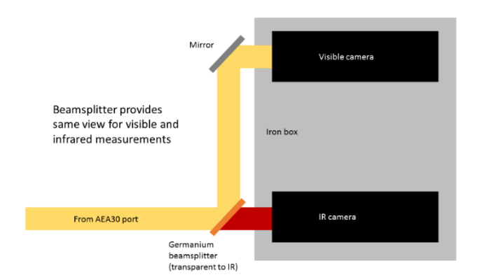
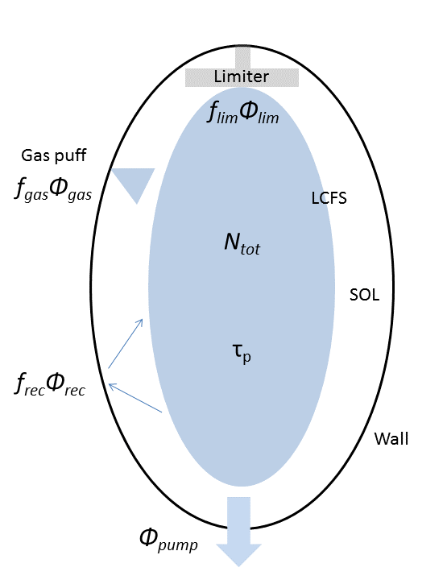
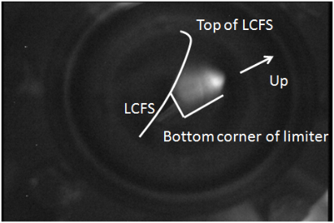
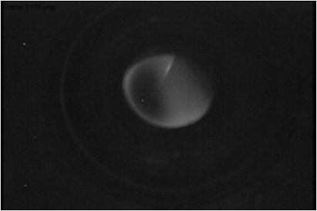
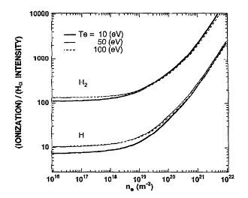
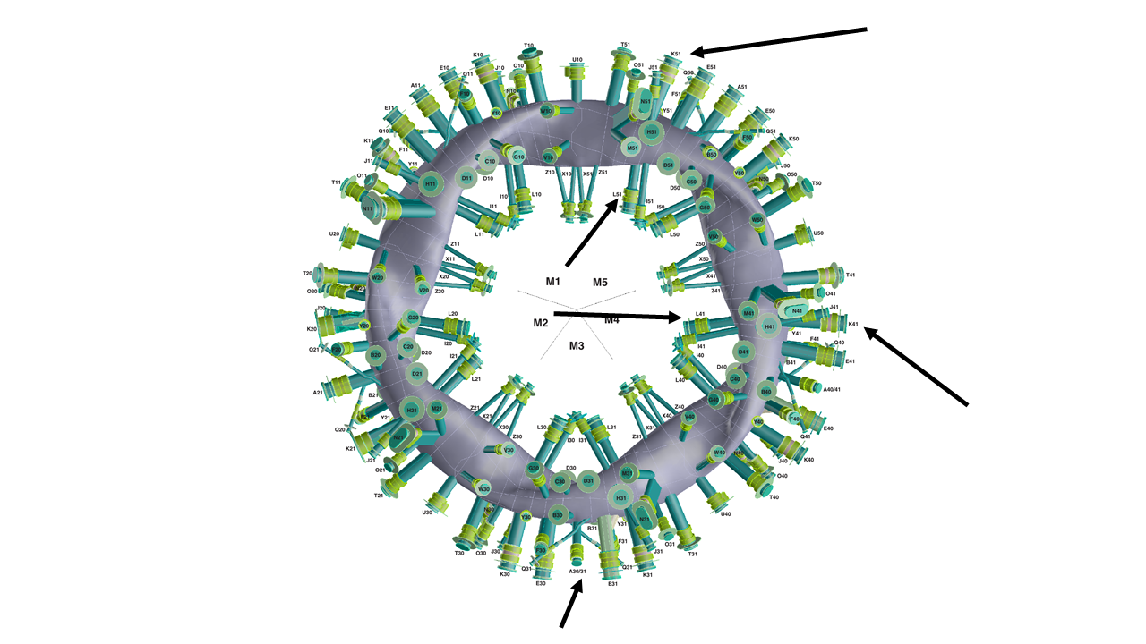
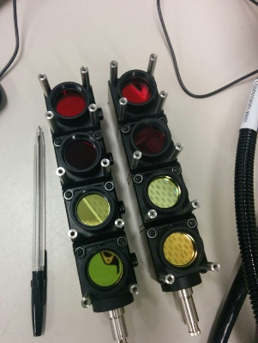
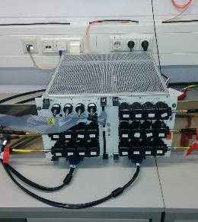
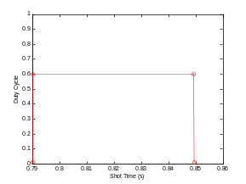
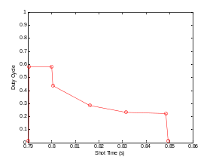
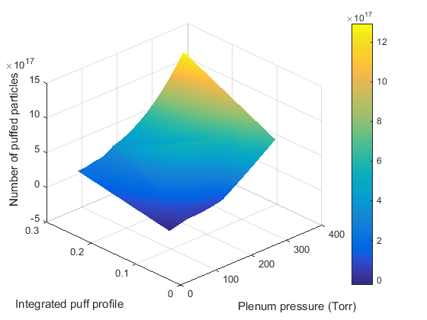
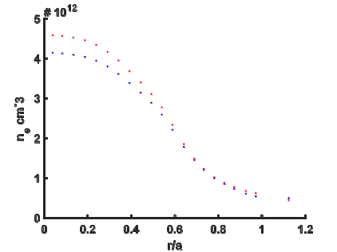
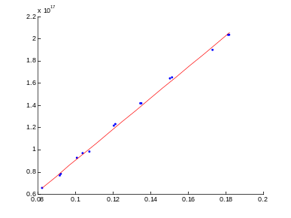
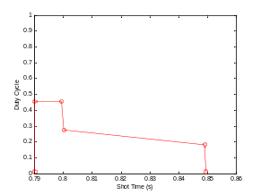
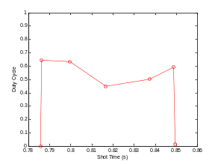
Neutral source and particle balance in the HSX edge
HSX
L. Stephey, A. R. Akerson, D. T. Anderson, F. S. B. Anderson, A. Bader, C. Biedermann, F. Effenberg, J. Harris, C. C. Hegna,
M. Jakubowski, M. Krychowiak, S. T. A. Kumar, O. Schmitz, J. N. Talmadge, E. Unterberg, G. Wurden
HSX Plasma Laboratory, Univ. of Wisconsin, Madison, USA
Motivation and goals
Measuring limiter particle flux
Estimating D˔
The ability to control the neutral particle and impurity source in fusion devices is critical to obtaining high purity, high confinement plasmas (“supershots” in TFTR, HDH mode in W7-AS)
Better understand the neutral particle source, which defines the edge density gradients and plasma flows
Measure and monitor particle flux to understand erosion (→ radiative collapse) and relationship to impurities
Compare measurements to simulation tools like EMC3-EIRENE that play an interpretative and predictive role (i.e. for W7-X)
HSX
W7-X
Measuring photon fluxes using line emission
EMC3-EIRENE [7] modeling can be used to infer the particle diffusivity in the edge
This will be performed by finding the best fit between the experimental characteristic decay length and the prescribed value of D˔ in the EMC3-EIRENE modeling
For both HSX and W7-X, preliminary limiter particle flux modeling has been completed and is ready for experimental comparison
It is estimated that the diffusivity in the W7-X edge will be greater than in the HSX edge
  HSX and W7-X have field line connection lengths on the same order in their limiter configurations
  W7-X will have higher plasma density → more collisions → more perpendicular transport
HSX has no specifically designed divertor --the vacuum vessel serves as the divertor plate
As a result, the estimated plasma wetted area is ~ 1 m²
Due to the geometry and port availability of HSX, it is not currently possible to monitor all of this area
We therefore insert two limiters to intercept more than 99% of field lines and assume the wall recycling flux goes to zero
Visible camera images will be used to infer the limiter particle flux
W7-X will have five symmetric inboard limiters for OP 1.1
These limiters are predicted to intercept 99% of field lines
Visible camera images will be used to infer the particle flux from the limiters
Data from embedded Langmuir probes can also be compared to the optically determined particle flux
The normal confinement (NC) and improved confinement (IC) regimes of W7-AS [2]. The improved confinement regime was found to be related to improved neutral screening by the islands.
Measured photons can be used to infer particle flux in the following manner [5]:
The measured intensity I (photons/cm²/sr/s) depends on the plasma density, the emission cross section, and the neutral density
This formulation assumes that the target is perpendicular to the camera
Once the intensity has been measured, the particle flux Γ can be determined by [6]:
where h is Planck’s constant, v is the wavelength of the light, S is the ionization rate coefficient, X is the excitation rate coefficient, and B is the branching ratio. S/XB is well known for H-alpha and other emission lines.
Once the optical system is absolutely calibrated, the measured photon intensity can therefore be used to determine the limiter particle flux
A representation of the density profile and how it is affected by the location of the plasma source. Reproduced from [1].
HSX
W7-X
Particle balance is used to understand plasma sources, sinks, and confinement
Both a visible and an infrared camera (G. Wurden) share a perpendicular view of the limiter through W7-X port A30.
High resolution visible camera will view limiter to provide particle flux data. H-alpha, helium, and carbon line filters will be used.
Without limiters, the predicted strike points (red) on the HSX vacuum vessel from Biot-Savart calculations.
R (m)
Particle flux deposition calculation as a function of D and heating power from EMC3-EIRENE courtesy of F. Effenberg.
1D cut of particle flux deposition as a function of D. This more clearly shows the differences in characteristic decay length.
Two limiters,, conformal to the QHS LCFS, together are predicted to intercept 99% of field lines
Particle flux deposition calculation from EMC3-EIRENE courtesy of A. Bader. The predicted particle flux footprint is shown on a single limiter. This calculation assumed D=0.3 m²/s.
Why is particle balance analysis useful [3,4]?
An indication of global particle confinement (τ_{p})
Quantify role of the wall (sinking, sourcing particles → especially important for D and T inventory), global recycling coefficient R
Quantify relative source contribution from wall, gas puff, NBI, etc., and location of source
Building block for multi-reservoir model, which can provide information about dwell time in SOL and divertor region
N_{tot} is the total number of plasma particles
f_{rec}, f_{gas}, f_{lim} are the fueling efficiency coefficients
Φ_{rec},Φ_{gas},Φ_{lim} are the neutral particle fluxes
Φ_{ext} is the total external plasma fueling
Φ_{pump} is the pumped plasma flux
τ_{p} is the particle confinement time
The relationship between ionization events and H-alpha photons emitted. This is the quantity S/XB.
Future Work
Limiter edge
Periscope used to provide view of limiter. Initial photographs show outboard half of limiter.
A beamsplitter (Ge) allows IR to penetrate and reflects the visible. This allows the two cameras to share the same limiter view, providing simultaneous measurements of heat and particle flux.
Complete measurement of HSX limiter particle flux using calibrated camera intensity data and EMC3-EIRENE as a synthetic diagnostic
Use this information to complete HSX particle balance and determine confinement time
Complete measurement of W7-X limiter particle flux using calibrated camera intensity data and EMC3-EIRENE and a synthetic diagnostic
Complete measurement of W7-X recycling flux using filterscopes and EMC3-EIRENE [5] as synthetic diagnostic
Use this information to complete W7-X particle balance and determine confinement time
Compare recycling behavior of hydrogen and helium plasmas and how they differ in HSX and W7-X
Compare HSX to W7-X and determine impact of magnetic topology and plasma density on global source distribution and confinement
Measuring wall particle flux
Since we have the capability to measure the wall particle flux in W7-X, we will not assume that the recycling flux goes to zero (as we will for HSX)
We will use data from 5 optical fibers positioned in different locations on W7-X
  Two outboard
  Two inboard
  One viewing limiter (same limiter as cameras view)
Each ORNL filterscope spatial channel has 4 spectral channels:
  H-alpha, proxy for H recycling
  H-beta, proxy for H recycling (ratio with H-alpha can provide density)
  He-I, proxy for He recycling
  C-II, proxy for carbon source
In the same manner as described above, we can equate the measured photons to the wall recycling flux
Use line emission measurements in conjunction with EMC3-EIRENE [7] as a synthetic diagnostic
The filterscopes are now absolutely calibrated and ready to take plasma data
W7-X
Measuring gas flux and total particles
Fiber locations
Typical gas puff profiles
HSX
W7-X
References
Φ_{gas}
N_{tot}
Total number of particles
Will use same procedure at W7-X as at HSX
Get Φ_{gas} from calibrated gas system
Get N_{tot} from interferometer chord and Thomson scattering
Stangeby, P. C. The plasma boundary of magnetic fusion devices (2000)
Feng, Y., Sardei, F., Kisslinger, J., et al. Contrib. Plasma Physics 44, 57–69 (2004).
D.S. Gray et al. J. Nucl. Fusion, 38 (1998) 1585.
O. Schmitz. J. Nucl. Mat.,390=391 (2009), 330-334
Hintz, E. & Bogen, P. Plasma edge diagnostics by optical methods. J. Nucl. Mat. 128 and 129, 229–239 (1984).
Mertens, P., Brezinsek, S., Greenland, P. T., et al. Plasma Phys. And Contr. Fusion 43, A349–A373 (2001)
Y. Feng et al, Contribution Plasma Physics, 44 1-3 (2004) p. 57-69.
Signal to piezo valve
Beamsplitters allow each spatial channel to be split into 4 spectral channels, providing more information without adjustment.
The filterscope system has been installed and calibrated and is ready for plasma data acquisition at W7-X.
Time (s)
Integrated gas puff profile
Total number of particles and change in time can be determined from interferometer inversion.
Integrated puff profile is linear with number of particles puffed into the HSX vacuum vessel
Whole operation space has been characterized to determine gas puff flux
This work supported by US DOE Grants DE-FG02-93ER54222 and DE-SC0014210

