Slide 1
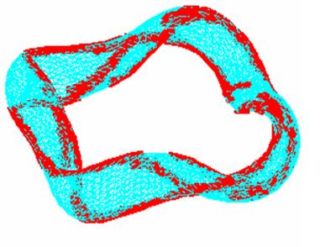
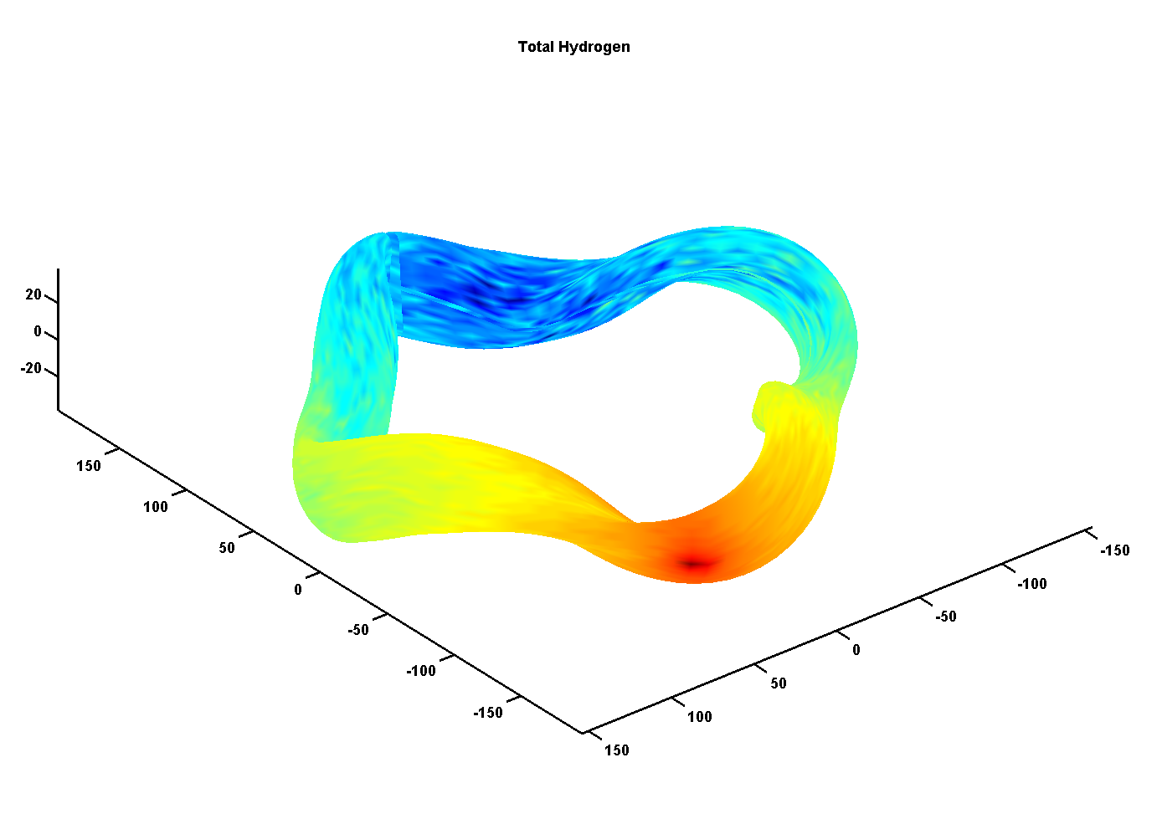
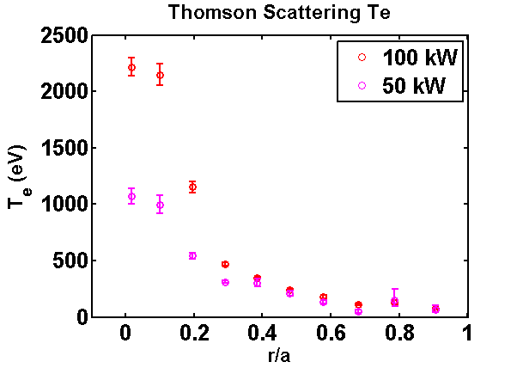
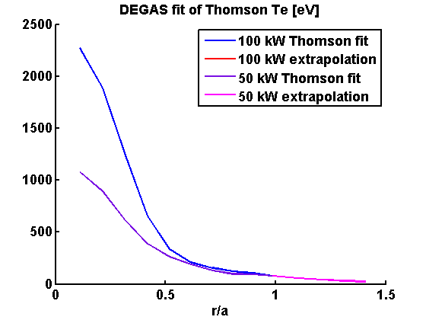
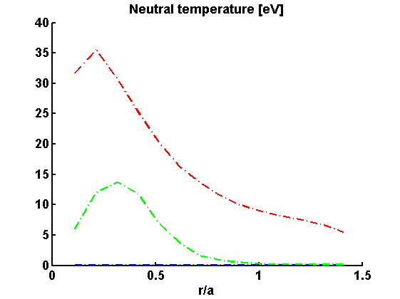
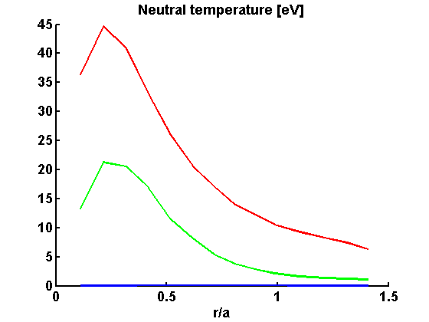
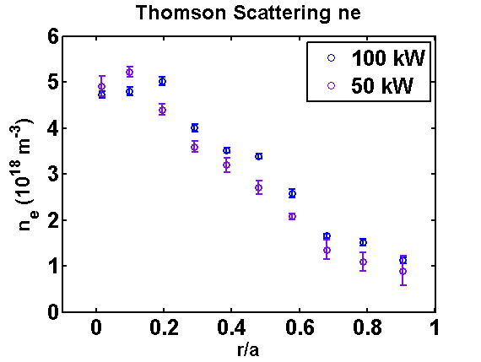
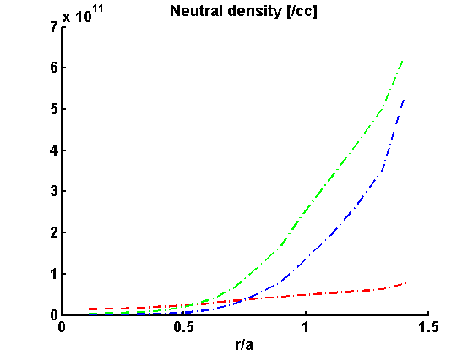
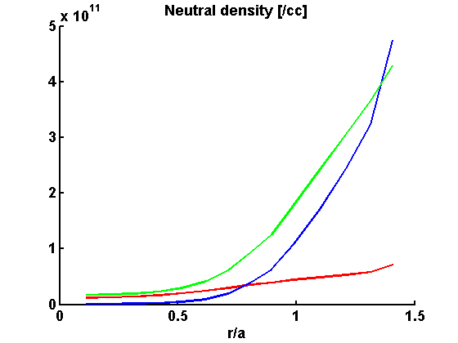
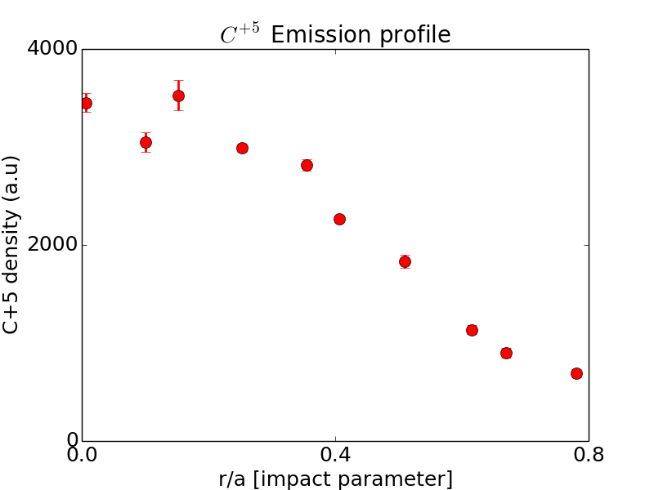
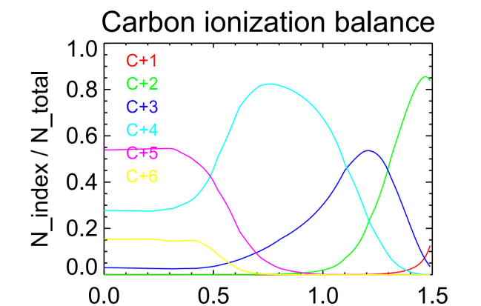
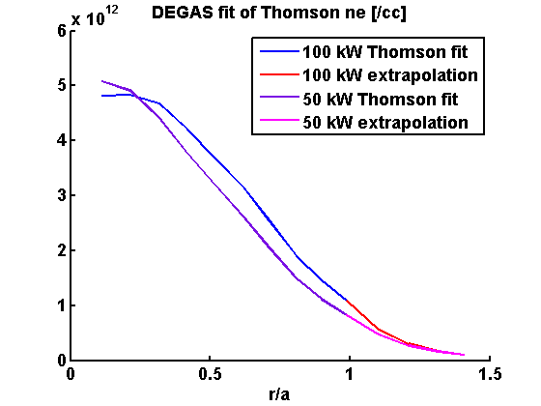
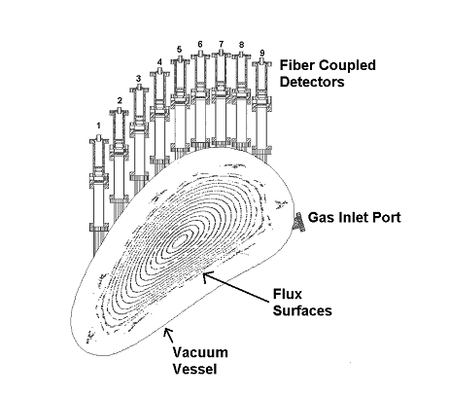
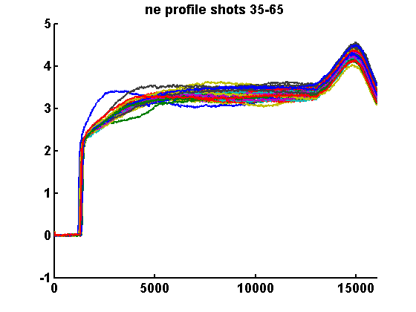
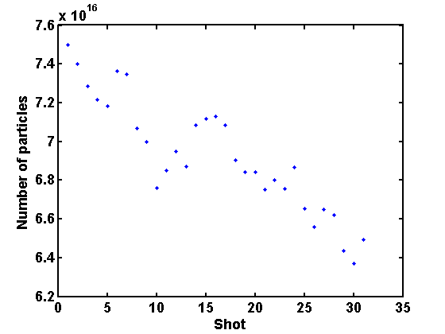
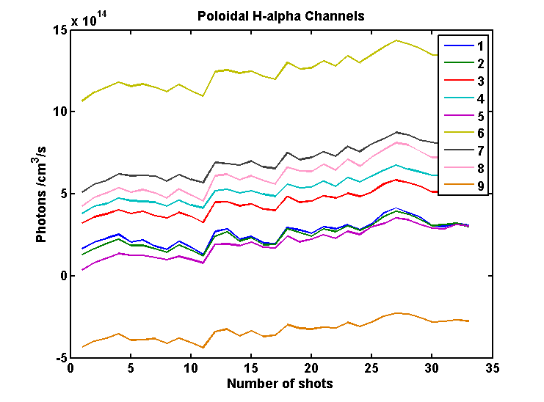
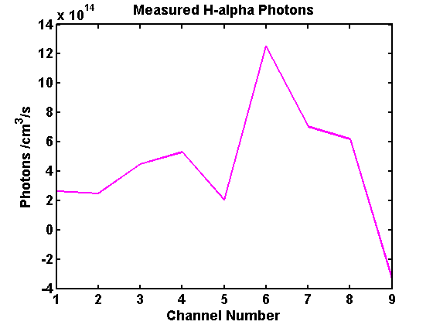
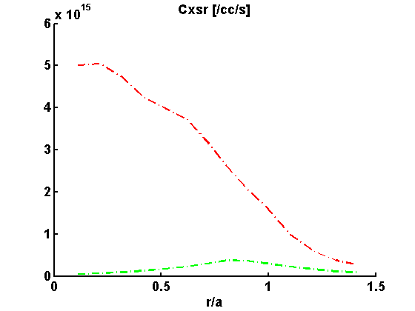
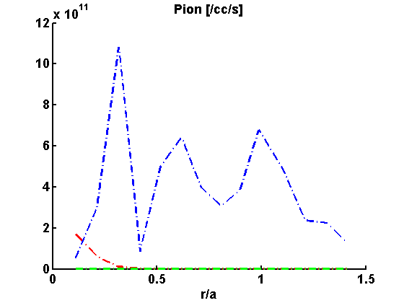
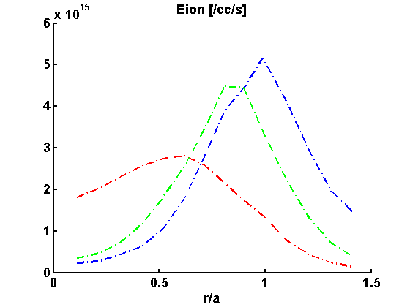
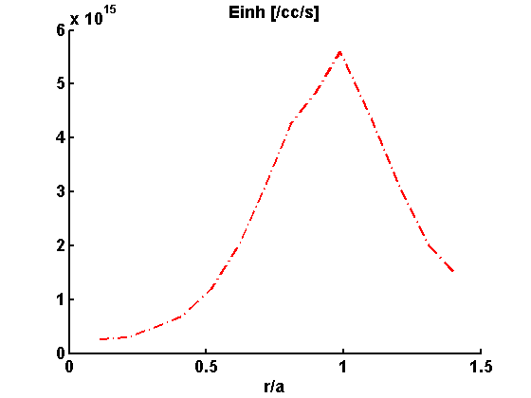
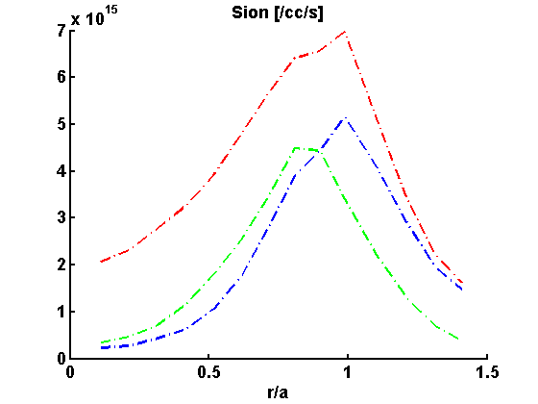
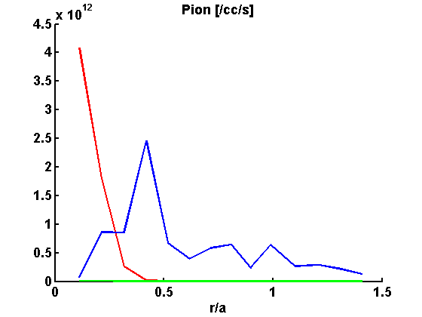
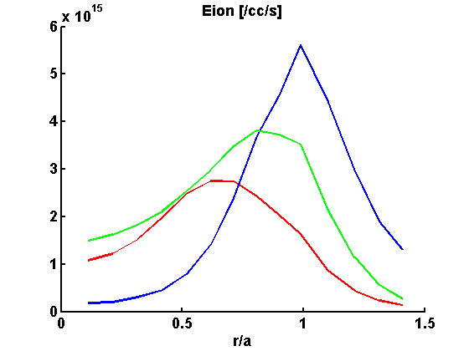
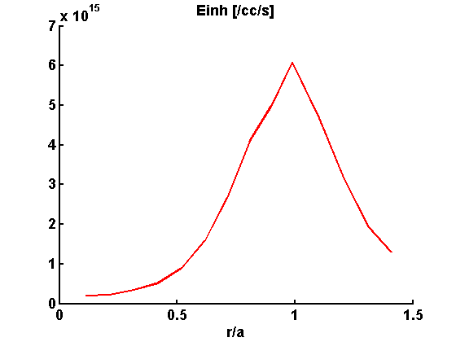
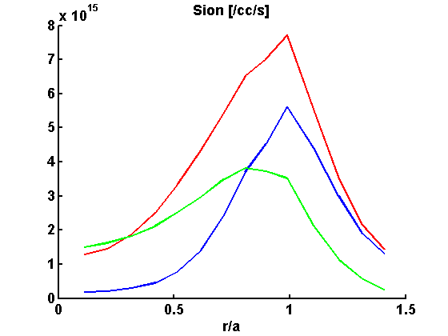
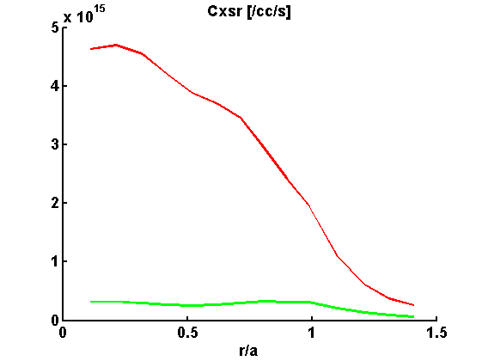
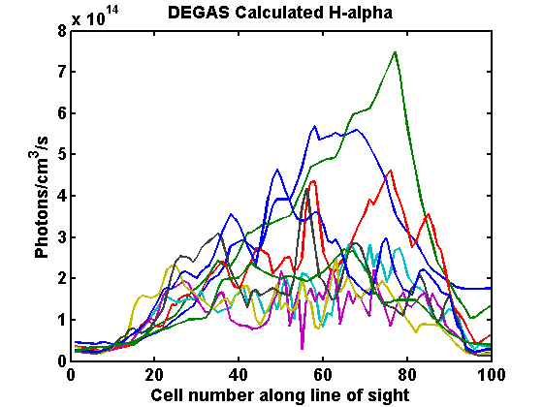
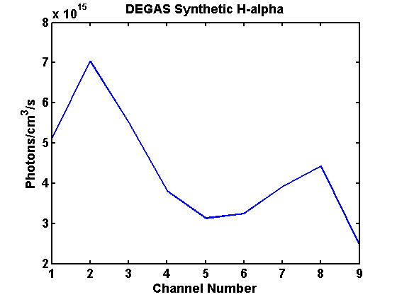
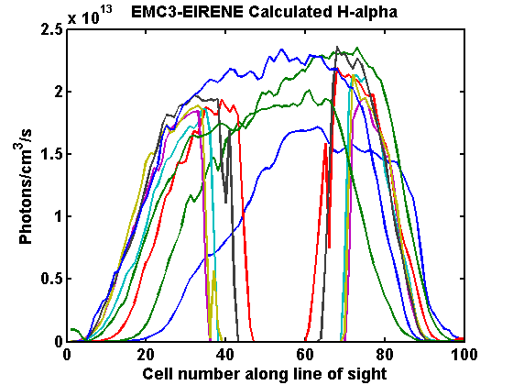
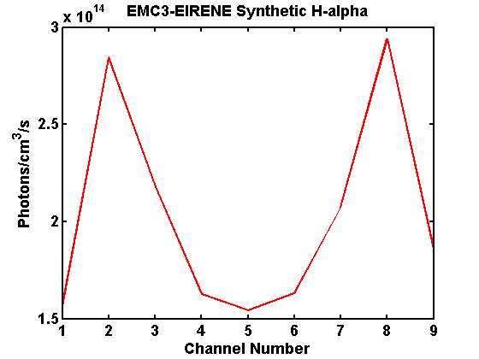
Exploration of control of neutral fueling and exhaust by a pumped limiter at the edge magnetic island chain of the HSX stellarator
L. A. Stephey, A. Bader, S.T. A. Kumar, O. Schmitz, D. T. Anderson, J. N. Talmadge, F. S. B. Anderson, C.C. Hegna
HSX Plasma Laboratory, Univ. of Wisconsin, Madison, USA
Motivation and goals
Location of ionization front is robust
Work in progress to verify the modeled H profile using spectroscopy and CRM
What is the source/sink inventory for H and He plasmas?
  What is the role of the wall?
  How are they impacted by a pumped limiter?
What are the neutral physics of H and He? What are the dominant processes (C-X, electron ionization,
dissociation) ionization profiles, and resulting neutral densities?
  Is this behavior captured in the DEGAS/EMC3-EIRENE [1,2] models?
  How is the neutral behavior impacted by the pumped limiter?
Can the limiter to be used to control the neutral fueling and exhaust?
Can the pumped limiter improve the plasma operation? (Longer τ_{p}, increased n_{e}, larger stored energy, lower radiated power, gradients in the edge pressure profile)?
Neutral physics was modeled using the DEGAS [1] Monte-Carlo code
Fully 3D neutral simulations with static background plasma profiles based on Thomson profiles and CHERS data
Two separate calculations for gas puff fueling and wall recycling so they can be independently scaled
In the puff run, we mimic our gas puffer at a toroidally localized wall triangle (on R)
In the recycling run, we assume the fueling is uniform from a set of strike points calculated from line following (on R)
The location of the ionization front is robust to change in species and change in heating power
The importance of using helium is that it is not retained and recycled by the wall
Numerical tools are ready for comparison and interpretation of measurements
Strike point fueling
Chord-averaged C+5 emission profile is measured
Emission is from both charge-exchange and electron impact excitation (C+6 and C+5, respectively)
A collisional radiative model (CRM) was used to calculate the carbon ionization balance (shown below) using the
same fits of n_{e} and Te used for DEGAS and the DEGAS calculated neutral H profile
The resulting CRM C+6 density is lower than the C+5 density in the core, even though T_{e} is as high as 2.5 keV
Core densities of C+6 > C+5 were obtained with a “guess” neutral profile with lower core density
This indicates that the modeled neutral profile may be too large, especially in the core
Future work may include measuring two charge states of carbon simultaneously, which will allow the H profile to
be determined directly
Gas puff fueling
Particle balance helps to analyze sources and sinks, role of wall
Ionization balance calculated with CRM. CRM uses DEGAS fits of n_{e}, T_{e}, and calculated H profile. C+5 density is greater than C+6 density in the core, even at T_{e} as high as 2.5 keV.
Using the single reservoir model [3], shown on right, to:
  Determine complete balance of sources and sinks
  Calculate particle confinement time
f_{gas} , the fueling efficiency for particles that are puffed from a gas valve, is taken from
the literature [4], f_{gas} = 0.1
Φ_{gas} , the particle flux from the gas puff source, is measured from gas puff calibration,
Φ_{gas}=3.5E18 particles/s
f_{rec} , the fueling efficiency for particles that are recycled from the wall, is taken from the
literature [4], f_{rec} = 0.7
Φ_{rec} , the particle flux from wall recycling, is measured using the two edge channels of
H-alpha array (Channels 1 and 9, shown on R), Φ_{rec} = 3.1E20
ionizations/sec
This method yields a particle confinement time of 4.4 msec for hydrogen
This simple model will be expanded to include the substantial contribution from core
source
Atomic H
Molecular H₂
Helium
Measured C+5 emission profile at 529 nm.
Dashed line: 50kW
Solid line: 100kW
(L) Thomson density and temperature profiles for 50kW and 100kW plasmas. (R) Fits and extrapolations of the Thomson data used in the DEGAS and CRM calculations.
DEGAS calculated neutral density and temperature profiles of H, H₂, and He using 50kW and 100 kW background plasmas.
Future Work
Ion impact ionization
Electron impact ionization
Dissociation
Total Source Rate (S_{ion})
P_{ion} + E_{ion} + Dissoc
Charge exchange
Use tangential camera view to make wall recycling measurements to determine role of wall
Expand single reservoir model to include substantial core fueling term
Make spectroscopic measures of H, H₂, He, He+ density
Compare spectroscopic measurements to DEGAS and EMC3-EIRENE simulations
Determine impact of pumped limiter on source/sink balance , neutral physics
Measurements at limiter target (downstream data) to be compared to upstream probe measurements
Examine any impacts of the pumped limiter from gross changes in Thomson profiles, stored energy, radiated power, particle confinement time, edge pressure profile
(L) Interferometer time traces of n_{e} over 30 repeatable discharges. (R) Number of gas particles puffed to maintain the same profile. This indicates that the wall contribution increases throughout the runday.
(L) H-alpha photons for each view over a series of 30 repeatable discharges. The H-alpha levels across edge and core channels increase throughout the runday. (R) Average of H-alpha photons for each view for the same 30 shots.
References
D. Heifetz et al., J. Comp. Phys. Vol. 46, Pg. 309 (1982).
Y. Feng et al, Contribution Plasma Physics, 44 1-3 (2004) p. 57-69.
D.S. Gray et al. J. Nucl. Fusion, 38 (1998) 1585.
O. Schmitz. J. Nucl. Mat.,390=391 (2009), 330-334.
DEGAS calculated source rate profiles of ion impact ionization, electron impact ionization, dissociation, and charge exchange rates (which are shown but do not contribute to the net source rate in these plasmas.) For H, the dominant source mechanism is dissociation. For H₂ and He, the dominant source mechanism is electron impact ionization. The location of the ionization front is robust to changes in species and heating power.
(L) Calculated H-alpha profile for 9 viewing chords from DEGAS. (R) Line integrated synthetic H-alpha for comparison to measurement.
(L) Calculated H-alpha profile for 9 viewing chords from EMC3-EIRENE. (R) Line integrated synthetic H-alpha for comparison to measurement.
This work supported by US DOE Grant DE-FG02-93ER54222

