Slide 1
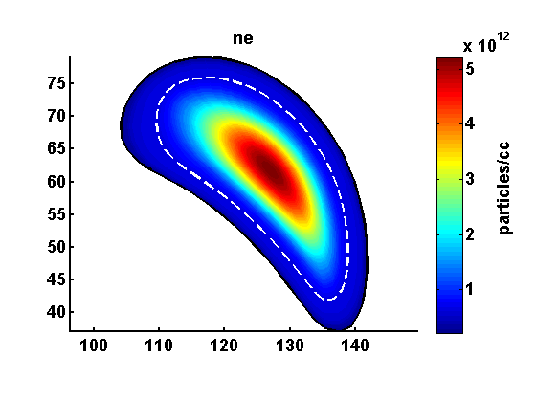
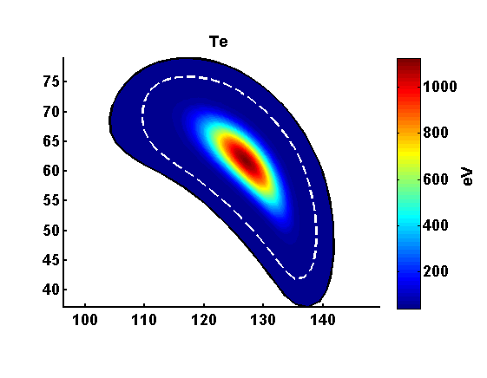
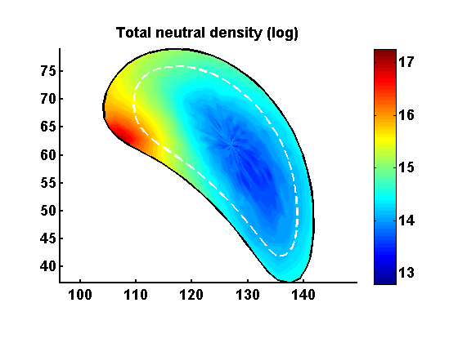
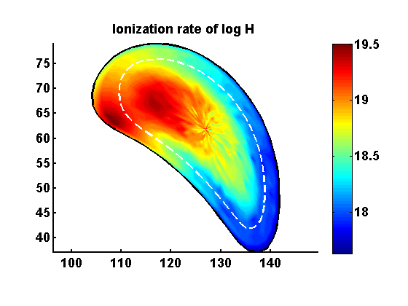
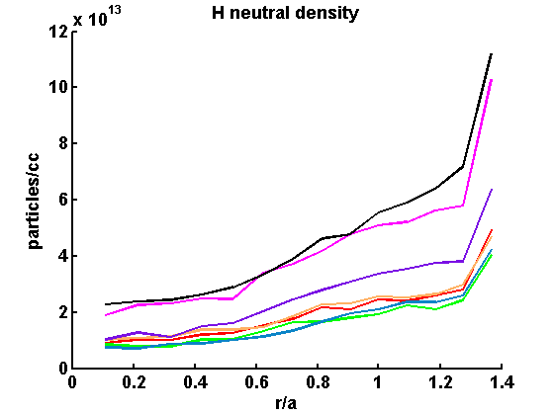
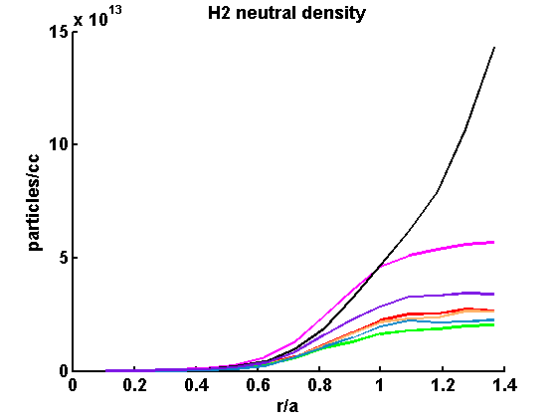
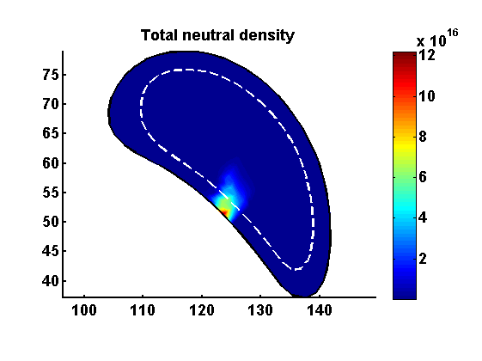
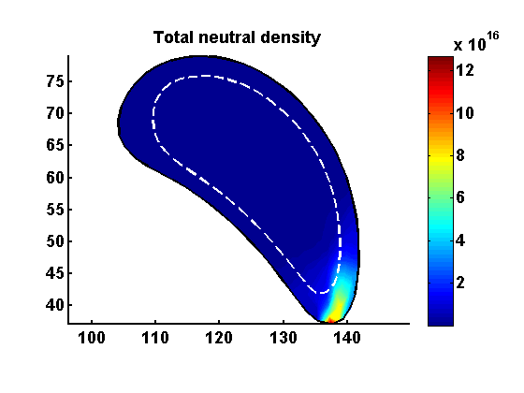
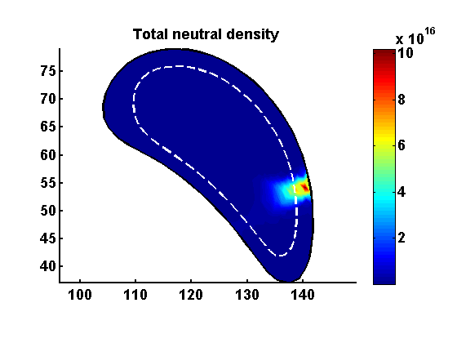
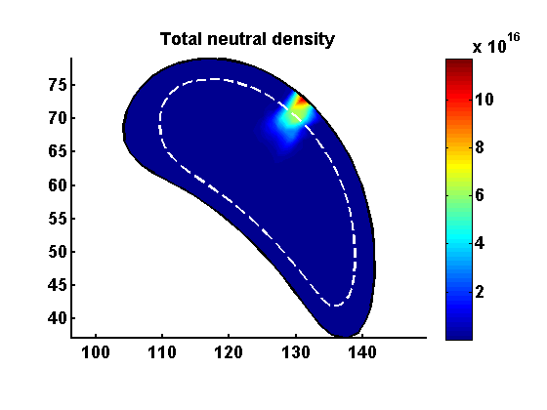
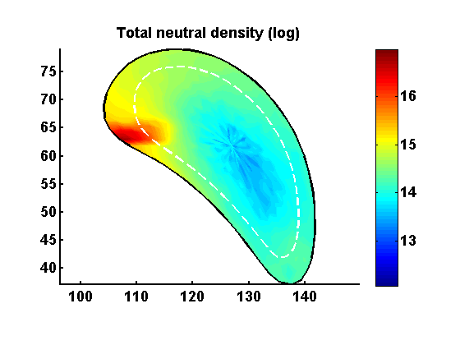
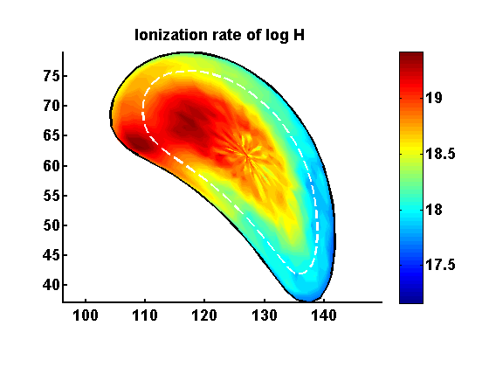
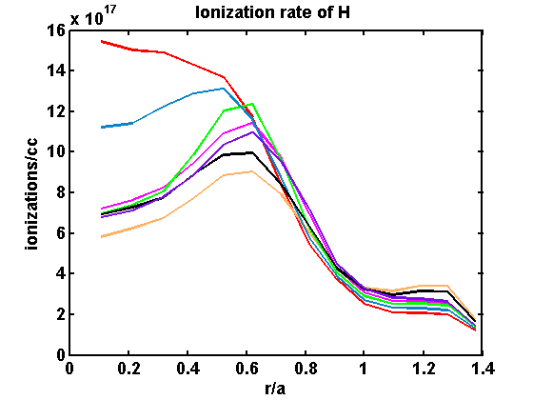
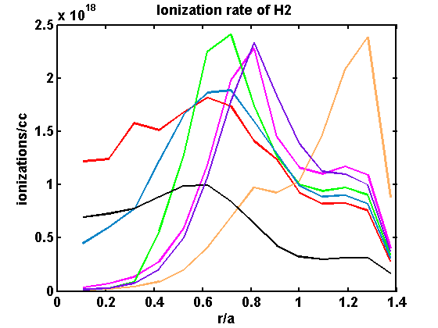
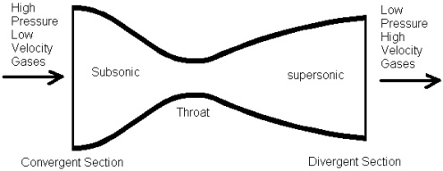
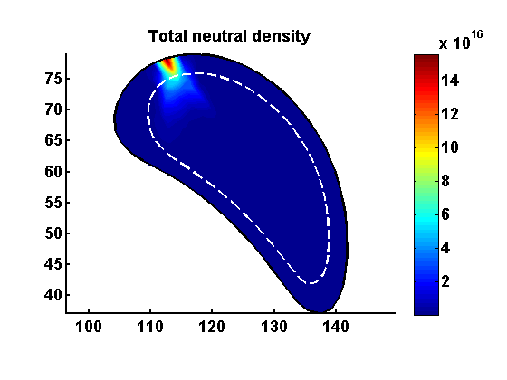
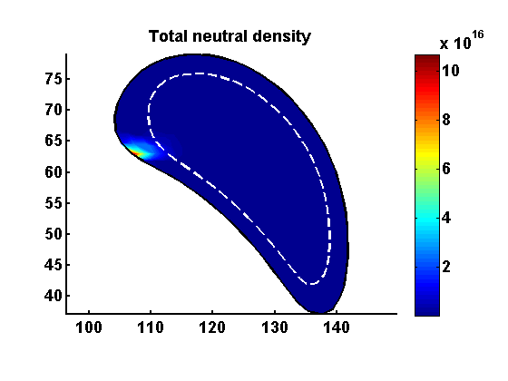
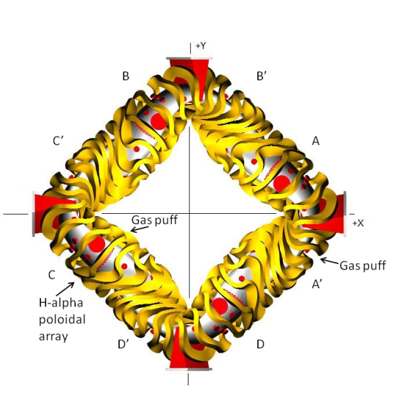
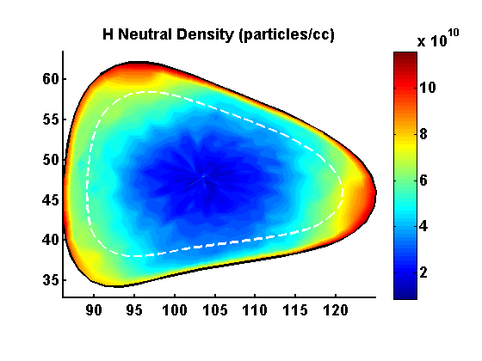
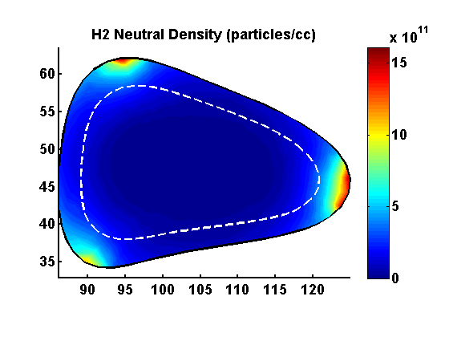
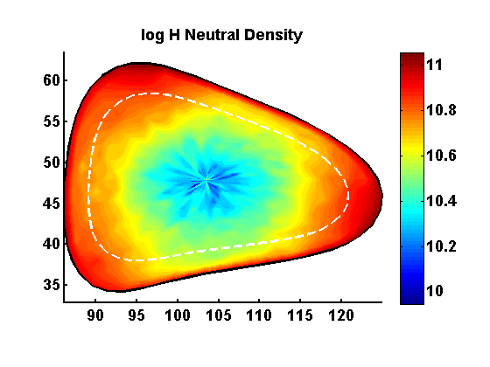
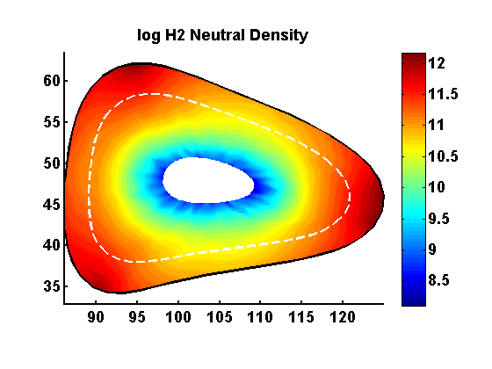
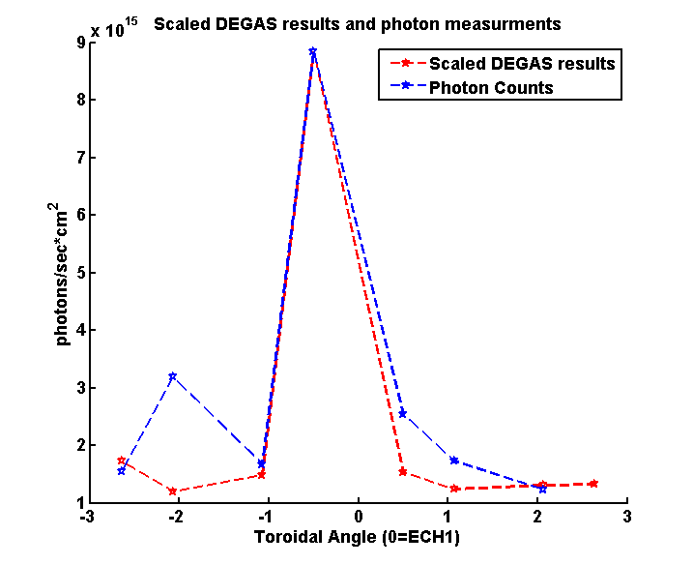
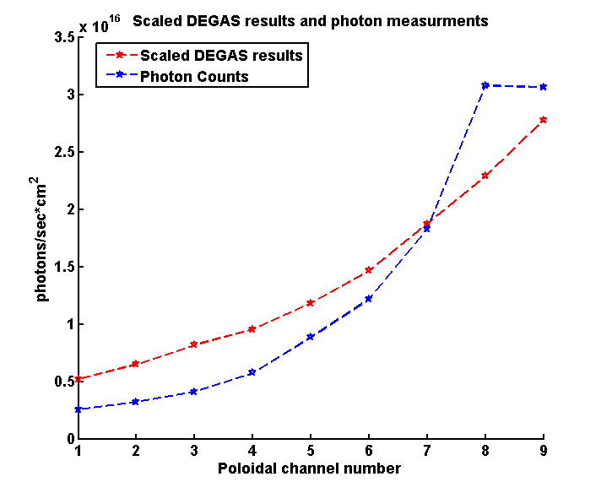
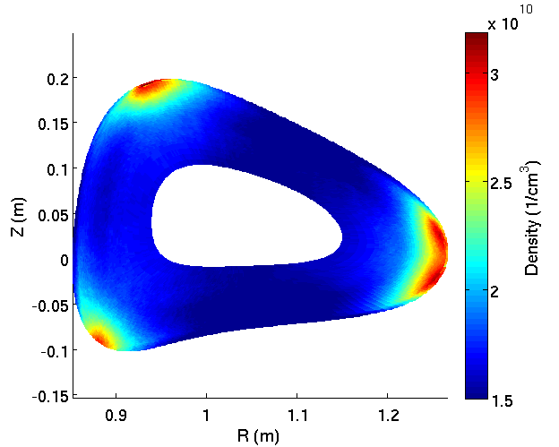
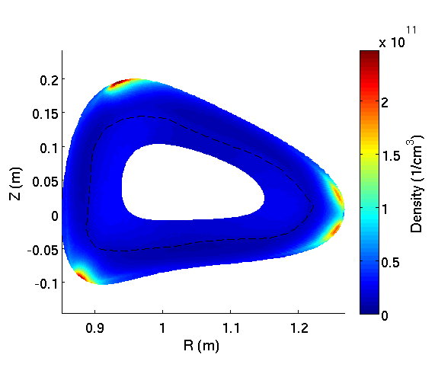
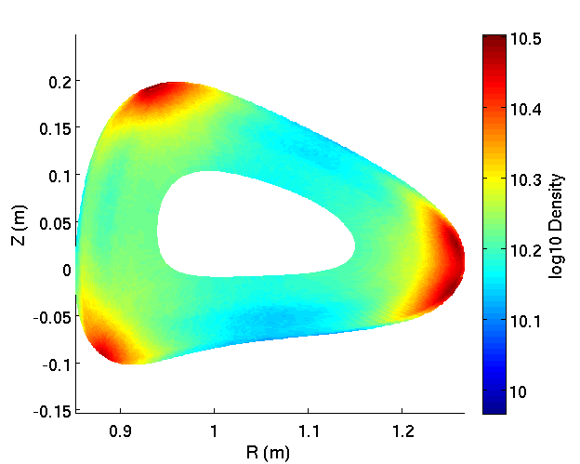
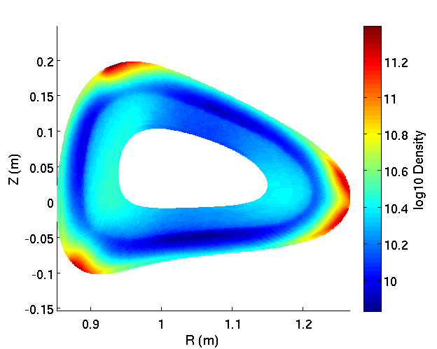
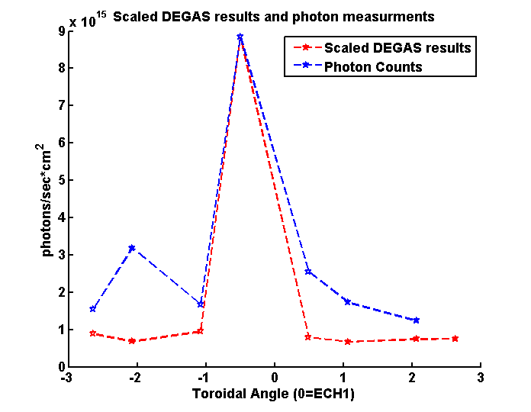
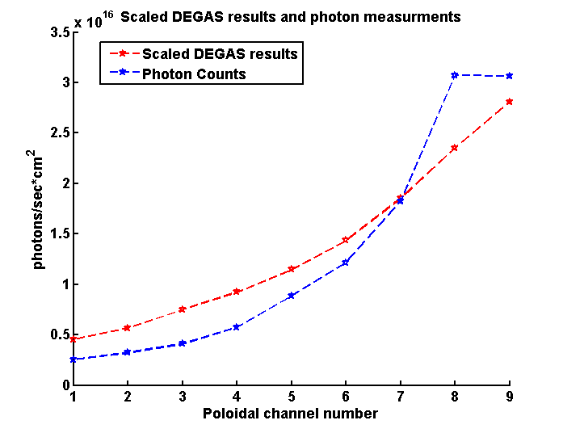
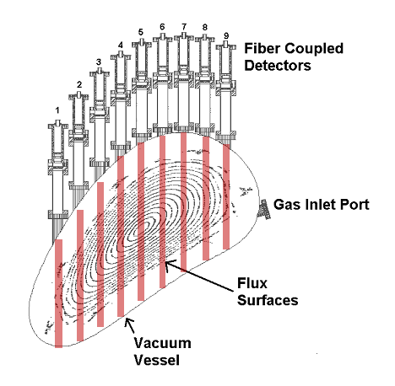
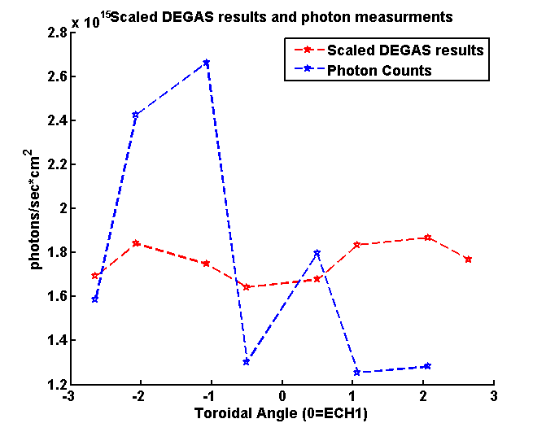
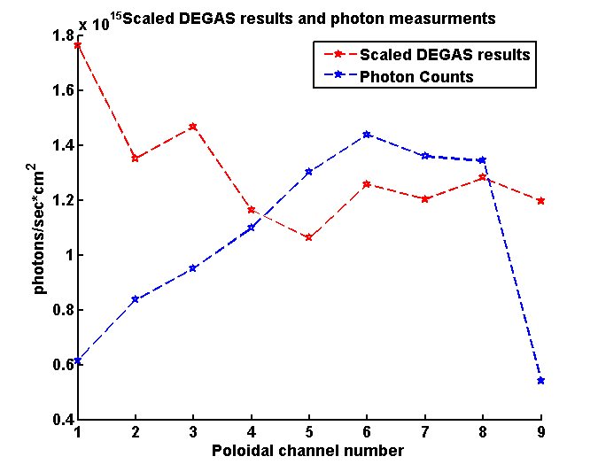
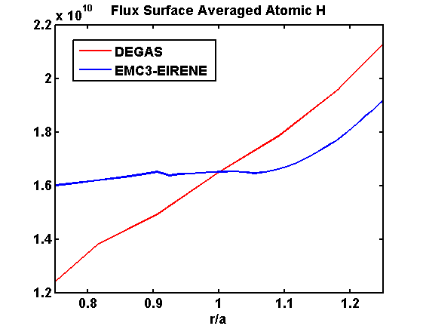
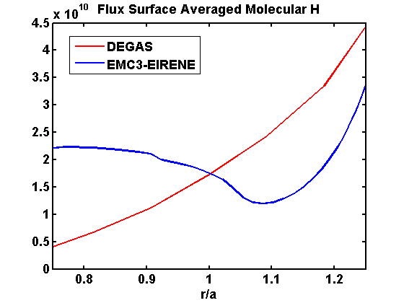
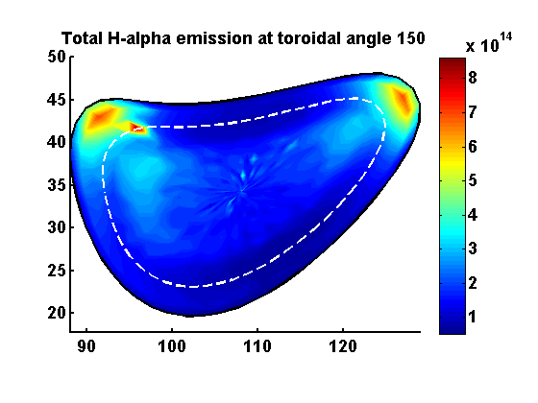
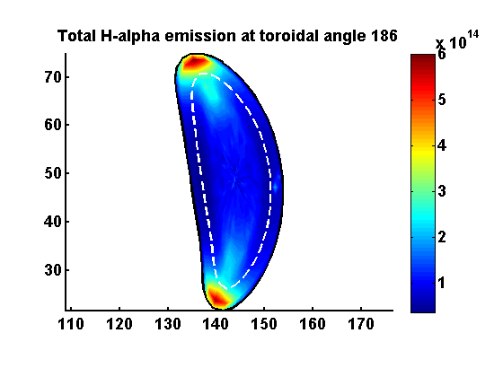
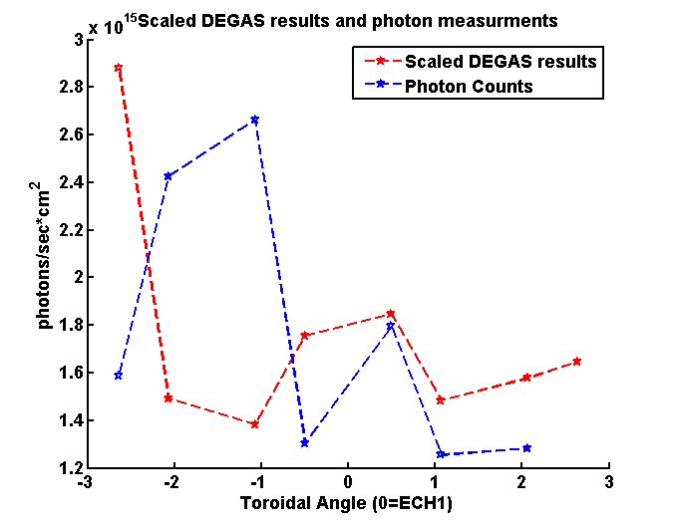
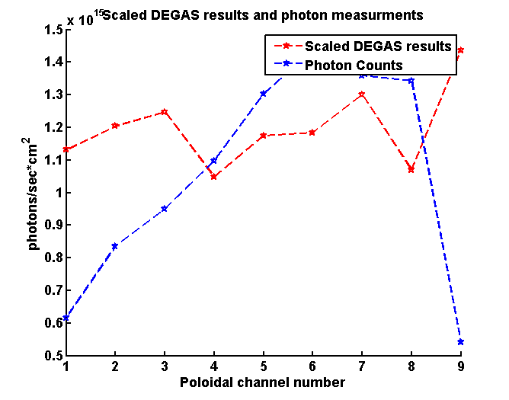
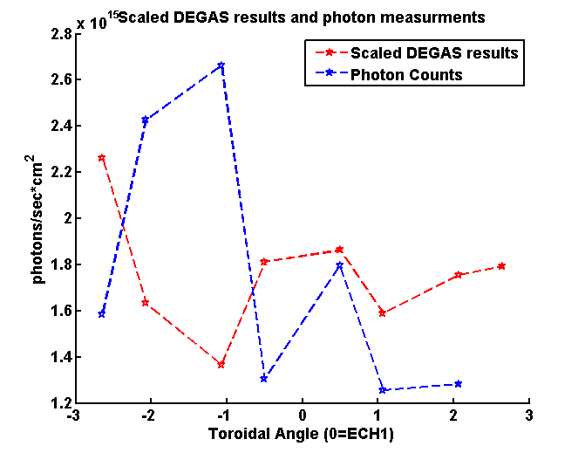
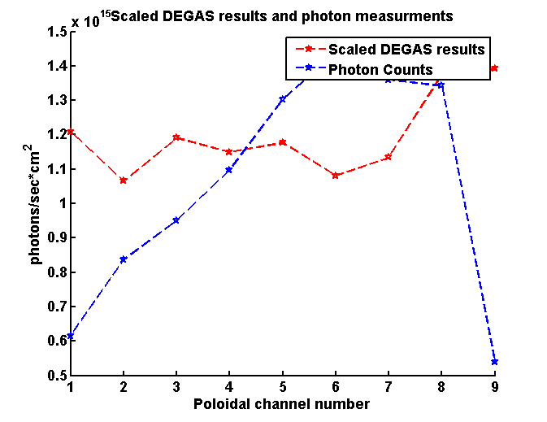
Modeling Neutral Hydrogen in the HSX Stellarator
L. Stephey, A. Bader, D.T. Anderson, J.N. Talmadge, C. Hegna, F.S.B. Anderson
HSX Plasma Laboratory, Univ. of Wisconsin, Madison, USA
Overview
Simulation of Supersonic Gas Injector (SGI)
The HSX neutral particle population plays an important role in plasma behavior as a result of relatively low operating density
The DEGAS code [1] is a fully 3D Monte-Carlo neutral particle code that is used to simulate the HSX neutral population
H-alpha measurements are used to scale DEGAS results to determine quantities including atomic and molecular neutral particle density, neutral particle flux, and ionization rate
The DEGAS code has been recently upgraded to simulate a supersonic gas injector (SGI) in HSX
Simulation results indicate:
  SGI performance will vary by location as a result of distance between SGI and core plasma
  An SGI in the same location as the current gas puff will increase fueling efficiency from 43 to 47 percent
  Because DEGAS simulations are steady-state, most likely the predicted fueling efficiency is somewhat overestimated
The DEGAS code has been compared to the EMC3-EIRENE code [2]
  Both predict the same general picture of neutral behavior
  DEGAS predicts a steeper falloff of H and H₂ density in the edge
  EMC3-EIRENE predicts a region of low H₂ density outside the separatrix
Several types of wall fueling scenarios were simulated in an attempt to better match H-alpha array data
  Simulations were able to match measurements relatively well when puffing from C-puffer
  Simulations were unable to match measurements when puffing from A’-puffer
  Results suggest that we are not accurately modeling particle fueling and recycling from the HSX wall
  A n H-alpha camera diagnostic may be used to study HSX wall recycling and developed an improved model
Supersonic gas injection is a method of fueling that has been used by many experiments to increase fueling efficiency [3,4]
A laval nozzle (pictured in Fig. 1) is used to create a narrow cone of supersonic particles
DEGAS has been upgraded to simulate the installation of an SGI on HSX
  Gas puff energy was increased from 0.026 eV to 0.06 eV
  Particle launch angle was changed from a cosine distribution to a narrow zcone with a 4.5 degree half-angle
The puff and SGI were simulated in the same location with the same particle source rate and background plasma
Simulations indicate that an SGI can increase fueling efficiency compared to the current gas puff system, but also that it is highly dependent upon position
This is most likely due to the differences in distance between the SGI locations and the center plasma
DEGAS directly calculates the H and H₂ ionization rate at each point in the computational grid
The particle source rate is directly input by the user
The H ionization rate within the separatrix and the particle source rate are used to calculate the fueling efficiency [5]
Fig.2. Background plasma in DEGAS simulations. Based on experimental Thomson profiles.
The SGI was simulated in six poloidal positions at the same toroidal angle
Overall H profiles were relatively unchanged, but SGI fueling generally decreased the H₂ profile in the edge region as compared to the gas puff
Fueling efficiency was highly dependent on position– most likely due to differences in distance to the center of the plasma
Fueling efficiency is calculated by
SGI grid position | Fueling efficiency
9 | 52.34
18 | 40.30
27 | 47.43
36 | 50.15
45
54 | 47.15
where
is the H ionization rate in the volume
and
is the particle source rate
 | H ionization rate | Particle source rate | Fueling efficiency
Puff | 2.6e23 | 6e23 | 43.44
SGI | 2.8e23 | 6e23 | 47.15
Fig. 1. A typical laval nozzle. HSX will install an SGI system with this type of nozzle with a 4.5 degree half-angle launch cone.
Because DEGAS predicts steady state quantities, it is likely that the fueling efficiency is somewhat overestimated as transient behavior is ignored
Fig.5. Plots of H neutral density and H ionization rate for various SGI positions (colors) and gas puff (black).
Fig.6. Plots of H₂ neutral density and H₂ ionization rate for various SGI positions (colors) and gas puff (black).
Fig.7. SGI was simulated in these six poloidal positions. Total neutral density is shown for each SGI simulation. Corresponding fueling efficiencies are tabulated in the table to the right.
Fig.3. Log plots of total neutral density for puff (top) and SGI (bottom).
Fig.4. Log plots of H ionization rate for puff (top) and SGI (bottom).
Comparison to EMC3-EIRENE
Efforts to Match H-alpha Measurements
Summary and Future Work
A’ puffer
H
DEGAS
HSX is currently equipped with 16 H-alpha detectors (and the system will soon be expanded by 20 detectors)
9 of these detectors are in a poloidal array in field period C and the rest are in a toroidal array extending around HSX
DEGAS synthetic H-alpha light is scaled by measured H-alpha in order to obtain calculated neutral quantities
Several wall fueling configurations were simulated
  The current HSX strike point model [6]
  The whole wall as a source
  Half the wall (every other point) as a source
DEGAS simulations match reasonably well with poloidal measurements when using C gas puff (very close to poloidal array)
DEGAS simulations do not replicate all features of toroidal measurements for the C gas puff
No wall fueling configuration was able to match poloidal or toroidal H-alpha measurements in poloidal array when using A’ puffer
This suggests that we are not correctly modeling fueling from the wall
Possible future work: develop a better model of wall fueling in HSX
DEGAS simulations indicate that far from the gas puff, most H-alpha light is produced near the wall (Fig.10)
This could be studied with an H-alpha filtered camera
C puffer
Installing an SGI on HSX is predicted to improve fueling efficiency from 43 to up to 52 percent
SGI performance will vary from 40 to 52 depending on location
DEGAS has been compared to EMC3-EIRENE for HSX and both generally agree
Several wall configurations were simulated to in an attempt to match DEGAS predictions to H-alpha data
  Simulations matched C puff data relatively well
  Simulations did not match A’ puff data
  This suggests the current HSX wall fueling model is incorrect
Future work:
Complete installation of 2 new H-alpha arrays (20 detectors) on HSX
Install SGI on HSX and compare to simulation
Consider upgrading to DEGAS 2 [7] if further simulations are needed (faster, newer and currently maintained)
Use an H-alpha filtered camera system to study plasma wall recycling far from gas source
Use information from H-alpha camera to develop more accurate model of plasma recycling in HSX and investigate role of neutrals in the SOL
DEGAS and EMC3-EIRENE simulations for HSX neutral particles were compared
Efforts were made to make as direct a comparison as possible:
  Similar values of T_{e}, T_{i}, n_{e}, and n_{i} throughout the plasma grid
  The same (HSX) geometry and magnetic configuration (QHS)
  Same (single) toroidal angle
  Same wall material (carbon)
Results:
  Both agree on the same general picture
  DEGAS predicts a steeper falloff in neutral density near the edge
  EMC3-EIRENE predicts a region of low H₂ just outside the separatrix
There are several factors that may contribute to these differences:
  DEGAS T_{e}, T_{i}, n_{e}, and n_{i} profiles are directly input whereas EMC3-EIRENE calculates these profiles
  DEGAS particle source rate from the wall is directly input whereas it is calculated by EMC3-EIRENE
  EMC3-EIRENE includes islands, flows, and subsequent poloidal variation in plasma density, temperature, and flow profiles that DEGAS does not
Future work may include
  Comparisons at more than one toroidal angle
  Comparisons of puff fueling behavior
H₂
log H
log H₂
Strike points
EMC3-EIRENE
Whole wall
H
H₂
log H
log H₂
Half wall
A’ puffer
Strike points
Fig.8. Plots of H, H₂, log H, and log H₂ density as predicted by DEGAS and EMC3-EIRENE at this particular toroidal angle (45 degrees). The center of the DEGAS log H₂ plot has been omitted to remove noise near the plasma center. EMC3-EIRENE plots courtesy of A. Bader.
Fig.9. Flux surface averaged H and H₂ as predicted by DEGAS and EMC3-EIRENE. Densities have been normalized to be equal at r/a=1. Flux surface averaged results can only be compared in this region as a result of the EMC3-EIRENE computational grid. EMC3-EIRENE results courtesy of A. Bader.
Whole wall
References
Fig.10. DEGAS predicted total H-alpha emission at two toroidal angles far from the gas puff source. Results suggest that most emission is produced close to the wall and could be investigated with a camera diagnostic.
Fig.11. A schematic of HSX that indicates the location of the two gas puffs, the H-alpha poloidal array, and the H-alpha toroidal array.
[1] D. Heifetz et al., J. Comp. Phys. Vol. 46, Pg. 309 (1982).
[2] Y. Feng et al, Contribution Plasma Physics, 44 1-3 (2004) p. 57-69.
[3] V. Soukhanovskii et al., Rev Sci. Instruments. Vol. 75, No. 10 (2004).
[4] T. Mizuuchi et al., Contrib. Plasma Phys. 50, No 6-7 (2010).
[5] D. Lundberg. Dissertation. PPPL. (2012).
[6] J. M. Canik et al., Phys. Plasmas Vol. 14, Pg. 056107 (2007).
[7] D. P. Stotler et al., J. Nucl. Mater. Vol. 967, Pgs. 290–293 (2001).
Half wall

