Slide 1
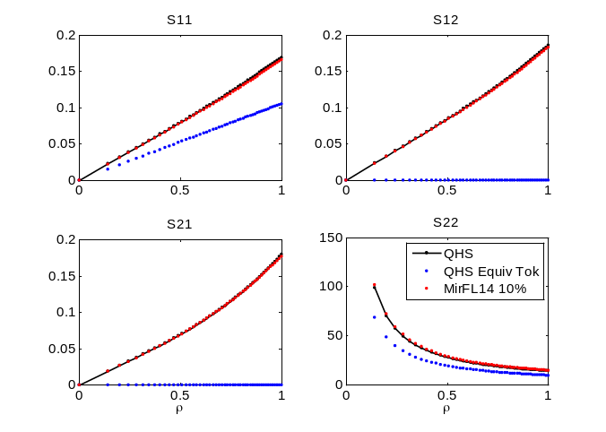
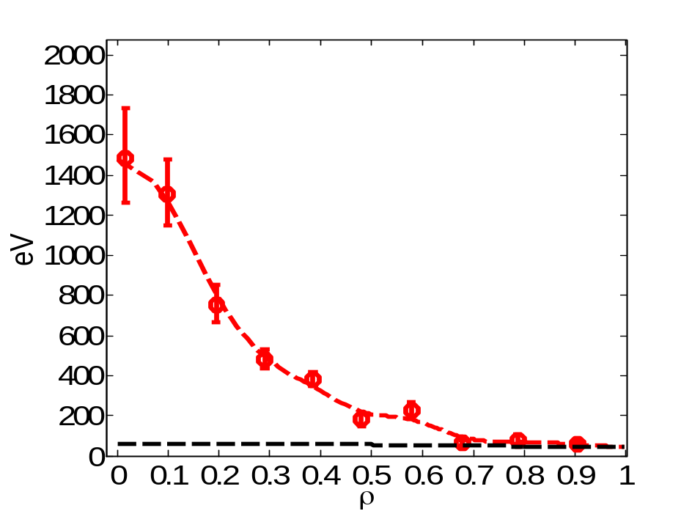
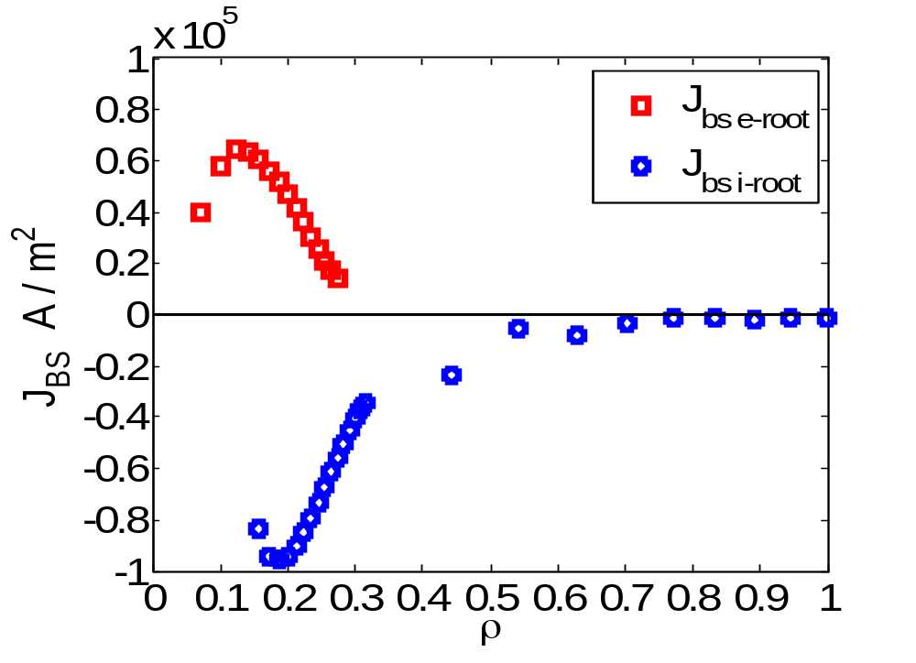
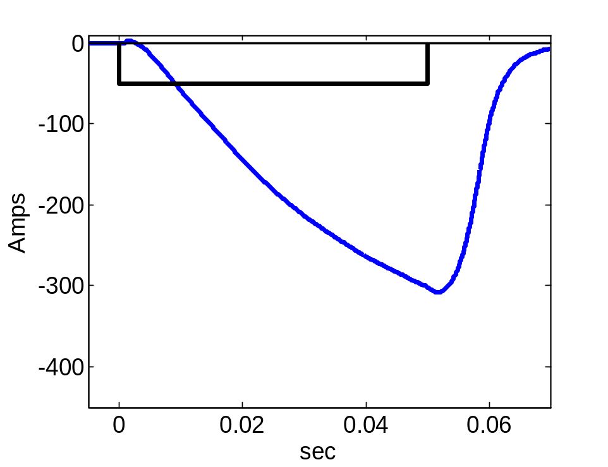
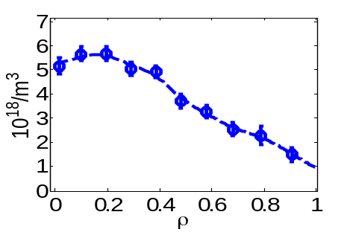


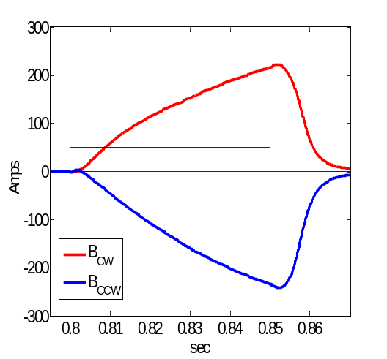
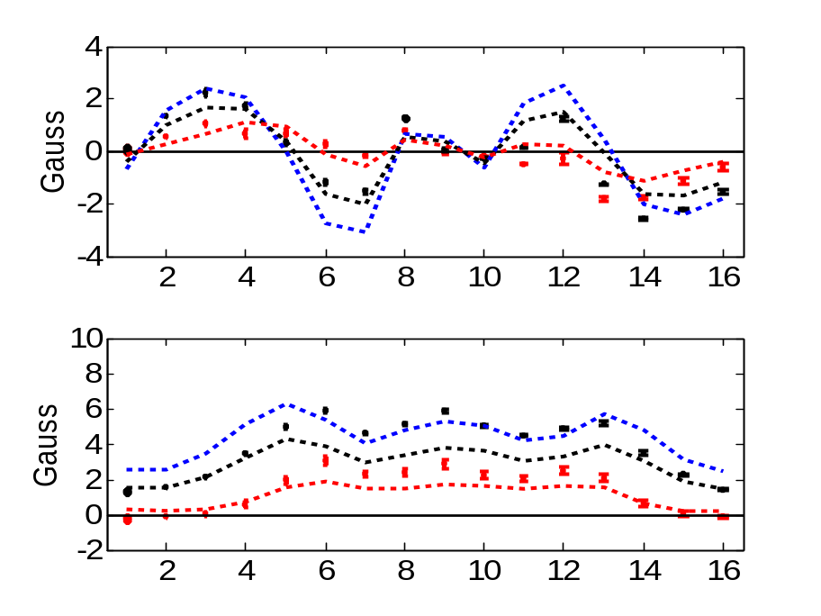
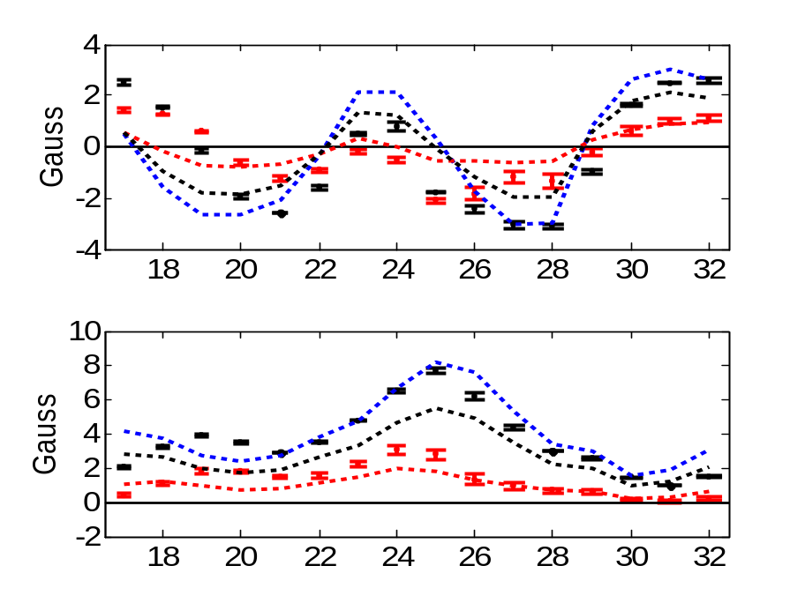


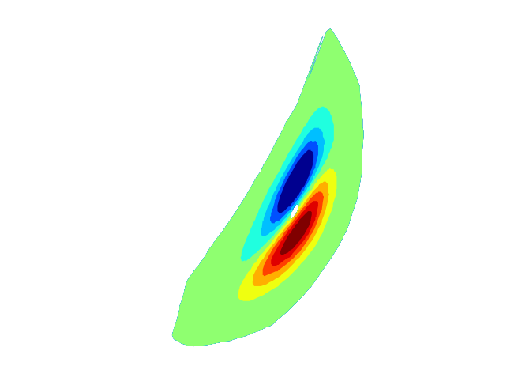
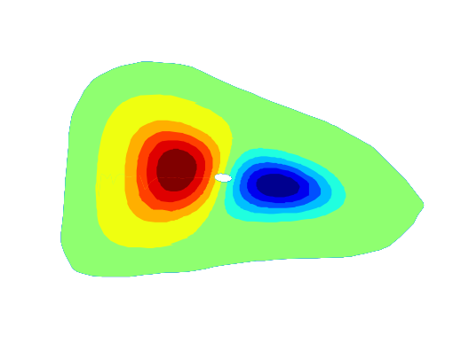
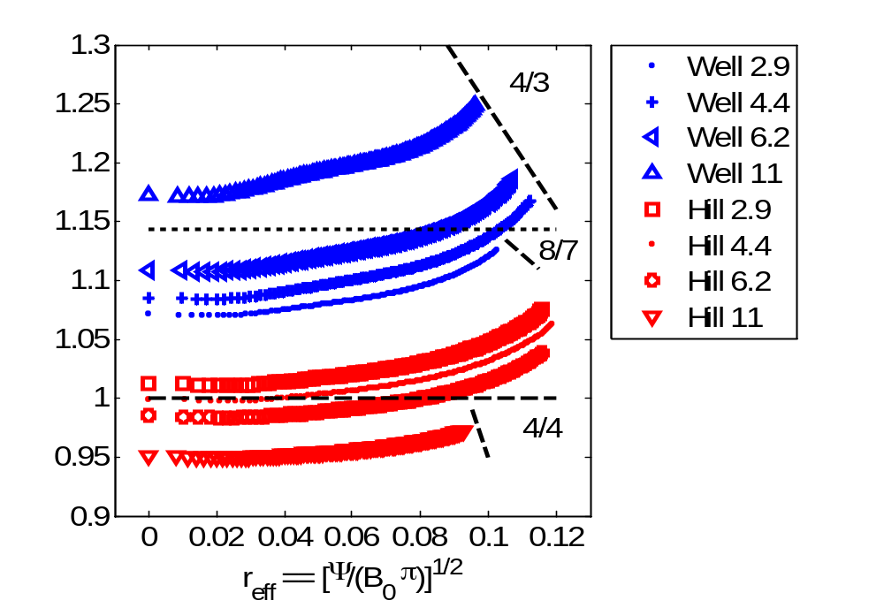
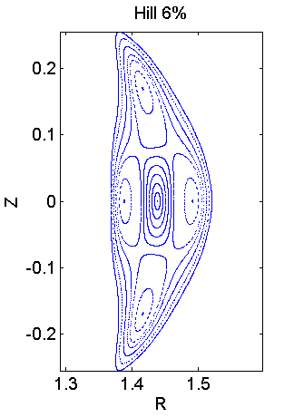
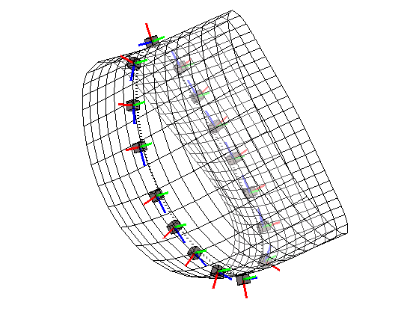
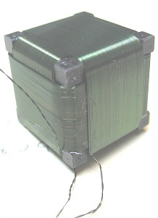
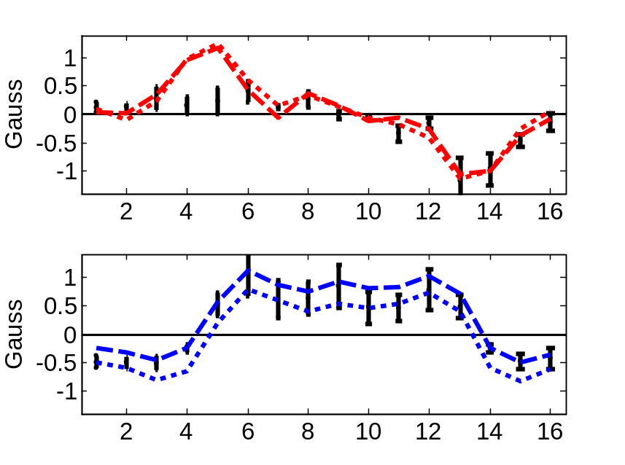
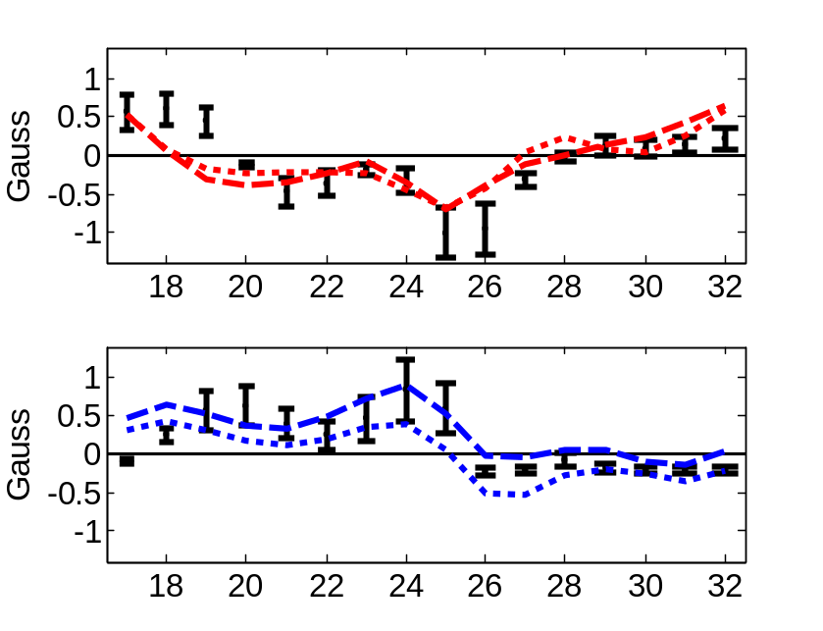
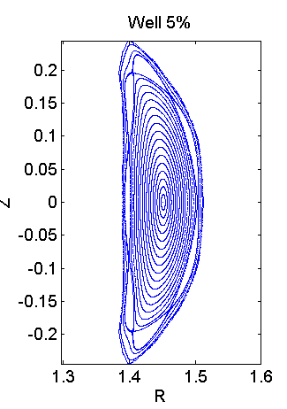
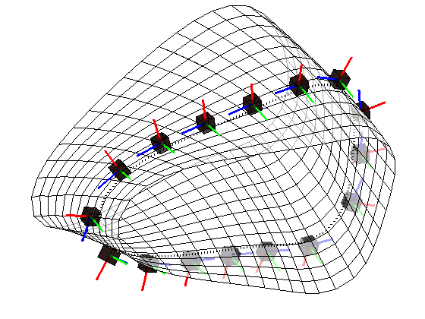
Modeling and Measurement of Toroidal Currents in the HSX Stellarator
J.C. Schmitt, J.N. Talmadge, J. Lore
HSX Plasma Laboratory, Univ. of Wisconsin, Madison, USA
Overview
Evolution of Toroidal Current
Bootstrap Current
The Helically Symmetric eXperiment
  Quasi-Helically Symmetric and almost no toroidal curvature
  B₀ = 1 Tesla
  26 kW – 100 kW ECR Heating (1st Harmonic)
    Perpendicular launch
    Little to no current drive seen during 1 Tesla campaign
Pfirsch-Schlüter current rotates with the |B| contours with toroidal angle and is reduced by a factor of 1/3 compared to a conventional stellarator
Bootstrap current
  Is in the opposite direction and reduced compared to a tokamak
  Reduces the rotational transform in HSX
  Reverses with B-field direction
  Induces toroidal current with long decay times: τ_{η||/μ0} ≥ τ_{EXP}
  Evolving current profile is modeled by a diffusion equation with a 3d susceptance matrix
V3FIT¹ calculations of magnetic signals are compared to diagnostic signals
  Special thanks to Steve Knowlton, Jim Hanson, and the V3FIT team
3d susceptance matrix links toroidal and poloidal currents
and magnetic fluxes²
S₁₂ = S₂₁ = 0 for Tokamaks S₁₁ ≈ S₁₂ ≈ S₂₁ for HSX
1-D diffusion equation for rotational transform
Boundary conditions
On axis: finite current density @ LCFS :set by measurement
Multiple ambipolar solutions
50 kW ECH
J_{BS e-root}
J_{BS i-root}
∆I_{BS} = 170 Amps
-250 A
-420 A
50 kW ECH
Any non-inductive source
Te, Ne from Thomson Scattering.
Ti from ChERS. Zeff ≈ 1 from Bremsstrahlung radiation (ChERS optics).
PENTA³ calculates the fluxes. E_{r} is determined by ambipolarity.
The electron-root reverses the direction of the bootstrap current
B_{θ} has large unidirectional contribution from <J∙B>
B_{r} is dominated by the m=2 structure of the vacuum vessel
Measurement evolves slightly faster than simulated values
Possible sources of error: Z_{eff}, initial plasma profiles, neoclassical calculation of bootstrap current
B_{r}
45 ms
15 ms
B_{r}
t_{sim} =
Pfirsch-Schlüter Current Rotates Helically
B_{θ}
45 ms
15 ms
B_{θ}
≈ 1/6 FP
Pfirsch-Schlüter current exhibits dipole behavior and rotates with |B| contours
Sign of signals at two toroidal locations demonstrate a phase shift showing the helical rotation.
Toroidal curvature is effectively eliminated in HSX
Diagnostic System
Summary + Future Plans
13
B_{r}
B_{θ}
Poloidal Index
32
Blue: J_{PS} OUT OF PLANE
Red: J_{PS} IN TO PLANE
The direction of the bootstrap current is reversed and reduced by ~1/3 compared to an equivalent tokamak. This results in a reduction in rotational transform.
Evolving current profile is modeled by a diffusion equation with a 3d susceptance matrix.
The Pfirsch-Schlüter current rotates with |B| contours and is reduced by ~1/3 compared to a tokamak, demonstrating the lack of toroidal curvature.
V3FIT for equilibrium reconstruction of HSX plasmas.
HSX can alter the magnetic spectrum with a set of auxiliary coils
  Mirror: The helical symmetry is spoiled by introducing (n,m) = (4,0) component (and harmonics) into magnetic spectrum, affecting equilibrium, bootstrap currents
  Well/Hill: Rotational transform profile may be raised/lowered, adjusting the location of rational surfaces, vacuum islands
2x Rogowski coils (I_{tor})
  External -- Low-frequency response ≤ 3kHz
  Internal -- High-frequency ≤ 200kHz
2x Diamagnetic Loops (W_{Kin})
  Internal – High-frequency ≤ 125kHz
2x dB/dt triplet array – 32 external triplets
  MHD and bootstrap currents
  Low-frequency response
High-frequency Mirnov array inside vessel
  36 coils: 26 poloidal, 10 toroidal
  Frequency response ≤ 200kHz
ChERS Diagnostic
    T_{i} and Z_{eff} estimate
10-chord Thomson Scattering
  T_{e}(ρ) and n_{e}(ρ) profiles
9
16
26
17
1
25
18
2
5
Φ≈1/2 Field Period
Φ≈ 1/6 Field Period
B_{r}
≈ 1/2 FP
B_{r}
≈ 1/6 FP
Φ=0 (symmetry plane)
Φ=1/2 Field Period
B_{θ}
B_{θ}
t_{sim}=7 ms
  ¹ J.D. Hanson, et al, Nucl. Fusion 49 (2009) 075031.
  ² P. I. Strand and W. A. Houlberg, Phys. Plasmas 8, 2782 (2001).
  ³ D.A. Spong, Phys. Plasmas 12, 056114 (2005).
P.S. only

