Slide 1

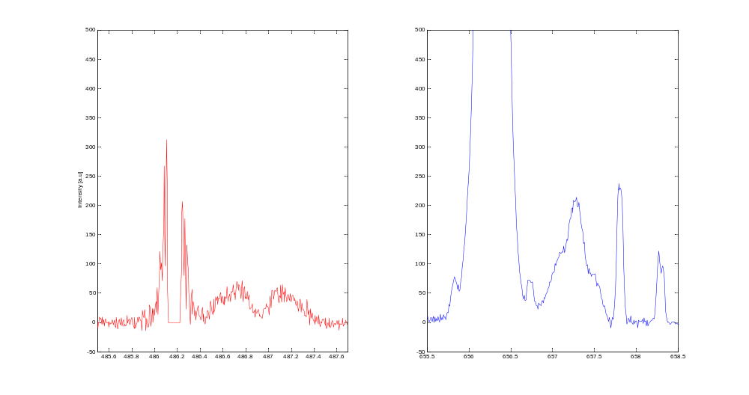
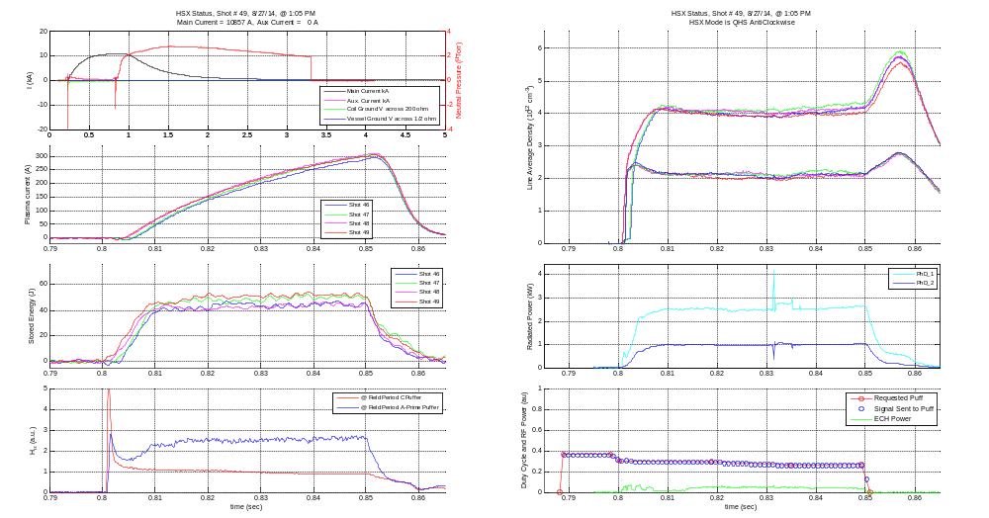
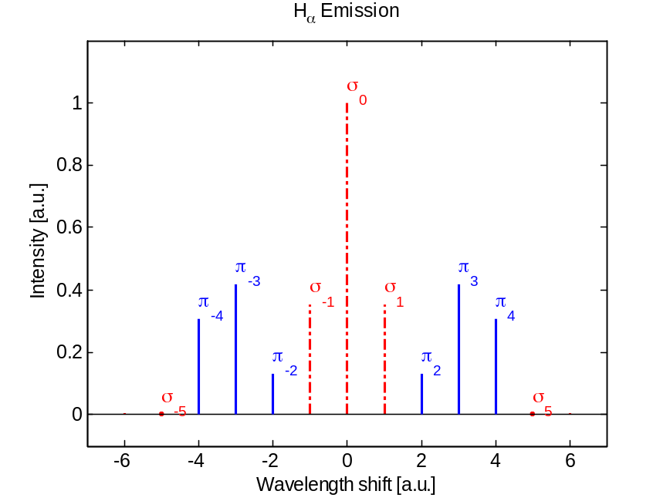

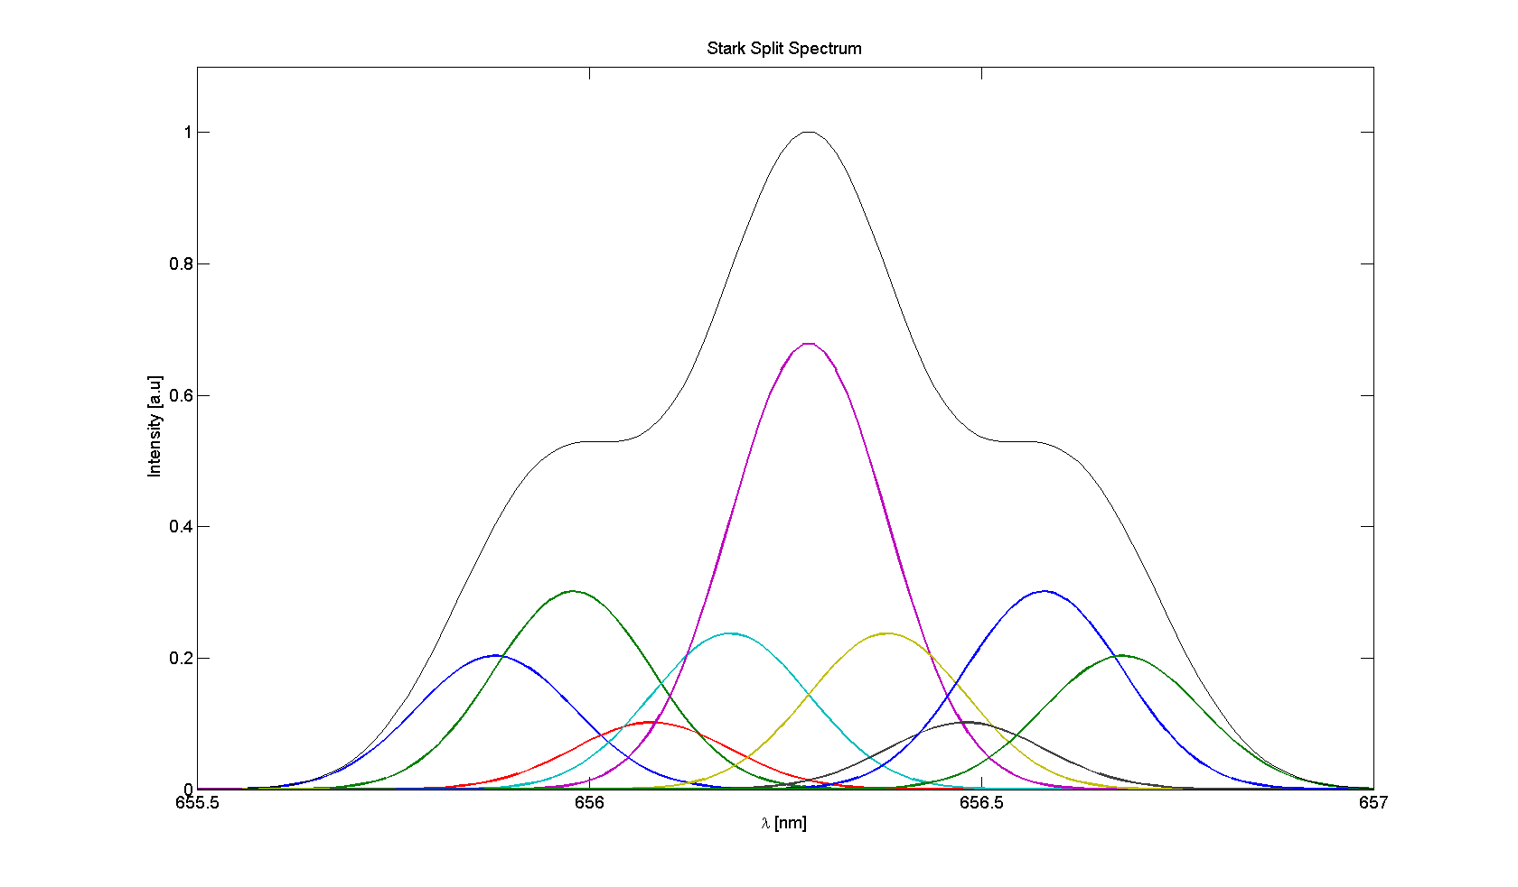



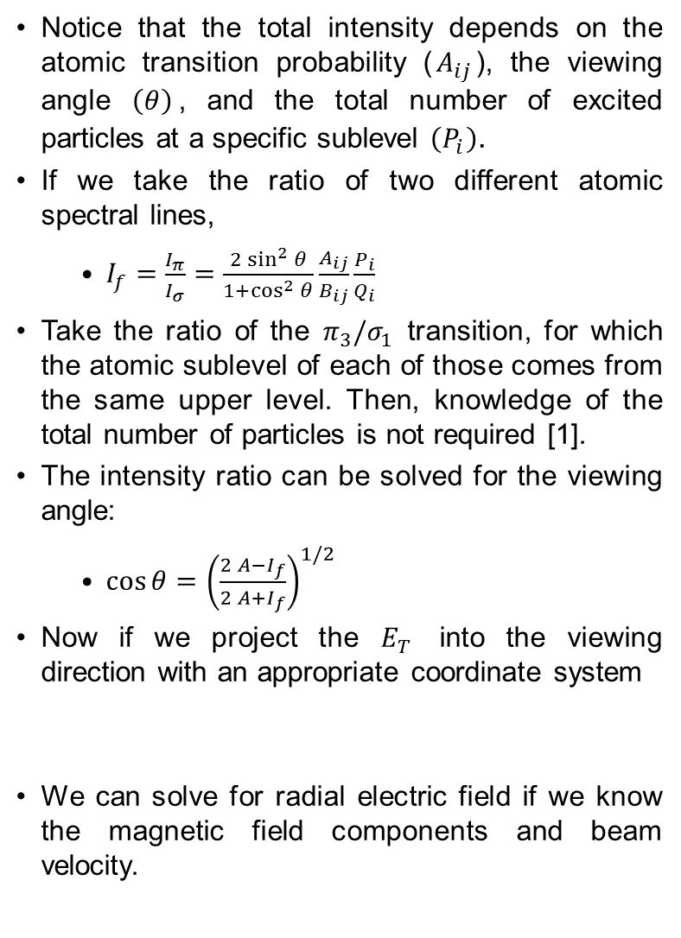



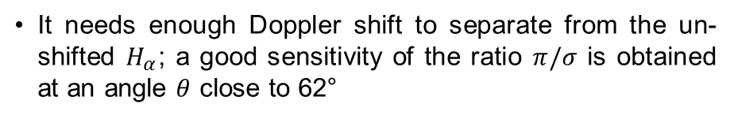
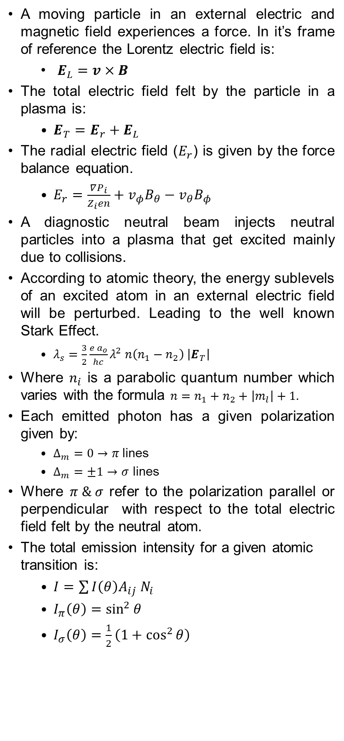
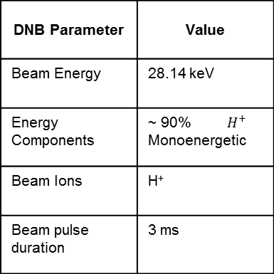
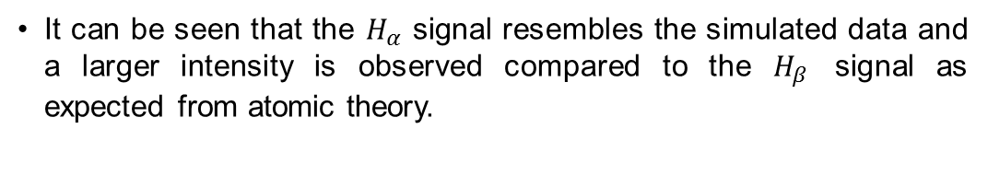



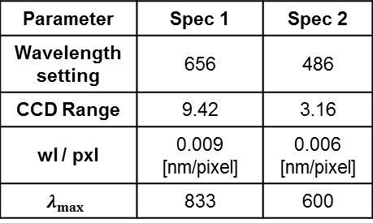
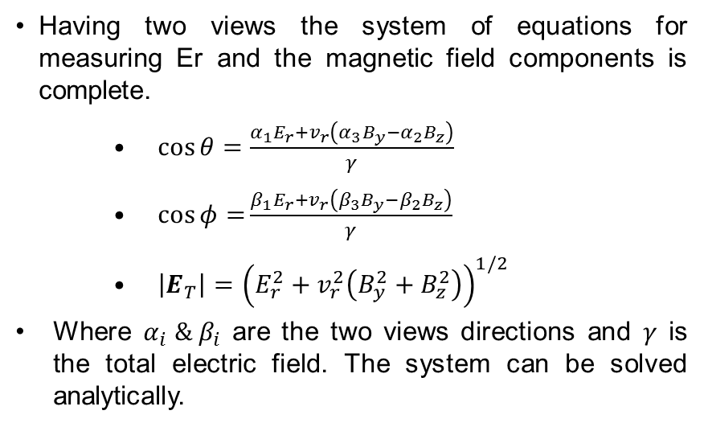
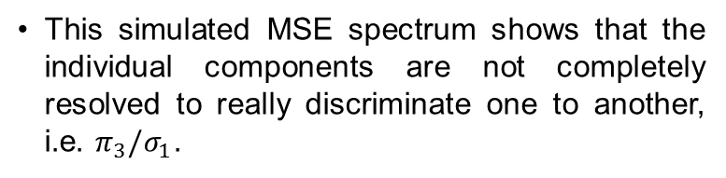





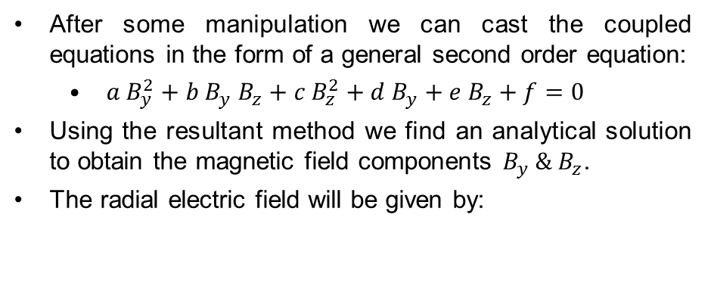
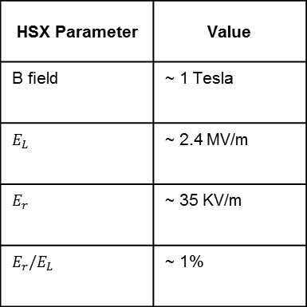
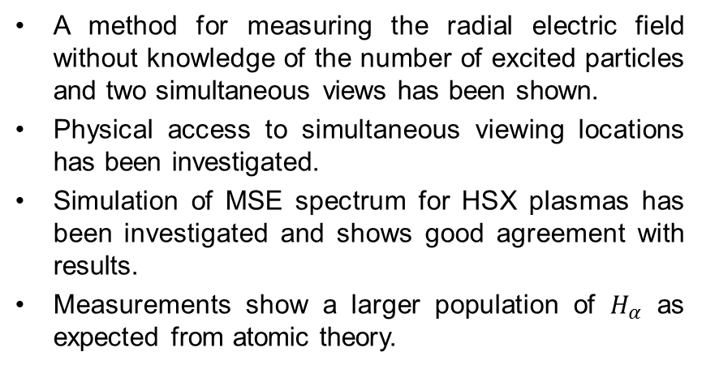
Spectral MSE Study on HSX and Non-Statistical Beam Level Populations
C. Ruiz, S.T.A. Kumar, O. Marchuck¹, F.S.B Anderson, D.T. Anderson
HSX Plasma Laboratory, Univ. of Wisconsin, Madison, USA;
¹Forschungszentrum Juelich GmbH, Germany
Introduction/Motivation
MSE Diagnostic with Simultaneous Views
Experiments
A good knowledge of the radial electric field profile is required to understand plasma transport properties.
A radial electric field results in ExB shear flows, which in turn leads to changes in the particle confinement and a reduction of turbulence.
Previous measurements of radial electric field using CXRS on HSX have shown discrepancy to the expected Er.
Perform a measurement of Er using motional stark effect diagnostic.
Validation of atomic physics codes for the non-statistical population of the atomic energy levels.
Show a method to measure radial electric field without specific knowledge of the population of the hydrogen atomic sublevels.
After some manipulation we can cast the coupled equations in the form of a general second order equation:
  $a{ B}_{y}^{2}+b{ B}_{y} B_{z}+c{ B}_{z}^{2}+d{ B}_{y}+e B_{z}+f=0$
Using the resultant method we find an analytical solution to obtain the magnetic field components $B_{y} \& B_{z}$.
The radial electric field will be given by:
Two spectrometers with different resolution were used to observe the spectrum at the same radial location.
An integrating sphere was used to cross calibrate the spectrometers.
A factor was obtained for different intensities and used on the results shown here.
Parameter | Spec 1 | Spec 2
Wavelength setting | 656 | 486
CCD Range | 9.42 | 3.16
wl / pxl | 0.009 [nm/pixel] | 0.006 [nm/pixel]
$$λ_{max}$$ | 833 | 600
Integrating
Sphere
Spec 1 @ 656 nm
$$\hat{α}$$
View 1
Spec 2 @ 486 nm
$${\vec{B}}_{y}$$
$$θ$$
$${\vec{E}}_{T}={\vec{E}}_{r}+{\vec{E}}_{L}$$
$E_{r}=\frac{γ\cos{θ}}{α_{1}}+\frac{v_{r}}{α_{1}}\left(α_{2}B_{z}−α_{3}B_{y}\right)$
Notice the un-shifted emission is saturated but that wouldn’t affect the MSE Spectrum
Overview/Theory/Background
$${\vec{B}}_{z}$$
$${\vec{E}}_{r}$$
View 2
Plasma Density
$${\vec{v}}_{r}$$
Viewing angle 87°
Angle to ${\hat{E}}_{T}$ 68°
Feasibility of a Secondary View
$H_{α}$ MSE Spectrum
A moving particle in an external electric and magnetic field experiences a force. In it’s frame of reference the Lorentz electric field is:
  $E_{L}=v×B$
The total electric field felt by the particle in a plasma is:
  $E_{T}=E_{r}+E_{L}$
The radial electric field ($E_{r}$) is given by the force balance equation.
  $E_{r}=\frac{∇P_{i}}{Z_{i}en}+v_{φ}B_{θ}−v_{θ}B_{φ}$
A diagnostic neutral beam injects neutral particles into a plasma that get excited mainly due to collisions.
According to atomic theory, the energy sublevels of an excited atom in an external electric field will be perturbed. Leading to the well known Stark Effect.
  $λ_{s}=\frac{3}{2}\frac{e a_{o}}{hc}λ^{2} n\left(n_{1}−n_{2}\right) \left|E_{T}\right|$
Where $n_{i}$ is a parabolic quantum number which varies with the formula $n=n_{1}+n_{2}+\left|m_{l}\right|+1$.
Each emitted photon has a given polarization given by:
  $Δ_{m}=0→π$lines
  $Δ_{m}=±1→σ$ lines
Where $π \& σ$ refer to the polarization parallel or perpendicular with respect to the total electric field felt by the neutral atom.
The total emission intensity for a given atomic transition is:
  $I=\sum{I\left(θ\right)A_{ij} N_{i}}$
  $I_{π}\left(θ\right)=\sin^{2}{θ}$
  $I_{σ}\left(θ\right)=\frac{1}{2}\left(1+\cos^{2}{θ}\right)$
It needs enough Doppler shift to separate from the un-shifted $H_{α}$; a good sensitivity of the ratio $π/σ$ is obtained at an angle $θ$ close to 62°
Un-shifted $H_{β}$
Un-shifted $H_{α}$
Having two views the system of equations for measuring Er and the magnetic field components is complete.
  $\cos{θ}=\frac{α_{1}E_{r}+v_{r}\left(α_{3}B_{y}−α_{2}B_{z}\right)}{γ}$
  $\cos{φ=}\frac{β_{1}E_{r}+v_{r}\left(β_{3}B_{y}−β_{2}B_{z}\right)}{γ}$
  $\left|E_{T}\right|={\left(E_{r}^{2}+v_{r}^{2}\left(B_{y}^{2}+B_{z}^{2}\right)\right)}^{1/2}$
Where $α_{i} \& β_{i}$ are the two views directions and $γ$ is the total electric field. The system can be solved analytically.
$H_{β}$ MSE Spectrum
C II
Four different locations where investigated and the optimal one, location B, has the following parameters:
Doppler shift angle 87°
Viewing angle 68°
t [s]
Neutral Beam
Two line average plasma densities has been investigated. Preliminary results show an increase in the excited population for the higher density case.
An ensemble of 10 shots and ccd binning is used to produce the spectrum shown here.
C
T
A
It can be seen that the $H_{α}$ signal resembles the simulated data and a larger intensity is observed compared to the $H_{β}$ signal as expected from atomic theory.
Notice that the total intensity depends on the atomic transition probability ($A_{ij}$), the viewing angle $\left(θ\right)$, and the total number of excited particles at a specific sublevel $\left(P_{i}\right)$.
If we take the ratio of two different atomic spectral lines,
  $I_{f}=\frac{I_{π}}{I_{σ}}=\frac{2\sin^{2}{θ}}{1+\cos^{2}{θ}}\frac{A_{ij}}{B_{ij}}\frac{P_{i}}{Q_{i}}$
Take the ratio of the $π_{3}/σ_{1}$ transition, for which the atomic sublevel of each of those comes from the same upper level. Then, knowledge of the total number of particles is not required [1].
The intensity ratio can be solved for the viewing angle:
  $\cos{θ}={\left(\frac{2 A−I_{f}}{2 A+I_{f}}\right)}^{1/2}$
Now if we project the $E_{T}$ into the viewing direction with an appropriate coordinate system
We can solve for radial electric field if we know the magnetic field components and beam velocity.
B
D
Simulation for HSX Plasmas
Summary and Proposed Work
The diagnostic neutral beam and plasma parameters influence the motional stark effect diagnostic. Our DNB and HSX plasma parameters are shown here:
A method for measuring the radial electric field without knowledge of the number of excited particles and two simultaneous views has been shown.
Physical access to simultaneous viewing locations has been investigated.
Simulation of MSE spectrum for HSX plasmas has been investigated and shows good agreement with results.
Measurements show a larger population of $H_{α}$ as expected from atomic theory.
The performed spectrometers cross calibration provides a basis for comparing results.
Improvement of the spectrum signal and removal of artifacts is in progress.
Validation of atomic physics codes for the non-statistical population of the atomic energy levels is in progress.
Although measurement of radial electric field seems unfeasible at the moment careful investigation of all the possibilities is in progress.
HSX Parameter | Value
B field | ~ 1 Tesla
$E_{L}$ | ~ 2.4 MV/m
$E_{r}$ | ~ 35 KV/m
$E_{r}/E_{L}$ | ~ 1%
DNB Parameter | Value
Beam Energy | 28.14 keV
Energy Components | ~ 90% $H^{+}$ Monoenergetic
Beam Ions | H⁺
Beam pulse duration | 3 ms
$$λ_{s}$$
References / Acknowledgements
$$E_{T}⋅\hat{α}=\left|E_{T}\right|\cos{θ}=α_{1}E_{r}+v_{r}\left(α_{3}B_{y}−α_{2}B_{z}\right)$$
This simulated MSE spectrum shows that the individual components are not completely resolved to really discriminate one to another, i.e. $π_{3}/σ_{1}$.
Thanks to Dr. N. Pablant for the support and communication for the realization of this work.
Thanks to the HSX group, my supervisor and colleagues who operate the HSX machine.
[1] N. Pablant, Measurements of the internal magnetic field on DIII-D using intensity and spacing of the motional Stark multiplet, Review of Scientific Instruments 79 (2008)
Notice that the radial electric field is only ~%1 percent of the total electric field experienced by the neutral atom.
This work supported by US DOE Grant DE-FG02-93ER54222
Notes:
To edit the bottom date go to View Slide Master

