Slide 1
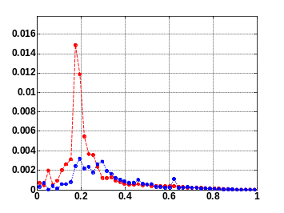
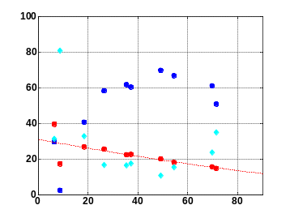
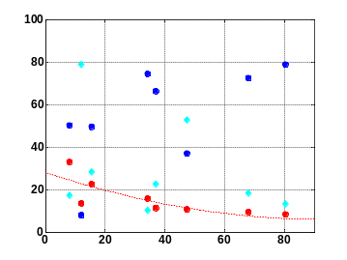
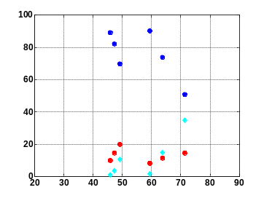
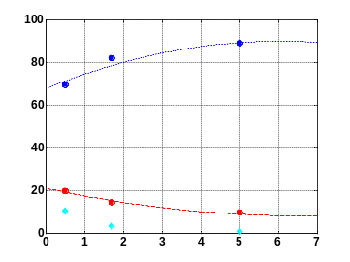
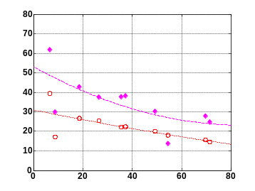
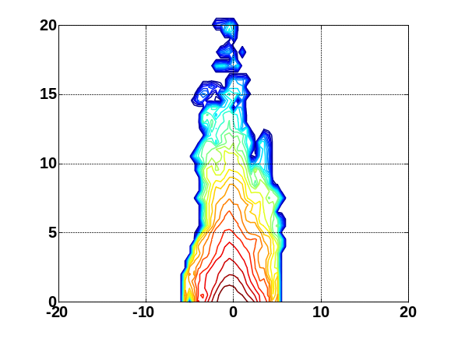
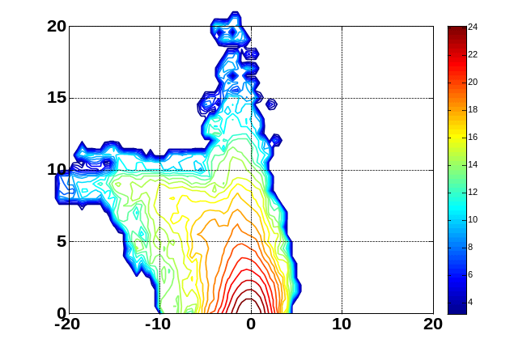
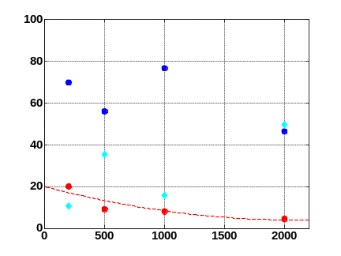
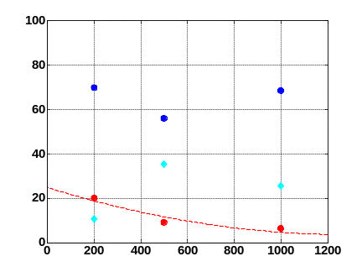
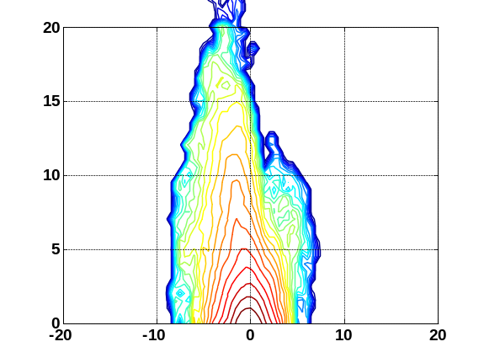
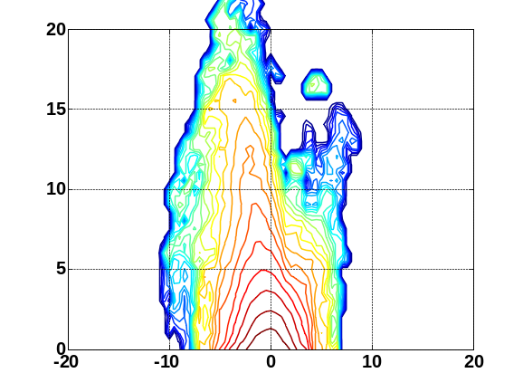
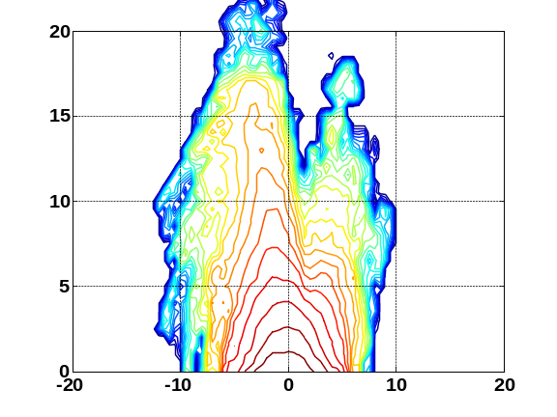
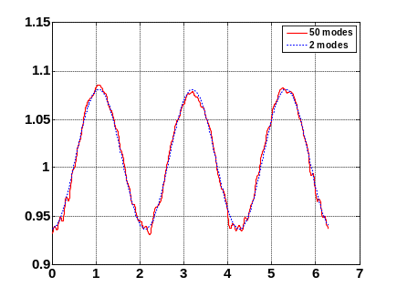
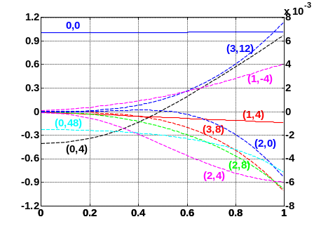
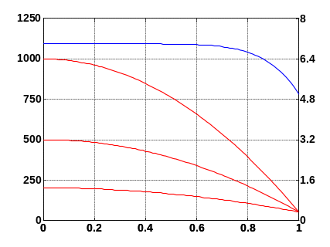
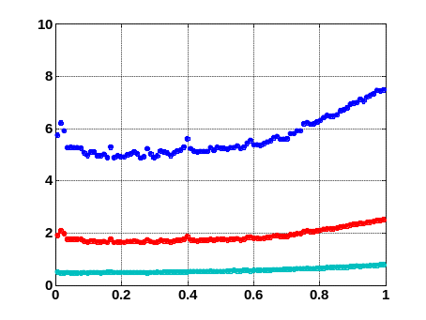
Study of ICRH and Ion Confinement
in the HSX Stellarator
K. M. Likin, S. Murakami¹, J.N. Talmadge
HSX Plasma Laboratory, Univ. of Wisconsin, Madison, USA; ¹University of Kyoto, Kyoto, Japan
Overview
Results from GNET Code
With ECRH the ion temperature in HSX remains low (< 100 eV) compared to the electron temperature (~ 2 keV)
With hot ions (a few hundred eV) the difference between quasi-symmetric and conventional stellarator configurations may be more pronounced
  Ion low collisionality regime becomes accessible
  Effect of radial electric field can be studied
GNET code has been adapted to the HSX geometry
  The code can predict (1) efficiency of ion cyclotron resonance heating (ICRH); (2) fast ion confinement; (3) charge-exchange losses; (4) ion confinement in different magnetic configurations
ICRH Efficiency Degrades with Heating Power and Neutral Density
ICRH Power Deposition
Heating Power Scan
At B_{res} = 0.975 T the power is deposited at (0.2–0.3)·r/a_{p}
In helically symmetric (HS) configuration the heating is more efficient than in quasi-symmetric (QHS) mode due to a better fast ion confinement
Neutral Density Scan
Efficiency in HS
Efficiency in QHS
Efficiency vs. P_{abs}
Efficiency vs. N_{o}
ICRH with and w/o Neutrals
HS Configuration
CX
CX
N_{o}
CX
CX
No Neutrals
P_{abs} (W/cm³)
η / CX / orbit loss (%)
Efficiency
η / CX / orbit loss (%)
Efficiency
Orbit
η / CX / orbit loss (%)
η / CX / orbit loss (%)
ICRH Efficiency
η (%)
QHS
Orbit
ICRH Efficiency
Orbit Loss
r / a_{p}
P_{abs} (kW)
P_{abs} (kW)
P_{abs} (kW)
N_{o} (10¹⁶ m⁻³)
P_{abs} (kW)
Minority Ion Distribution Function in QHS Configuration
There is a large V┴ distortion of the distribution function inside the resonance region
High energy (> 5 keV) ions are predicted in both configurations
In QHS a distortion is more pronounced than in HS
In HSX the charge-exchange losses prevail over heating efficiency and fast ion orbit loss
Without neutrals the heating efficiency may get up to 40%
r / a_{p} = 0.2
P_{abs} = 34 kW
T_{i,e} = 200 eV
r / a_{p} = 0.5
P_{abs} = 34 kW
T_{i,e} = 200 eV
V┴ / V_{th}
V┴ / V_{th}
Electron and Ion Temperature Scans
Efficiency vs. T_{e}
Efficiency vs. T_{i}
η / CX / orbit loss (%)
CX
η / CX / orbit loss (%)
CX
V|| / V_{th}
V|| / V_{th}
Orbit Loss
Orbit Loss
Linearized Drift Kinetic Equation is solved in 5-D space
ICRH Efficiency
ICRH Efficiency
Ion Temperature Scan in HS Configuration
T_{e} (eV)
T_{i} (eV)
r / a_{p} = 0.5
P_{abs} = 37 kW
T_{i,e} = 200 eV
r / a_{p} = 0.5
P_{abs} = 50 kW
T_{i,e} = 500 eV
r / a_{p} = 0.5
P_{abs} = 38 kW
T_{i,e} = 1000 eV
At high plasma temperature the heating efficiency drops drastically
Distortion of the ion distribution function increases with plasma temperature due to a poor confinement of high energy ions at a such low magnetic field
As high as 20% of heating power is estimated to go directly to the ions
Up to 80% of absorbed power will be lost through charge-exchange process and ions leaving the confinement volume
V┴ / V_{th}
V┴ / V_{th}
V┴ / V_{th}
  3-D equilibrium is calculated by the VMEC code
Linear Coulomb collision operator C(f_{min}) is used
Q_{ICRF}(f_{min}) is a heating operator based on the results of TASK/WM code for the LHD stellarator
Particle losses L_{particle} account for charge-exchange and orbits beyond the last closed flux surface
Particle source S_{particle} is determined by neutrals (AURORA code)
Minority ion distribution function f_{min} is a convolution of a particle source and a time dependent Green’s function
V|| / V_{th}
V|| / V_{th}
V|| / V_{th}
Helically Symmetric and Quasi-Symmetric Magnetic Configurations
Summary
Mod B along a field line and its 10 spectral harmonics
Helically symmetric (HS) configuration has two main terms (0,0) & (1,4) in its magnetic field spectrum
In the quasi-helically symmetric (QHS) configuration there are non-symmetric harmonics as well
Due to the symmetry-breaking terms the fast ions drift out from the confinement volume in a short period of time
A new parallel version of the code has been installed on the NERSC Cray computer and benchmarked against the runs on the computer at Kyoto University
At 1 T the heating efficiency is less than 20%
In HSX the GNET code predicts rather high charge-exchange loss (> 60%)
Plasma Density and Temperature
Neutral Density Profiles
r / a_{p} = 0.5
T_{i,e} (eV)
B (T)
b_{0,0} & b_{1,4}
b_{mn}
N_{e} (10¹⁸ m⁻³)
N_{o} (10¹⁶ m⁻³)
Close to experiment
φ (rad)
r / a_{p}
r / a_{p}
r / a_{p}

