Slide 1
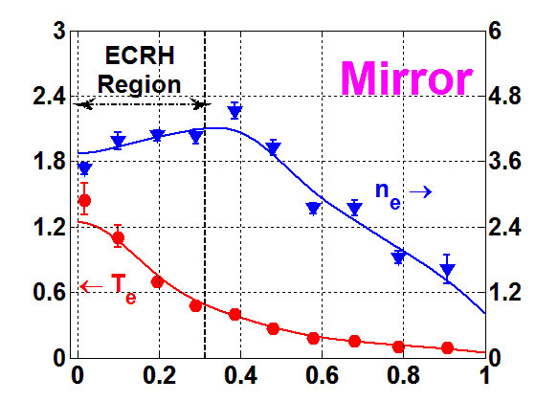
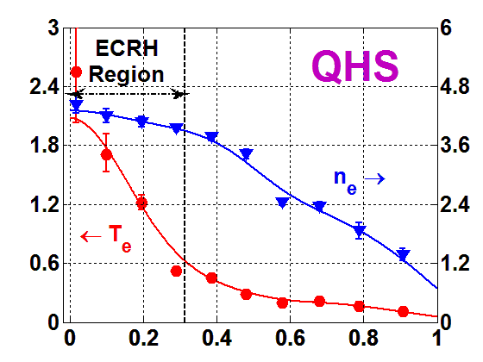
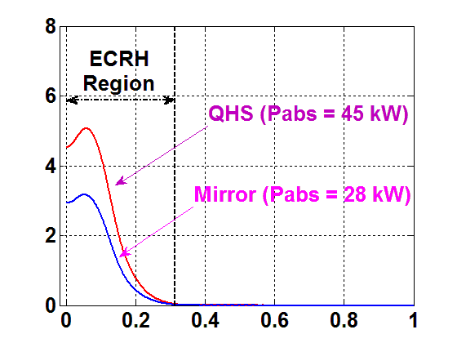
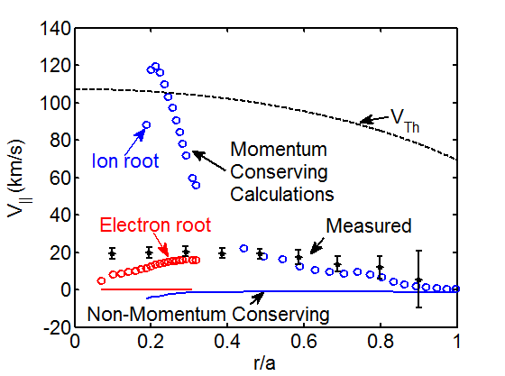
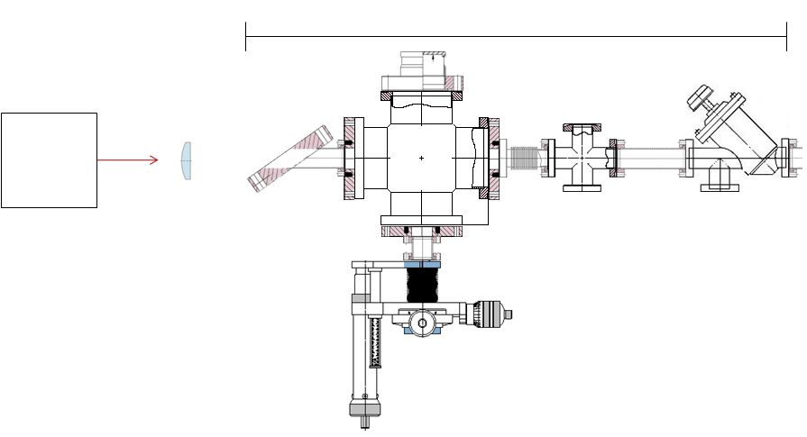
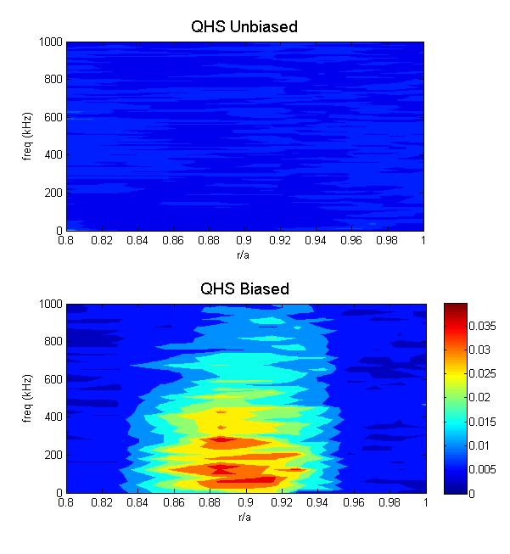
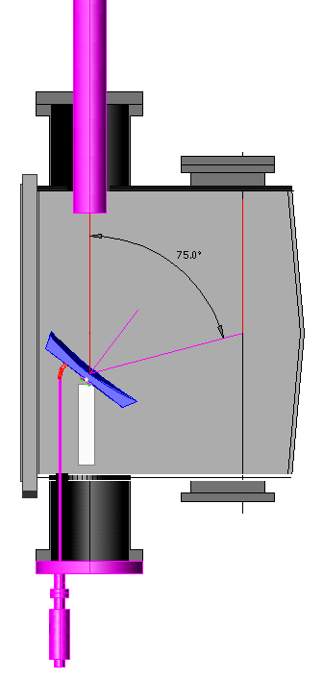
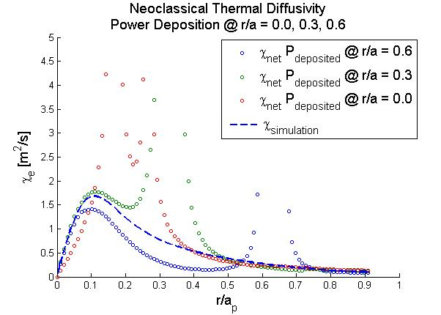
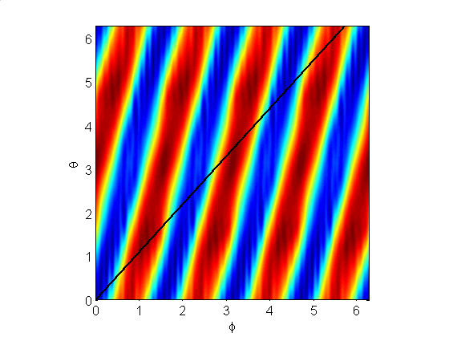
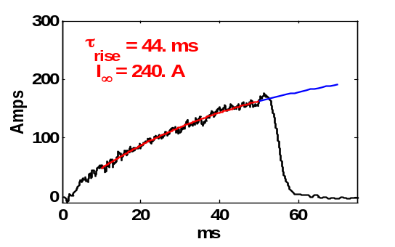
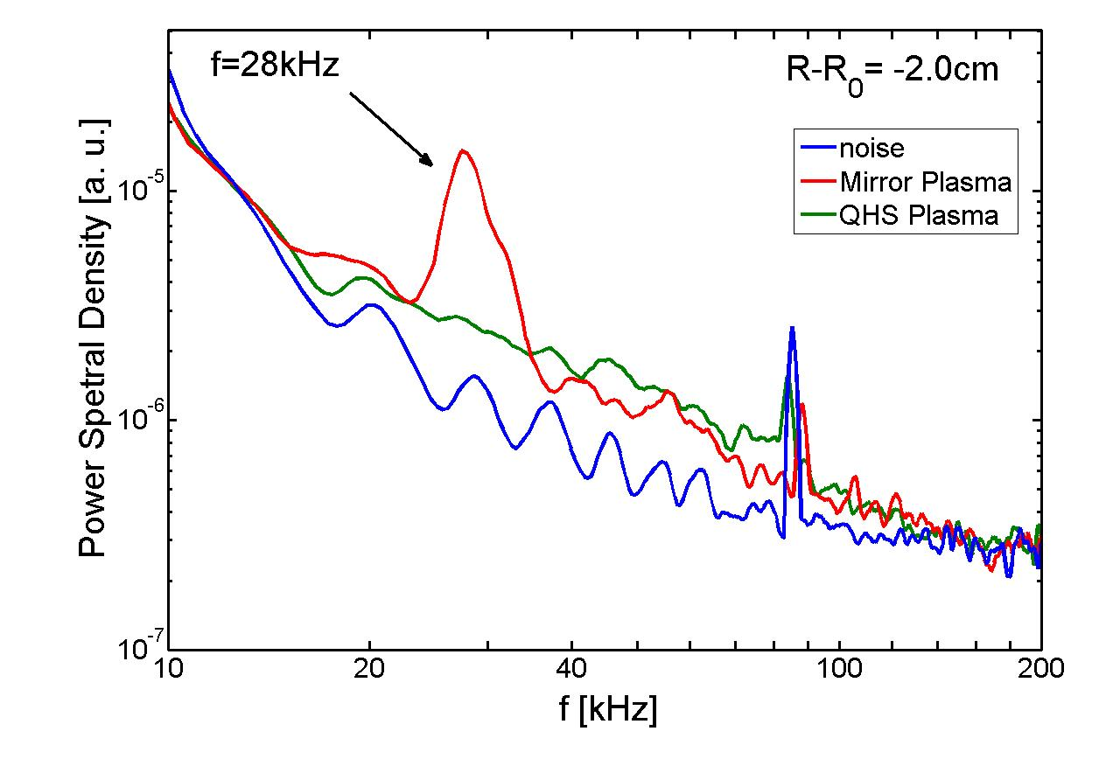
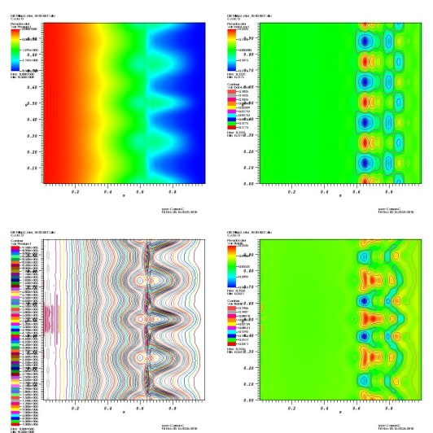
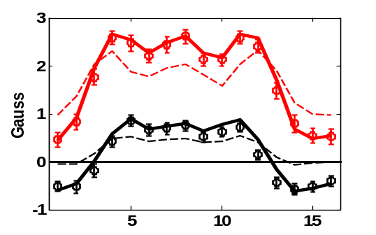
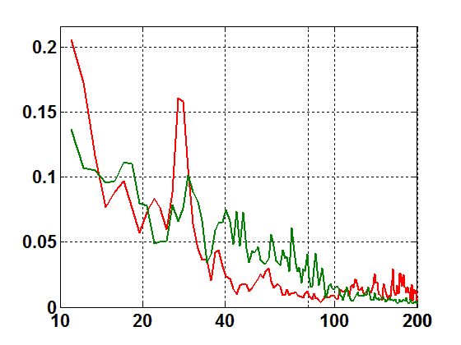
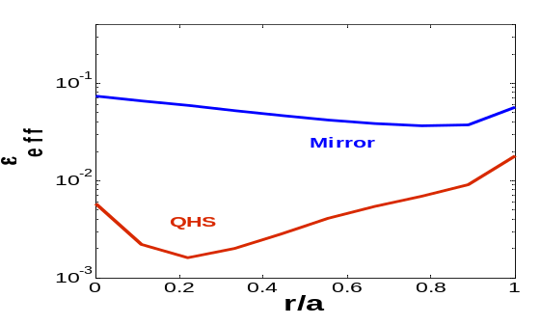
Overview of HSX Stellarator Experiments
K. M. Likin, D.T. Anderson, F.S.B. Anderson, A.R. Briesemeister, D.L. Brower¹, C.A. Clark, C.R. Cook, C. Deng¹, J.W. Radder, J. C. Schmitt, J.N. Talmadge, G.M. Weir, R.S. Wilcox, K. Zhai
HSX Plasma Laboratory, Univ. of Wisconsin, Madison, WI, USA; ¹University of California, Los Angeles, CA, USA
Summary
Parallel Velocity and E_{r}
Impurity Transport
Electron Temperature and Density from TS diagnostic
Absorbed Power Profile
Parallel Velocity Profile
See poster by Alexis Briesemeister
Laser Blow-off Diagnostic
See posters by Chris Clark and Kan Zhai
Large parallel flow (~15 km/s) observed for QHS configuration, often neglected in neoclassical calculations
Non-momentum conserving calculations under-predict V|| by an order of magnitude compared to measured values
Derived radial electric field corresponds to that in the neoclassical ion root regime
Laser beam
About 1% of aluminum will be injected into plasma by a laser blow-off technique
Time evolution of the Al⁺ radiation will be measured by a set of bolometers and SXR detector arrays
Impurity diffusivity and convective velocity will be found with the STRAHL code and a nonlinear optimization algorithm
Thomson Scattering diagnostic is being upgraded to get three snapshots of plasma profiles in each discharge
T_{e} (keV)
n_{e} (10¹⁸ m⁻³)
P_{abs} (W/cm³)
Target inside chamber
HSX valve
r/a_{p}
r/a_{p}
r/a_{p}
Zonal Flow
Second ECRH System and ECE
At 100 kW of launched power the central electron temperature in QHS is above 2 keV while in Mirror mode the maximum T_{e} value does not exceed 1.4 keV; this results is, primarily, due to better confinement in QHS than in Mirror
Emphasis now is investigating anomalous and neoclassical electron transport by heating electrons to low collisionality regime at higher power level; the second ECRH system will be available shortly
Momentum conservation between species must be taken in account to predict the parallel velocity in HSX measured by CHERS diagnostic
When a bias is applied to the plasma, a signature of zonal flow has been detected in HSX
V3FIT code used for plasma equilibrium reconstruction predicts a broad pressure profile
Measured toroidal current matches the estimated value by PENTA code with E_{r} that corresponds to the neoclassical ion root solution
Impurity transport is a key issue for stellarators; HSX is starting an investigation using a laser blow-off technique with bolometry and soft X-ray diagnostics
We use VMEC, PENTA, GNET, SIESTA codes to model the HSX experiment
Total bi-coherence of E_{θ}
See poster by Robert Wilcox
New Launching Antenna
See poster by Gavin Wier
Zonal flow levels predicted to be higher in configurations optimized for reduced neoclassical transport
A presence of zonal flow can be found through the wave coupling; high bi-coherence indicates three waves interaction into a plasma
In HSX, high bi-coherence and long-range correlations of potential fluctuations in the region of the induced radial electric field are consistent with zonal flow formation
Second ECRH system is to be operational early next year; second gyrotron has been tested on a dummy load; assembly of the second transmission line is expected to complete in this December
Additional 200 kW will be available
To shift the ITB region the steerable mirror is designed for off-axis heating
To study an electron diffusivity the second heating source can produce a power modulation in a heat pulse propagation experiment
1-D modeling of T_{e} perturbations in HSX plasma has been made
Next steps on ECE diagnostic: (1) to improve sensitivity of some ECE channels; (2) to model ECE signals from the modeled T_{e} perturbation
w/in Deposition region 1
w/in Deposition region 2
w/in Deposition region 3
Steerable mirror
HSX Device
Equilibrium Reconstruction
Density Fluctuations
Equilibrium with Islands
HSX Magnetic Field Strength
Major radius of equivalent torus - 1.2 m
Averaged minor plasma radius - 0.12 m
Magnetic field on plasma axis - up to 1.1 T
Rotational transform - 1.05 (axis) => 1.12 (edge)
ECRH power from one source - up to 100 kW
Total number of coils - 96
48 Modular coils produce the quasi-helically symmetric (QHS) magnetic configuration
There is almost no toroidal curvature in the QHS configuration that with a high effective transform (ι_{eff} ~ 3) results in small banana widths, low plasma currents and low neoclassical transport
48 Planar coils can alter the main configuration to degrade the QHS symmetry increasing magnetic field ripple, viscous damping and neoclassical transport to a higher level. Magnetic configuration with a broken symmetry is called Mirror
Time Evolution of I_{tor}
See poster by John Schmitt
Density Fluctuation Spectrum
Forward Scattering Data
See poster by Chuanbao Deng
Field Line
The steady-state neoclassical bootstrap current is calculated by PENTA and the evolving current profile is modeled by a diffusion equation with a 3D susceptance matrix
Toroidal current matches or exceeds the neoclassical ion-root solution for most cases
A set of small coils outside the HSX vessel provide data for 3-D equilibrium reconstruction and current profile by the V3FIT code
At the beginning the dipole-field from the Pfirsch-Schlüter current is detected ; later a contribution from the bootstrap current is measured as well
In HSX, density fluctuation spectrum is measured by the interferometer (forward scattering) and the reflectometer
Density fluctuation spectrum in QHS and Mirror are almost identical except a narrow feature at 28 kHz; T_{e} profile in QHS is peaked with central temperature ~ 1.2 keV and Mirror plasma with core T_{e} ~ 500 eV does not manifest a steep T_{e} gradient
See poster by Carson Cook
Poloidal Angle (rad)
Plasma Pressure / B•J Contours
Using SIESTA, equilibrium can be resolved in finite-beta plasmas; the code also will be used for optimization of 3-D magnetic configurations
Due to the strong helical shaping in HSX, a large number of modes and pseudo-spectral points are required within SIESTA
Toroidal Angle (rad)
B_{θ} in Poloidal Plane
Reflectometer Data
Magnetic Field Ripple
Mirror
Radial dimension
Conventional Stellarators
V3FIT
t = 50 ms
PSD [a.u.]
QHS
@ t = 8 ms
Poloidal dimension
Frequency [kHz]

