Slide 1

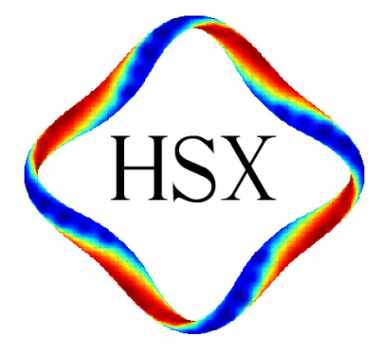
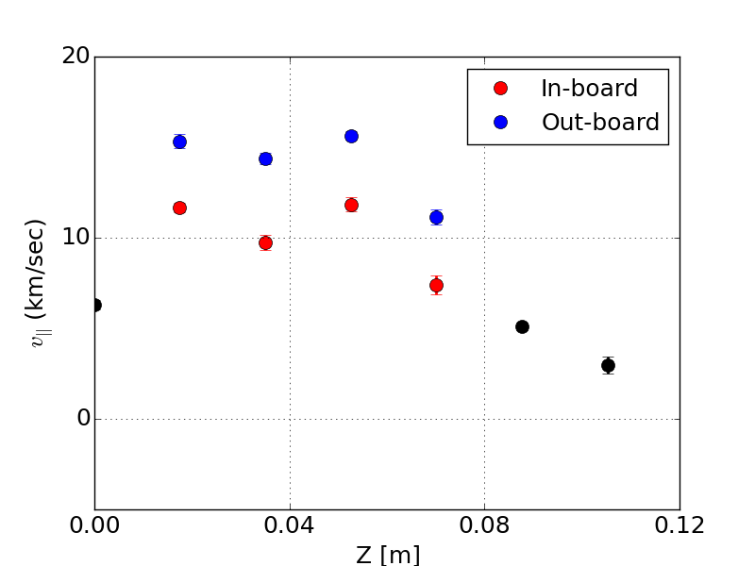
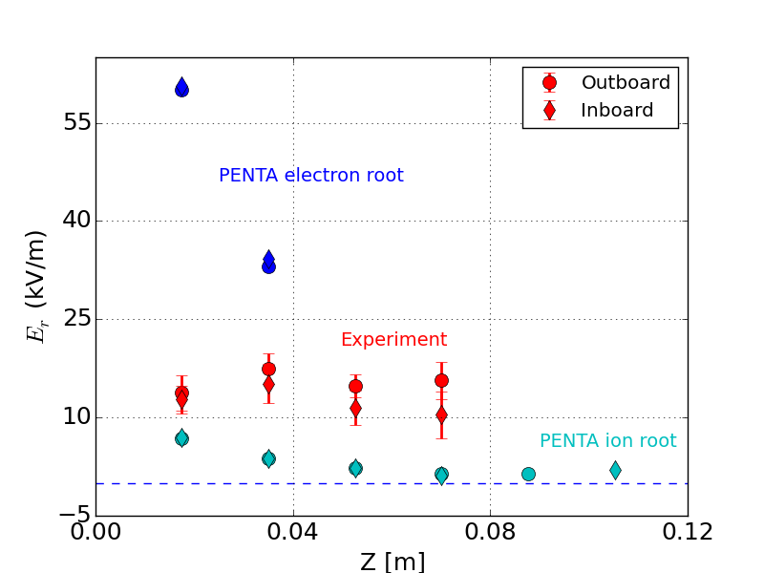
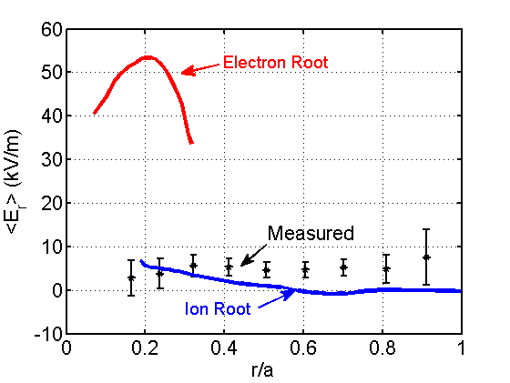
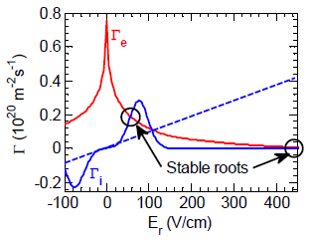
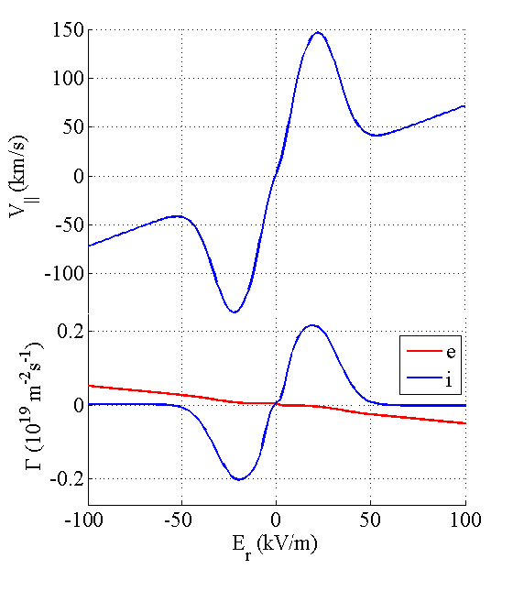
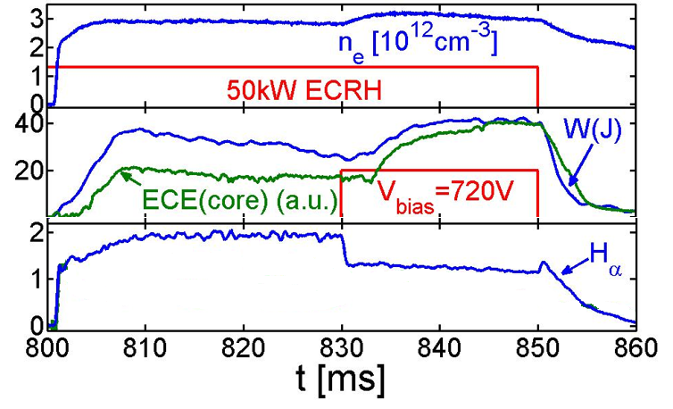
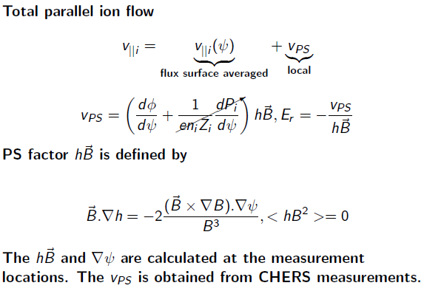
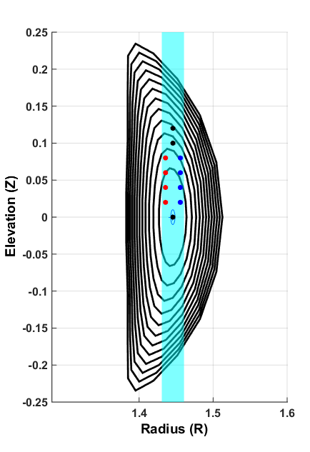
Progress in understanding flows and electric field in HSX
S. T. A. Kumar, J. Smoniewski, T. Dobbins, J.N. Talmadge, F. S. B. Anderson, D. T. Anderson,
HSX Plasma Laboratory, University of Wisconsin, Madison, USA
Experiments in the past could not reproduce flows and E_{r} calculated by the PENTA code.
Flow measurements are made in 100 kW Methane plasma.
III. Motional Stark Effect polarimetry is used for direct measurement of E_{r}
A dual Photo Elastic Modulator Motional Stark Effect (MSE) polarimetry has been designed, being built. Initial characterization of the diagnostics is underway.
E_{r} as small as 1.5 kV/m can be detected with careful selection of sightlines
See poster CP12.00082 T. Dobbins et al.
Previous carbon flow measurements using charge exchange spectroscopy (CHERS). Radial electric field (E_{r}) calculated from force balance.
No indication of large positive electron root E_{r} at the core calculated by PENTA.
Inboard/Outboard velocity asymmetry has been observed
PENTA-Expt. comparison
IV. Modeling is being improved.
The E_{r} calculated from PS flows is between Electron and Ion roots calculated by PENTA, higher than that previously obtained from radial force balance.
Large E_{r} is due to large ion flux at helical resonance.
PENTA assumes that particle energy is constant – this assumption is invalid at resonance.
We are bench-marking PENTA results with SFINCS and FORTEC-3D, which do not have mono-energetic assumption.
Also investigating the effect of impurities in the calculated E_{r} and velocities.
Improvements in measurements and modeling are being undertaken to understand this discrepancy
(A. Briesemeister et al.)
II. Biased electrode experiments trying to detect the ion resonance effect.
I. E_{r} can be determined from Pfirsch-Schlüter (PS) flows.
PENTA calculation
Typical biased discharge. Graphite tipped electrode inserted at the edge of the plasma
Advantage: avoids perpendicular flow measurements that are difficult to make, especially near the core
HSX CHERS PS views
Summary
Improvements in experiment and modeling are underway to understand the discrepancy between neoclassical modeling and experiment
Pfirsch-Schlüter flows have been measured, the E_{r} has been calculated.
Experiments with biased electrode and MSE polarimetry are progressing.
Benchmarking the E_{r} calculated by SFINCS and FORTEC-3D to the PENTA results is underway to understand the effect of monoenergetic assumption.
beam
Helical resonance would appear as a sudden change in electrode current and parallel velocity.
Biased electrode discharges in HSX show H-mode like characteristics. However, expected change in electrode current and large change in parallel flow haven’t been observed during bias.
APS-DPP 2015. Work Supported by US DOE award DE-FG02-93ER54222

