Slide 1

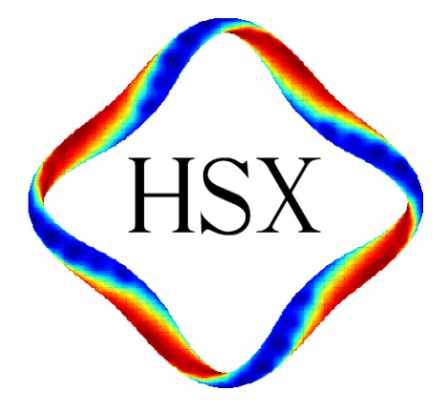
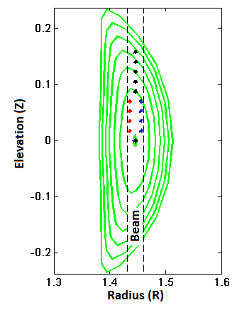
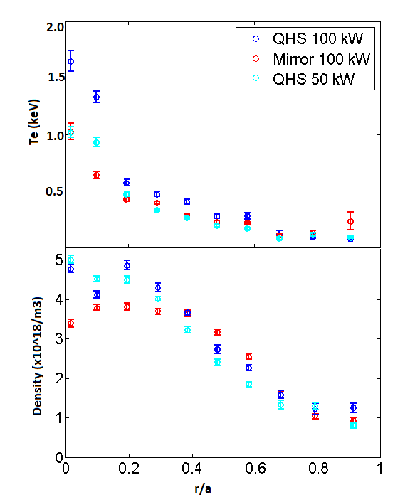
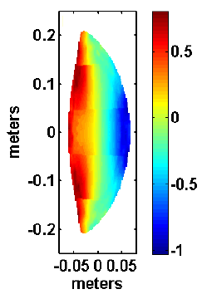
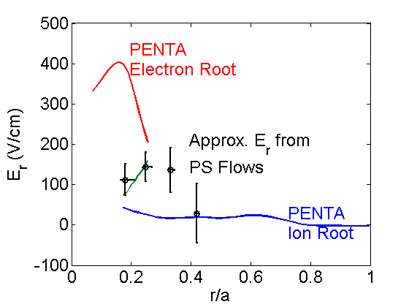
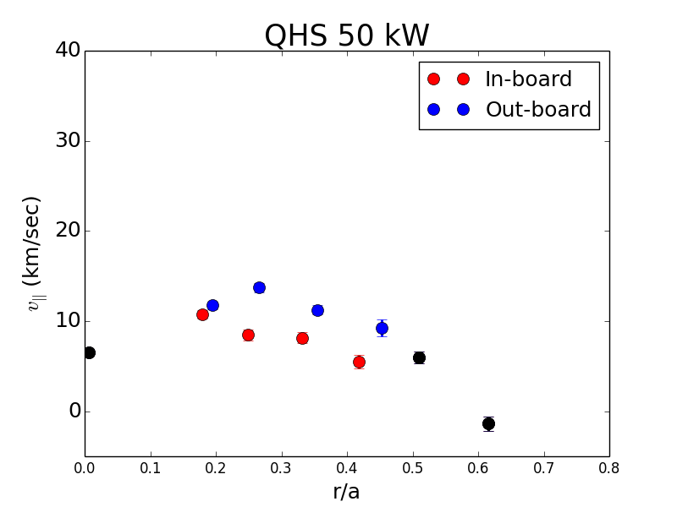
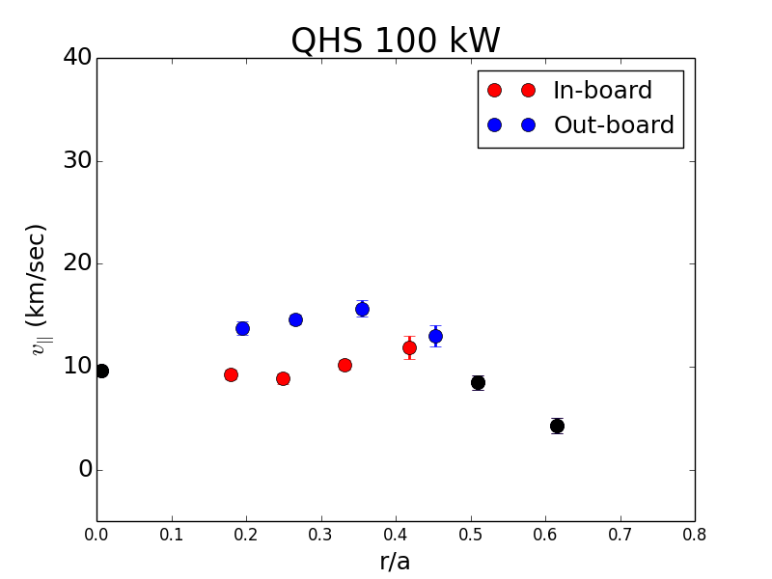
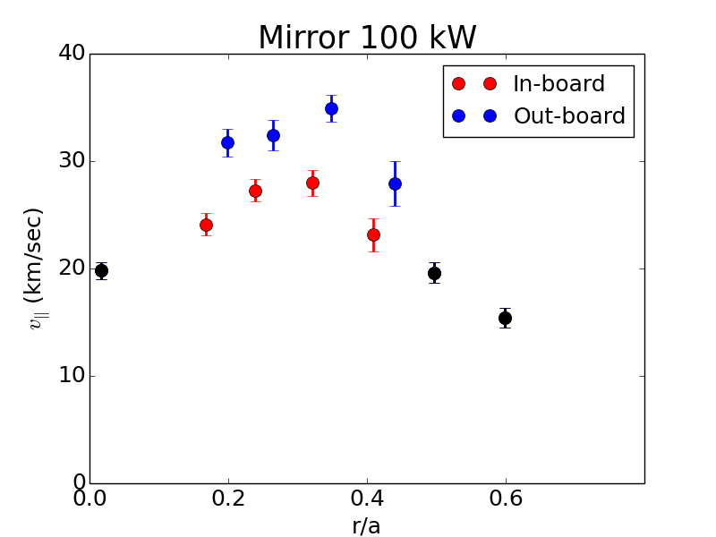

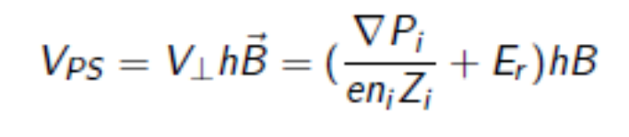
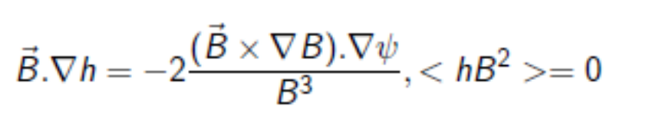
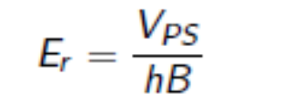
Measurement of Pfirsch-Schluter flows and radial electric field in HSX
S. T. A. Kumar, F. S. B. Anderson, D. T. Anderson, J.N. Talmadge
HSX Plasma Laboratory, University of Wisconsin, Madison, USA
Overview
Measurement of inboard-outboard V|| asymmetry
Radial electric field
Inboard-outboard asymmetry in the parallel C⁺⁶ ion flow has been measured using the Charge Exchange Recombination Spectroscopy in the HSX stellarator, indicating the presence of counter-streaming Pfirsch-Schluter (PS) ion flows.
Measurements are made for the helically symmetric (QHS) and the mirror configurations.
Similar level of PS flows is observed for all cases studied.
The mean carbon flow is larger for the mirror configuration (by a factor of ~2) compared to that in QHS.
PS flows are observed to be parallel to B in low field side and anti-parallel to B in high field side. This observation is opposite to what is previously calculated.
The radial electric field, which is proportional to the magnitude of the PS flow, is larger than the previous measurements (from radial force-balance) but still significantly less than the neoclassically calculated value for QHS.
HSX CHERS PS views
Plasma parameters (Te and n_e)
Comparison with neoclassical calculations
30 keV, 3 ms, ~4 A Hydrogen diagnostic neutral beam.
CVI emission at 529.1 nm is collected.
Focused optics, measurement spot size ~1.4 mm.
PS views are positioned in-board and out-board sides of the beam.
PS factor hB
QHS 100 kW
Methane plasmas
Radial electric field higher than previous measurements (of ~40-50 V/cm), still less than the PENTA electron-root estimate
Pfirsch-Schluter flows
Pfirsch-Schulter (PS) parallel flows arise due to the flow incompressibility,
PS flow is a local parallel flow that compensates for the compression of perpendicular flows.
Therefore, the total parallel flow (local) = flux-surface-averaged flow + PS flow.
PS flow can be written as
Where h is an integration constant satisfying
When pressure gradient is negligible, radial electric field can be calculated from the PS flow
Experimental Results
Summary
Counter-streaming parallel ion flows (Pfirsch-Schluter flows) has been observed in the HSX stellarator for the first time.
Magnitude of the PS flow is similar in all cases studied.
The mean flow is nearly doubled in the mirror configuration compared to that in QHS.
Direction of the measured PS flow is opposite to what is previously calculated.
Preliminary calculation indicates higher than previously measured radial electric field, but lower than the electron-root estimates.
Increase in heating power
Change in configuration
Similar PS flows in all cases studied.
Large mean flows in mirror geometry compared to that in QHS
Measured PS flow direction is opposite to the calculation. (See the PS factor ‘hB’ calculation)
56th APS-DPP meeting, New Orleans, Louisiana, October 27-31, 2014. This work is supported by the US DOE contract DE-FG02-93ER54222

