Slide 1

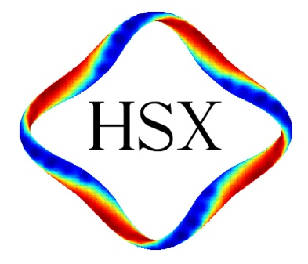
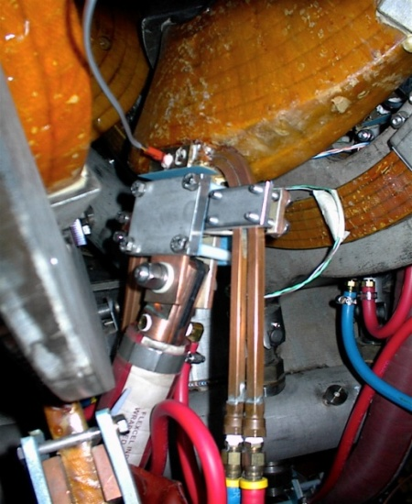
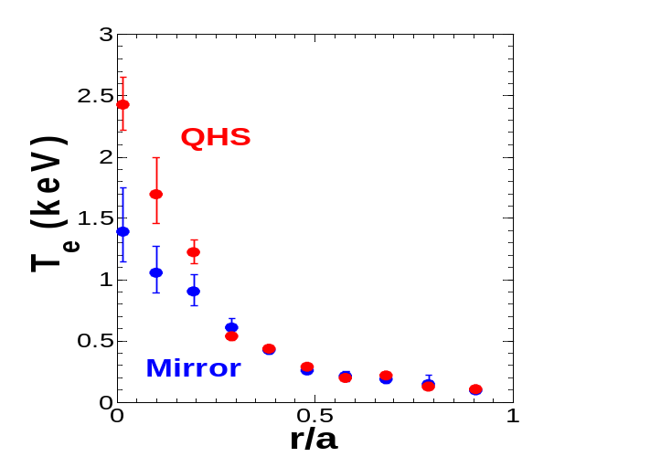
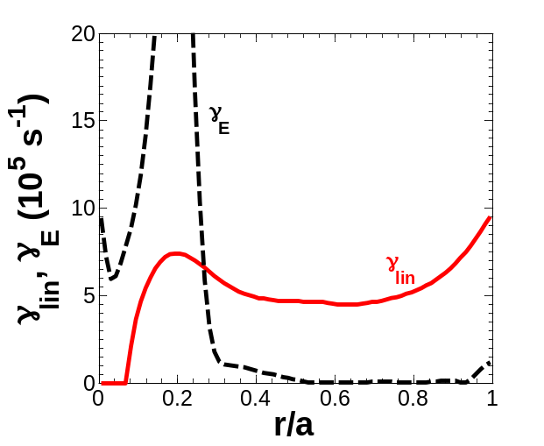
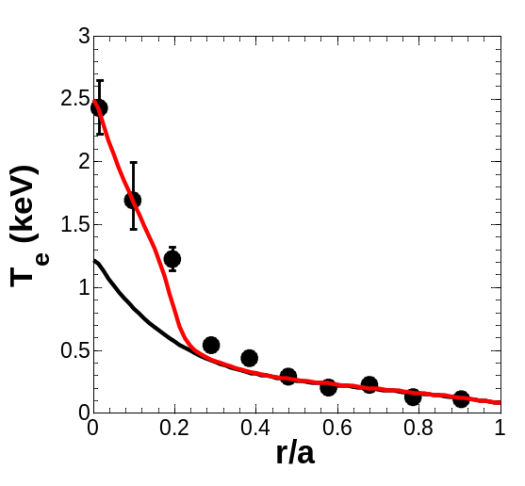
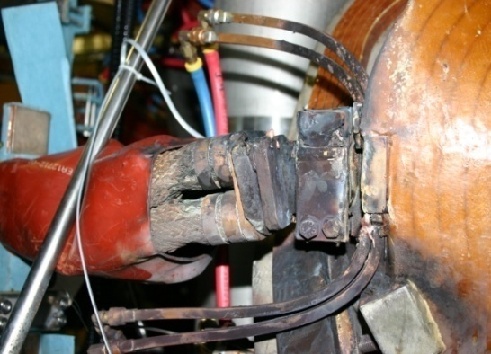
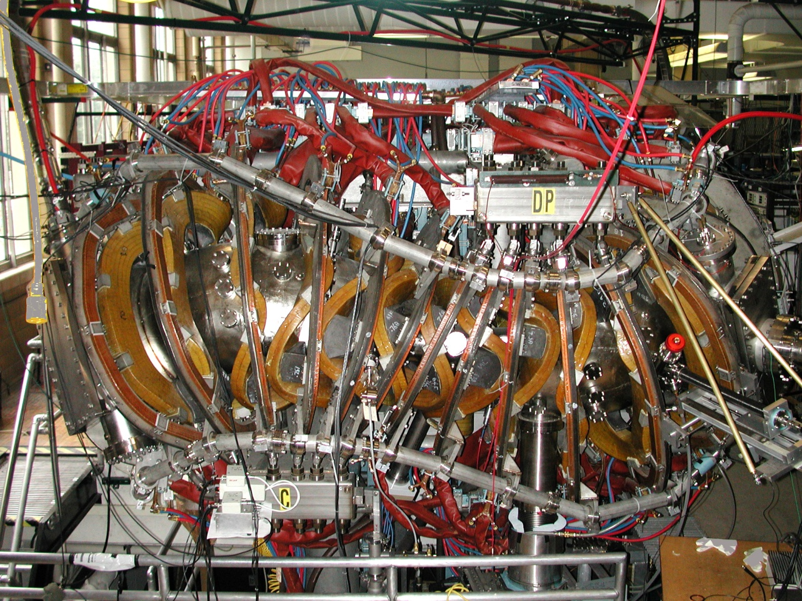
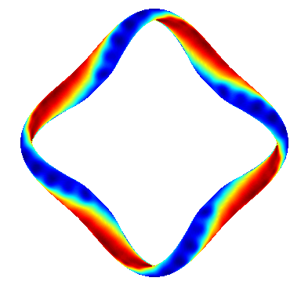
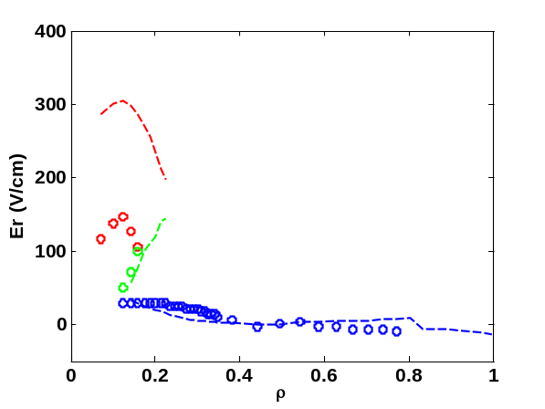
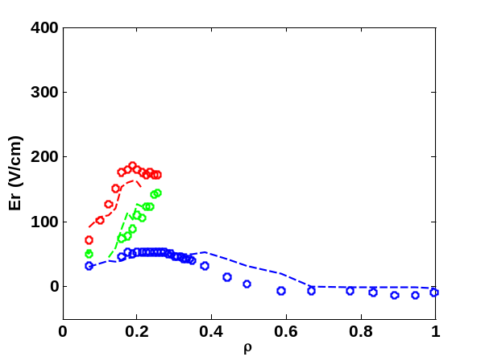
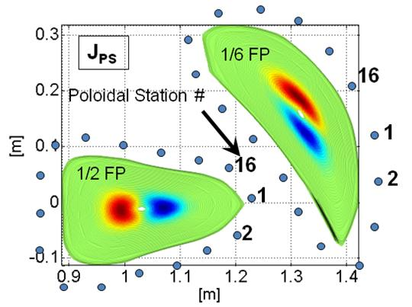
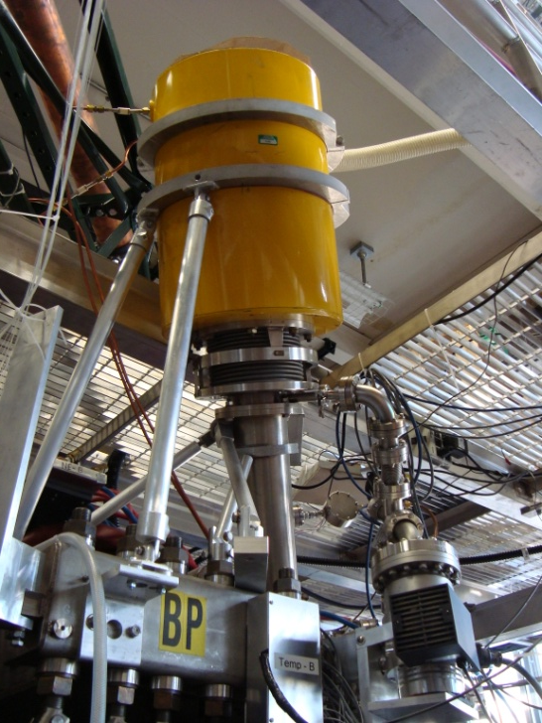
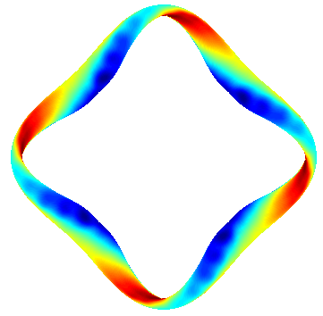
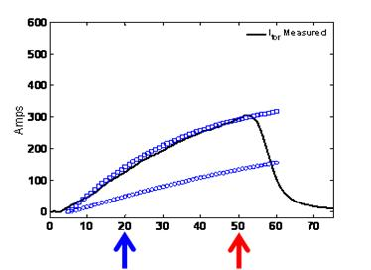
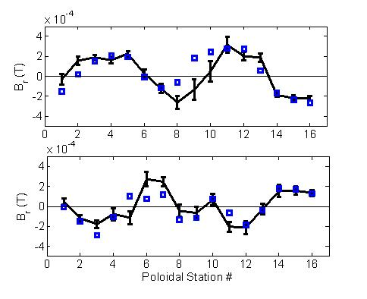
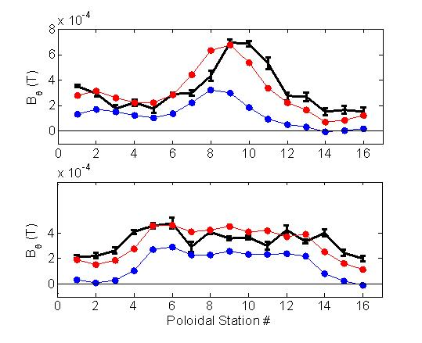
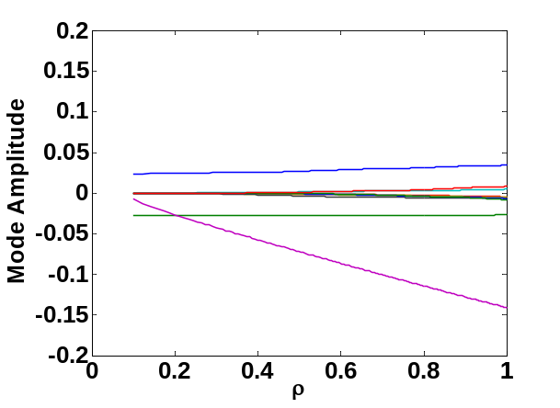
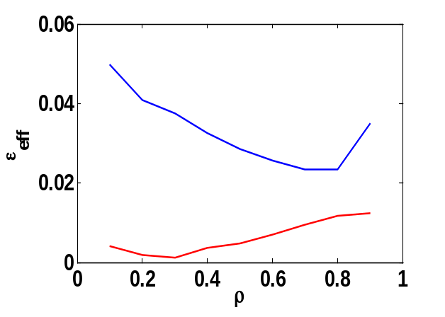
The HSX Experimental Program
F. Simon B. Anderson, D.T. Anderson, A.R. Briesemeister, C. Clark, K.M.Likin, J. Lore, H. Lu, P.H. Probert, J.W. Radder, J. Schmitt, J.N. Talmadge, R. Wilcox, K. Zhai HSX Plasma Laboratory, University of Wisconsin
C. Deng UCLA, W. Guttenfelder University of Warwick, U.K.
Program
Coil repair and Feed/Bus Redesign
Neoclassical and Anomalous Thermal Transport (J. Lore)
HSX – Designed to demonstrate the potential benefits of quasisymmetry in general, and specific properties of quasihelical symmetry
HSX has resumed operation after repairs to a failed coil feed region, reinstallation and alignment, and redesign of an improved coil feed was implemented on all coils.
Measurements of the Bootstrap current and the helical nature of the Pfirsch-Schluter current have been made and compare well to calculations from V3FIT.
Strongly peaked electron temperature profiles and large positive radial electric field and flow predictions support the presence of a neoclassical central transport barrier (CERC) for QHS plasmas.
Turbulent transport simulations reproduce full radial T_{e} profiles – thermal transport is dominated by ITG/TEM turbulence in the outer region and core ExB shear stabilization.
One coil feed failed under 1Tesla operation – 11kA/turn, 14 turns/coil, current risetime 1 second.
High mechanical stress caused by non flexible cable to bus connection
Failed area repaired, and new feed and cabling implemented on all 48 coils
Water cooled flexible cables, with internal triplet of twisted pair conductors
Safety jumper from cable to central coil-pack conductors (2 out of 6 ) can carry load under main feed failure
1 T Profile Comparison
Electron temperature profiles are strongly peaked in the core in QHS
Steep temperature gradient is evidence of Core Electron Root Confinement (CERC) in QHS configuration
Quasi-linear Weiland model has been used to model turbulent transport
With local geometry considerations, good agreement with 3D gyrokinetic GS2 results.
ExB shear turbulence suppression needed to model core heat transport
Including E_{r} shear and quench rule in model can explain T_{e} peaking.
Original failed feed area
Coil – 14 turns, 2 layer, 6 conductors per turn
New feed and jumper implementation
100 kW ECRH input
Shearing and growth rates
Failed feed
α_{E} = 0.3
Redesigned feed and safety jumper
α_{E} = 0
Weiland + Neoclassical
The HSX Stellarator
Original stiff 4xcoaxial cabling
Flexible cabling
Neoclassical Transport Modeling
The PENTA code (D. Spong) calculates the neoclassical fluxes and flows using a momentum conserving collision operator.
The QHS configuration has reduced flow damping due to the direction of symmetry in the magnetic field strength, has larger parallel flows, and significant E_{r} (but significantly reduced from DKES calculations)
The Mirror configuration, without a direction of symmetry, does not show these effects – more like a conventional stellarator.
QHS
B = 1.0T
28 GHz ECH
Up to 150 kW
Current Measurements (J Schmitt)
An array of 16 3-axis pick-up coils are used to measure the current evolution at two toroidal locations
Magnetic signals are analyzed using the V3FIT code suite for 3D toroidal device equilibrium reconstruction
Pfirsch Schluter currents calculated from VMEC using measured Thomson scattering T_{e} & n_{e} profiles – helical nature demonstrated by B_{r} phase at 1/6 and 1/2 Field Period locations
Bootstrap current calculated using BOOTSJ code – evolves on a slower timescale seen by increasing B_{θ} offset, magnitude and direction consistent with V3FIT calculation
QHS
-- Ion root
-- Electron root
Mirror
-- Ion root
-- Electron root
DKES (Kinetic)
DKES (Kinetic)
30kV, 4A, H DNB on HSX (from MST)
PENTA (Kinetic + Flows)
PENTA (Kinetic + Flows)
Measured toroidal plasma current
Mirror
E_{r} measurements through ChERS (A. Briesemeister)
Quasisymmetry broken-Similar V, ι , well, shear
Z_{eff} = 3
Z_{eff} = 1
Measurements of the Electric field radial profile are crucial
To verify CERC in QHS using radial force balance on C_{VI} emissions
To verify PENTA application to neoclassical transport in stellarators with momentum conservation and flow
To examine ExB shear suppression of instabilities and bulk flows
A ChERS system has been implemented and is hoped to soon provide this information
HSX has a helical axis of symmetry in |B| , low magnetic field ripple, high effective transform, and very low toroidal curvature
  Reduction of direct loss orbits
  Improvement in low ν neoclassical transport
  Small viscous damping of plasma flow
For experimental flexibility, the quasi-helical symmetry can be broken by adding a mirror field.
t msec
Pfirsch-Schluter current
Bootstrap current
Future Plans and Directions
1/6 FP
V3FIT
Extend plasma current studies
Internal toroidal and poloidal b-dot pickup arrays have been implemented for better time response and broader machine and field-period coverage
Include E_{r} in Current magnitude calculations, and improve bootstrap current modeling.
Continue examination of transport barrier, E_{r}, flows and neoclassical and anomalous transport
Electric field measurements through ChERS in QHS and Mirror and under scaling studies
Microwave reflectometer to obtain density fluctuation profiles
16 channel ECE system to look for electron/ion root jumping and temporal T_{e} evolution
Density and power scans to look for threshold behavior
Examine effects of non resonant fields on flows in helically symmetric system
Expanded operational capabilities
Implement a profiled graphite limiter for plasma control and edge recycling and edge interaction studies (C. Clark poster) - ORNL collaboration on EMC3/EIRENE
Implement second ECH gyrotron with steerable launch capabilities, and improve modeling (J. Radder poster)
Implement ICH to enter Ion root in core – effects on confinement and flows - ORNL collaboration
Magnetic Spectrum
Effective Ripple
Parameters
V3FIT
Mirror
<R> | 1.2 m
<a> | 0.12 m
ι | 1.05 →1.12
B₀ | 0.5 -1.0 T
ECRH | <150 kW
28 GHz
1/2 FP
V3FIT
n=4,m=0
Mirror
n=8,m=0
V3FIT
QHS & Mirror
n=4,m=1
QHS
50th Annual Meeting of the Division of Plasma Physics, November 17-21, 2008, Dallas, Texas

