Slide 1
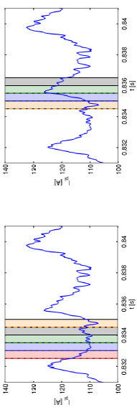
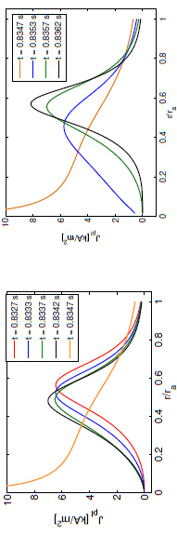
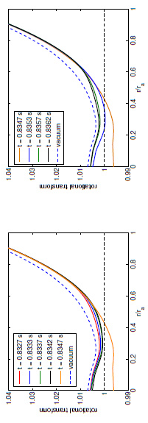
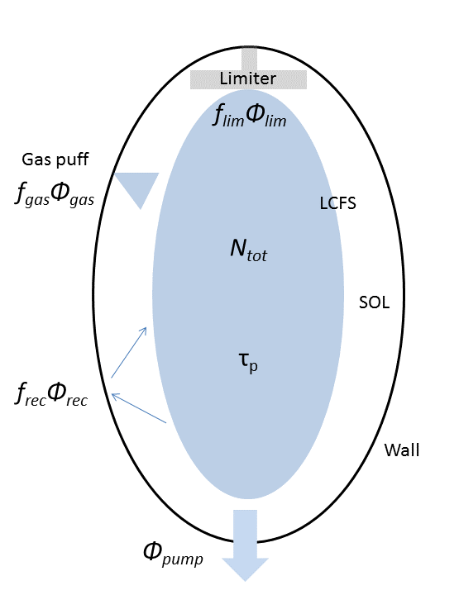
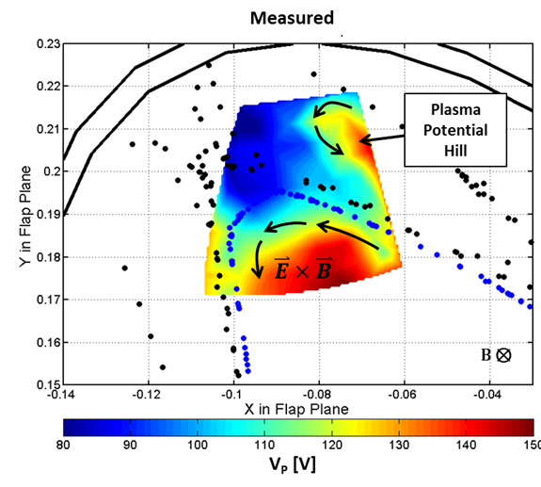
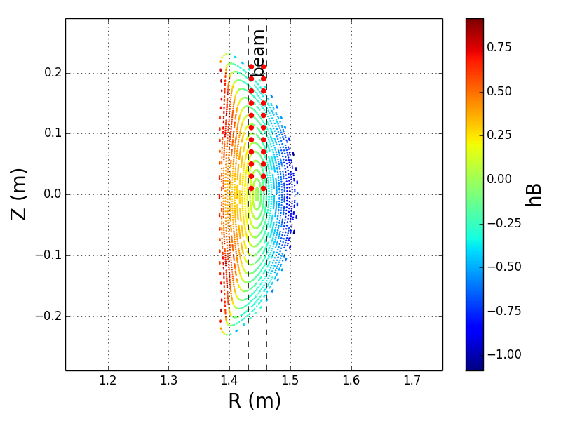
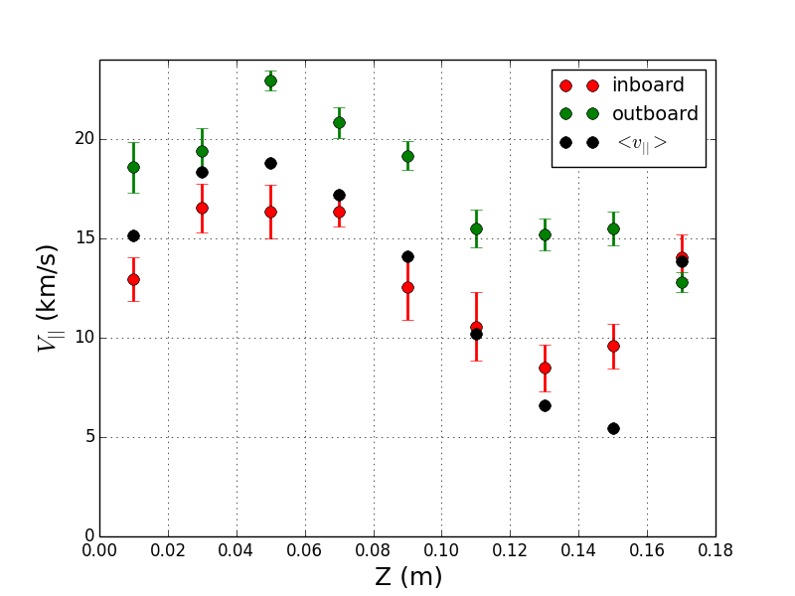
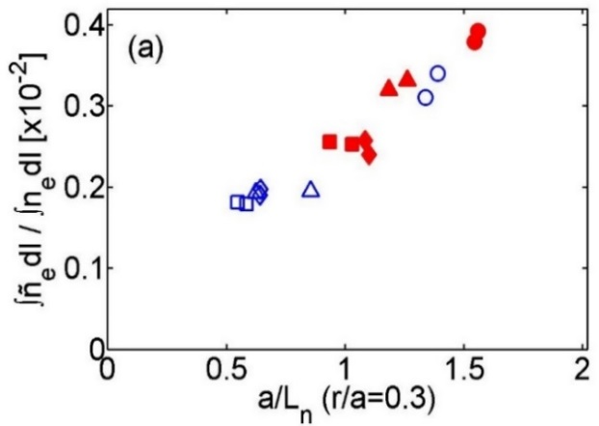
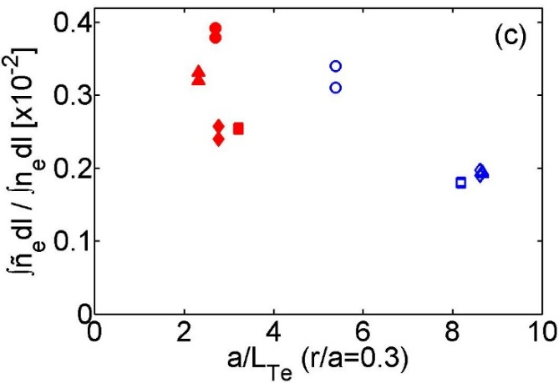
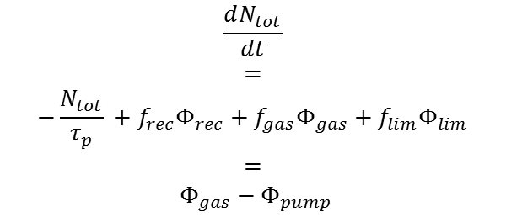

HSX Program Overview and Research Directions
F Simon B Anderson & the HSX Team
HSX Plasma Laboratory, Univ. of Wisconsin, Madison, USA
Overview
Equilibrium Reconstruction
Edge Transport and fueling
Current experimental program concentrated on 4 main areas: 1) turbulent transport, 2) equilibrium reconstruction, 3) plasma flows and electric fields and 4) edge transport and fueling.
  Heat pulse propagation experiment demonstrates lack of stiffness in heat transport, in agreement with non-linear GENE 3-D gyrokinetic calculations using two kinetic species
  Equilibrium reconstruction demonstrates evolution of bootstrap current, and bootstrap current generation of islands in Hill configuration.
  Improvement in neoclassical theory are being used to examine impurity effects on bootstrap currents and flows which will be compared to experiments.
  Differential counter-streaming Pfirsch-Schlüter parallel ion flow measurements provide a measure of E_{r} in the core.
  Motional Stark Effect polarimetry measurement of the radial electric field profile in HSX has begun.
  Edge studies show 2D density, flows and electric fields in edge island.
  Particle balance studies in a limiter configuration aim to examine the fueling, recycling and particle balance.
HSX plans focus on energetic ion confinement, ion root transport with hotter ions, turbulent transport mitigation through magnetics optimization and extensions to equilibrium reconstruction.
Theory and Modeling
Experiment
Theory and Modeling
Experiment
Optimized coil placement for bootstrap OR Pfirsch-Schlüter sensitivity
Spark used to model vessel eddy currents
V3FIT for reconstruction
Model Te, ne and plasma flow at edge with EMC3-EIRENE for different HSX magnetic configurations
Compare DEGAS neutral calculations to EIRENE and derive fueling efficiency (f) coefficients
Develop single reservoir model to quantify particle balance Stephey CP12.00084
2D contours of n_{e} , T_{e} , V|| and V_{p} measured in edge.
Electric fields measured within islands that are not included in EMC3-EIRENE model Akerson CP12.00085
Study neutral fueling and particle balance with limiter in HSX and W7-X Stephey CP12.00084
Significant reduced profile uncertainty
Eddy current modeling crucial for reconstruction
Bootstrap current evolution & rational surfaces reconstructed for Hill operation
$$\frac{dN_{tot}}{dt}$$
$$=$$
$$−\frac{N_{tot}}{τ_{p}} {{+ f}_{rec}Φ}_{rec}+{f_{gas}Φ}_{gas}+{f_{lim}Φ}_{lim}$$
$$=$$
$$Φ_{gas}−Φ_{pump}$$
Plasma Flow & Electric Fields
Theory and Modeling
Experiment
Turbulent Transport
Compare DKES and PENTA codes, both assume mono-energetic distribution, to SFINCS (Landreman) and FORTEC-3D (Satake) which do not. Smoniewski CP12.00083
Use SFINCS to model transport with impurities and flux-surface variation
Inboard/outboard CXRS measurement of Pfirsch-Schlüter flow indicates larger core Er than measured previously Kumar CP12.00080
Use Motional Stark Effect Polarimetry to measure Er profile directly Dobbins CP12.00082
HSX Directions
Theory and Modeling
Experiment
${\vec{V}}_{||}= \left(\frac{〈V_{||}B〉}{〈B^{2}〉}+\left(\frac{1}{enZ}\frac{dp}{dΨ}+\frac{dΦ}{dΨ}\right)h\right)\vec{B}$
  Explore feasibility of optimizing magnetics for reducing turbulent transport
    Builds on quasisymmetric topology which is optimized for improved neoclassical transport
Increase ion temperature with 20kV 10ms neutral beam -- H or D
  Study fast ion confinement with injection into high T_{e} plasma through D-D neutron production
  Explore transport dependence on E_{r} in electron- and ion-root plasmas
Bootstrap evolution current profile reconstruction comparisons to model
  Examine Zeff and impurity injection effects on currents and current profiles – Laser Blowoff
Improved fluctuation diagnostic capabilities for direct comparison to GENE turbulence predictions
  Heterodyne interferometer for spatial density resolution, k resolution
  Collective scattering upgrade to extend k sensitivity
  Doppler reflectometer for density fluctuations and plasma rotation measurements
  Correlated ECE for T_{e} fluctuation spectrum as related to n_{e} fluctuations
Higher density operation with neutral source control and different fueling - SGI
  Higher density core plasma and interface to scrape-off layer
  Study impurity transport and exhaust in ion root E_{r}
GENE non-linear calculations confirm experimental lack of stiffness in core.
Pulse propagation experiments demonstrate transport is not stiff in core.
Interferometer measurements of density fluctuations show increase with decreasing L_{n} (off-axis heating), consistent with TEM drive Deng CP12.00081
Pfirsch-Schlüter factor
Measured parallel ion flow
10
TEM1
Exp
_{/Q}GB
e e
TEM2
Q
ETG1
0.1
0.01
0
1
2 3
a/L
4
5
Te

