Slide 1
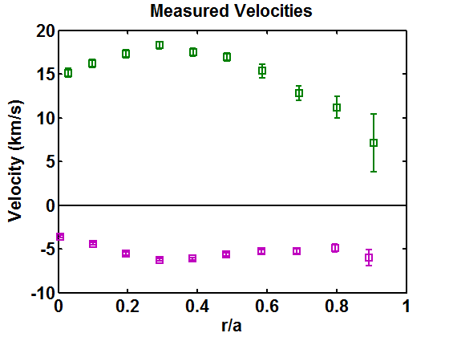
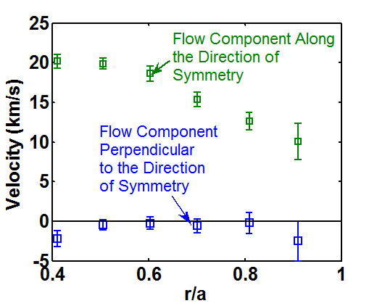
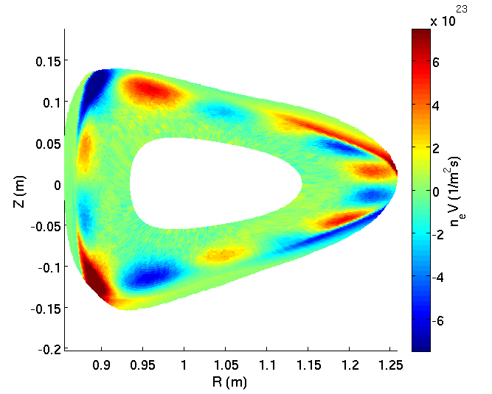
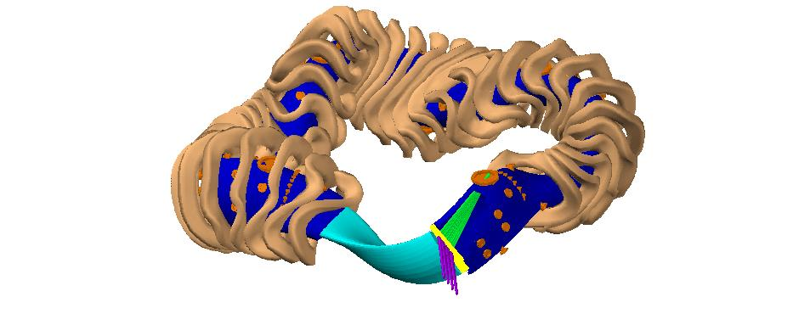
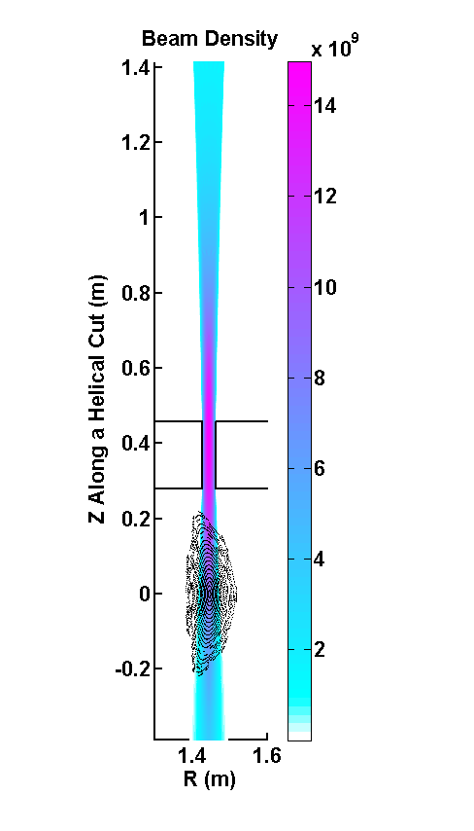
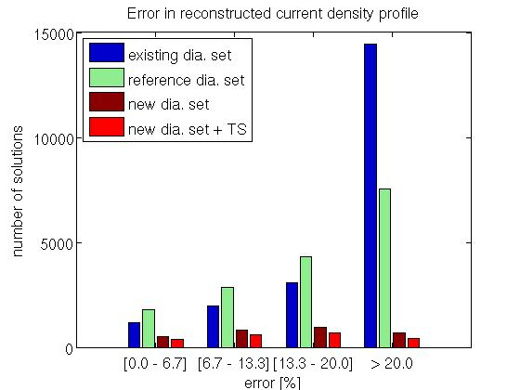
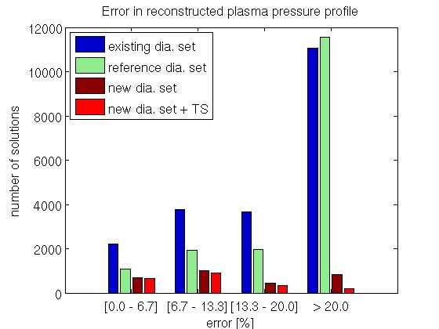
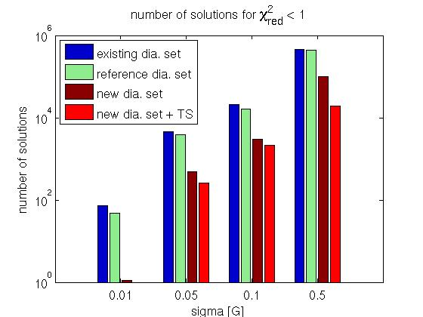
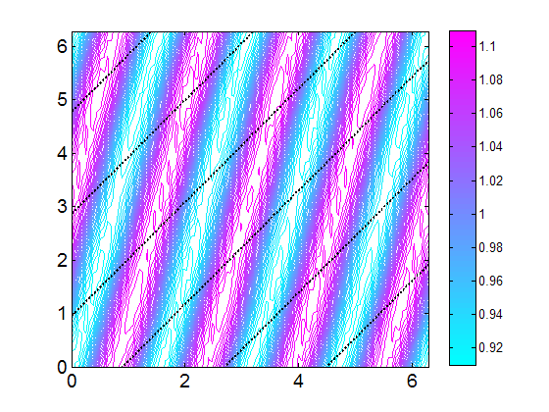



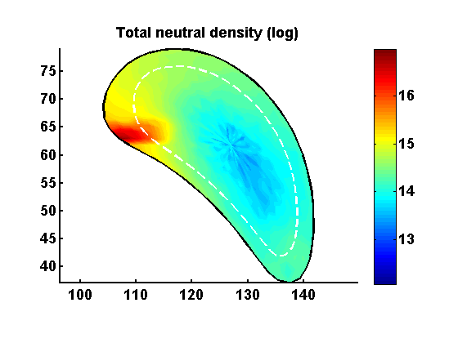
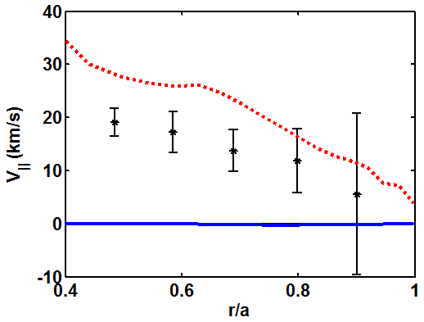
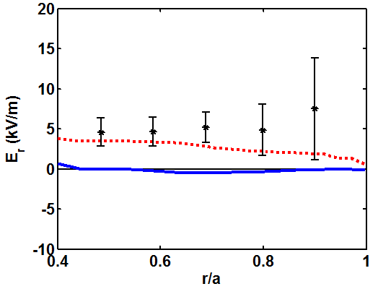



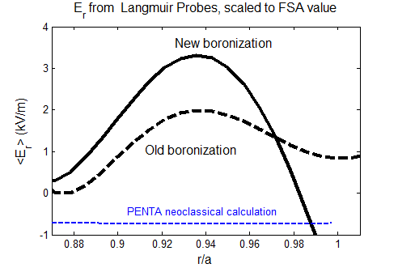
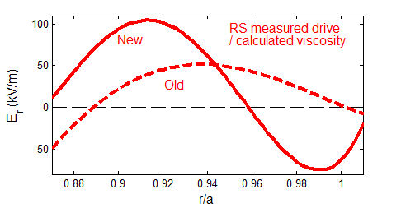
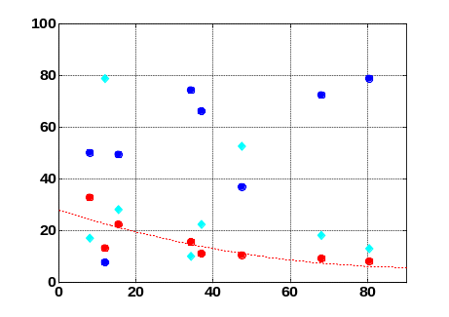
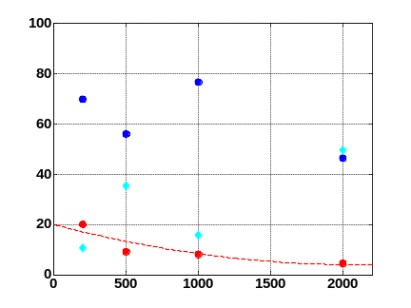
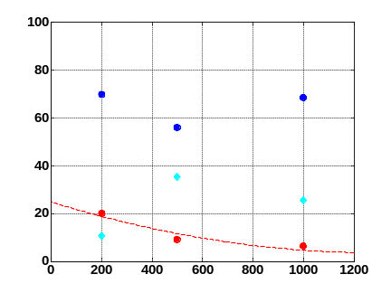
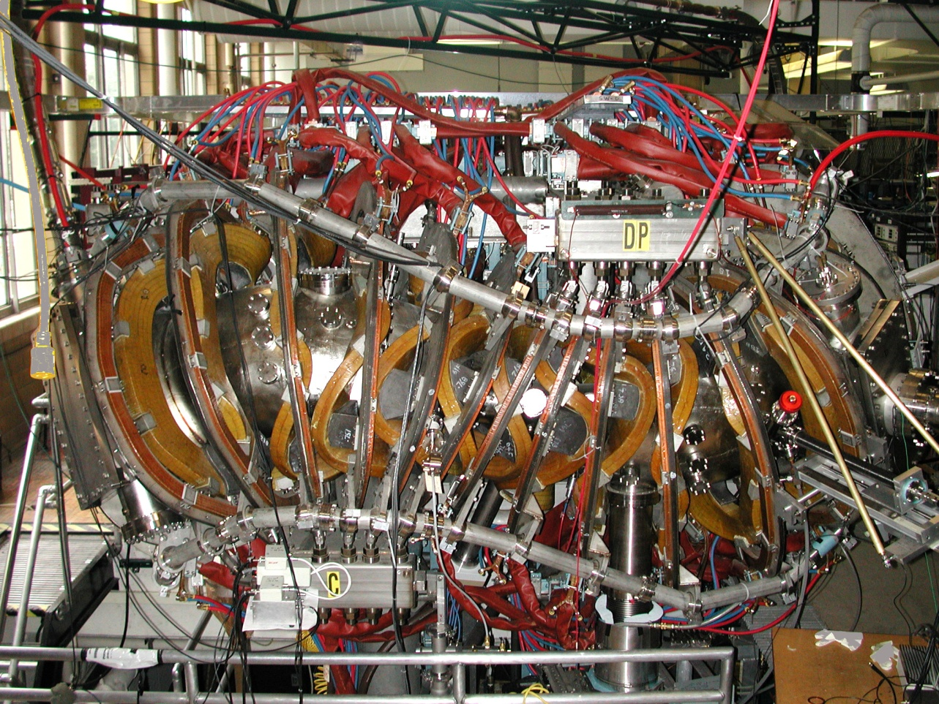
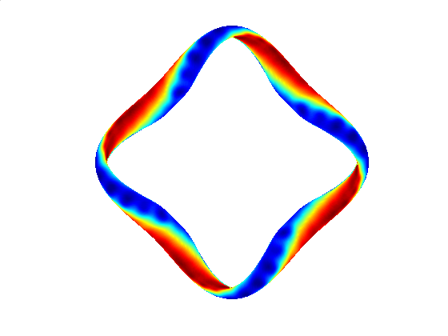
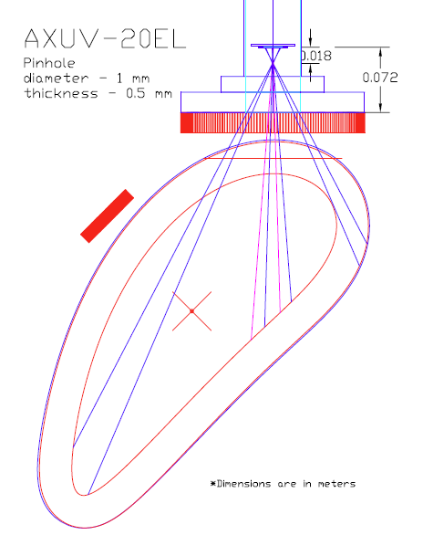
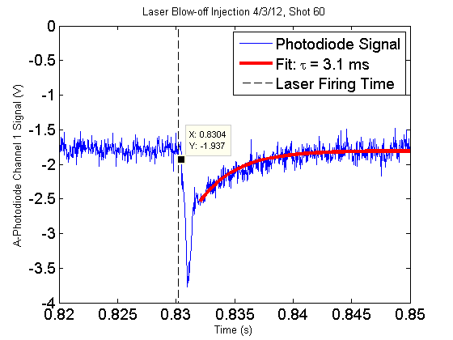
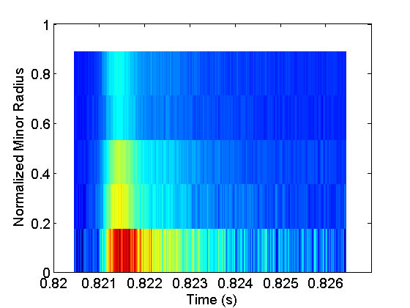

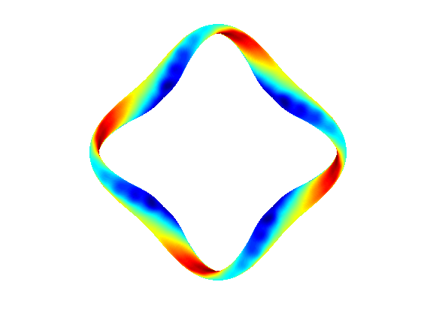
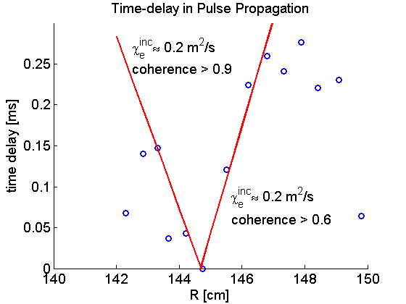
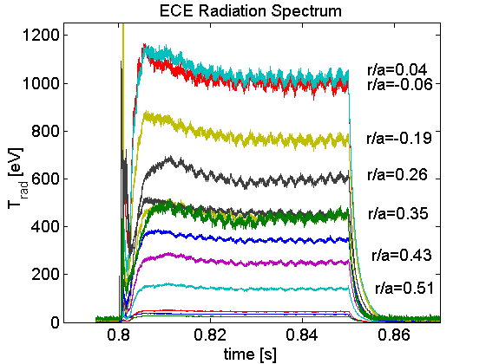
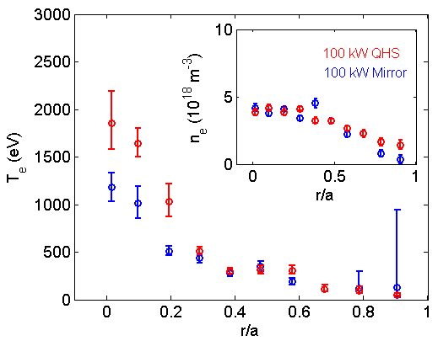
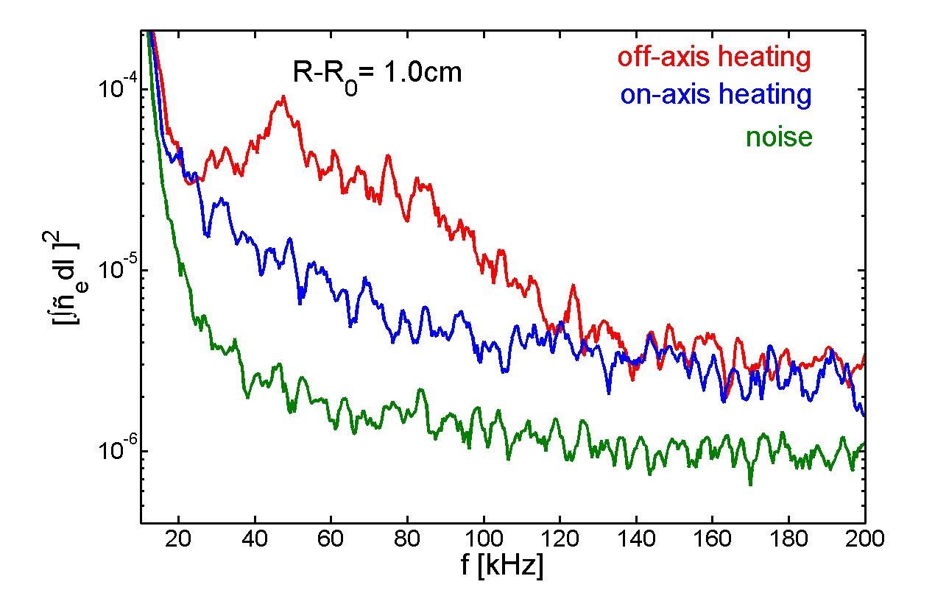
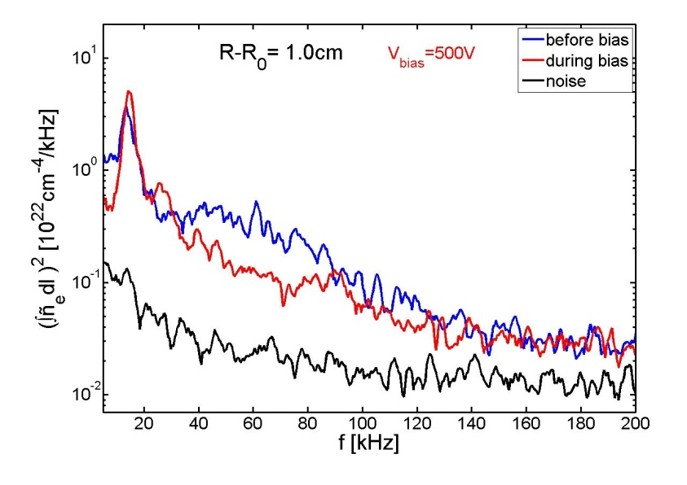
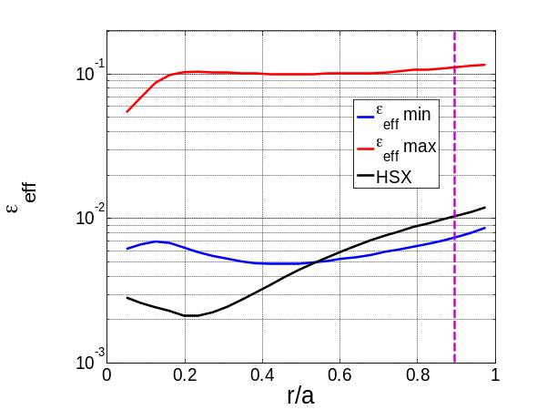
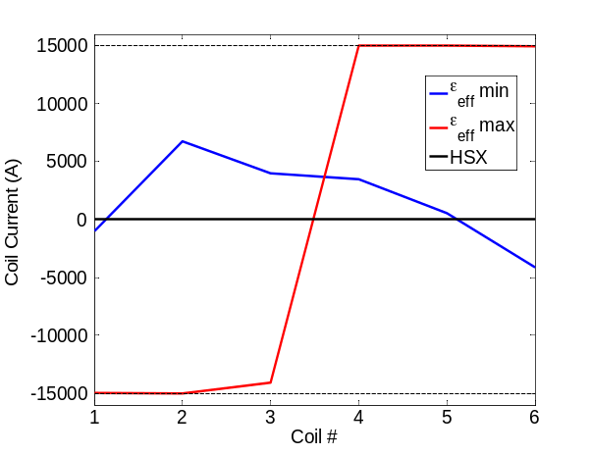
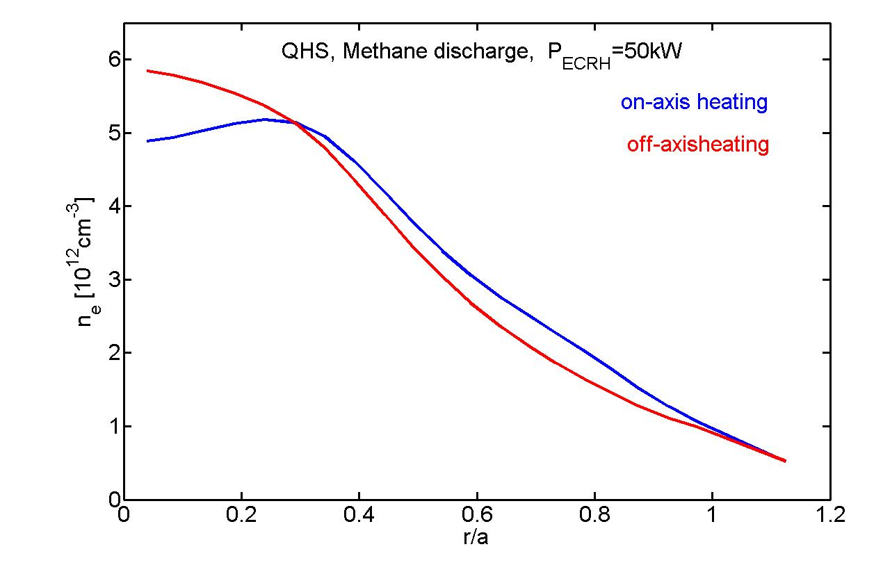
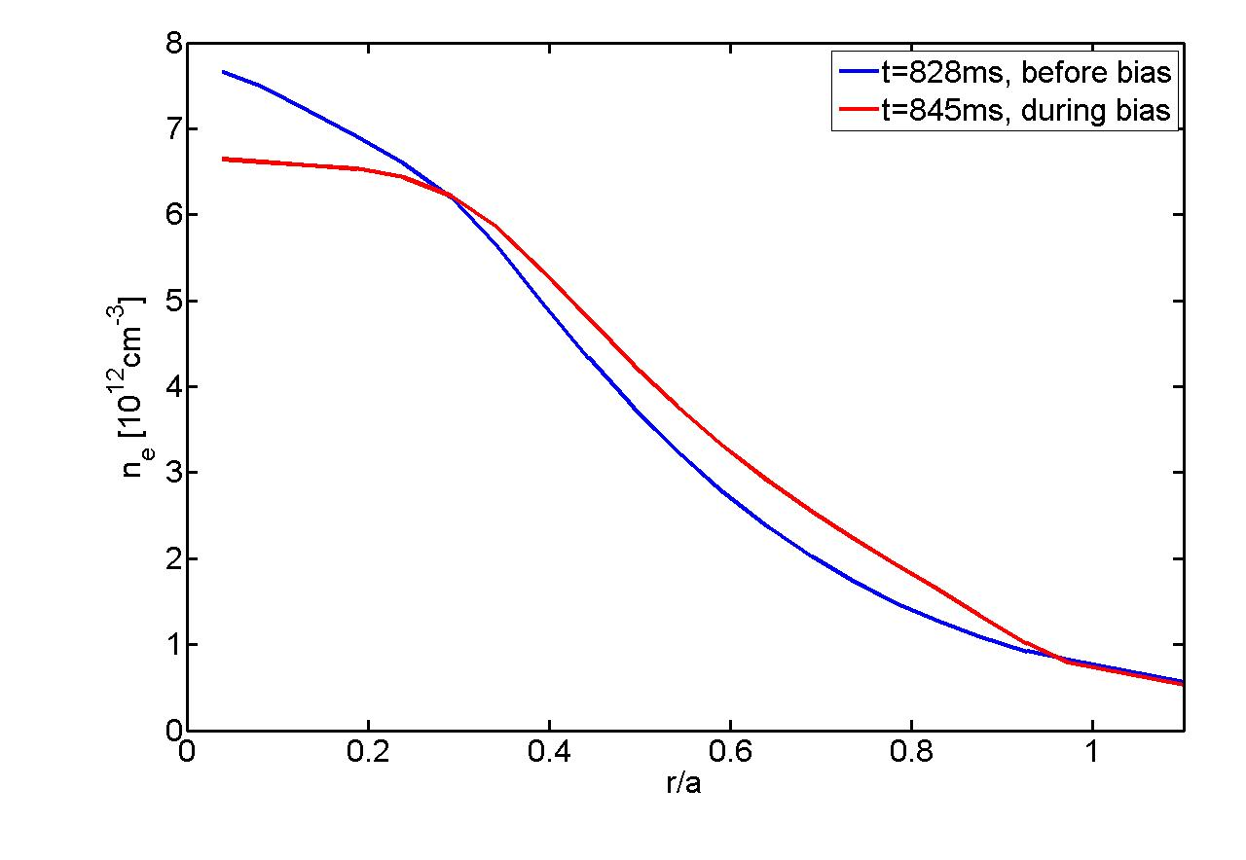

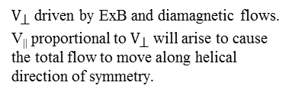

Overview and New Directions in the HSX Program
F.S.B Anderson, D.T. Anderson, A. Akerson, A.R. Briesemeister, A. Bader, D. Brower¹, E. Chlechowitz, C. Clark, C. Cook, C. Deng¹ K.M. Likin, J. Radder, J. Smoniewski, L. Stephey, J.N. Talmadge, G. Weir, R. Wilcox
HSX Plasma Laboratory, Univ. of Wisconsin, Madison, USA 1. UCLA
Overview
Intrinsic flow measurements and neoclassical modeling
(invited talk by A. Briesemeister)
Plasma equilibrium reconstruction (poster by E. Chlechowitz)
Divertors and fueling (posters by A. Bader & L. Stephey)
Neoclassical transport in qhs
Large intrinsic flows have been measured by CHERS in the direction of symmetry. E_{r} and flows modeled with PENTA which corrects DKES for momentum conservation in the collision operator.
Impurity transport experiments have begun using laser blow-off.
A second ECRH system with beam steering and modulation is now operational and being used for heat pulse propagation studies.
Previous equilibrium reconstruction and fluctuation studies are being extended through optimized diagnostics.
Fluctuations and turbulence
Edge probe measurements show the Reynolds stress may play an important role in the edge poloidal momentum balance.
Central coherent density fluctuations appear for off-axis ECRH power deposition.
Edges and fueling
Improved H-alpha diagnostics and fueling systems are being installed to better understand neutral transport. This is carried out with comparisons between DEGAS and EMC3-EIRENE.
These codes are being applied to guide new experimental studies of the divertor structure, and divertor flows, in HSX.
Ion heating and particle confinement
The GNET 5D Fokker-Planck code is being used to study both confinement of energetic ions produced by ICRH heating, and non-Maxwellian distribution function effects on SX and ECE measurements with high power density ECRH.
Calculations are underway to determine and possibly test elements in the magnetic structure critical for energetic particle confinement.
CHERS diagnostic
Velocity Measured By Each View
Velocity Along and Across the Symmetry Direction
Investigate MHD equilibrium properties via plasma reconstruction using the V3FIT code, experimental data and modeled signal responses
Magnetic diagnostic upgrade for improved reconstruction by solution reduction and improved signal-to-noise ratio
Calculations used to find most sensitive diagnostics relative to measured equilibrium currents
DIVERTORS and EDGE STRUCTURES
EMC3 predicts the existence of measurable flows around remnant island structures in the HSX SOL.
Islands give rise to counter-streaming ion flows in the edge which are thought to degrade edge performance in stellarators such as W7-AS.
Flow strength and location can be altered significantly with external coils, providing a testable basis for code validation.
Measurements of flows around the islands in the edge of HSX are underway
FUELING
DEGAS has been upgraded to simulate a supersonic gas injector (SGI) in HSX
Simulations indicate an improved fueling efficiency
HSX is upgrading to use a SGI fueling ystem, and increasing the toroidal number of H-alpha arrays
EMC3 calculation of n_{e}V|| in HSX
30keV, 4Amp, 3ms hydrogen neutral beam
“Toroidal” Views
Neutral Beam
“Toroidal” Views
Neutral Beam
Poloidal View
“Poloidal” Views
“Poloidal” Views
|B| and Velocity in HSX
Intrinsic flows of up to 20 km/s have been observed.
These flows are in the direction of symmetry of the quasisymmetric field.
θ_{Boozer}
V┴
V
V||
${\text{V}}_{\text{⊥}}$ driven by ExB and diamagnetic flows.
V|| proportional to ${\text{V}}_{\text{⊥}}$ will arise to cause the total flow to move along helical direction of symmetry.
SGI
PENTA corrects DKES for momentum conservation in collision operator
Applicable to symmetric (quasi-symmetric stellarator and tokamak) through non-symmetric (classical stellarator) devices
E_{r} is found by enforcing ambipolarity
Differences between the E_{r} from PENTA and DKES become significant when there are multiple ion species in the calculation
Momentum conservation is required for modeling to predict flows of this level
B
ζ_{Boozer}
Z(cm)
Measured and Calculated V||
Measured and Calculated E_{r}
Effect of Reynolds stress on momentum balance
(poster by R. Wilcox)
PENTA
Measured
R(cm)
Measured
PENTA
Measurements with both Langmuir probes and CHERS indicate that E_{r} deviates from neoclassical calculations which calculate particle flux and enforce the ambipolarity condition
A 5-pin Langmuir probe measures floating potential to infer and and differential ion saturation current configured as a mach probe for V||
Reynolds stress drive calculated from fitted measurement curve and calculated poloidal viscosity, including approximate neoclassical and neutral damping terms
Local measurements of Reynolds stress indicate a flow drive corresponding qualitatively to the deviation in the measured radial electric field
ICH and ion confinement (poster by K.M. Likin)
With ECRH the ion temperature in HSX remains low (< 100 eV) compared to the electron temperature (~ 2 keV)
With hot ions (a few hundred eV) the difference between quasi-symmetric and conventional stellarator configurations may be more pronounced
Low ion collisionality regime becomes accessible
The GNET code can predict (1) efficiency of ion cyclotron resonance heating (ICRH); (2) fast ion confinement; (3) charge-exchange losses; (4) ion confinement in different magnetic configurations
DKES
DKES
The HSX device
Impurity transport through laser blow-off (poster by C. Clark)
Efficiency vs. Power
Efficiency vs. T_{e}
Efficiency vs. T_{i}
Impurity radiation detected with full spectrum and AXUV photodiode arrays
  Two arrays installed on HSX, 5 under construction
The transport code STRAHL solves the 1-D continuity equation for each impurity charge state, including the source and sink terms due to ionization and recombination from adjacent charge states
STRAHL, in conjunction with a nonlinear optimization routine, will be used to determine the impurity convective velocity and diffusivity from the time dependent emissivity profiles
CX
Major Radius | 1.2 m
Minor Radius | 0.12 m
# Field Periods | 4
Coils/Field Period | 12
Transform Effective transform ( N- mι ) | 1.05 →1.12 ~ 3
Magnetic Field | 1.0 T
ECH Power (75 ms) | 2 x 100kW 28 GHz
ε_{eff} at r/a = 2/3 | QHS : 0.005 Mirror : 0.04
η / CX / orbit loss (%)
CX
CX
QHS
Efficiency
η / CX / orbit loss (%)
Orbit Loss
η / CX / orbit loss (%)
Orbit Loss
Orbit Loss
ICRH Efficiency
ICRH Efficiency
Quasi-helical symmetry in |B|
P_{abs} (kW)
T_{e} (eV)
T_{i} (eV)
AXUV-20EL
Inverted Emissivity profile
Modulated ECH experiments (poster by G. Weir)
HSX Magnetic configuration studies (poster by J.N. Talmadge)
A second 100 kW / 28 GHz ECRH system has been installed and tested, doubling the heating capacity of HSX and allowing modulated heating experiments.
Modulated heating experiments are used to determine the electron thermal diffusivity from the dynamic response of the electron temperature using the Electron Cyclotron Emission (ECE) diagnostic.
Initial measurements yield an incremental thermal diffusivity consistent with the power-balance value in the core of HSX and consistent with other stellarator results.
Goal is to vary magnetic configuration using auxiliary coils and minimize or maximize target physics parameters: effective ripple, energetic particle confinement or bootstrap current. Then, test this capability experimentally.
Initial optimization runs show that the effective ripple can be decreased with the auxiliary coils, but difficult to decrease energetic trapped particle losses at the core.
The [n,m] = [48,0] component of the magnetic field spectrum, due to the 48 modular coils, leads to large trapped alpha particle losses in an HSX reactor. Doubling the number of coils reduces this loss.
Minimization of effective ripple does not lead to optimized alpha particle confinement.
Pinhole
Channel 1
HSX has a helical axis of symmetry in |B|, low magnetic field ripple, high effective transform, and very low toroidal curvature
  Reduction of direct loss orbits
  Improved neoclassical transport
For experimental flexibility, the quasi-helical symmetry can be broken by adding a mirror field.
Mirror
Separatrix
Channel 20
Vessel
Quasisymmetry broken-Similar volume, ι , well, shear
Fluctuation studies (poster by C. Deng)
$$χ^{PB}<0.3$$
Optimization of ε_{eff} at r/a = 0.9
Core density fluctuation spectrum is affected by:
ECRH heating location. - Density peaks while temperature drops
Applied bias @r/a=.7 - Density flattens and broadens
Basic plasma profiles for ECH plasmas

