Slide 1
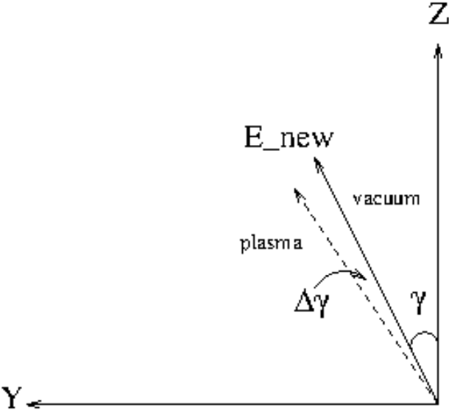
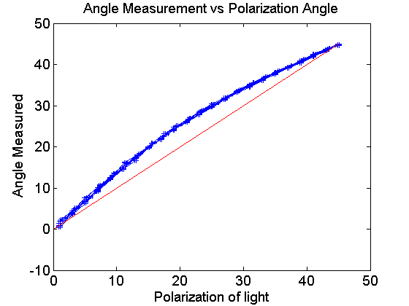
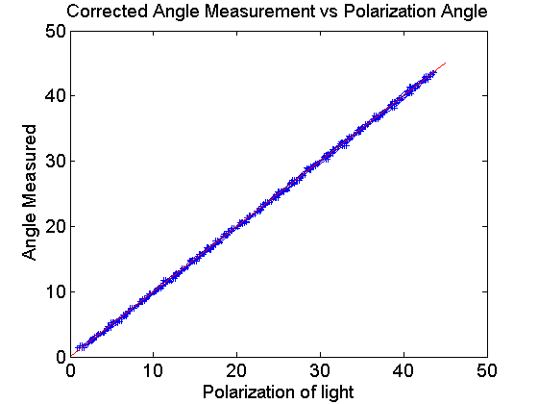
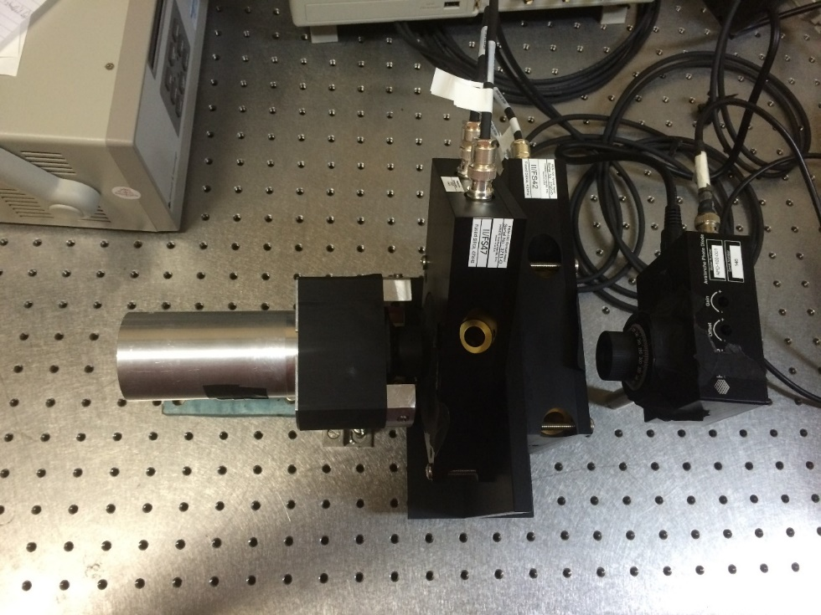
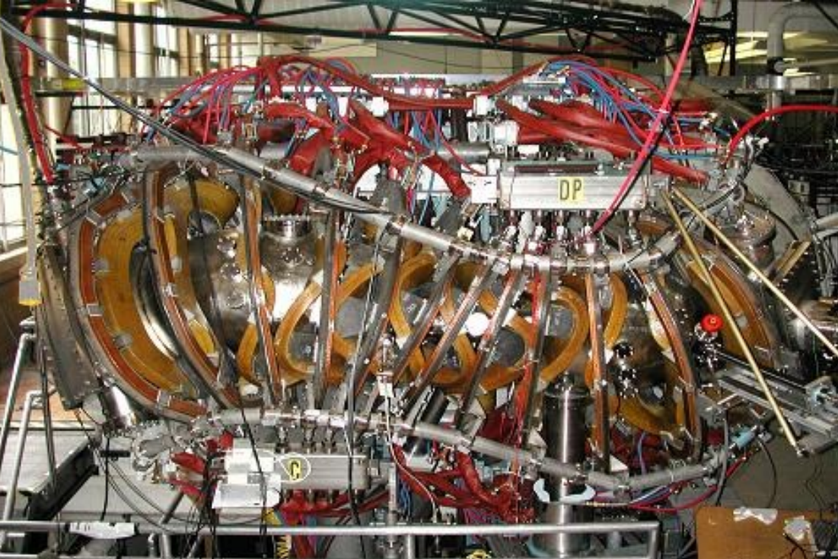
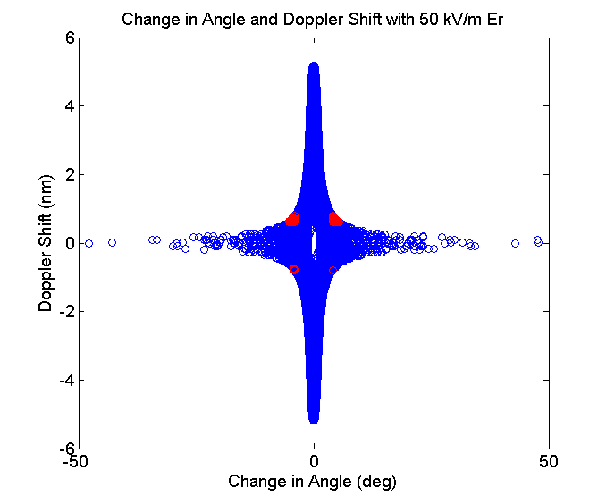
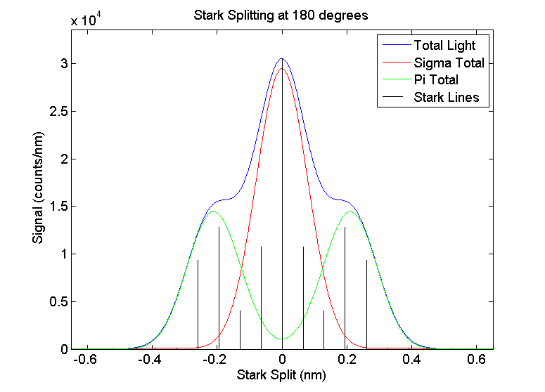
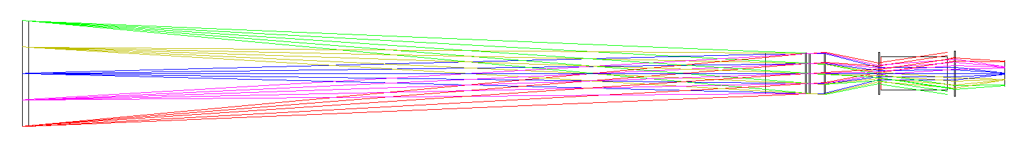
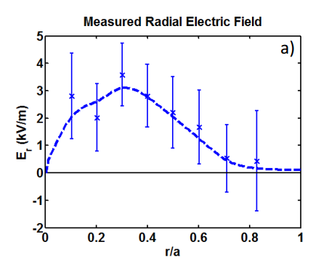
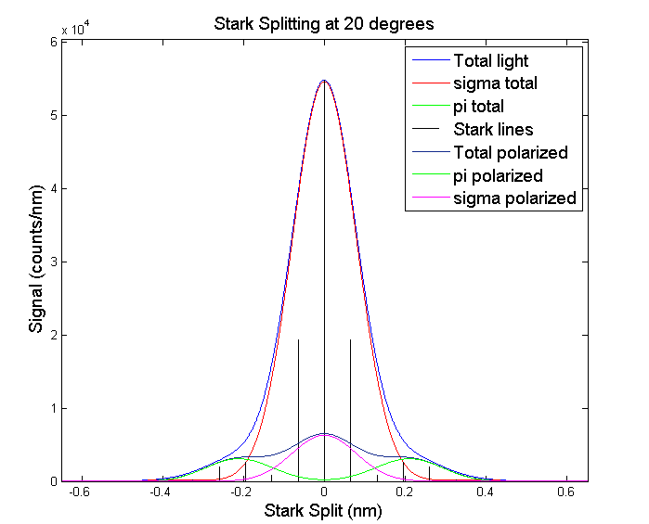
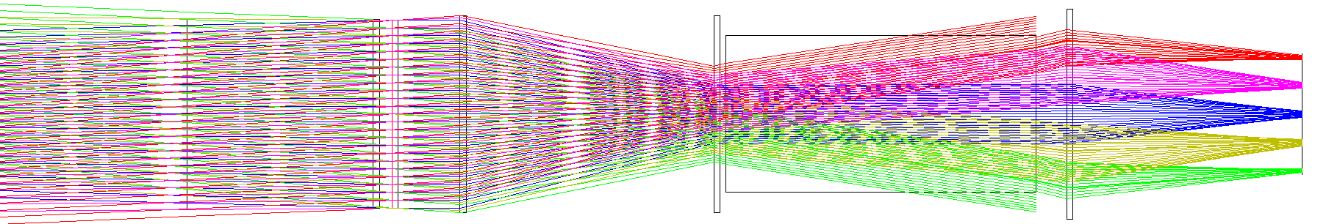
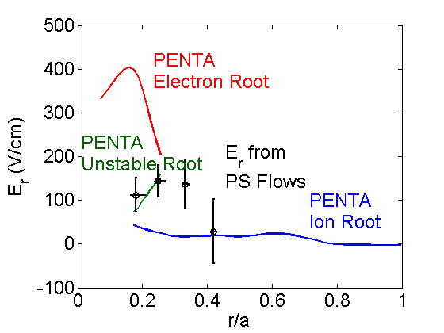
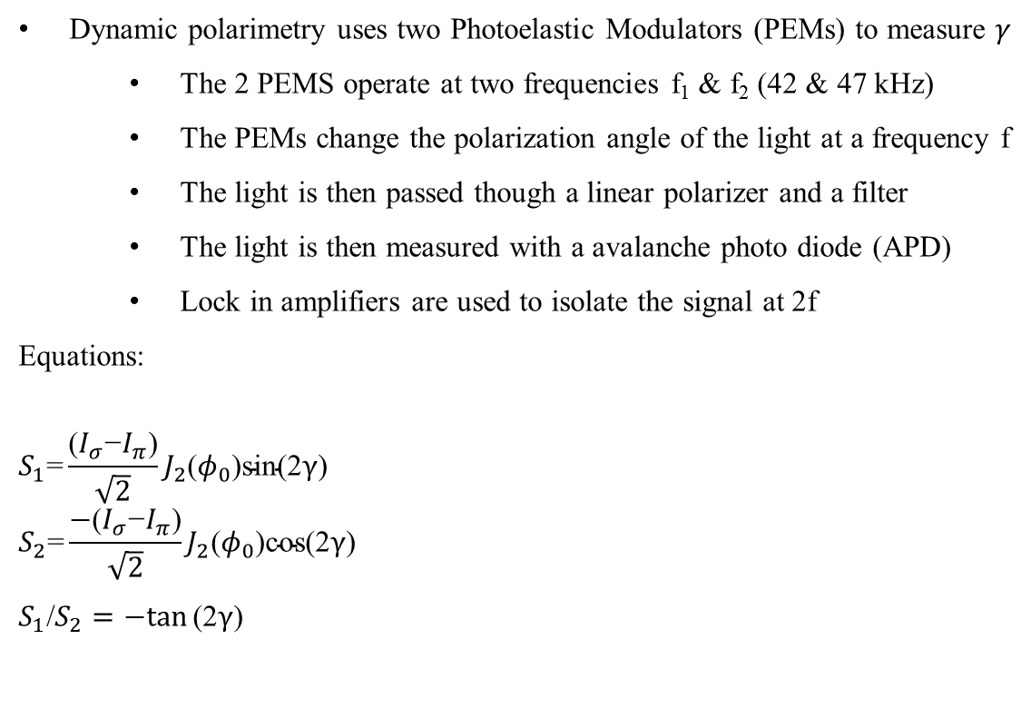
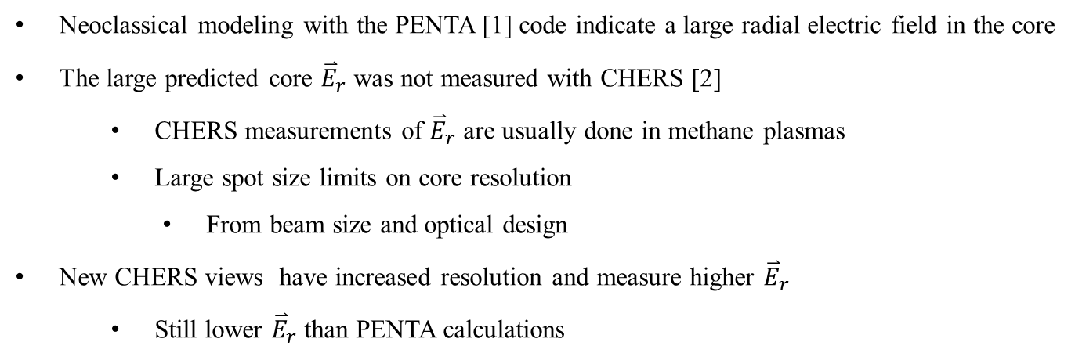
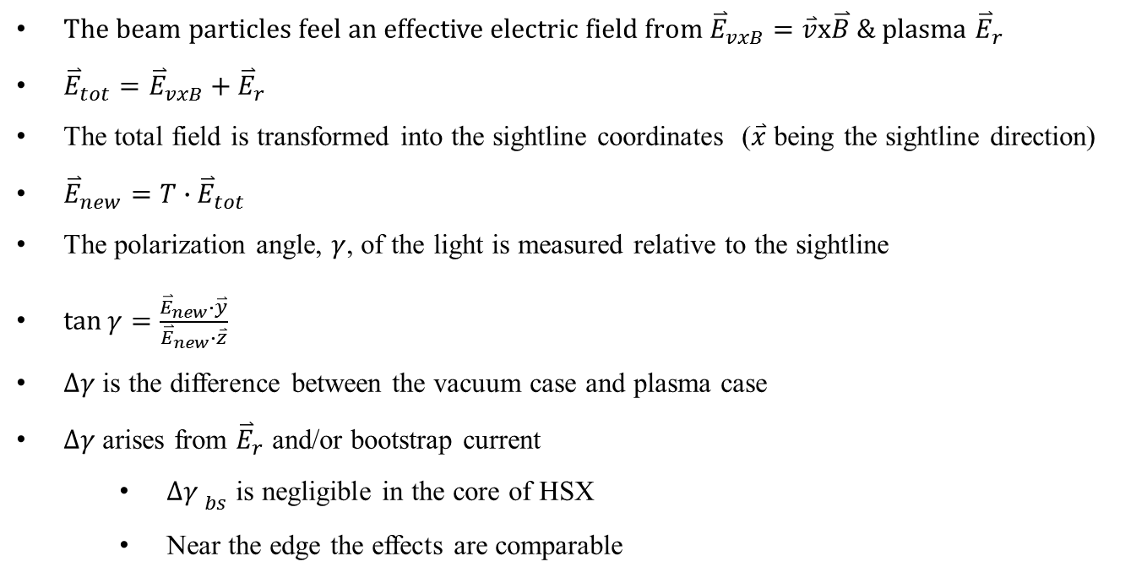
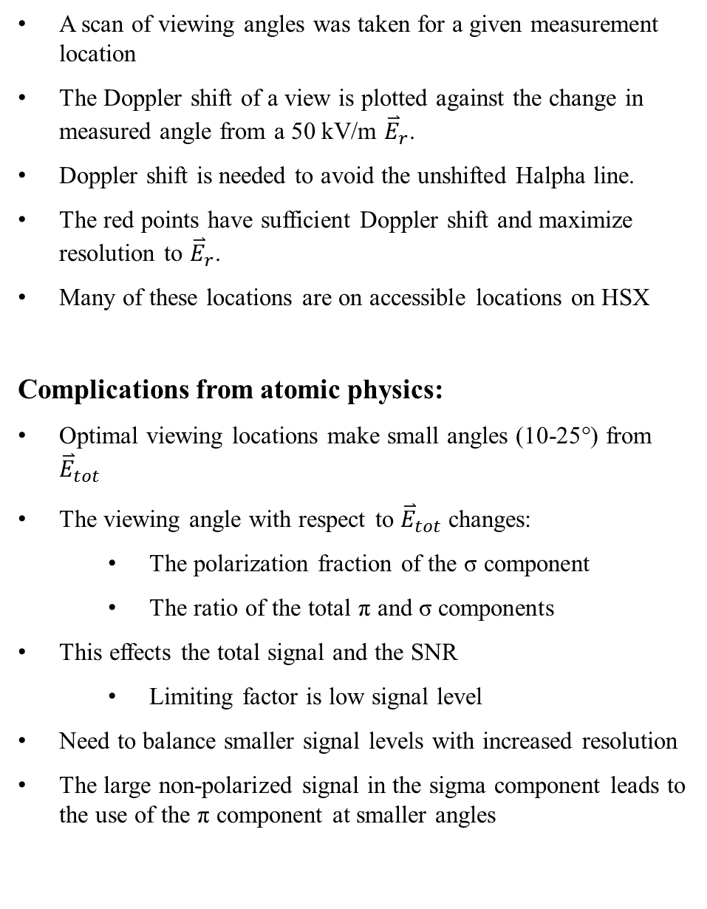
The design of a MSE polarimetry diagnostic for the measurement of radial electric fields on the HSX stellarator
T. Dobbins, S. T. A. Kumar, D. T. Anderson, F. S. B. Anderson HSX Plasma Laboratory, University of Wisconsin, Madison
Overview
MSE Polarimetry Overview
Design & Testing
Abstract
The beam particles feel an effective electric field from ${\overset{⃑}{E}}_{vxB}=\overset{⃑}{v}x\overset{⃑}{B}$ & plasma ${\overset{⃑}{E}}_{r}$
${\overset{⃑}{E}}_{tot}={\overset{⃑}{E}}_{vxB}+{\overset{⃑}{E}}_{r}$
The total field is transformed into the sightline coordinates ($\overset{⃑}{x}$ being the sightline direction)
${\overset{⃑}{E}}_{new}={T∙\overset{⃑}{E}}_{tot}$
The polarization angle, $γ$, of the light is measured relative to the sightline
$\tan{γ}=\frac{{\overset{⃑}{E}}_{new}∙\overset{⃑}{y}}{{\overset{⃑}{E}}_{new}∙\overset{⃑}{z}}$
$∆γ$ is the difference between the vacuum case and plasma case
$∆γ$ arises from ${\overset{⃑}{E}}_{r}$ and/or bootstrap current
  $∆{γ }_{bs}$ is negligible in the core of HSX
  Near the edge the effects are comparable
Hardware
Calibration
Neoclassical codes estimate a large positive radial electric field (40-50 kV/m) near the core of HSX
Impurity ion flow measurements could not resolve this large electric field.
A MSE polarimetry diagnostic has been designed for the HSX stellarator to directly measure the radial electric field near the core of the plasma
The design has been optimized to get a maximum change in polarization angle from a radial electric field with good spatial resolution.
The diagnostic design and initial characterization are presented
Dynamic polarimetry uses two Photoelastic Modulators (PEMs) to measure $γ$
  The 2 PEMS operate at two frequencies f₁ & f₂ (42 & 47 kHz)
  The PEMs change the polarization angle of the light at a frequency f
  The light is then passed though a linear polarizer and a filter
  The light is then measured with a avalanche photo diode (APD)
  Lock in amplifiers are used to isolate the signal at 2f
Equations:
$$S_{1}\text{=}{\frac{\text{(}I_{σ}\text{−}I_{π}\text{)}}{\sqrt{2}}J}_{2}\text{(}φ_{0}\text{)}\text{sin}\text{(2}γ\text{)}$$
$$S_{2}\text{=}{\frac{\text{−}\text{(}I_{σ}\text{−}I_{π}\text{)}}{\sqrt{2}}J}_{2}\text{(}φ_{0}\text{)}\text{cos}\text{(2}γ\text{)}$$
$S_{1}$/$S_{2}=−tan⁡\text{(2}γ$)
Two lock in amplifiers are used to measure the 2f frequencies of the two PEMS
The relative gain on the lock-in amplifiers is calibrated out
A known input polarization angle is compared to the output angle
A linear relative gain factor is applied to the ratio of signals to minimize the deviation from a one to one correlation in angle
HSX & Beam Parameters
PEMs & APD
HSX
<R> | 1.2 m
<a> | .12 m
<n_{e}> | 1-4*10¹⁸/m³
T_{e} | 0.5-2.5 keV
T_{i} | 30-60 eV
B₀ | 1 T
ɩ | 1.05-1.12
HSX Neutral Beam
E_{b} | 30 keV
I_{b} | 4 A
Time | 3 ms
Species | Hydrogen
Full energy component | ~80-90%
Beam radius | ~1.5 cm
Optimization
A scan of viewing angles was taken for a given measurement location
The Doppler shift of a view is plotted against the change in measured angle from a 50 kV/m ${\overset{⃑}{E}}_{r}$.
Doppler shift is needed to avoid the unshifted Halpha line.
The red points have sufficient Doppler shift and maximize resolution to ${\overset{⃑}{E}}_{r}$.
Many of these locations are on accessible locations on HSX
Complications from atomic physics:
Optimal viewing locations make small angles (10-25°) from ${\overset{⃑}{E}}_{tot}$
The viewing angle with respect to ${\overset{⃑}{E}}_{tot}$ changes:
  The polarization fraction of the σ component
  The ratio of the total π and σ components
This effects the total signal and the SNR
  Limiting factor is low signal level
Need to balance smaller signal levels with increased resolution
The large non-polarized signal in the sigma component leads to the use of the π component at smaller angles
PEM
APD
Future Plans & Summary
Future Work
HSX Radial Electric Field
Optical Design
1. Complete the calibration of the PEM/lockin system
2. Calibrate the tunable filter used to isolate the π or σ components
3. Machine the new ports
4. Calibrate the complete system using beam into gas shots with the magnets
Neoclassical modeling with the PENTA [1] code indicate a large radial electric field in the core
The large predicted core ${\overset{⃑}{E}}_{r}$ was not measured with CHERS [2]
  CHERS measurements of ${\overset{⃑}{E}}_{r}$ are usually done in methane plasmas
  Large spot size limits on core resolution
    From beam size and optical design
New CHERS views have increased resolution and measure higher ${\overset{⃑}{E}}_{r}$
  Still lower ${\overset{⃑}{E}}_{r}$ than PENTA calculations
Several views planned per port (e.g. r/a=.1,.15, .2)
Only one filter, APD, and pair of lock-ins are currently available
  limits collection to one view at a time
ZEMAX modeling of the collection optics
Summary
Neoclassical codes predict a large radial electric fields in the core of HSX
A new MSE diagnostic has been designed to directly measure E_{r}
Optimized to measure E_{r} in the core
Calibrations are currently in progress
Beam viewing locations Port and collection optics
E_{r} from new CHERS Views & PENTA Calculations E_{r} from CHERS Views
References
[2]
[1] D.A. Spong, Phys. Plasmas 12 (2005) 056114; J. Lore at al., Phys. Plasmas 17 (2010) 056101
[2] Briesemeister, Alexis R. "Measurement and Modeling of the Flows and Radial Electric Field in the HSX Stellarator." (2013).
This work is supported by US DOE Grant DE-FG02-93ER54222
Port focusing optics PEMS collection optics

