Slide 1
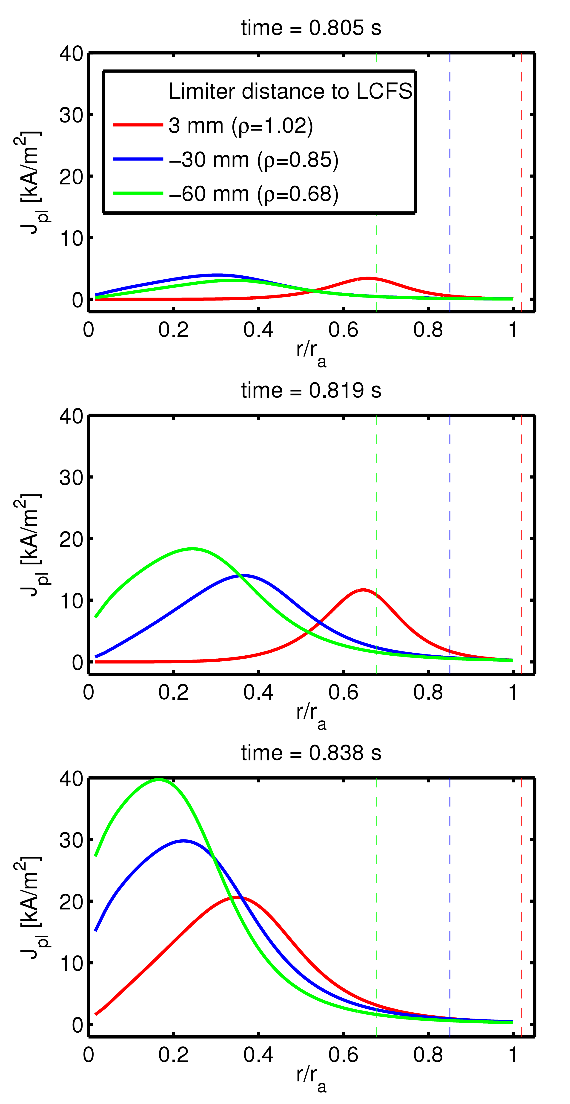
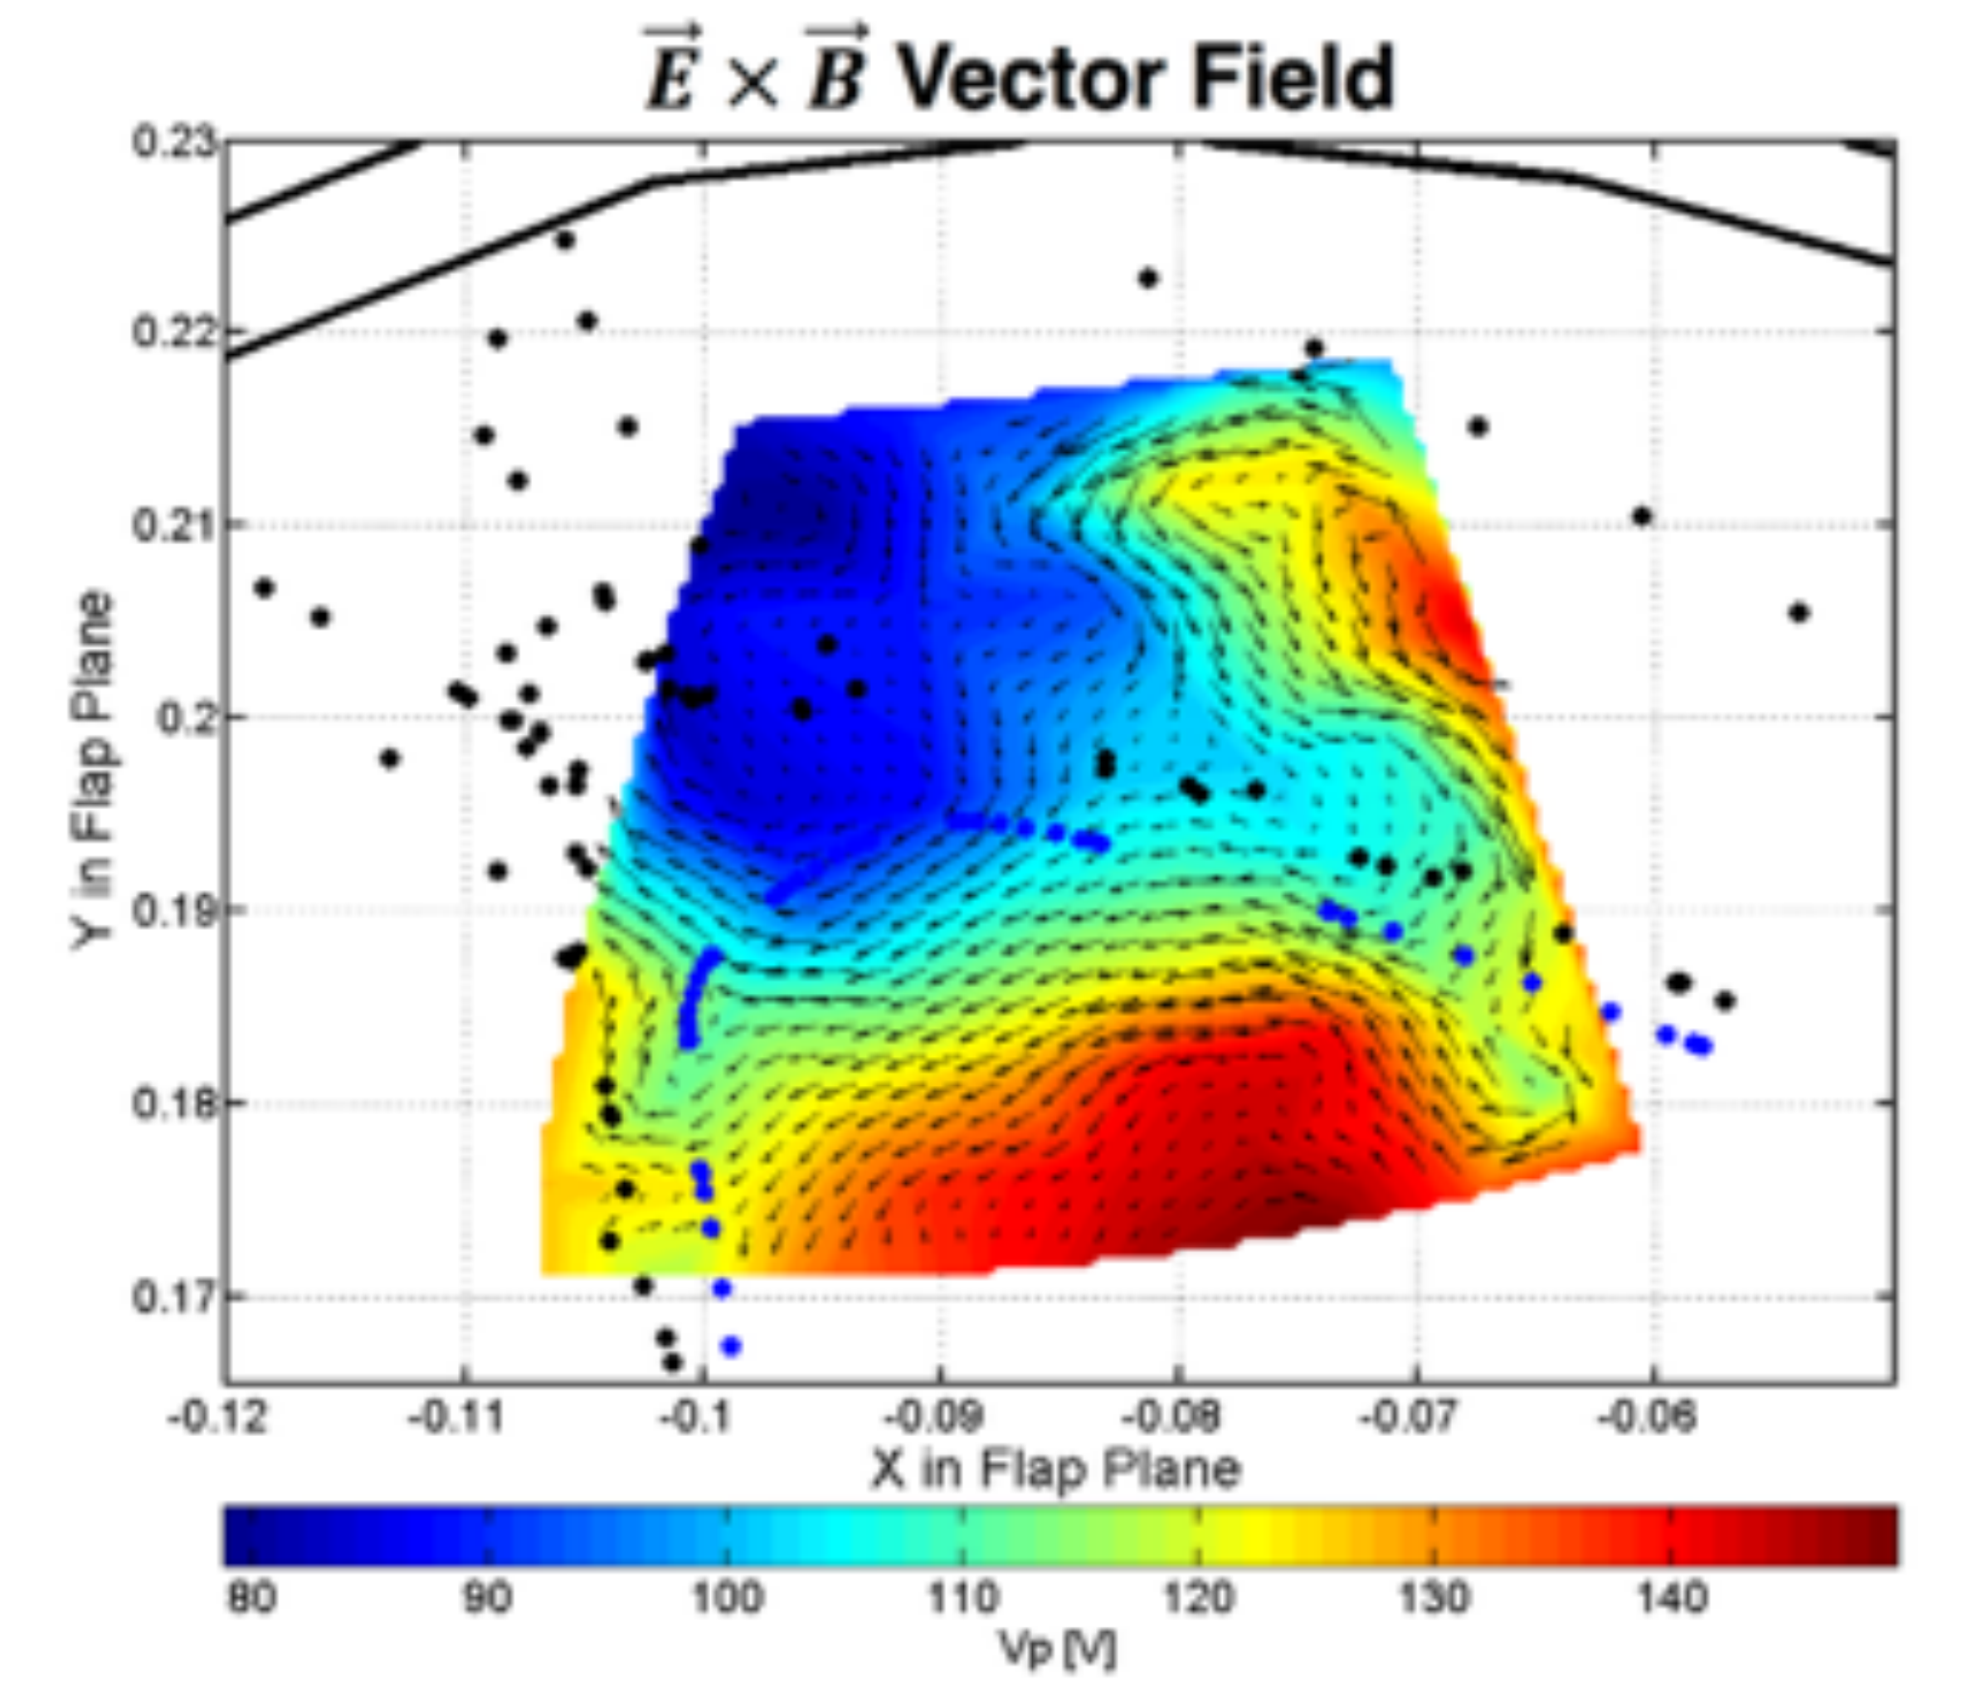
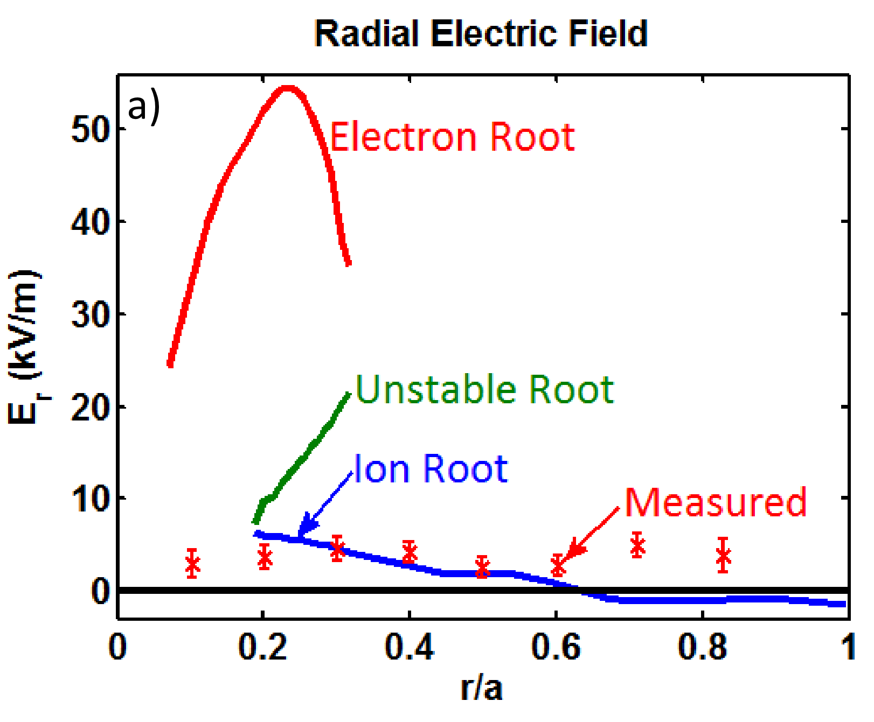
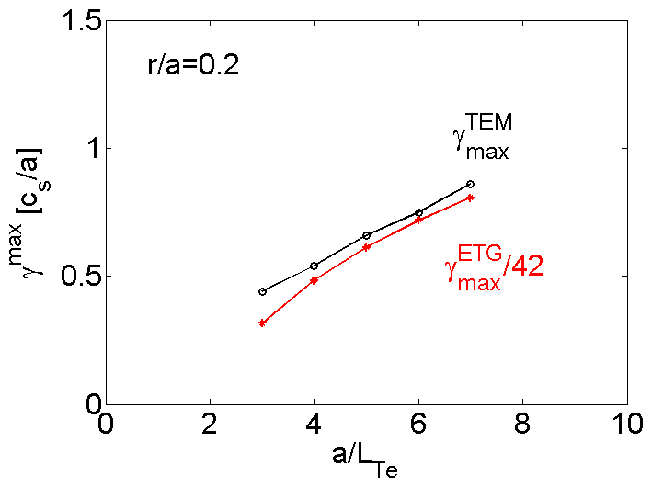
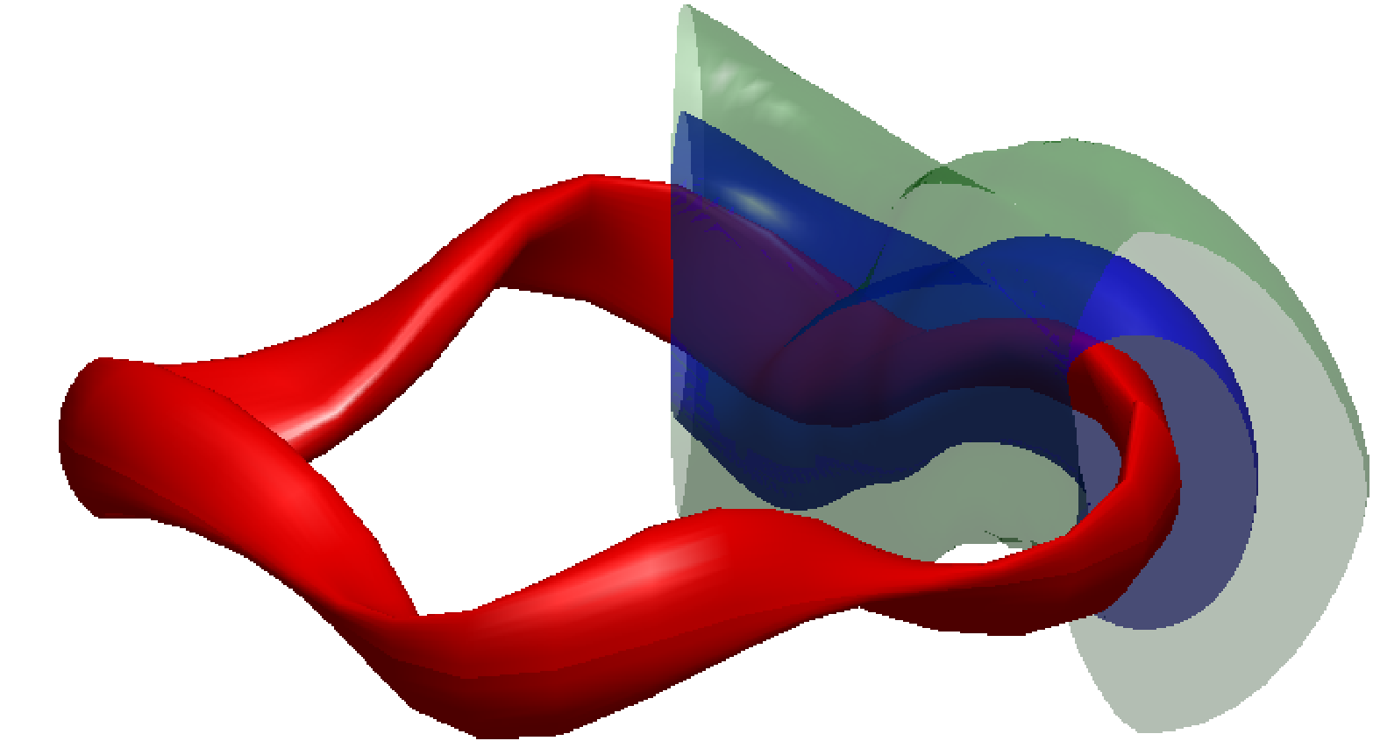
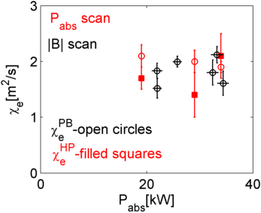
Overview of the HSX Program and Plans for Upgrade
D.T. Anderson & the HSX Team
HSX Plasma Laboratory, Univ. of Wisconsin, Madison, USA;
Overview
Proposed Collaboration with W7X
Present experimental program concentrated on 4 main areas: 1) equilibrium reconstruction, 2) core transport, 3) plasma flows and electric fields and 4) edge transport.
Experimental and theoretical results illuminate physics issues that impact Wendelstein 7-X, which comes on-line in 2015.
  Equilibrium reconstruction demonstrates time evolution of bootstrap current, critical to proper functioning of W7-X divertor.
  Heat pulse propagation experiment demonstrates lack of stiffness in heat transport, in agreement with 3-D gyrokinetic calculations using two kinetic species
  Improvement in neoclassical theory are being benchmarked and demonstrated experimentally.
  Work has begun on using motional stark effect to measure radial electric field and bootstrap current profile in HSX.
  Edge studies show electric field in edge island which could impact W7-X divertor and is not included in EMC3-EIRENE modeling.
Proposal submitted by Prof. O. Schmitz as PI investigates 3-D equilibrium reconstruction and impact on edge transport and island divertor performance in W7-X involving HSX, CTH (Auburn) and small plasma device.
HSX upgrade planned to focus on hotter ion temperatures, ion root transport, turbulent transport mitigation and divertor optimization .
Equilibrium Reconstruction
Core Transport
Plasma Flow & Electric Fields
Edge Transport
Joint proposal with Auburn University aims at investigating 3-D equilibrium effects on edge transport and divertor performance at Wendelstein 7-X. P.I.: O. Schmitz, UW-Madison
Domestic activities include HSX, CTH, helicon linear device, EMC3-EIRENE and V3FIT.
Edge Transport
Equilibrium Reconstruction
Activities on HSX center on validation and testing of EMC3-EIRENE, implement and test line ratio spectroscopy on helium as a divertor diagnostic, and explore helium exhaust.
Proposal takes advantage of HSX strength in examining core-edge coupling.
Theory and Modeling
Experiment
Theory and Modeling
Experiment
Simulate edge Te, ne and plasma flow at edge with EMC3-EIRENE given different boundary conditions Bader UP8.00061
Compare DEGAS neutral calculations to EIRENE Stephey
Electric fields measured within islands that is not modeled with EMC3-EIRENE Akerson UP8.00054
Study neutral fueling in preparation for pumped limiter studies Stephey UP8.00060
Optimized coil placement
Spark
V3FIT
Reduced profile uncertainty
Eddy current modeling
Bootstrap current evolution & rational surfaces eChlechowitz UP8.00053
HSX Upgrade
Core Transport
Schmitt, PoP Sept. 2014: momentum conservation and E_{r} impacts bootstrap current in HSX
Plasma Flow & Electric Fields
Increase ion temperature with neutral beams:
  Study role of high-effective transform (i_{eff} ~ 3) on ion confinement
  with tangential injection into high-electron temperature plasma
  Explore transport with E_{r} in reactor-relevant ion root
  Study low-collisionality ion transport
Higher density operation with neutral source control:
  Higher density core plasma and interface to scrape-off layer
  Study impurity transport and exhaust in ion root E_{r}
  Reduce neutral source in core to facilitate density and exhaust control
  Explore feasibility of optimizing for reducing turbulent transport
    Builds on quasisymmetric magnetic topology which is optimized for improved neoclassical transport
Upgrades needed for physics program:
  New vacuum vessel and type #1 coils for NBI and diagnostic access, improved conditioning, larger plasma/wall separation, more room for flexible divertor configurations
  ECH: 500 kW, 0.3 s, 56 GHz; energetic electron transport and beam target
  NBI: 2 X 300 kW 40 keV 0.3s systems (Budker Inst./ Compass D units)
  Infrastructure upgrades to accommodate new capabilities
  Bader UP8.00061, Talmadge (UP8.00052)
Theory and Modeling
Experiment
Briesemeister 2013: CXRS measurements of E_{r} do not agree with model at center and edge. Is the model or the expt in error?
Theory and Modeling
Experiment
GENE calculations confirm experimental lack of stiffness in core. Faber CP8.00035 (Monday)
Optimization of auxiliary coil currents to reduce TEM transport Talmadge UP8.00052
Pulse propagation experiments indicate transport is not stiff in core. Weir TI1.00002 (Monday)
Interferometer measurements of density fluctuations show increase with decreasing L_{n} (off-axis heating), consistent with TEM drive Deng UP8.00057
Compare DKES and PENTA codes, both assume mono-energetic distribution, to SFINCS (Landreman) and FORTEC-3D (Satake) which do not Smoniewski UP8.00058
Inboard/outboard CXRS measurement of Pfirsch-Schluter flow indicates larger core Er than measured previously Kumar UP8.00059
Examine Motional Stark Effect to measure Er and B using spectral fitting Ruiz UP8.00056 and polarimetry Dobbins UP8.00055
Reynolds stress measurements at plasma edge suggest that in a quasisymmetric stellarator, it influences Er Wilcox YP8.00039 (Friday)

