Slide 1
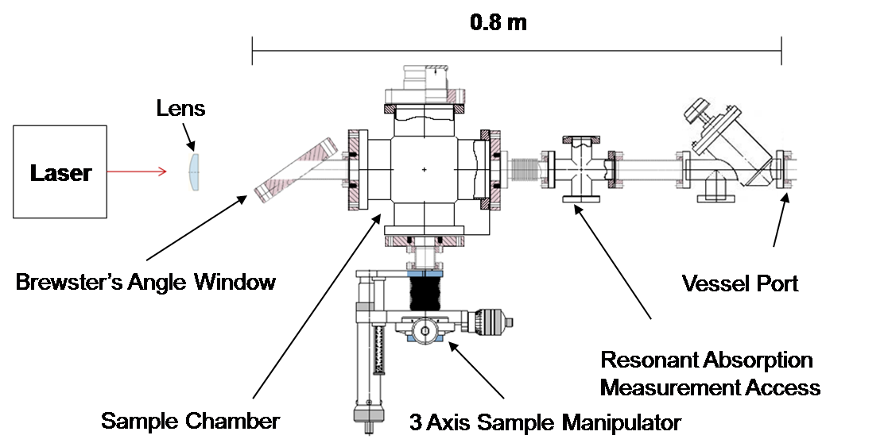
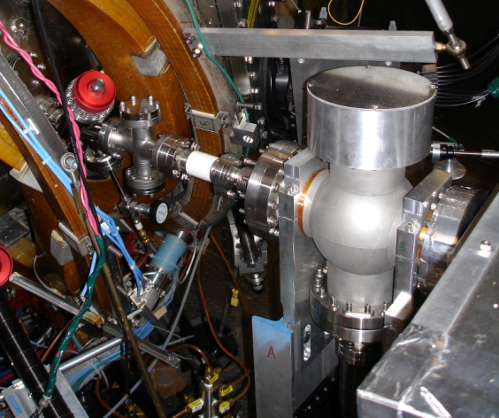
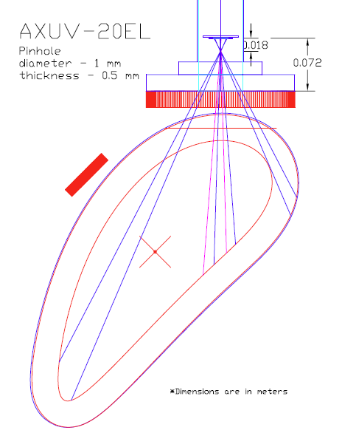
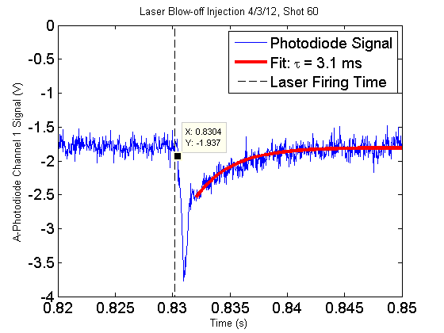
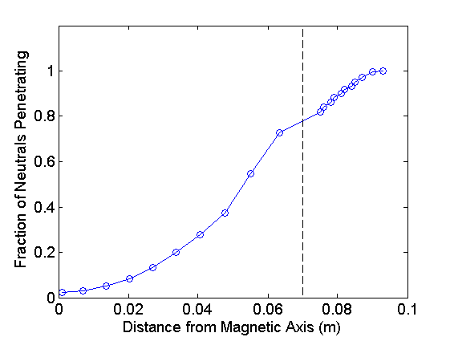
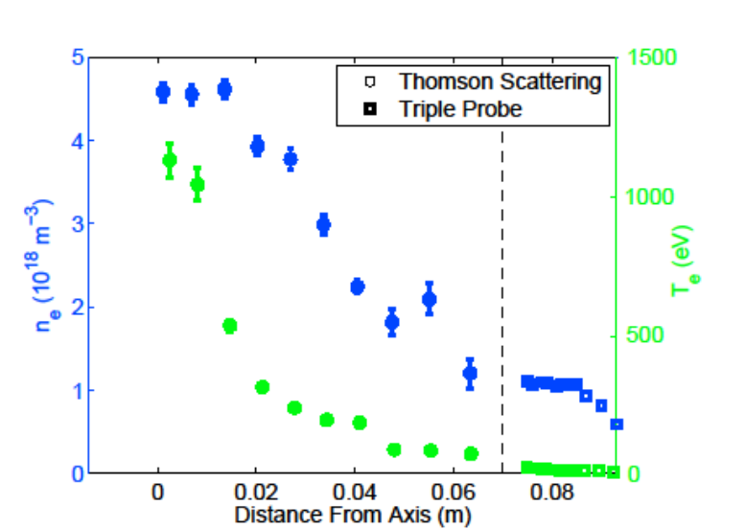
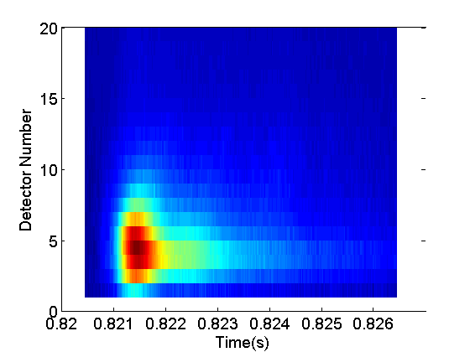
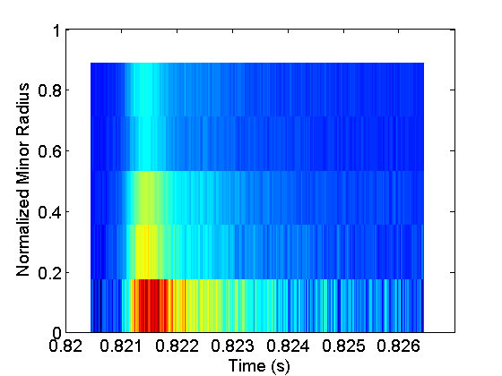
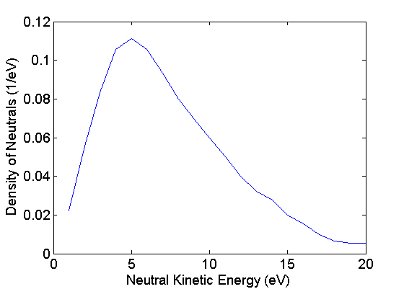

Impurity Transport Research at the HSX Stellarator
C. Clark, D.T. Anderson, F.S.B Anderson, K. Likin, J.N. Talmadge, K. Zhai
HSX Plasma Laboratory, Univ. of Wisconsin, Madison, USA
Overview and Motivation
The HSX Laser Blow-Off System
Reconstruction of Impurity Emissivity Profile
Impurity control and effective helium exhaust are open areas of research for the stellarator reactor concept
  The expected “Ion Root” operating point of a stellarator reactor is predicted to enhance impurity confinement
  Some stellarators have seen unexpected, and unexplained increase in impurity transport under specific operating conditions
    W7-AS had a “High Density H-mode”[Grigull, ’01]
    LHD has an impurity “hole” [Ida, ‘09]
  No clear path exists to satisfactory impurity handling in a reactor scale stellarator
We have undertaken an experimental program to measure the impurity transport properties of the HSX stellarator. Our goals are to:
  Inject aluminum neutrals into HSX plasmas using a laser blow-off technique
  Measure the resulting radiation using AXUV photodiode arrays
  Determine the impurity diffusivity and convective velocity using the STRAHL code
  Compare these findings with the neoclassical model using the PENTA code
Progress has been made toward the experimental goals
  Aluminum has been injected into HSX discharges
    The injection was visible on a photodiode
    The injection did not perturbing the background plasma parameters
  Two photodiode pinhole cameras have been installed on HSX, and five more are under construction.
  A code has been developed to invert the photodiode signals into an emissivity profile
HSX Beam Line Details:
Impurity radiation will be detected with AXUV photodiode arrays
  Two have been installed on HSX
  Five more are under construction
The detectors view the plasma through a 1 mm pinhole to achieve spatial resolution
Filter can be used to limit the spectrum of light reaching the photodiode
Laser: 850 mJ YAG – Surelight III
  Allows use of up to a 4 mm spot at 7 J/cm²
Solid angle of injection: 3 x 10⁻³ sr
Spot size adjustable by movable lens
Determining the View of Each Detector:
AXUV-20EL Chip
The volume around the paraxial ray is discretized
The solid angle of the detector, as viewed from the center of each volume element, is calculated
  This gives the relationship between the emission in each volume element and the signal at the detector
Since each volume element is small, it is taken to be located at a single radial location
  The volume elements can be binned into the appropriate portion of a matrix relating the 1D emissivity profile to the power incident on each detector
Typical Injection Results:
Bare Photodiode
Background Parameters
Pinhole
Injections are typically performed with:
  1 μm aluminum layer
Channel 1 View
Separatrix
Channel 20 View
Vessel
Results:
Laser Firing Time
Background Plasma Parameters
Neutral Penetration Prediction
Simulation of Impurity Beam Penetration:
Laser Blow-Off
Considers only electron impact ionization
  Atomic data from ADAS
Neutral spectrum taken from [Breton ‘80]
Projects adequate deposition within the confinement volume
Inversion
A glass slide with a 0.5–2.0 μm thick layer of the selected material is back-illuminated with a laser
  This creates short burst of neutrals, which ballistically enter the plasma
  The energy spectrum of neutrals is a function of the laser energy density, film thickness, and material
  The number of neutrals injected can be controlled with spot size and film thickness
The laser blow-off properties of aluminum have been particularly well characterized by other researchers [Marmar, ’75 & Breton, ’80]
Last Closed Flux Surface
Importance of Chromium Layer
Calculating Transport Coefficients with STRAHL
Total Emissivity Profile
Comparison of Injection with / without Chromium
The transport code STRAHL [Behringer, ‘87] is used to solve the 1-D continuity equation for each impurity charge state, including the source / sink term due to ionization / recombination from adjacent charge states
Laser
Glass Slide
Metal
ADAS is used for atomic data calculations
The background plasma parameters are assumed to be constant and are inputs to the code
Temporal and spatial impurity source rates, diffusivities and convective velocities are inputs to the code
The code outputs the time dependent emissivity profile
When used in conjunction with a nonlinear optimization algorithm, STRAHL can be used to determine the impurity convective velocity and diffusivity from the time dependent emissivity
A schematic view of the laser blow-off process
A laser blow-off target that has been used on HSX
The neutral spectrum for a 2 μm aluminum film illuminated with a 7 J/cm² laser pulse [Breton ‘80]

