Slide 1
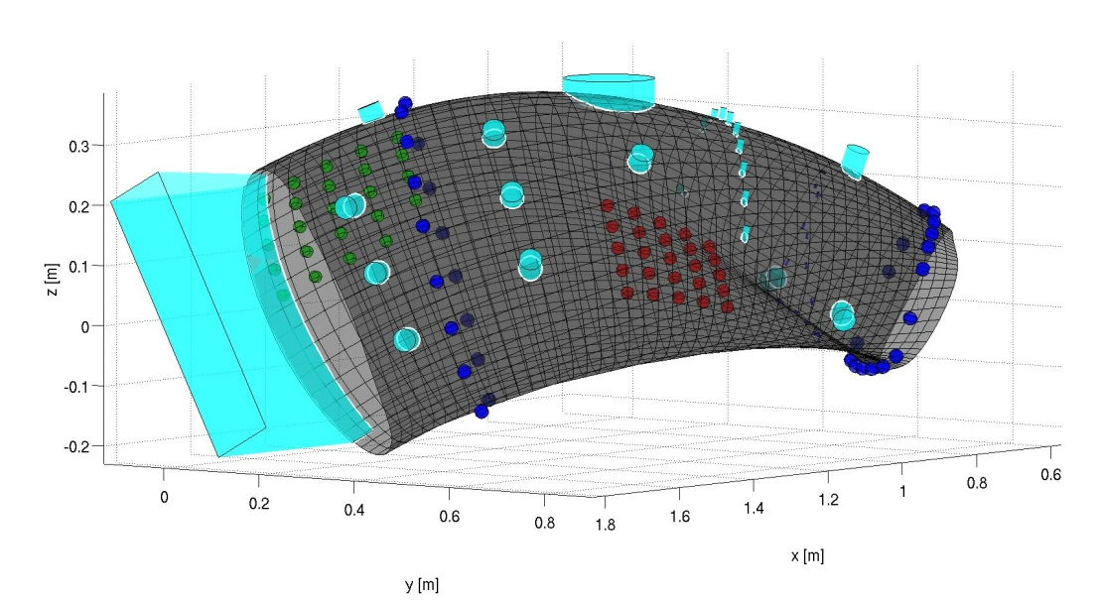
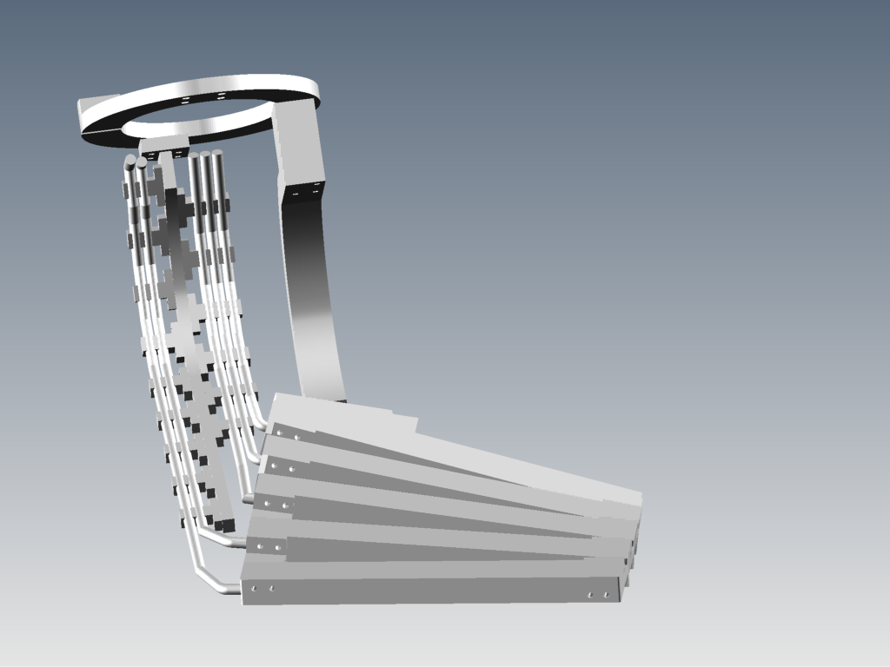
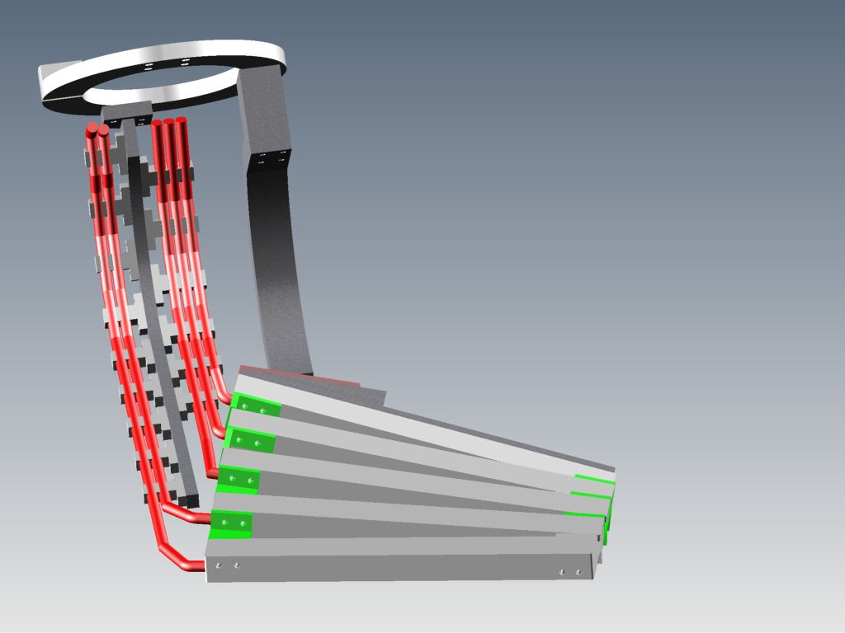
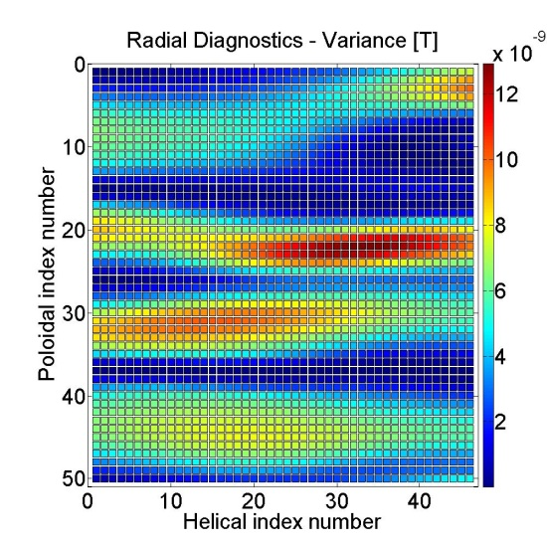
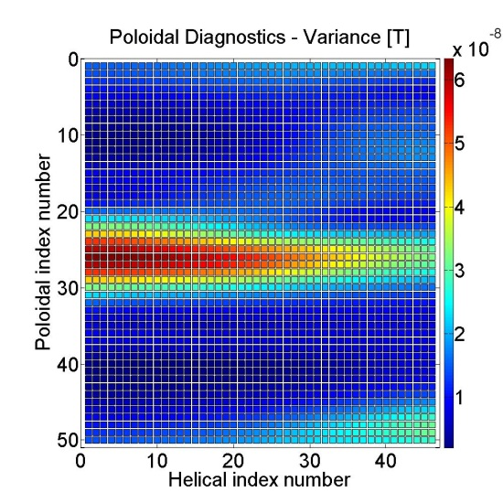
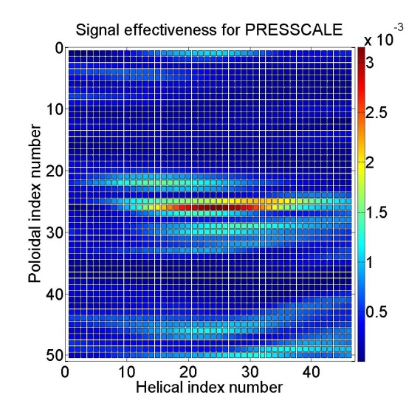
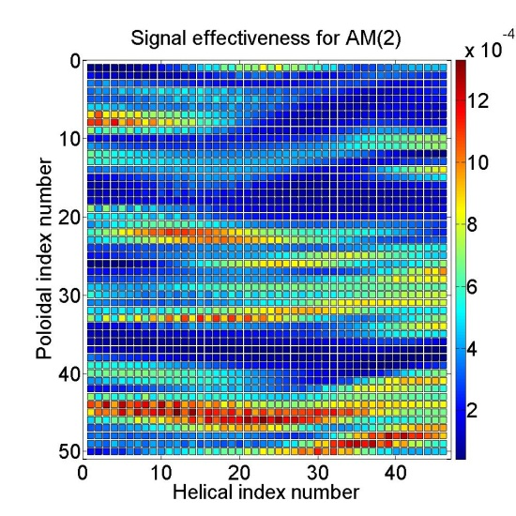
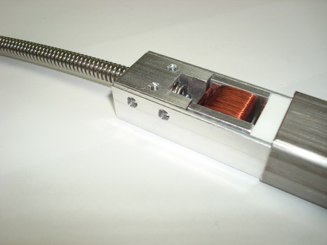
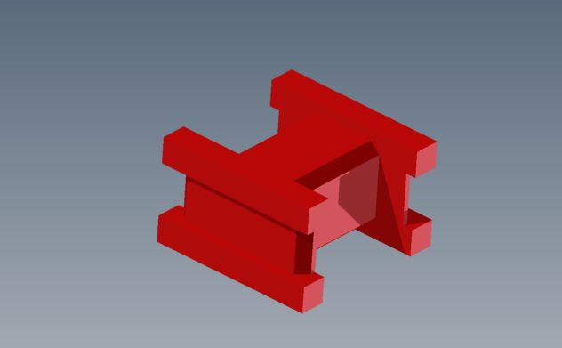
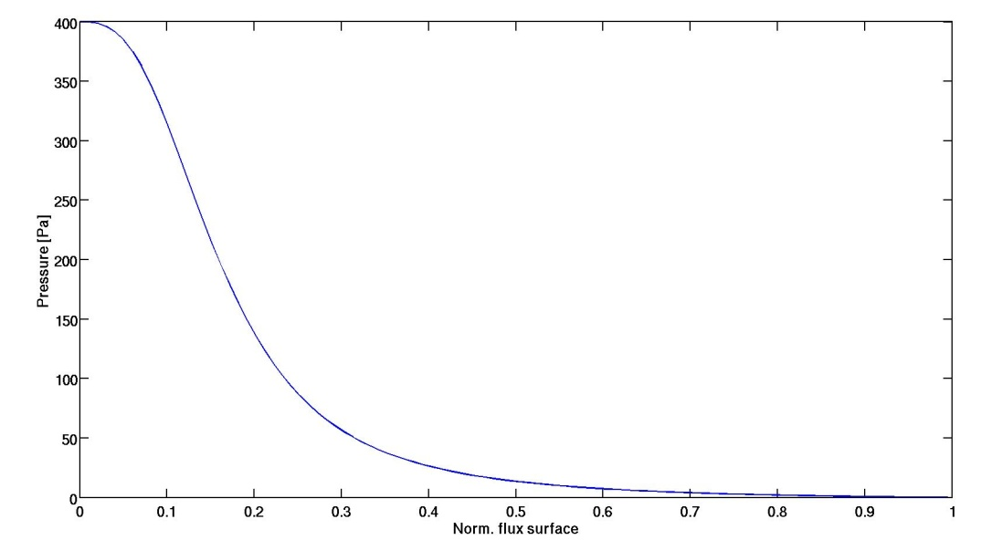
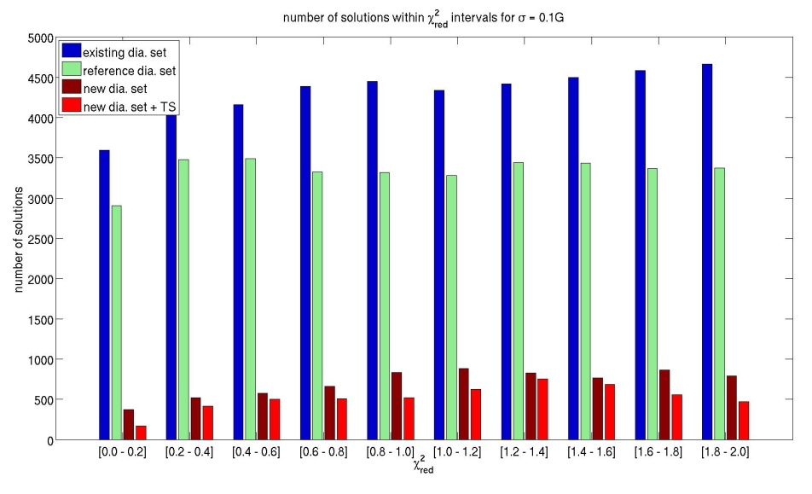
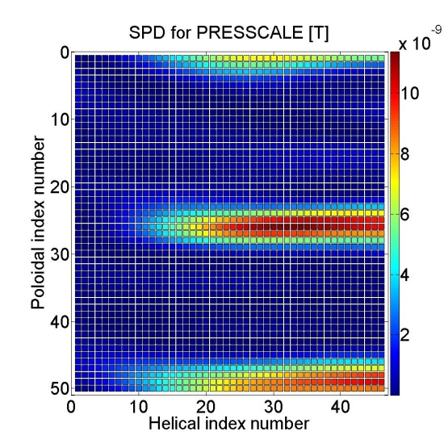
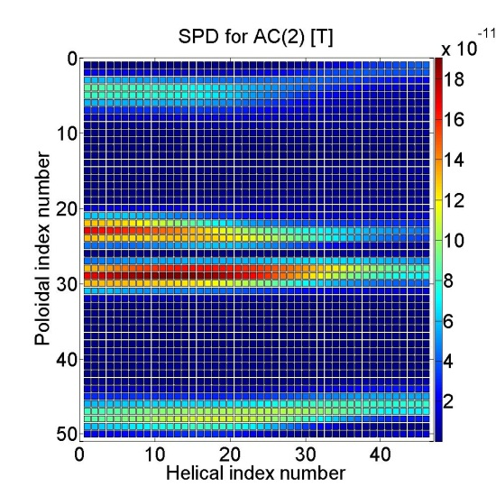
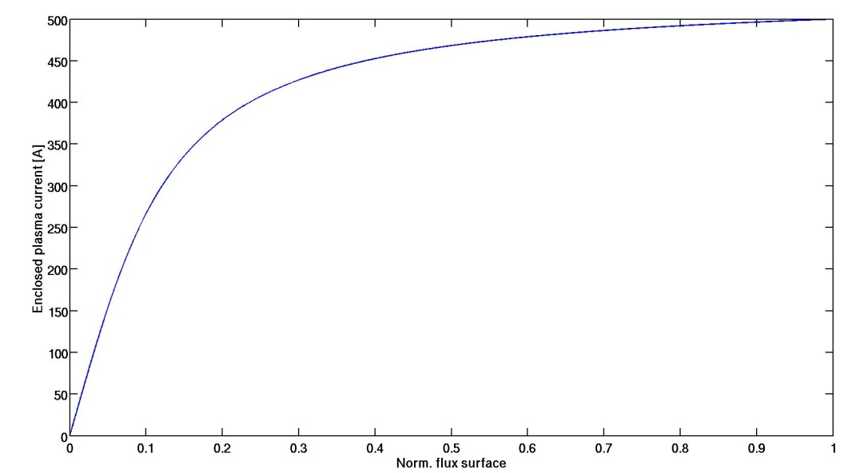
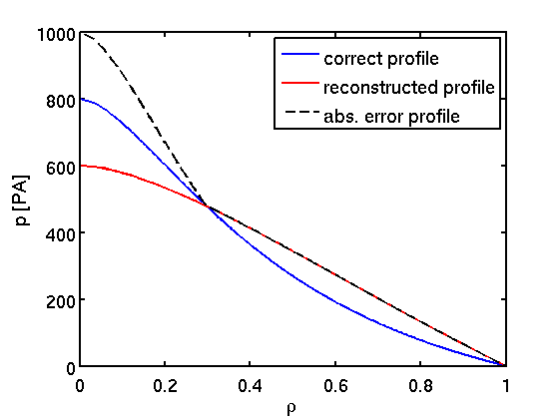
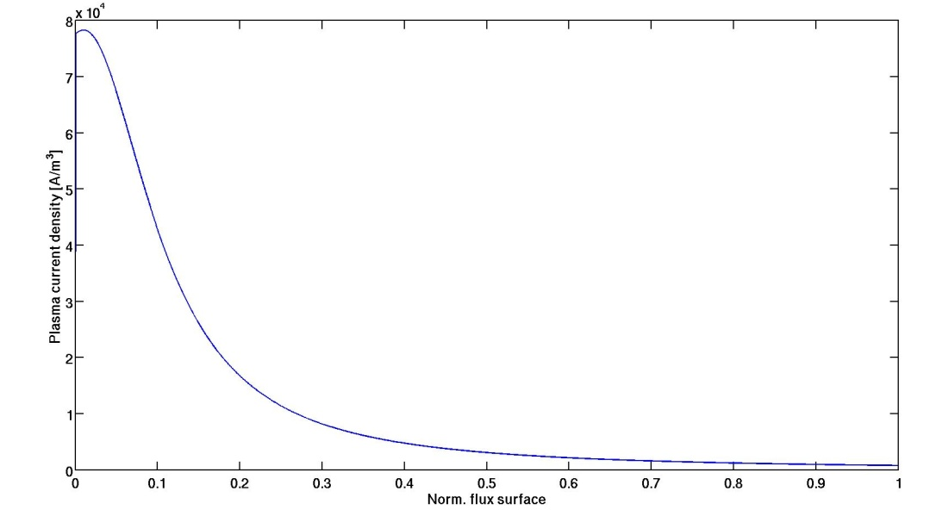
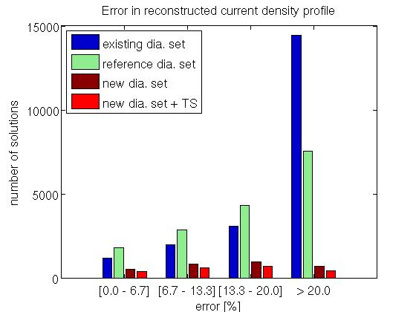
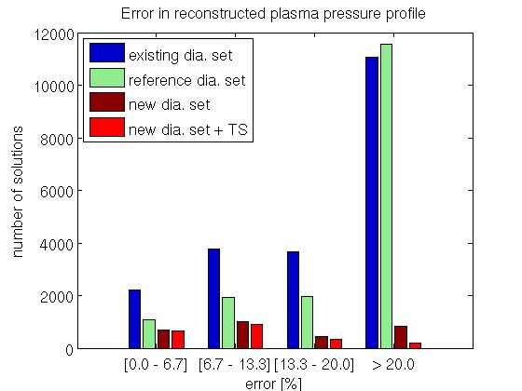
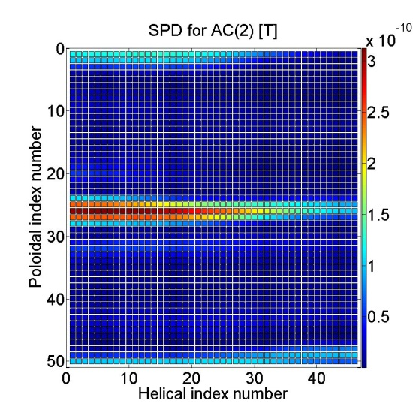
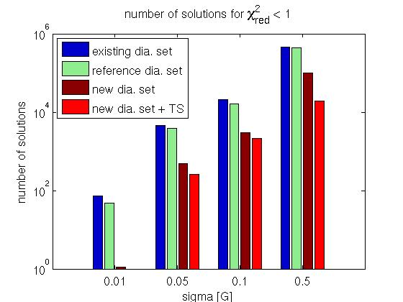
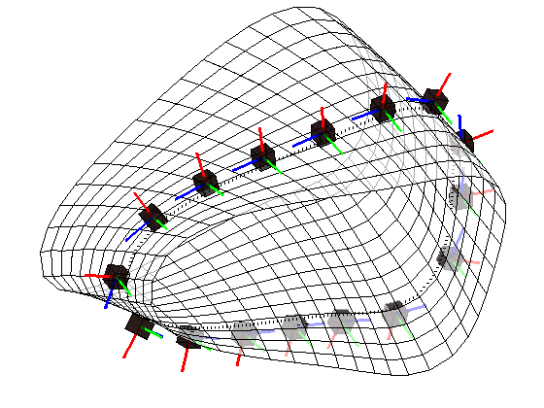
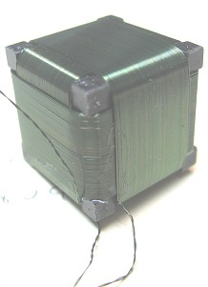
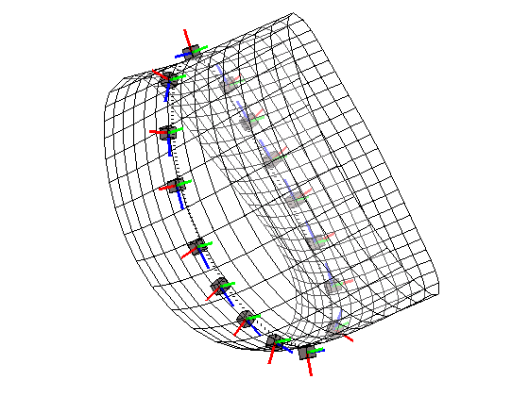
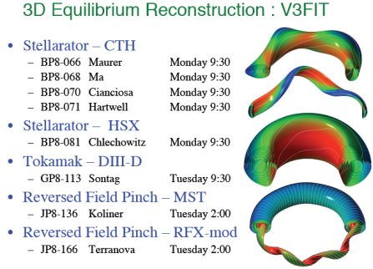
3-D Plasma Equilibrium Reconstruction at the HSX Stellarator
Current Status and Diagnostic Development
E. Chlechowitz, J.C. Schmitt¹⁾, D.T. Anderson
HSX Plasma Laboratory, Univ. of Wisconsin, Madison, USA, ¹⁾ PPPL, Princeton, USA
Motivation
Diagnostic Positioning
Performance Improvement
Diagnostic Construction
Investigate MHD equilibrium properties via plasma reconstruction using the
V3FIT code [1], experimental data and modeled signal responses [2]
Three dimensional plasma reconstruction is necessary in stellarators to
determine finite beta effects and in tokamaks to measure effects of
non-axisymmetric coils
HSX offers test bed for plasma reconstruction and benchmarking algorithms
Magnetic diagnostic upgrade necessary for improved reconstruction by
solution reduction and increased signal-to-noise ratio
Necessary to find most sensitive diagnostics regarding the plasma
equilibrium currents to be measured
Understand the limitations of plasma reconstruction performance
  Signal Effectiveness Study (SEFFS)
Use of χ²_{red} to estimate number of reconstruction solutions
with n = # of diagnostics
and m = # of free model
parameters
Standard reconstruction at HSX yields
χ²_{red,recon} = 0.001... 1
Solution space: all equilibria which satisfy
Five dimensional scan of parameter space performed
≈ 760,000 equilibria
x
3 diagnostics sets
Number of solutions reduced by factor 7 for new diagnostic set with 0.1 G signal noise
(factor of 10 by using Thomson Scattering system in addition)
Based on current/pressure profile an error profile is determined to allow an error estimation weighted by flux surface volume
Planned magnetic diagnostic set leads to suppression of solutions which strongly deviate from correct equilibria
Five arrays consisting of 5 poloidal and 5 radial magnetic coils, placed inside the vacuum vessel
Same direction vector for all pol./rad. coils in one array
Fixed distance between all coils allows the determination of the position using the measured magnetic field pattern
Flat design to avoid touching the plasma
Arrays, supporting structure, and corrugated hose holder follow HSX geometry
Port ring
  Signal effectiveness E_{ji} has been calculated for 2300 virtual diagnostic coils (local pol. & radial mag. field measurements) and a set of 1366 test equilibria (TE)
  E_{ji} determines most sensitive (and thus most important) diagnostics for each model parameter
  E_{ji} describes fractional reduction in j-th parameter variance σ_{j}^{P} for fractional reduction in i-th signal variance σ_{i}^{S}
Signal variance from 2300 radial and poloidal magnetic field measurements for a set of 1366 test equilibria [T]
Corrugated hose holder
Corrugated hose (cable)
Clamps
Supporting structure
Angle adjuster
Diagnostic array connectors
Diagnostic arrays
  Tested
  Diagnostic sets:
  15 internal pol. + 32 ext. pol + 32 ext. rad Bdot coils
  25 internal pol. + 25 rad. mag. coils (reference)
  25 internal pol. + 25 rad. mag. coils (under
  construction)
Signal Effectiveness for two model parameter for the radial diagnostics
Adjusted coil geometry for flat diagnostic array
Ceramic used as coil body
Stainless steel used as shielding for the coils
Each array can be separately calibrated, replaced, and upgraded with more coils
radial mag. field
Plasma Reconstruction
VMEC run
(50 kW, 50 Joule Plasma)
VMEC run VAR1
V3POST run VAR1
VMEC run VAR2
V3POST run VAR2
poloidal mag. field
V3POST
Calculate signal response
…
…
Reconstruction is used to calculate seven free parameters, which describe plasma size, plasma current and plasma pressure profile
VMEC is used to compute the plasma equilibrium [3]
Plasma reconstruction is based on minimizing
deviation between measured signals S^{measure}, and predicted values S^{model}, by adjusting the model parameters
h = {PRESSCALE, AM(2), AM(3)}
k = {CURTOR, AC(2), AC(3)} [1]
Two external and one internal magnetic coil array (at two different toroidal positions) in continuous use
By means of plasma reconstruction helical structure of Pfirsch-Schlüter current was proven at HSX [4]
Free parameters in plasma current and pressure profile
χ_{red}
PRESSCALE → axis height
AM(2) → width
AM(3) → steepness
Summary
  Single Parameter Dependence Study (SPDS)
  Test if diagnostics with high E_{ji} undergo signal change for possible plasma scenarios at HSX
  Further set of TE have been generated where only one model parameter value was varied
SPDS for two model parameter for the poloidal diagnostics
Plasma equilibrium reconstruction at HSX is based on the determination of seven free parameters describing plasma current profile, pressure profile and plasma size
Signal effectiveness has been used to find the most sensitive diagnostics
Off-axis peaks in plasma current densities are challenging to reconstruct due to overlapping diagnostic positions with a high signal effectiveness
Single parameter dependence study introduced as additional tool to find the final composition of diagnostics with high signal effectiveness
Number of solutions will be greatly reduced with new set of magnetic diagnostics
Error in remaining solutions is greatly reduced as well
Diagnostic set is under construction, completion 12/2012
New magnetic diagnostics allow benchmarking of different theories applied for positioning diagnostics and the effectiveness of single coils and subsets [5]
CURTOR→ integral value
AC(2) → shift in peak
AC(3) → height & steepness
  Subset of SEFFS and SPDS have to be considered for diagnostic development
  Locations sensitive to changes in axis peaked plasma currents overlap with sensitive positions for core plasma current changes
  First order parameters show (PRESSSCALE, CURTOR, show good agreement between SEFFS and SPDS
  Rad. and pol. diagnostics which are effected by one model parameter lie close to each other
  → Construction of 25 radial and 25 poloidal magnetic field
  coils covering poloidal and helical index 20 – 30
SPDS for the rad. diagnostics
Set of two external already installed magnetic diagnostic coils (measuring toroidal, poloidal, and radial field components)
Reducing sigma by two orders of magnitude allows significant reduction of number of solutions
Further reduction can be achieved by including Thomson Scattering (TS) measurements for the plasma core (largest uncertainty in the reconstruction results)
Weighting of one TS channel is adjusted to the 50 magnetic coil signals
Free parameters in plasma current and pressure profile
References
J.D. Hanson et al. Nucl. Fusion 49 (2009)
S.P. Hirshman et al. Phys. Plas. 11 (2004)
S.P. Hirshman and J.C. Whitson. Phys. Fluids, 26 (1983)
J.C. Schmitt Dissertation UW-Madison (2011)
N. Pomphrey et al Phys. Plasmas 14 (2007)
Φ=1/2 Field Period
Φ=0 (ellipse shape)

