Slide 1


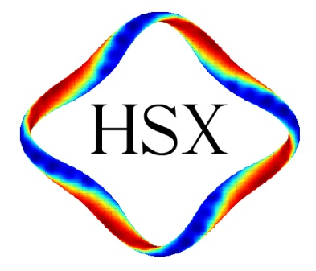
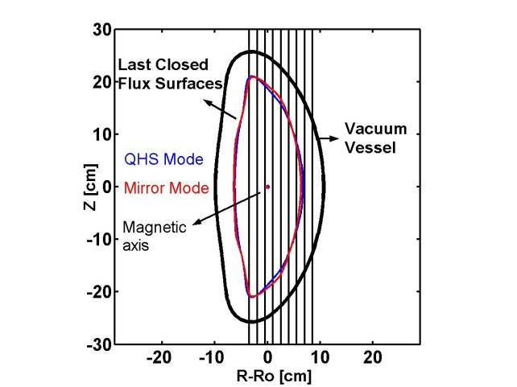
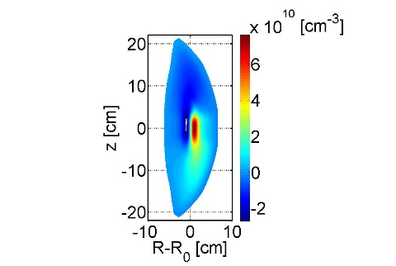
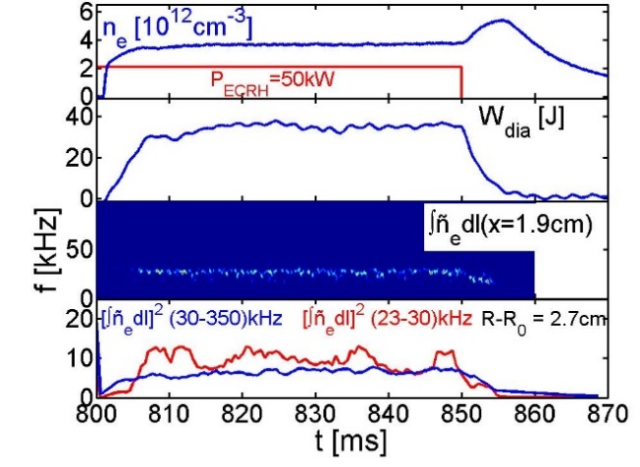
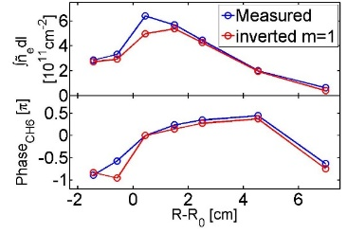
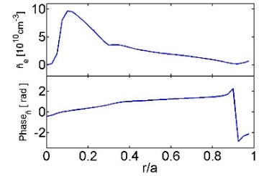
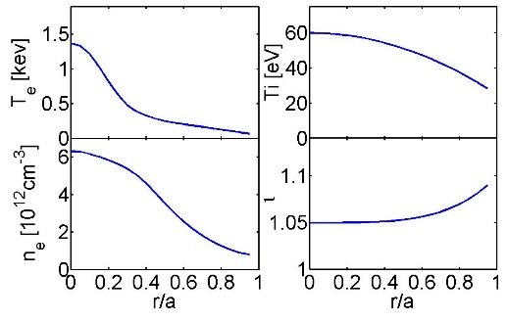
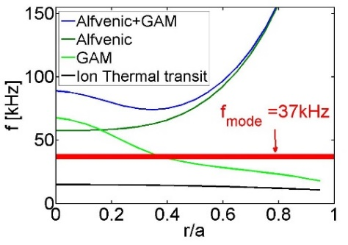


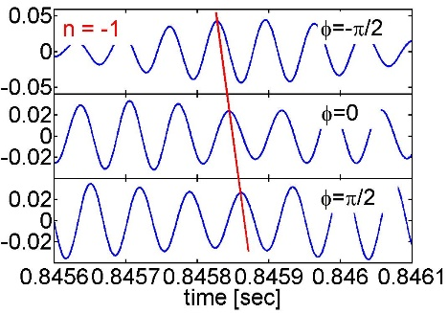
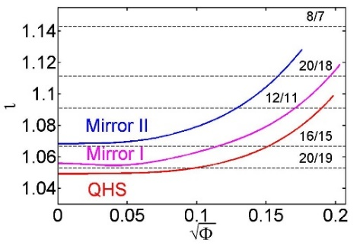
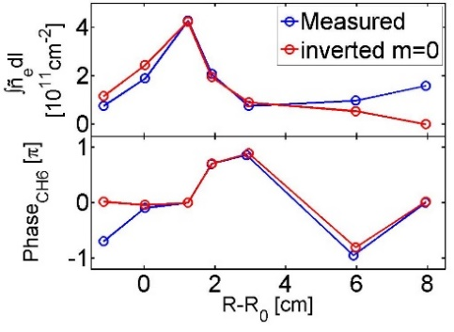
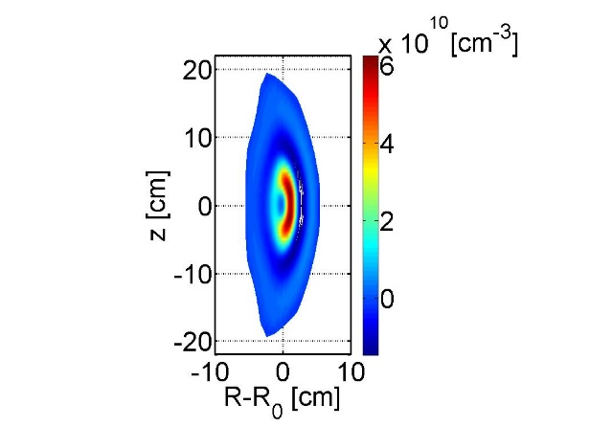
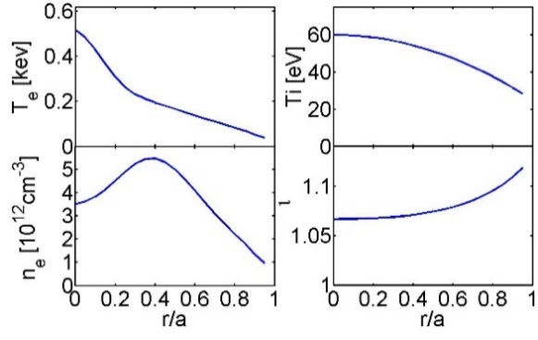
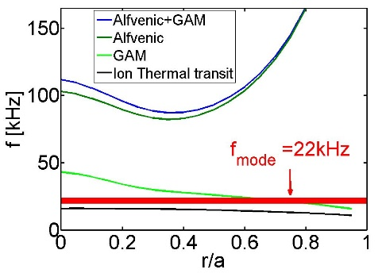
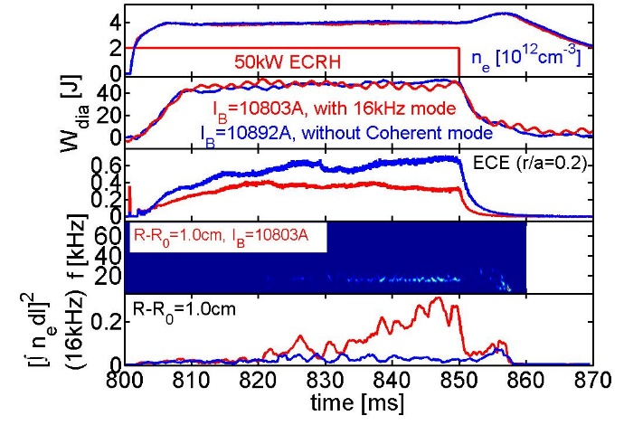
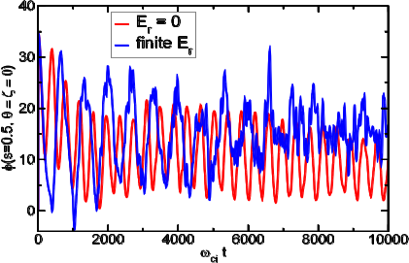
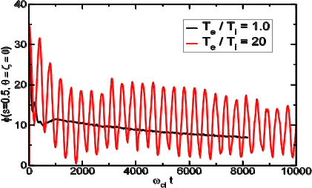
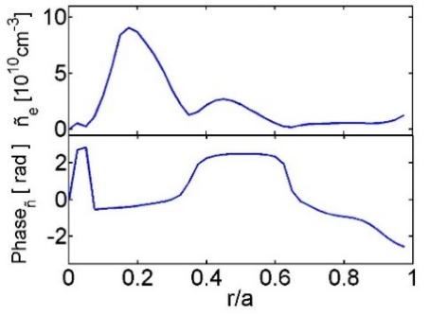
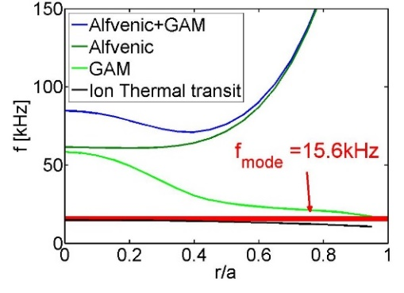
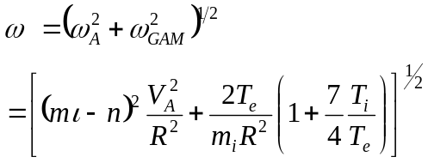

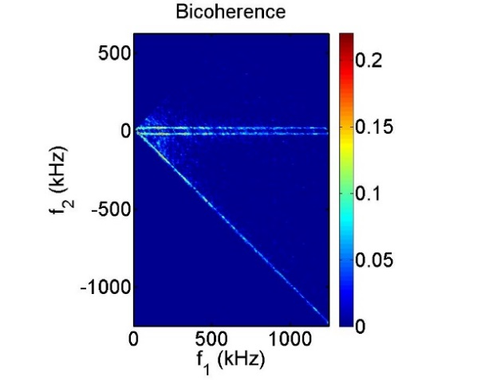
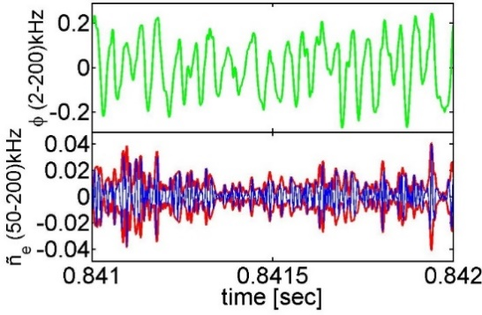
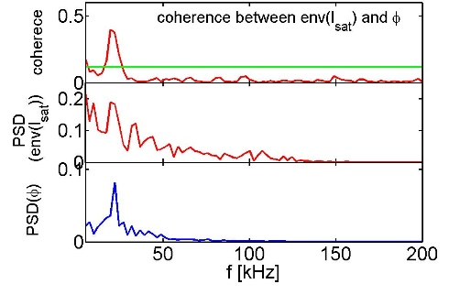
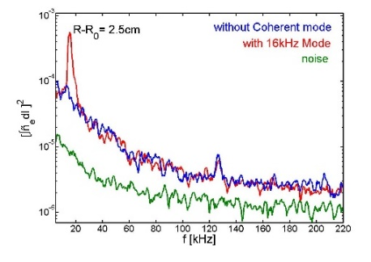
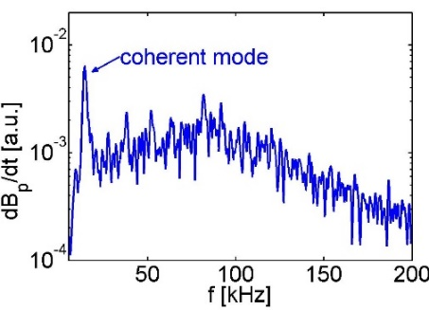
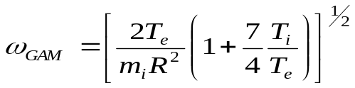
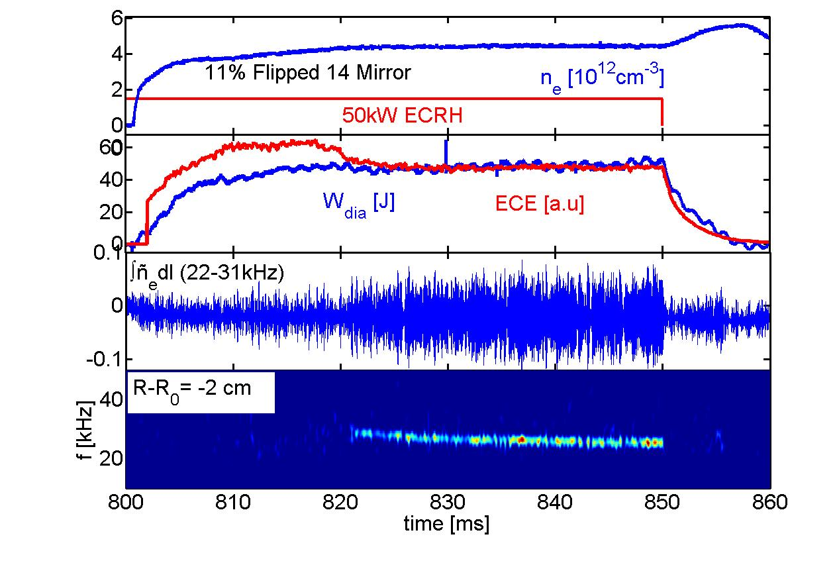
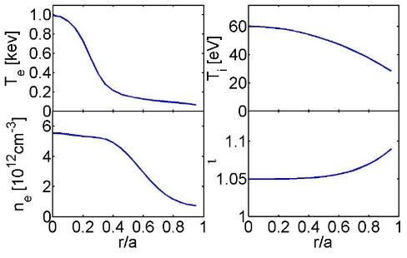
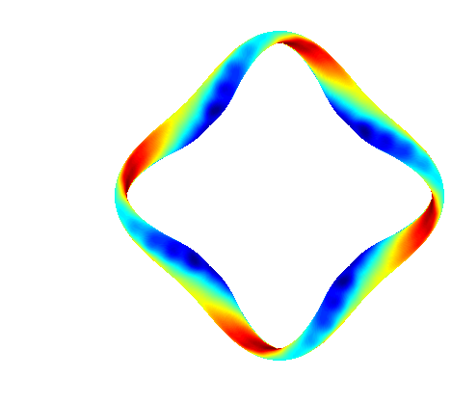
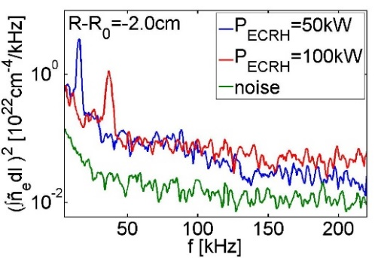
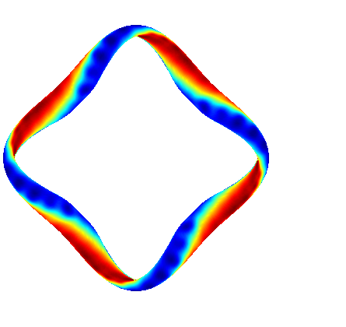
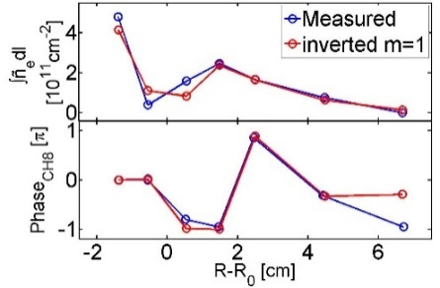
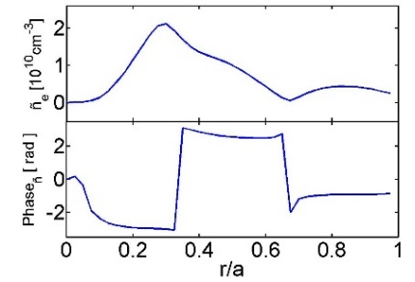
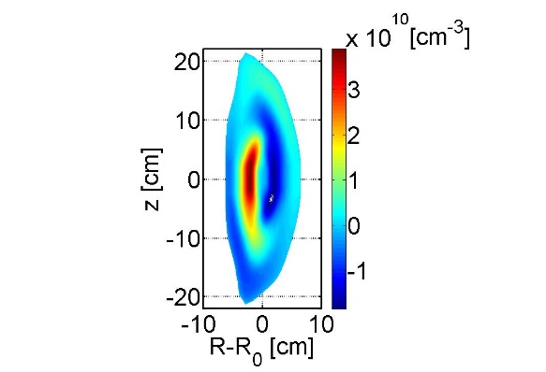
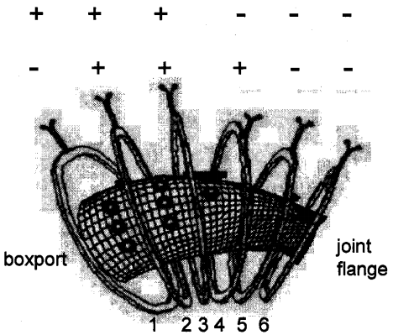
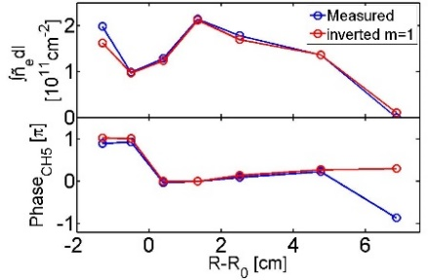
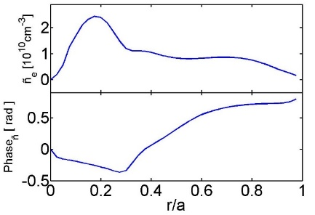
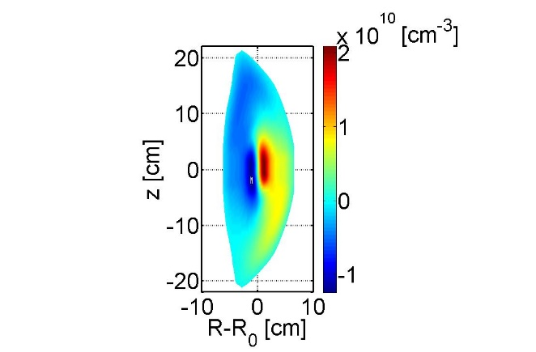
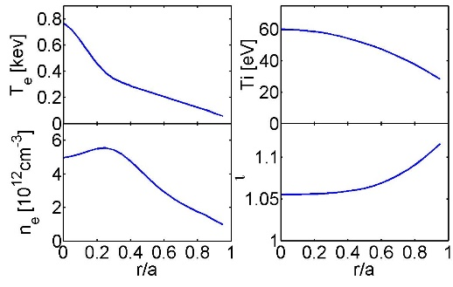
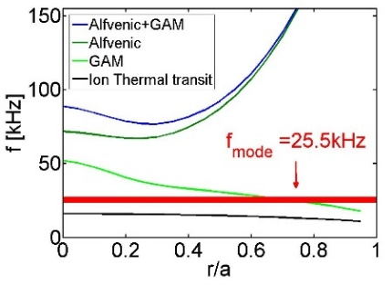
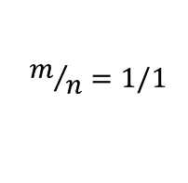
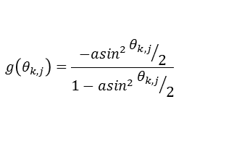

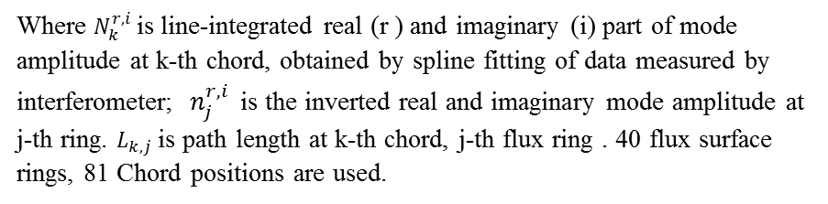


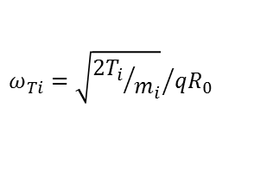

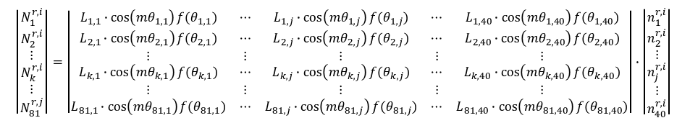
Coherent Density Fluctuations in the HSX Stellarator
C. Deng , D.L. Brower, University of California, Los Angeles
D.T. Anderson, F.S.B. Anderson, K.M. Likin, J.N. Talmadge University of Wisconsin-Madison
Abstract
Interferometry System
Coherent mode in 50kW ECRH plasma is likely an m=1 mode
Mode Frequency is close to GAM frequency for 100kW ECRH plasma
Coherent Density Fluctuation mode observed in Mirror II Plasma
A multi-channel interferometer system is used to measure equilibrium density profile and its fluctuations in the HSX stellarator. Low-frequency, coherent density fluctuation modes are observed in certain quasi-helically symmetric (QHS) plasma conditions and have characteristic frequency of ~15kHz. The mode is observed for small displacement of the 1st harmonic O-mode ECRH location inward from the magnetic axis. This mode is also observed on magnetic fluctuation signal, using external coils, which shows n=1. When HSX is operated without quasi-helical symmetry (mirror configuration), a coherent electrostatic mode at ~28 kHz is observed. Mode radial structure can be obtained from inversion of interferometer measurement when the m number is known. Under certain Mirror conditions, the coherent modes display strong bi-coherence with Langmuir probe signals. Detailed characterization of the observed coherent modes will be reported and their identification will be explored. *Supported by USDOE grants DE-FG03-01ER54615 and DE-FG02-93ER54222.
Flux Surface and Chord Positions
Line-integrated Amplitude and Phase
Inverted Amplitude and Phase
2 D image of the mode
Plasma parameters
Mirror II: ε_{eff}^{2/3} ~1.8%;ι(0)/ι (a)~1.067/1.13
Interferometer System:
1. 9 chords
2. 1 MHz bandwidth
3. 1.5 cm chord spacing, width
k⊥ < 2 cm⁻¹
Density fluctuations can be measured from information of:
Amplitude
Phase
Differential
Frequencies
mode at f=20kHz is observed on interferometer, magnetic pick-up coils and Langmuir probes
mode is intermittent, coherent
Mode not driven by energetic electrons ( mode exists for 5ms after ECRH)
Bi-coherency observed on Langmuir probe signals: zonal flows may be active
m=1 mode located in the plasma core: r/a~0.1
Candidates of the coherent Mode:
(1) GAM (2) Ion sound wave
Interferometry
(phase measurement)
Far-forward Scattering- amplitude
Coherent toroidal mode number is n=-1
Simulations show GAM could exist on HSX when Te>>Ti (Alexey Mishchenko)
Coherent mode in Mirror II plasma is likely an m=0 mode
Mode frequency is close to GAM wave frequency
Magnetic fluctuation(Mirnov coils)
ι and rational surfaces
Plasma parameters
Frequencies
Coherent Modes in QHS plasms
HSX for 50kW ECRH QHS plasma Te(0)/Ti(0)=1000eV/55eV=18, no Landau damping to sound wave
Coherent mode is observed in 50kW QHS plasma
GAM damping rate:
$$γ∝−exp\left(−\left(τ^{−1}+\frac{3}{4}\right)q^{2}−ξ\right)exp\left(−q^{2}\right)$$
$$τ=\frac{T_{i}}{T_{e}} ; q=\frac{1}{ι}$$
QHS: ε_{eff}^{2/3} ~0.04%; ι(0)/ι(a)~1.05/1.10
n=-1 toroidal mode number (measured by magnetic), no low m/n rational surfaces in HSX:
indicating the mode may be driven by energetic particles, or non-linear turbulence
GAM observed when T_{e}/T_{i}=20 on HSX
Coherent mode (density fluctuation) is observed with slight inboard offset of ECRH heating location at r/a~0.05
Coherent magnetic fluctuations also observed on some Mirnov coils
ECE signal reduced when coherent mode present
No change in n_{e}(r)
Mode unknown….
Best fit of Inversion shows:
the mode is most likely m=0 mode, peaked at r/a~0.2
Candidate of the coherent mode: GAM
Mode frequency is close to ion thermal transit frequency (50kW ECRH Plasma)
Coherent mode modulates density fluctuations
Outline
The linear HSX simulations (using adiabatic-electron approximation) at large flat Te/Ti ~ 20 show:
GAM exists
Ambient Er affects GAM
Floating potential and envelop of ion saturation current
Floating potential and envelop of ion saturation current fluctuations are correlated
1. HSX configurations: QHS, Mirror
2. Density fluctuation measurement techniques
3. Measurement Results:
I: Coherent mode in slightly inboard ECRH QHS plasmas
II: Coherent mode in Mirror configurations
III: Candidates for the coherent modes
4. Summary and future plans
Coherent mode is sensitive to ECRH location
Frequencies
Strong Bicoherence of ion saturation currents is observed
Coherent mode appears on both density and magnetic fluctuations
Density fluctuation
Magnetic fluctuation(Mirnov coils)
$$m/n=1/1$$
Coherent modes in Mirror I plasma
f₂=20kHz
Mirror I: ε_{eff}^{2/3} ~0.3%; ι(0)/ι (a)~1.055/1.125
Plasma parameters
Coherent mode observed in Mirror I Plasma for B_{T}=1 T
Mode observed in density, not in magnetic signals
Density window for mode is narrow: (3.5-4.5)*10¹²cm⁻³
Decrease in ECE emission suggests decrease in energetic electron confinement.
f₂=-20kHz
HSX Provides Access to Configurations With and Without Symmetry
$$ω_{Ti}={\sqrt{{2T_{i}}/{m_{i}}}}/{qR_{0}}$$
f₁+f₂=20kHz
envelope
Interferometer measurement shows:
There is sharp peak at f=16kHz on density fluctuations spectrum for slightly inboard heating [ECRH inboard at r/a~0.05]
Coherent mode observed in both density and magnetic fluctuation signals
Broadband fluctuations are similar for on-axis and (slightly) inboard heating locations
Mode frequency close to ion transit frequency, indicating the mode may be : (1) BAE (2) BAAE (3) KBM
Strong correlation between floating potential and envelop of ion saturation current fluctuations at mode frequency in Mirror II
QHS: helical axis of symmetry in |B|; predicted very low neoclassical transport Mirror: quasi-helical symmetry broken by adding a mirror field.
Bicoherence of ion saturation current :
Zonal flow-like oscillations
Mode frequency increases with ECRH Power
Coherent mode is sensitive to electron density
Summary and Future Plans
QHS
ε_{eff}^{2/3}~0.04%
Red→|B|>1.0 T
Blue→|B|<1.0 T
Broken Bands
Mirror
Spectrum of density fluctuations
Mode frequency:
16 kHz: 50 kW ECRH
(ion transit frequency)
37 kHz: 100 kW ECRH
(GAM frequency)
Coherent mode is likely an m=1 and shows anti-ballooning effect
Interferometry and Differential Interferometry are used to measure density fluctuations in HSX
      Non-perturbing measurement, both broad-band (Nucl. Fusion 55 (2015)123003)
      and coherent fluctuations are measured.
Coherent mode radial structure could be obtained by Abel Inversion
QHS: coherent mode observed on density and magnetic signals, f=(15-40) kHz, when ECH at slightly inboard (r/a=0.05); m=1, f_{mode} increases with ECRH power.
Mirror I: coherent mode with f=(20-30)kHz observed only on density signals in certain density window ne~(3-5)x10¹²cm⁻³ , m=1 mode frequency is close to GAM frequency.
Mirror II: coherent mode with f=(20-30)kHz, observed on density and magnetic signals with likely m=0; Langmuir probe measurements show strong bicoherence and density turbulence modulated by the coherent mode: indicating zonal flow may be active
Inversion method used to get mode structure
Mirror I:
ε_{eff}^{2/3} ~0.3%
Mirror II: ε_{eff}^{2/3} ~1.8%
assuming m is known, also including the ballooning effect, find the best fit to both the line-integrated mode amplitude and phase of Interferometer data by varying values of m and a.
Line-integrated
Inverted
Mirror: Helical Bands are Broken
$$\left|\begin{matrix}N_{1}^{r,i} \\ N_{2}^{r,i} \\ ⋮ \\ N_{k}^{r,i} \\ ⋮ \\ N_{81}^{r,j}\end{matrix}\right|=\left|\begin{matrix}L_{1,1}∙\cos\left(mθ_{1,1}\right)f(θ_{1,1}) & ⋯ & L_{1,j}∙\cos\left(mθ_{1,j}\right)f(θ_{1,j}) & ⋯ & L_{1,40}∙\cos\left(mθ_{1,40}\right)f(θ_{1,40}) \\ L_{2,1}∙\cos\left(mθ_{2,1}\right)f(θ_{2,1}) & ⋯ & L_{2,j}∙\cos\left(mθ_{2,j}\right)f(θ_{2,j}) & ⋯ & L_{2,40}∙\cos\left(mθ_{2,40}\right)f(θ_{2,40}) \\ ⋮ & ⋮ & ⋮ & ⋮ & ⋮ \\ L_{k,1}∙\cos\left(mθ_{k,1}\right)f(θ_{k,1}) & ⋯ & L_{k,j}∙\cos\left(mθ_{k,j}\right)f(θ_{k,j}) & ⋯ & L_{k,40}∙\cos\left(mθ_{k,40}\right)f(θ_{k,40}) \\ ⋮ & ⋮ & ⋮ & ⋮ & ⋮ \\ L_{81,1}∙\cos\left(mθ_{81,1}\right)f(θ_{81,1}) & ⋯ & L_{81,j}∙\cos\left(mθ_{81,j}\right)f(θ_{81,j}) & ⋯ & L_{81,40}∙\cos\left(mθ_{81,40}\right)f(θ_{81,40})\end{matrix}\right|∙\left|\begin{matrix}n_{1}^{r,i} \\ n_{2}^{r,i} \\ ⋮ \\ n_{j}^{r,i} \\ ⋮ \\ n_{40}^{r,i}\end{matrix}\right|$$
mode resonates to different particle energies
QHS:Helical Bands of Constant |B|
Coherent mode in 100kW ECRH plasma is likely an m=1 mode
Where $N_{k}^{r,i}$is line-integrated real (r ) and imaginary (i) part of mode amplitude at k-th chord, obtained by spline fitting of data measured by interferometer;${ n}_{j}^{r,i}$ is the inverted real and imaginary mode amplitude at j-th ring. $L_{k,j}$ is path length at k-th chord, j-th flux ring . 40 flux surface rings, 81 Chord positions are used.
Line-integrated
Inverted
2 D image of the mode
Best fit to Inversion of Interferometer data shows:
the mode is most likely m=1 mode and located at r/a~0.3
,
+ (-): direction of current through auxiliary coils, which adds (subtracts ) B field to main field
ε_{eff}^{2/3} : effective magnetic field ripple at r/a=2/3
Mode frequency is close to GAM frequency
Plasma parameters
Frequencies
Future works
Identification of coherent modes and relation to transport
Upgrade of FIR interferometer and collective scattering system is proposed to increase wavenumber sensitivity from an upper bound of 2 cm⁻¹ to 10-15 cm⁻¹.
Ballooning effect has the form:
$$f\left(θ_{k,j}\right)={10}^{g(θ_{k,j})};$$
$$g\left(θ_{k,j}\right)=\frac{−asin^{2}{θ_{k,j}}/2}{1−asin^{2}{θ_{k,j}}/2}$$
Candidates of the coherent mode:
(1) GAM (2) EPM
helical axis of symmetry,
no toroidal curvature,
no toroidal ripple
Conventional stellarators exhibit poor neoclassical transport in
low-collisionality regime due to magnetic field ripple
When a>0, ballooning effects, when a<0, anti-ballooning effects
Best fit to Inversion of Interferometer data shows: mode is most likely m=1 mode, and located at r/a~0.2
Mode phase can be obtained: ${phase}_{j}=\tan^{−1}{\frac{n_{j}^{i}}{n_{j}^{r}}}$
57th Annual Meeting of the APS Division of Plasma Physics, November 16-20, 2015, Savannah, Georgia

