Slide 1


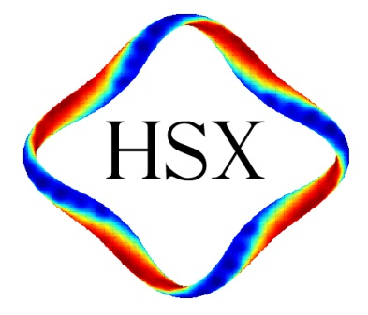
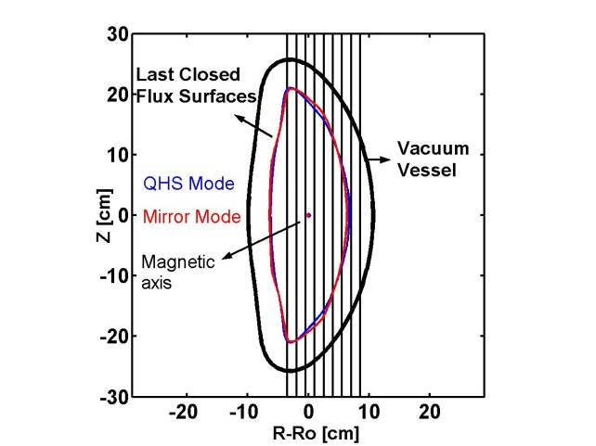
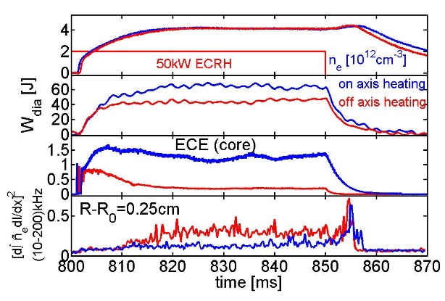
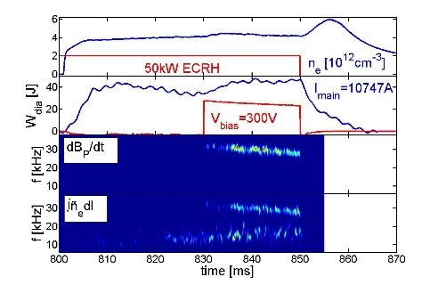
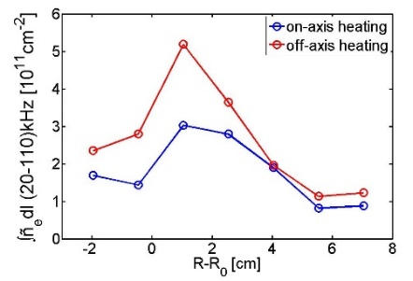
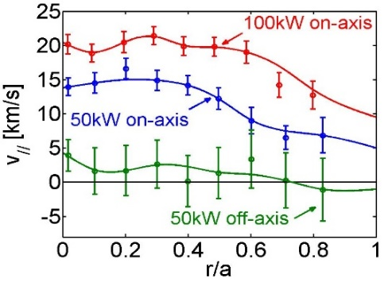
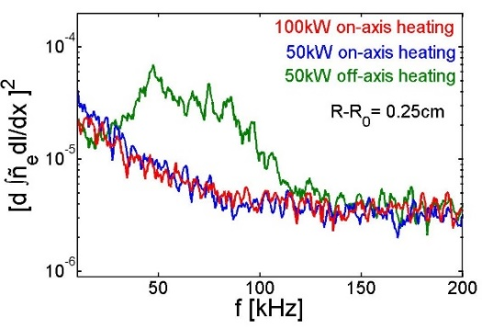
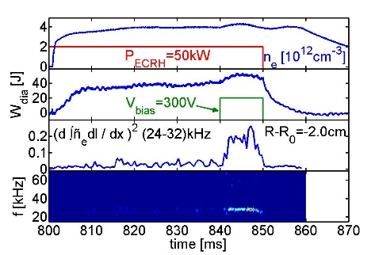


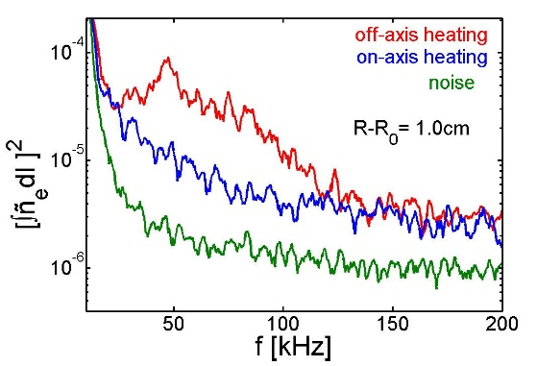
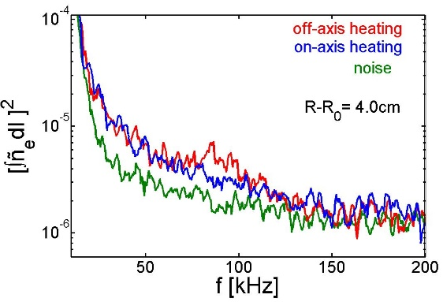
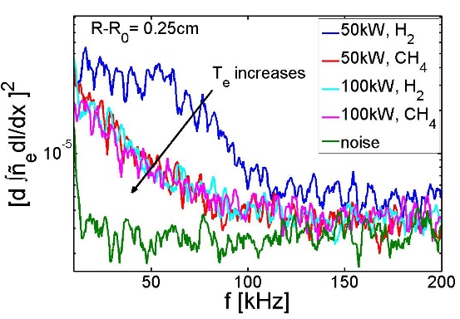
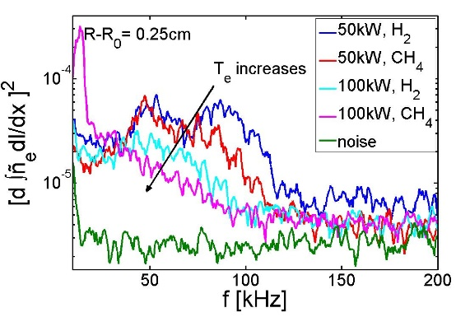
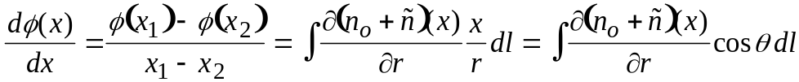
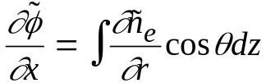
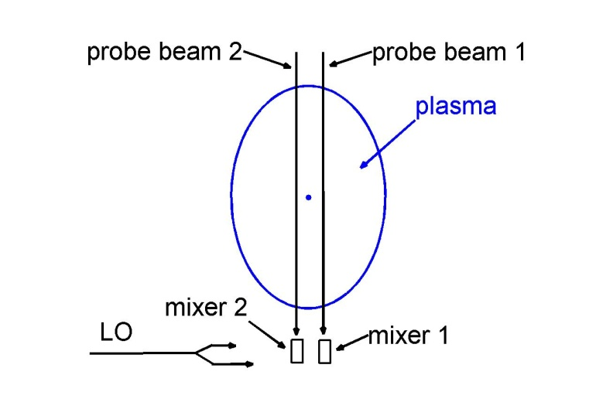
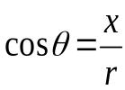
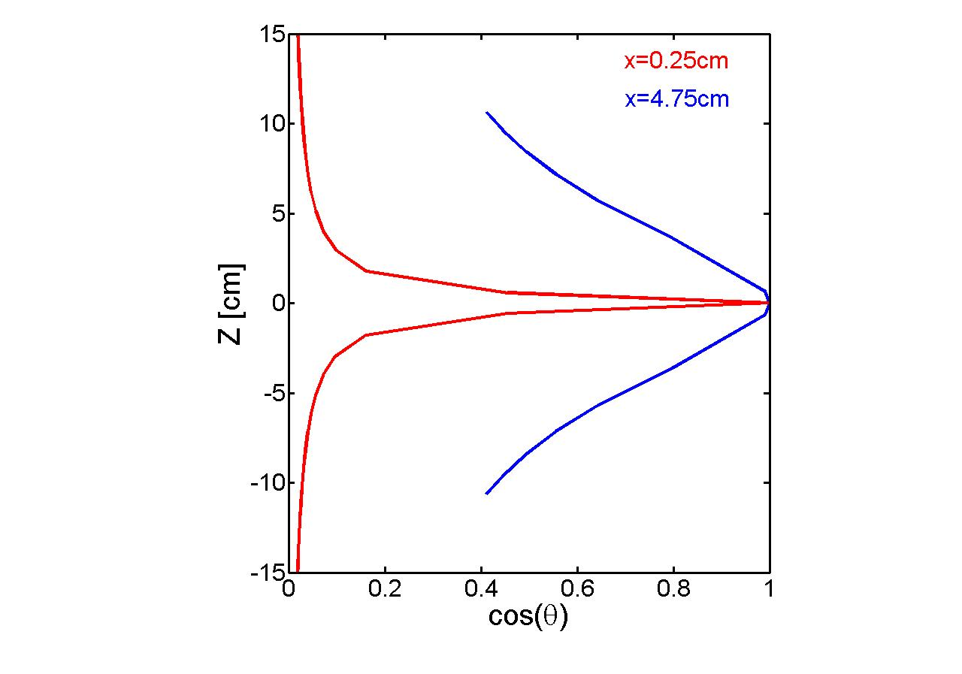
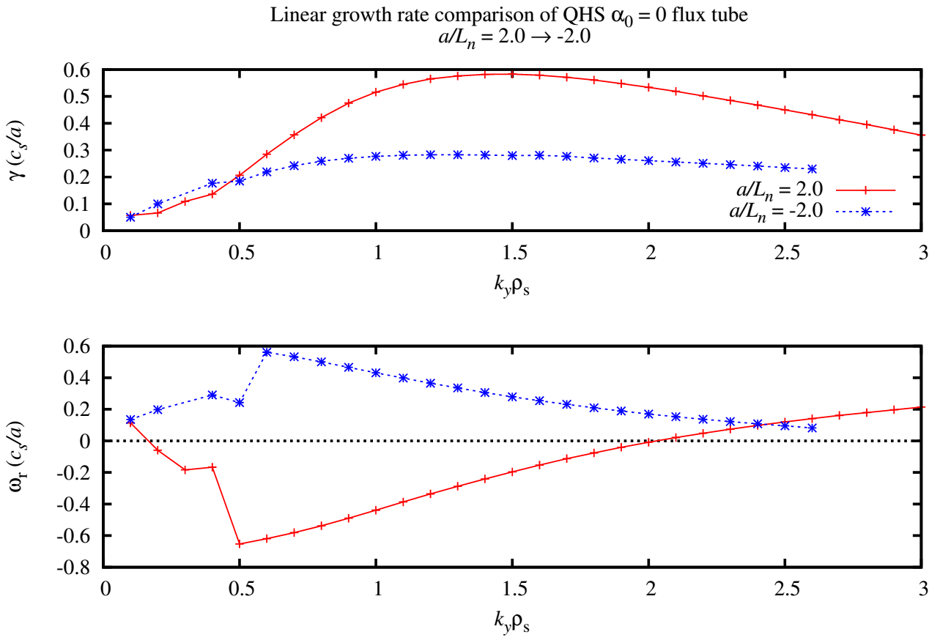



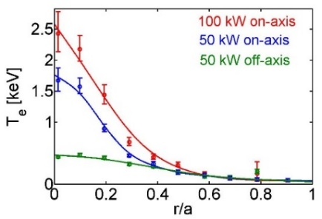
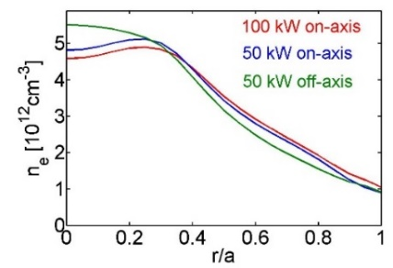
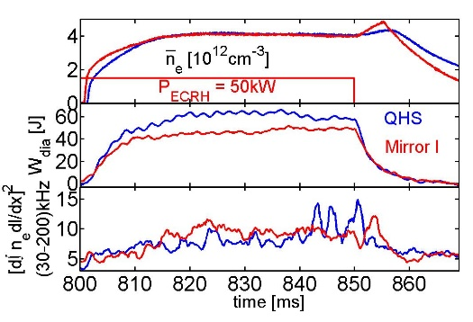
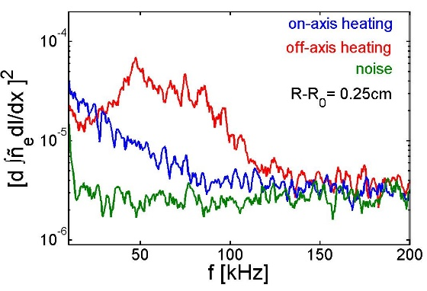
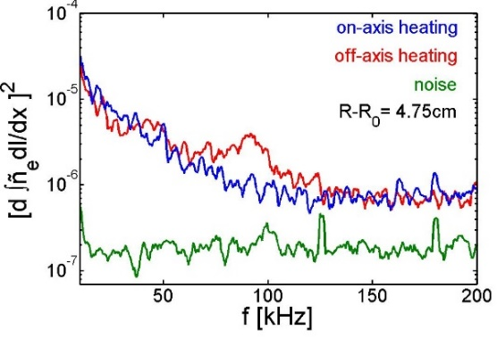
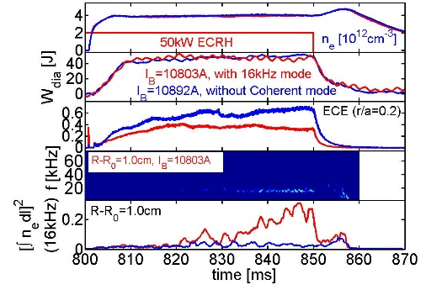
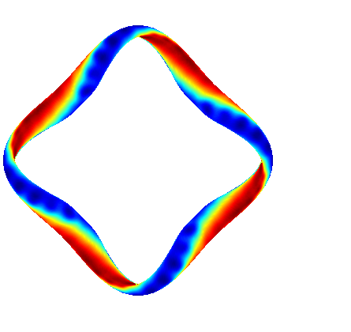
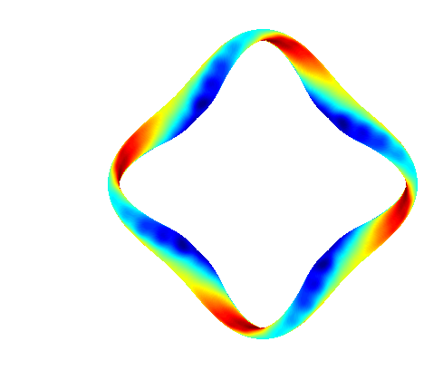
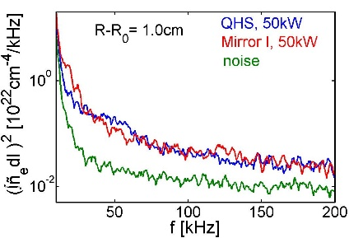
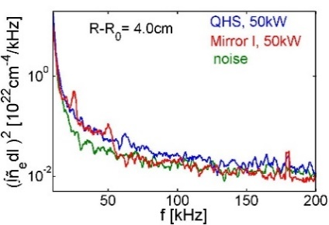
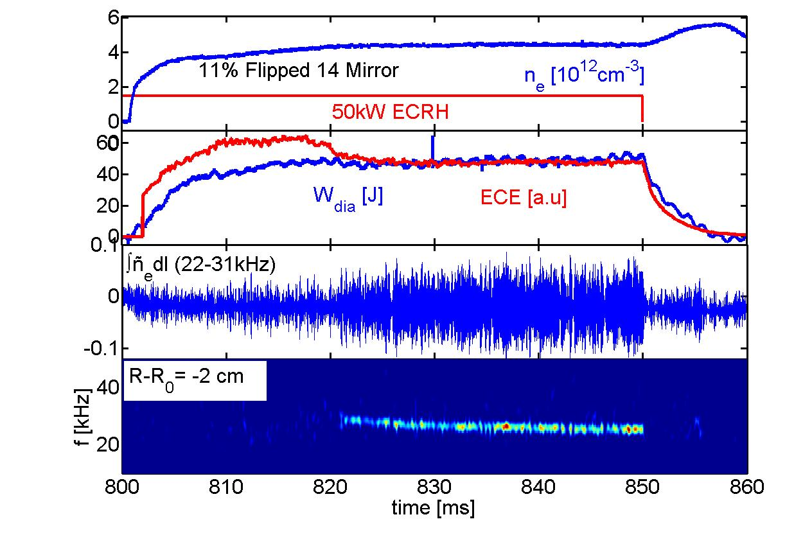
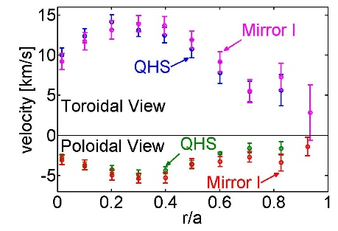
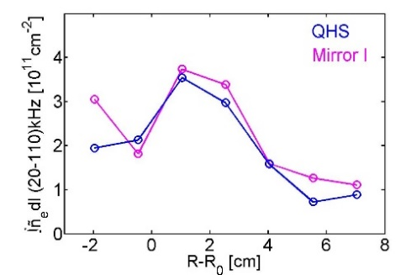
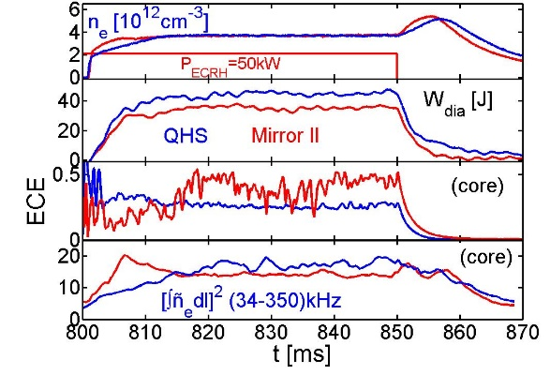
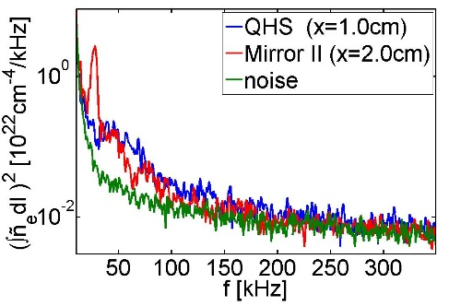
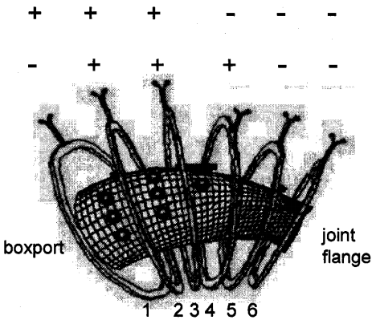
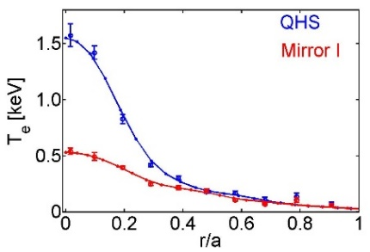
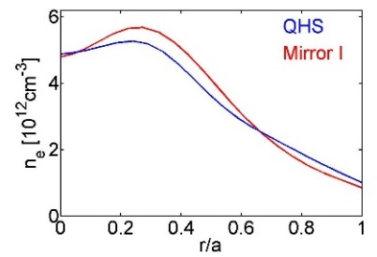
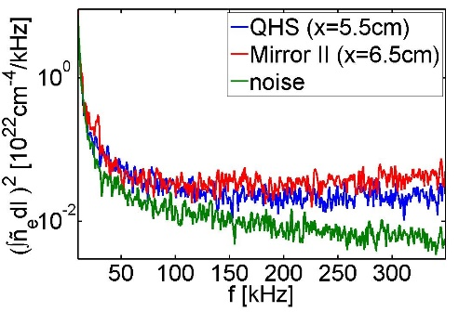
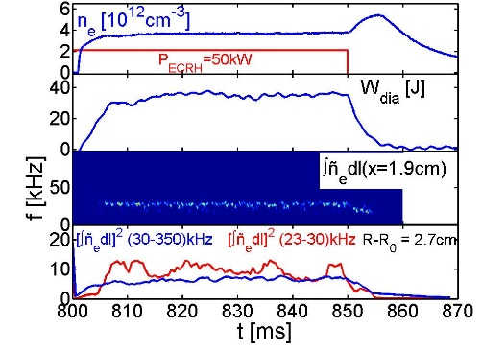
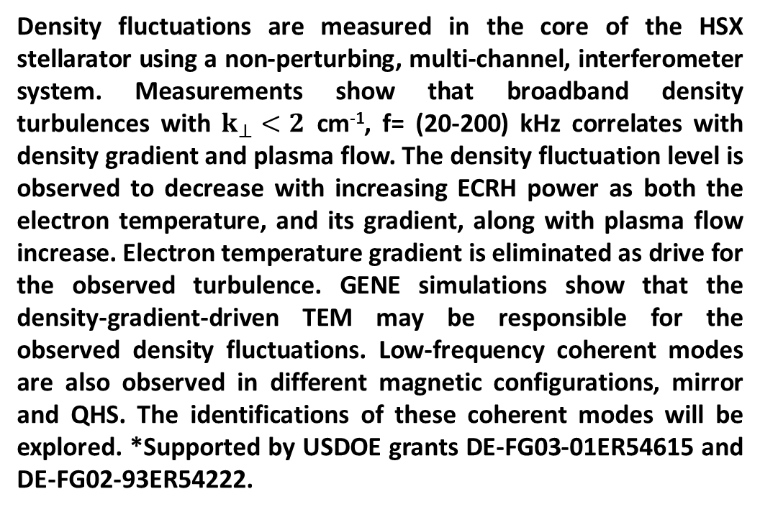

Core Density Fluctuations in the HSX Stellarator
C. Deng , D.L. Brower, University of California, Los Angeles,
D.T. Anderson, F.S.B. Anderson, A. Briesemeister, S. T. A. Kumar, K. Likin, J.N. Talmadge University of Wisconsin-Madison
Abstract
Interferometry System
Case I: Density Fluctuations Increase for QHS Plasmas With Off-axis ECRH
Coherent Modes in HSX With Bias
Density fluctuations are measured in the core of the HSX stellarator using a non-perturbing, multi-channel, interferometer system. Measurements show that broadband density turbulences with $k_{⊥}<2$ cm⁻¹, f= (20-200) kHz correlates with density gradient and plasma flow. The density fluctuation level is observed to decrease with increasing ECRH power as both the electron temperature, and its gradient, along with plasma flow increase. Electron temperature gradient is eliminated as drive for the observed turbulence. GENE simulations show that the density-gradient-driven TEM may be responsible for the observed density fluctuations. Low-frequency coherent modes are also observed in different magnetic configurations, mirror and QHS. The identifications of these coherent modes will be explored. *Supported by USDOE grants DE-FG03-01ER54615 and DE-FG02-93ER54222.
Flux Surface and Chord Positions
QHS Plasma 50 kW ECRH
Density fluctuations from all interferometer viewing chords.
Large Flows correlate with lower density turbulence!
Biasing excites coherent mode in QHS plasmas
Interferometer System:
1. 9 chords
2. 1 MHz bandwidth
3. 1.5 cm chord spacing, width
k⊥ < 2 cm⁻¹
Density fluctuations can be measured from information of:
Amplitude
Phase
Differential
on-axis ECRH
off-axis ECRH, inboard r/a=0.2
Profiles of density fluctuations in frequency range of (20-110)kHz
Parallel flow measured by CHERS
Biasing excited coherent mode sensitive to bias voltage and electron density
Bi-coherency is observed for this coherent mode on Langmuir probe signal.
Significantly lower T_{e} and stored energy for off-axis heated plasma while measured density fluctuations have larger amplitude.
Largest fluctuation change observed on central chords indicating a change in core turbulence
Core density fluctuations
Biasing enhance the coherent mode in Mirror I plasmas
Interferometry
(phase measurement)
Far-forward Scattering- amplitude
Core Density fluctuations increases with off-axis ECRH
Core density fluctuations vary inversely with P_{ECRH}
Biasing increases the coherent mode amplitude, but dose not change mode frequency
Coherent mode observed on magnetic probe when biasing
Core density fluctuations
Edge density fluctuations
On-axis heating
Off-axis heating (inboard)
1) Flow (parallel) is largest for on-axis power.
2) Doppler shift from plasma flow cannot account for
higher frequency density fluctuations with off-axis heating
–– lower flow but higher fluctuation frequency
3) Density turbulence largest for case with reduced flow (off-axis heating or lower power) and lower stored energy.
Differential Interferometry Measurement
(1) For density gradient and gradient fluctuations
Summary: Coherent modes in HSX
(2) For density gradient fluctuations
central chords provide core localization
Data suggest large parallel flows may be associated with reduced core plasma density turbulence!!!
QHS: magnetic ripple ε_{2/3} ~ 0.04%, mode observed when ECH at slightly inboard(r/a~0.06), observed on density and magnetic signals, f=(15-40) kHz, depend on heating locations and density;
Mirror I: ε_{2/3} ~ 0.3% , mode observed in certain density window ne~(3-5)x10¹²cm⁻³ , f=(20-30)kHz, observed only on density signals;
Mirror II: ε_{2/3} ~ 1.9% , f=(20-30)kHz, mode observed on density and magnetic signals;
When biased,
a) QHS: the f=15kHz mode is not affected by bias, but new coherent mode at f=(10-40)kHz is observed when electron density is lower than 3x10¹²cm⁻³ , and bias voltage is lower than 400V
b) Mirror I: coherent mode is enhanced, and magnetic feature is observed.
Outline
Geometrical
weighting factor
Linear GENE simulations show reduced growth rate with hollow density profiles
1. HSX configurations: QHS, Mirror
2. Density fluctuation measurement techniques
3. Measurement Results:
Case I: Fluctuation changes with heating location and power
Case II: Fluctuations in QHS and Mirror I configurations
Case III: Fluctuations in QHS and Mirror II configurations
Coherent fluctuations
4. Summary and future plans
Interferometer measurement shows:
Line-Integrated density fluctuations increase in amplitude for off-axis heating [ECRH inboard at r/a~0.2]
Increased fluctuation levels observed on central chords, not edge chords, indicating change in core turbulence
For both on-axis and off-axis ECRH: core density fluctuations are reduced in amplitude with increased heating
--- inconsistent with T_{e} drive for turbulence.
--- is density gradient playing a role?
Z
Linear growth rate is reduced with hollow density profile
Differential interferometer measurement confirms: density fluctuations increase is from the plasma core, not edge.
Temperature and Density Response to ECRH
$$ω_{e}^{∗}∙{\overline{ω}}_{d}<0$$
Electron temperature
Electron density
Case II: Comparison of QHS and Mirror I Plasmas
Core density gradient fluctuations
Edge density gradient fluctuations
Coherent Modes in HSX
Coherent modes appear more easily with higher magnetic ripple
E_{r} from biasing affects the mode amplitude and frequency
Mode frequency scales as acoustic velocity for QHS plasma, [not observed for coherent modes in Mirror I and II plasmas]
HSX Provides Access to Configurations With and Without Symmetry
ECRH Power: 50kW
Heating locations: on axis
Two different configurations:
Time evolutions
Coherent mode in QHS plasma
QHS: ε_{2/3}~0.04%
Mirror I : ε_{2/3}~0.3%
1) Electron temperature highest for 100kW on-axis heating,
2) Density profiles appear quite similar (peaking near magnetic axis)
3) Plasmas with largest T_{e} and T_{e} gradients have the lowest fluctuation amplitudes ----- inconsistent with T_{e} drive for turbulence
4) Plasma stored energy is largest for plasmas with high T_{e} and reduced core fluctuations
Core density gradient may be playing a role…..
Coherent mode (density fluctuation) is observed with slight (r/a~0.05) inboard offset of heating location
Coherent magnetic fluctuations observed on some Mirnov coils
ECE signals reduced when coherent mode present
No change in n_{e}(r)
Mode unknown….
QHS: helical axis of symmetry in |B|; predicted very low neoclassical transport Mirror: quasi-helical symmetry broken by adding a mirror field.
QHS
ε_{2/3}~0.04%
Plasma stored energy reduced for Mirror I plasma
Density fluctuations are quite similar for QHS and Mirror I plasmas.
Summary and Future Plans
Red→|B|>1.0 T
Blue→|B|<1.0 T
Broken Bands
Mirror
Case II: Comparison of QHS and Mirror I Plasmas
Coherent mode is sensitive to ECRH location
1. Interferometry and Differential Interferometry are used to measure density fluctuations in HSX
Non-perturbing measurement
line-integrated measurements; spatial information available
by comparing chords
differential interferometry is used to obtain core localized
measurements
2. For QHS plasmas
Significant changes (amplitude and frequency) of fluctuations
are observed with changes in heating location and power
measured density fluctuation change consistent with density
gradient drive (not T_{e} gradient)
Reduction of density fluctuations is accompanied by improved confinement and increased plasma flow.
3. Mirror plasmas:
Coherent mode observed in density fluctuations (and magnetic fluctuations, depending on specific mirror configuration)
broadband fluctuations and plasma flow similar to those in
QHS plasma.
Coherent modes are observed for different
configurations and plasma conditions
Future work will focus on identification of fluctuations and relation to transport and flows.
Similar Density fluctuations for QHS and Mirror I
Plasma flow unchanged between QHS and Mirror I
Coherent modes in Mirror I plasma
Mirror I:
ε_{2/3} ~0.3%
Mirror II: ε_{2/3} ~1.9%
Core density fluctuations
Edge density fluctuations
Velocity measured by CHERS views
Profile of density fluctuations
Case III: Comparison of QHS and Mirror II Plasmas
Coherent mode observed in Mirror Plasma for B_{T}=1 T (ccw)
Mode observed in density, not in magnetic signals
Density window for mode is narrow: (3.8-4.5)*10¹²cm⁻³
Decrease in ECE emission suggests decrease in energetic electron confinement.
QHS:Helical Bands of Constant |B|
Mirror: Helical Bands are Broken
Line-integrated Interferometer measurements show:
Core density fluctuations
QHS: ε_{2/3}~0.04% Mirror II : ε_{2/3}~1.9%
Density fluctuations are similar for QHS and Mirror I plasmas, at plasma core and edge.
Coherent mode is sensitive to electron density
+ (-): direction of current through auxiliary coils, which adds (subtracts ) B field to main field
ε_{2/3} : effective magnetic field ripple at r/a=2/3
T_{e} and n_{e} for QHS and Mirror I Plasmas
1) QHS: transport dominated by anomalous effects (suppressed neoclassical transport)
2) Mirror I: transport dominated by neoclassical effects
3) Plasma turbulence and flow are little changed between the 2 different magnetic configurations
Similarity of fluctuations, density gradient and flow consistent with Case I picture
Coherent modes in Mirror II plasma
,
Significantly lower T_{e} (T_{e} gradients) and stored energy for Mirror configuration is caused by increased
Electron temperature
Electron density
Plasma Stored energy 25% lower than that in QHS plasma
Broad band fluctuations do not have much differences at edge and core, but coherent mode appears for Mirror II plasma
CHERS measurement shows faster flow in Mirror II
Edge density fluctuations
Mode at f=(20-30)kHz is observed on interferometer, magnetic pick-up coils and Langmuir probes
Mode is intermittent, coherent
Mode not driven by energetic electrons ( mode exists for 5ms after ECRH)
Strong bi-coherency observed on Langmuir probe signals
helical axis of symmetry,
no toroidal curvature,
no toroidal ripple
Conventional stellarators exhibit poor neoclassical transport in
low-collisionality regime due to magnetic field ripple
neoclassical transport.
Density profile is slightly hollow for Mirror configuration
Data inconsistent with T_{e} drive for turbulence (similar to Case I)
consistent with Case I picture
Observed coherent may indicate existence of GAM
56th Annual Meeting of the APS Division of Plasma Physics, October 27-31, 2014, New Orleans, Louisiana

