Slide 1


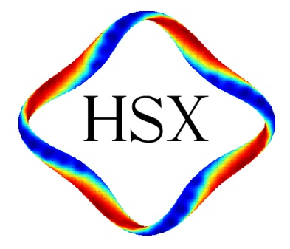
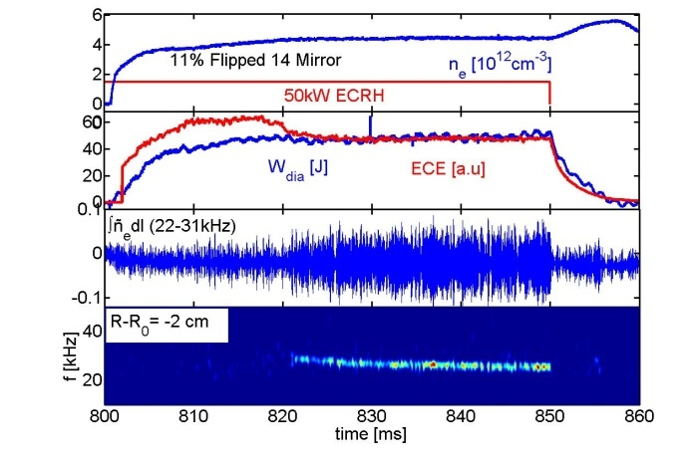
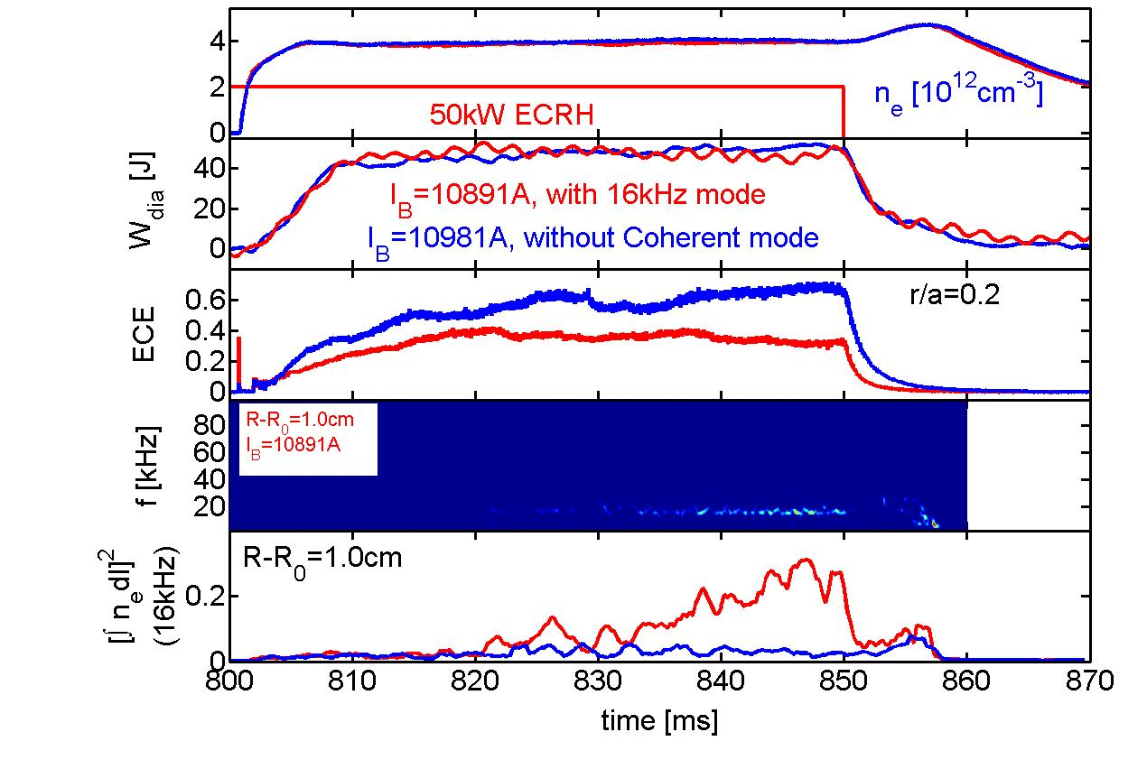
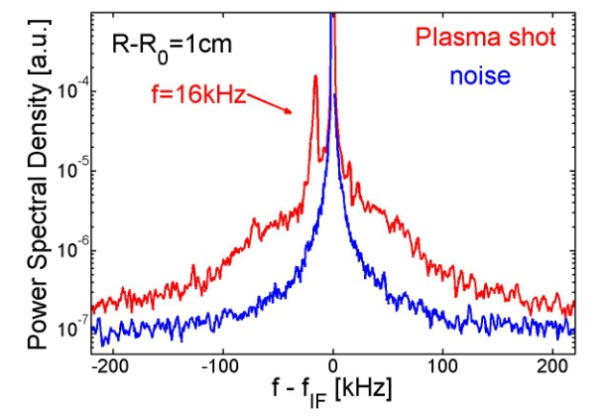
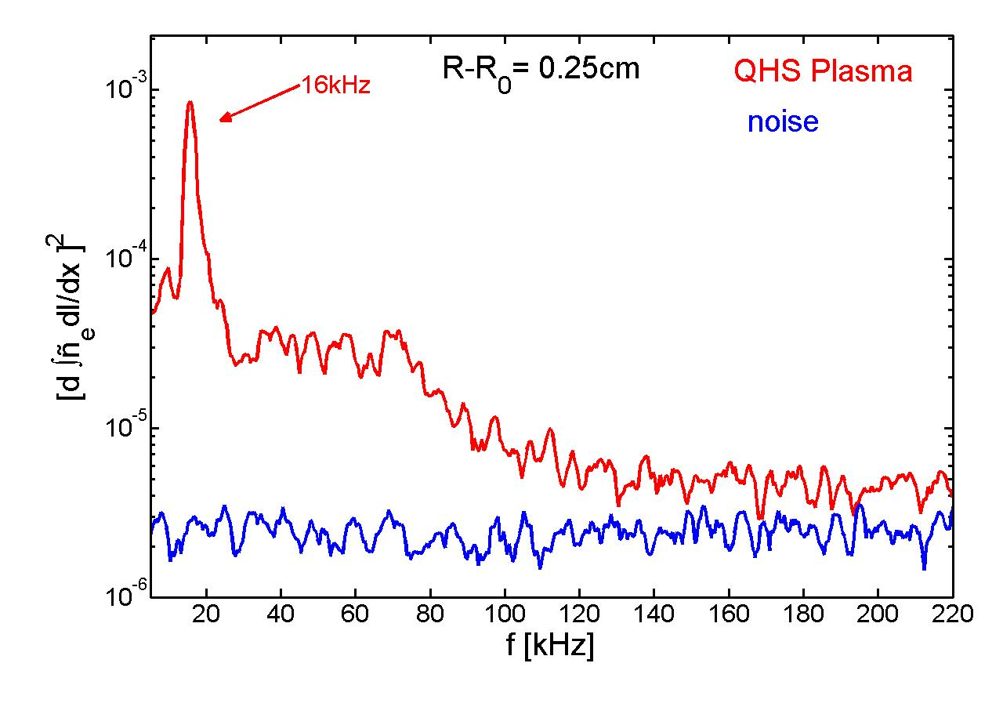
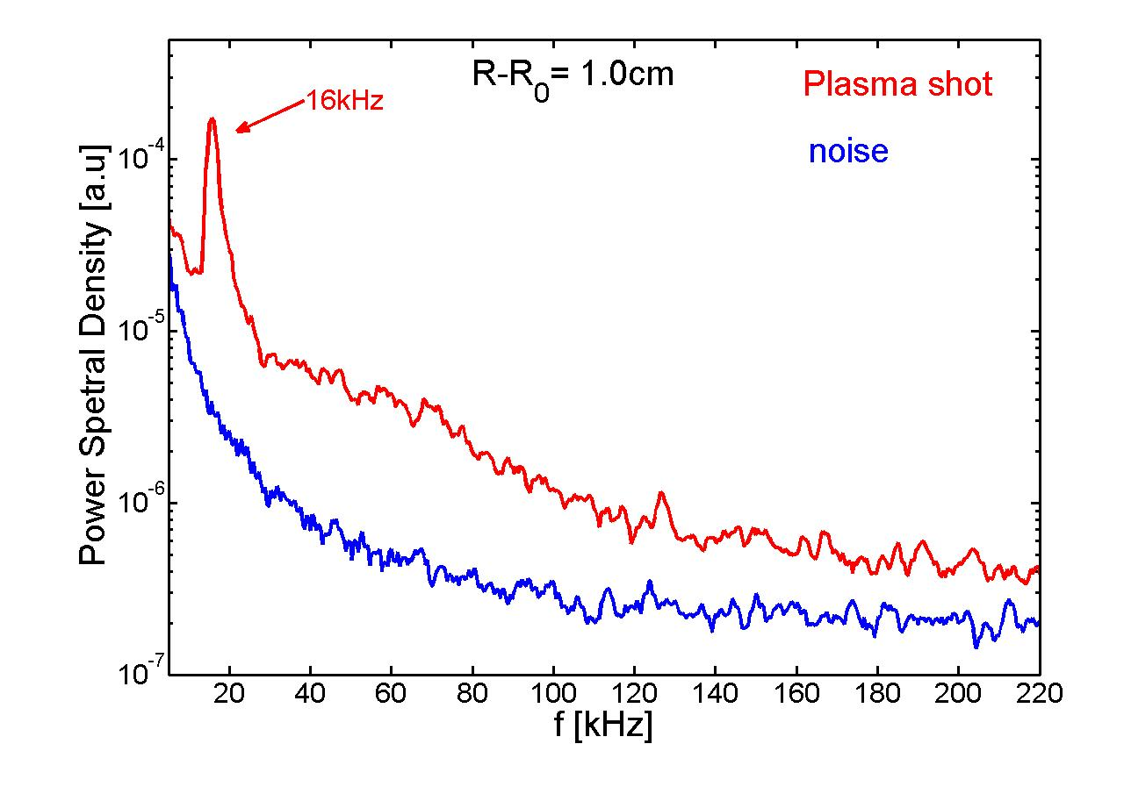
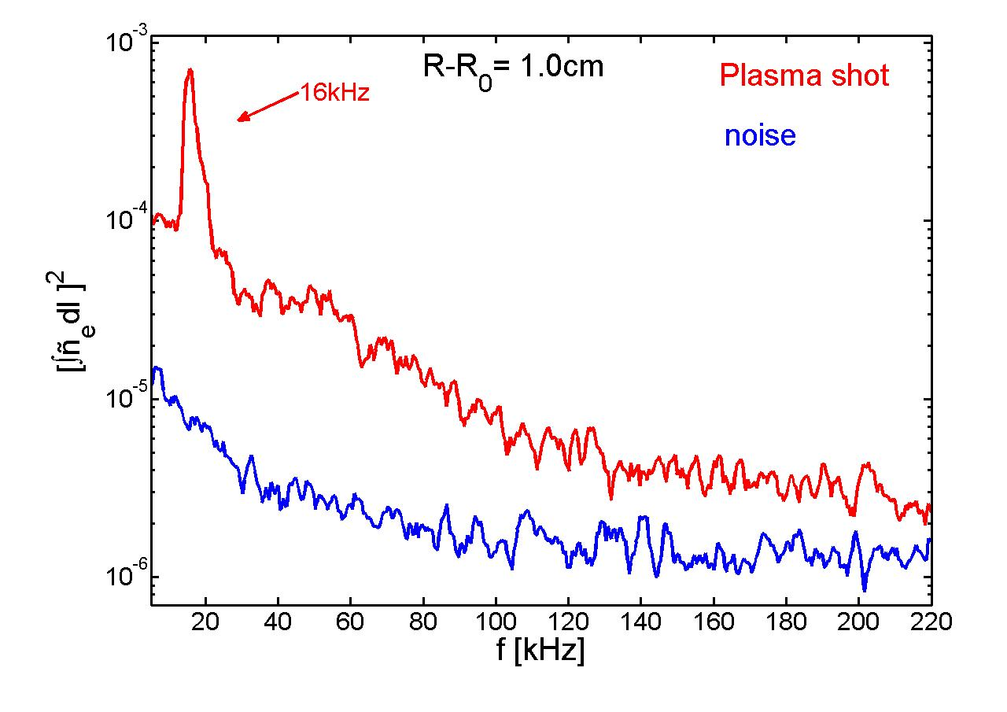
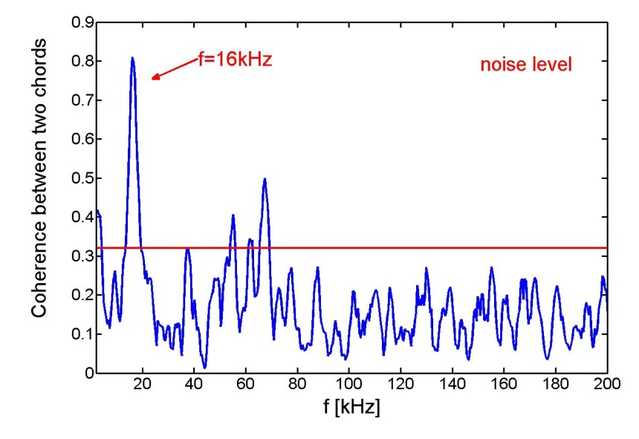
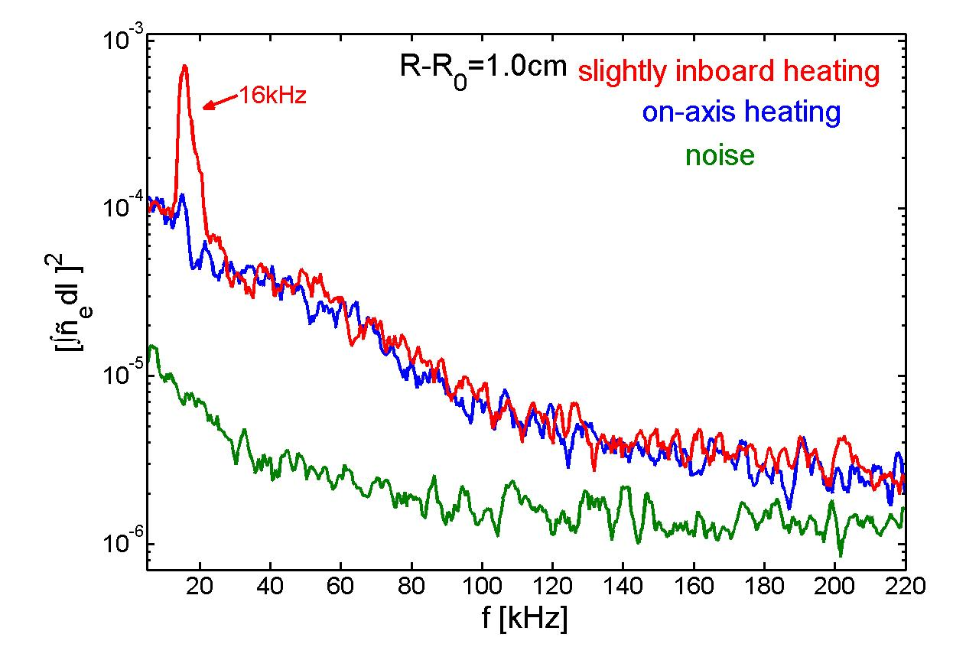
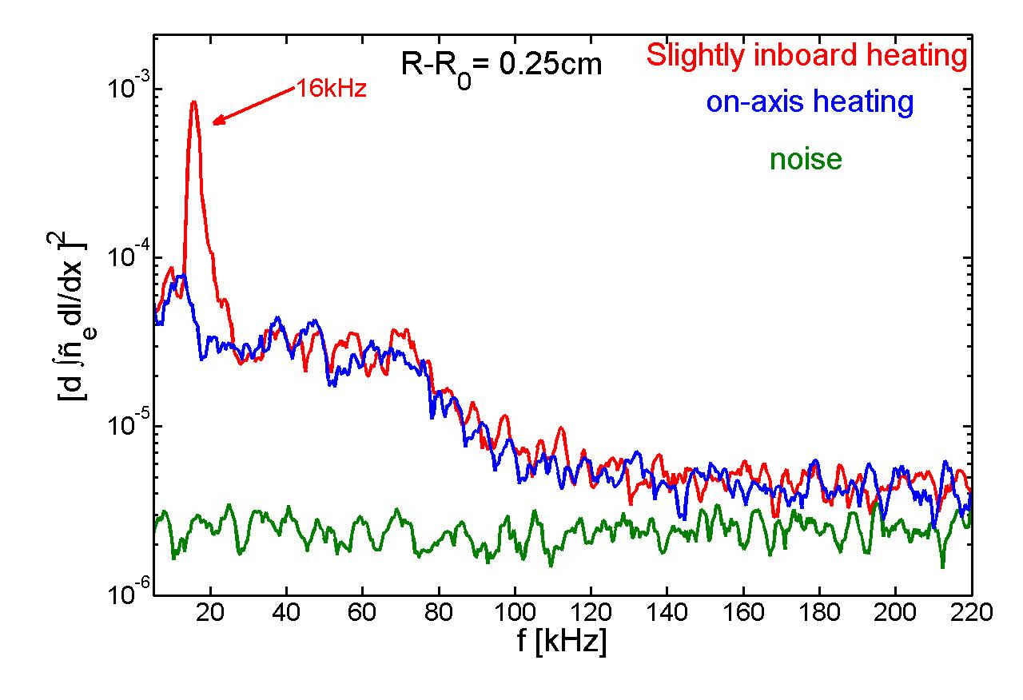
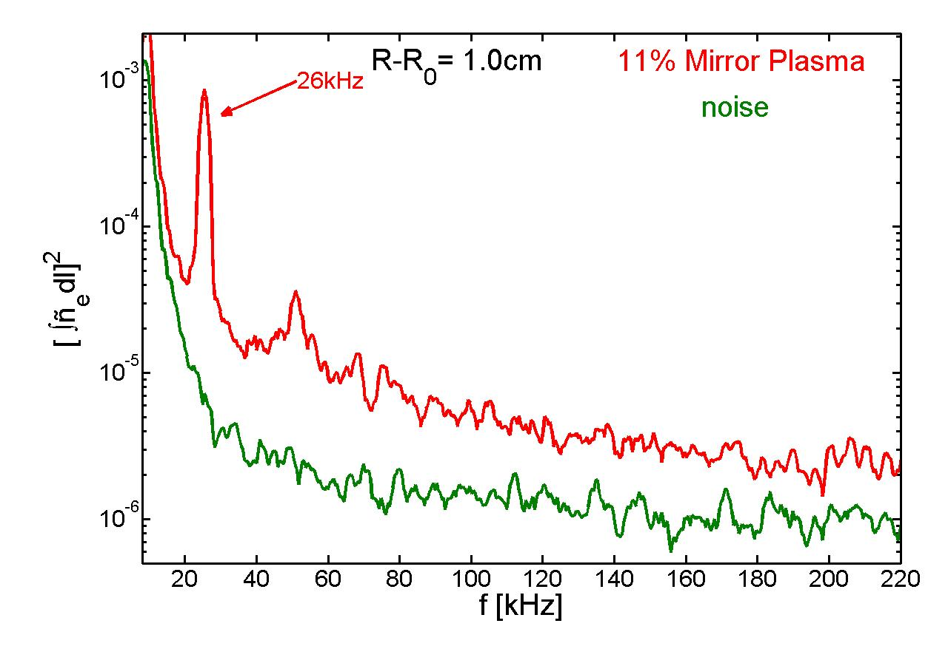
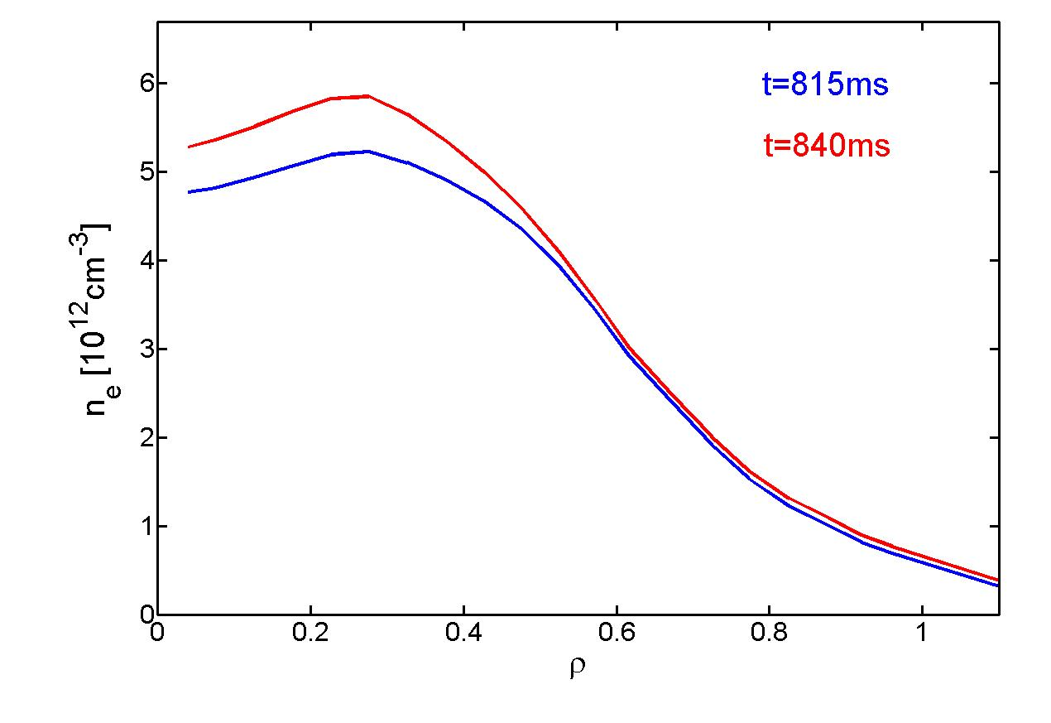
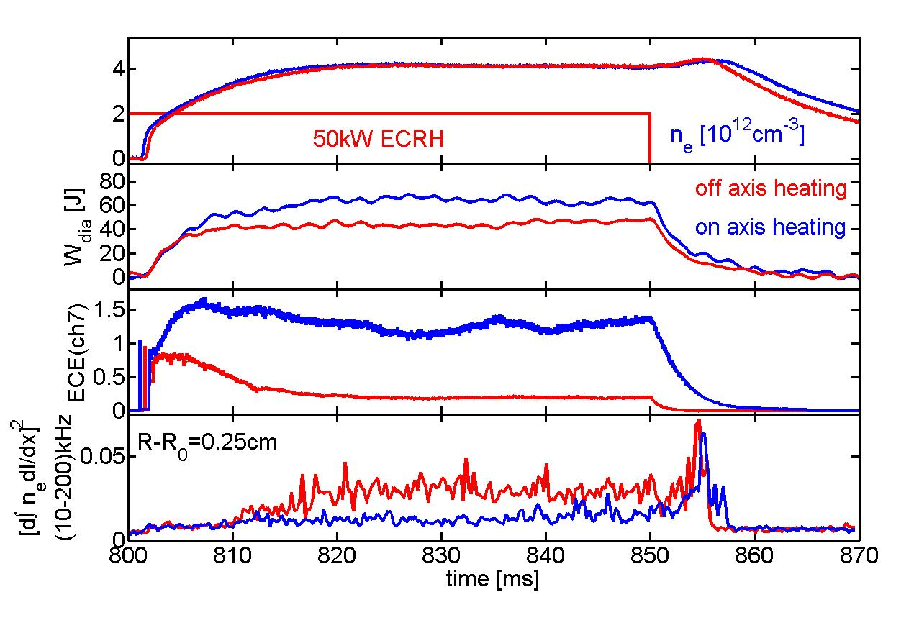
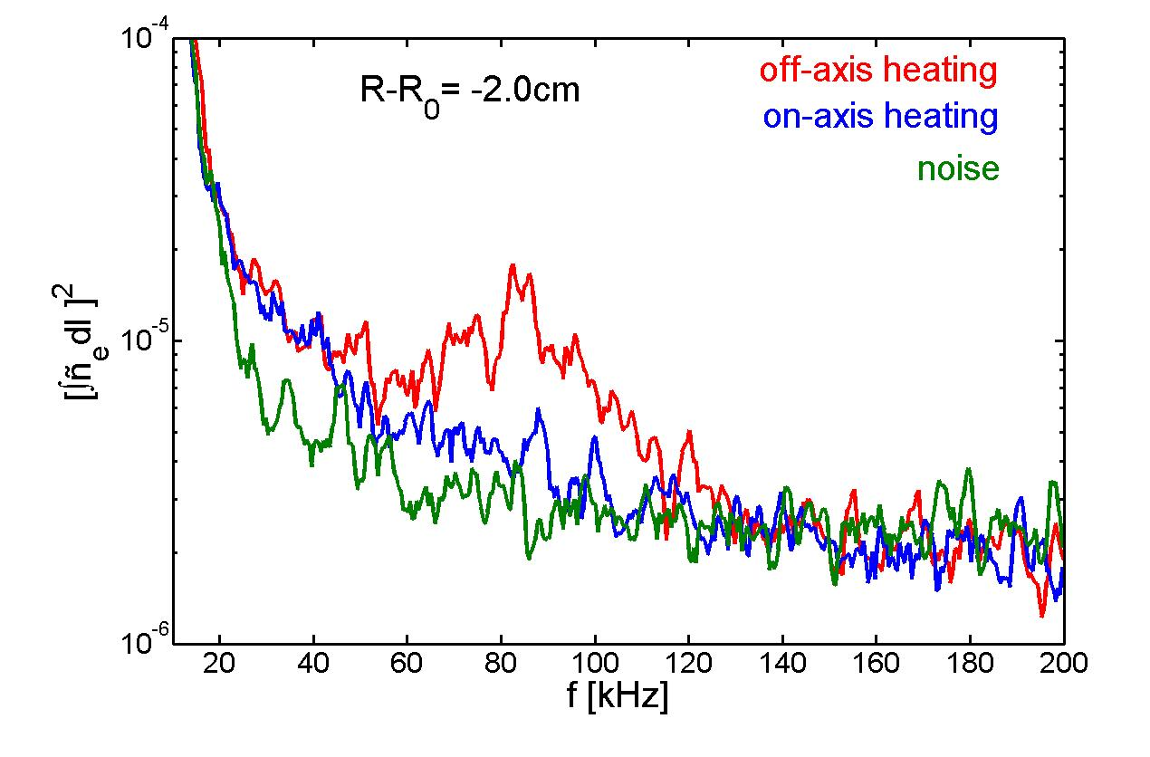
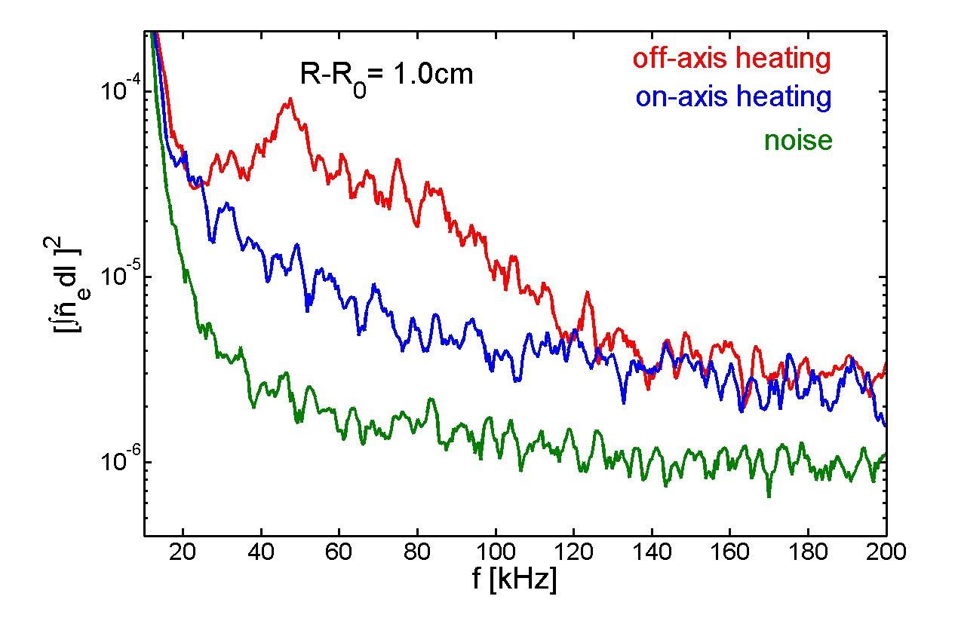
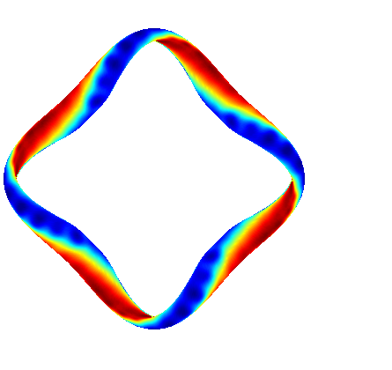
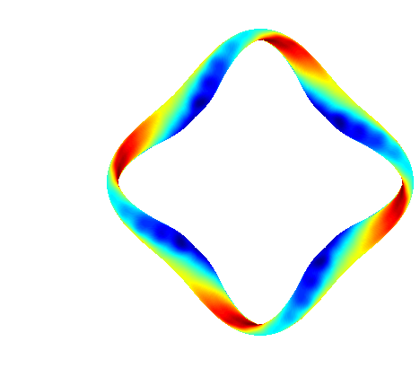
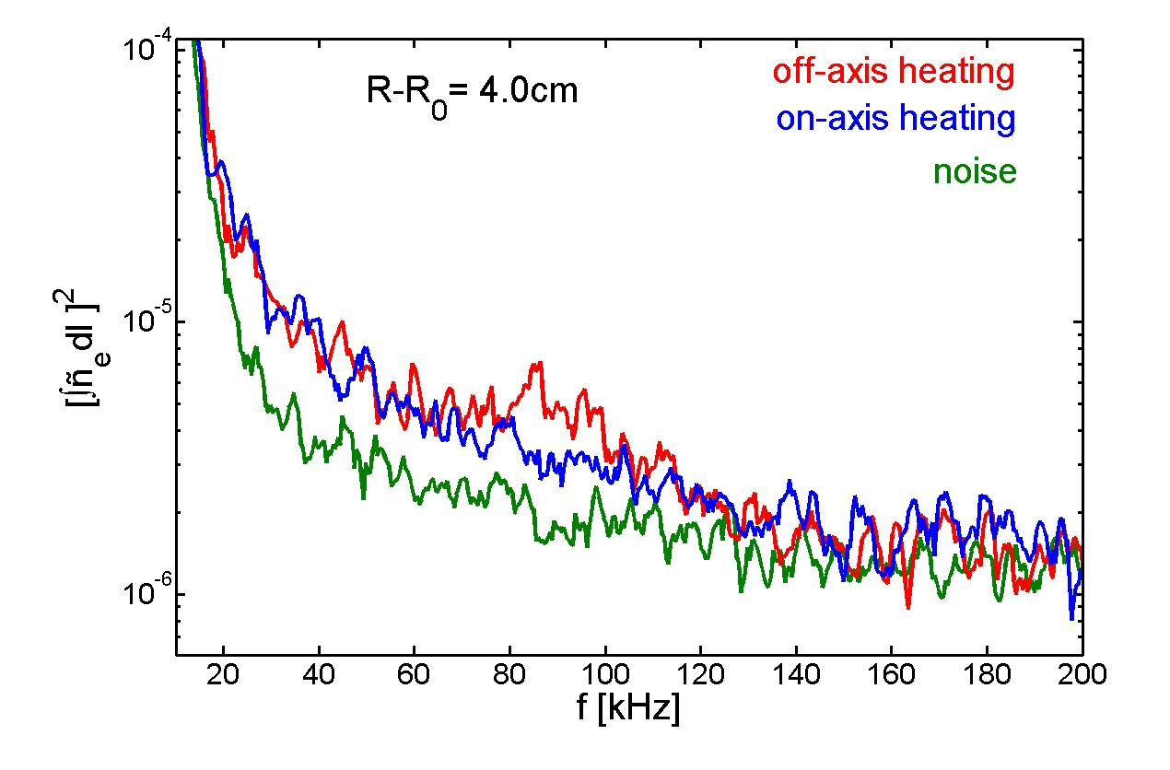
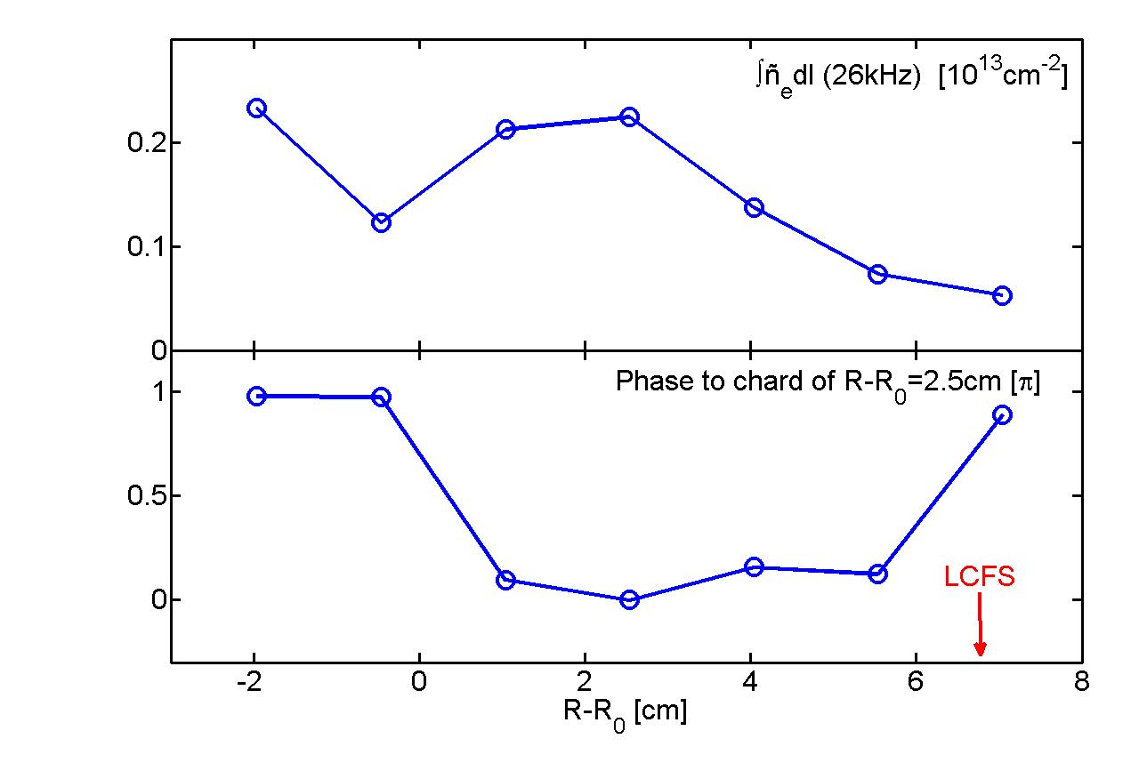
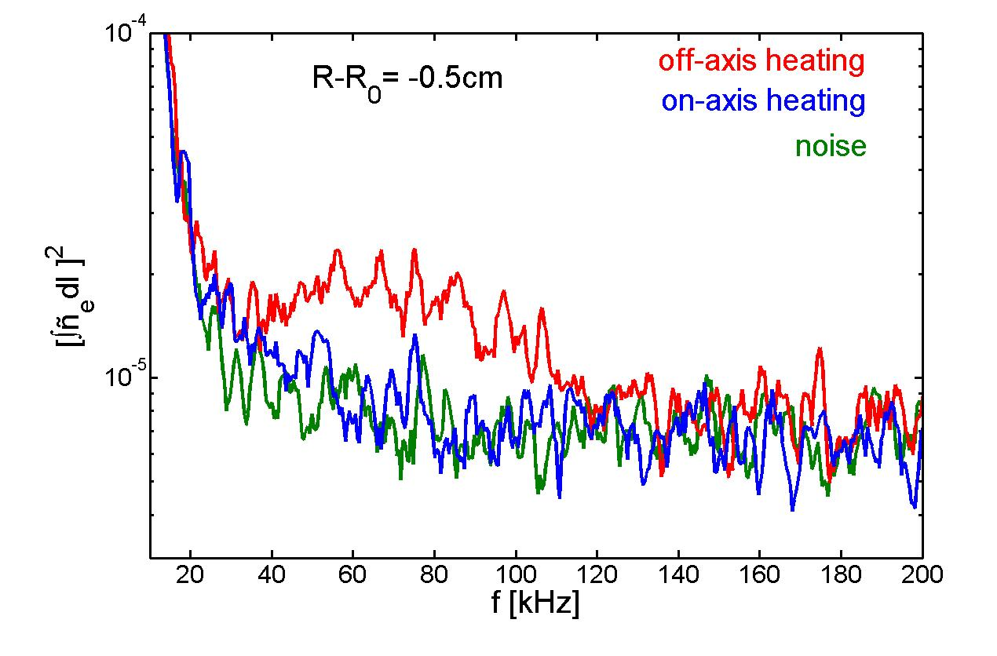
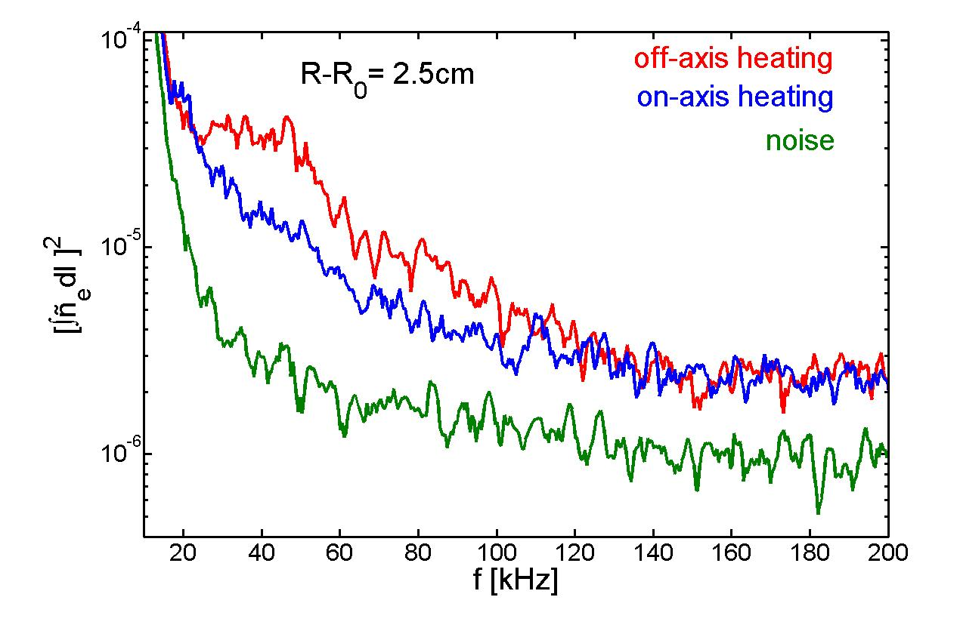
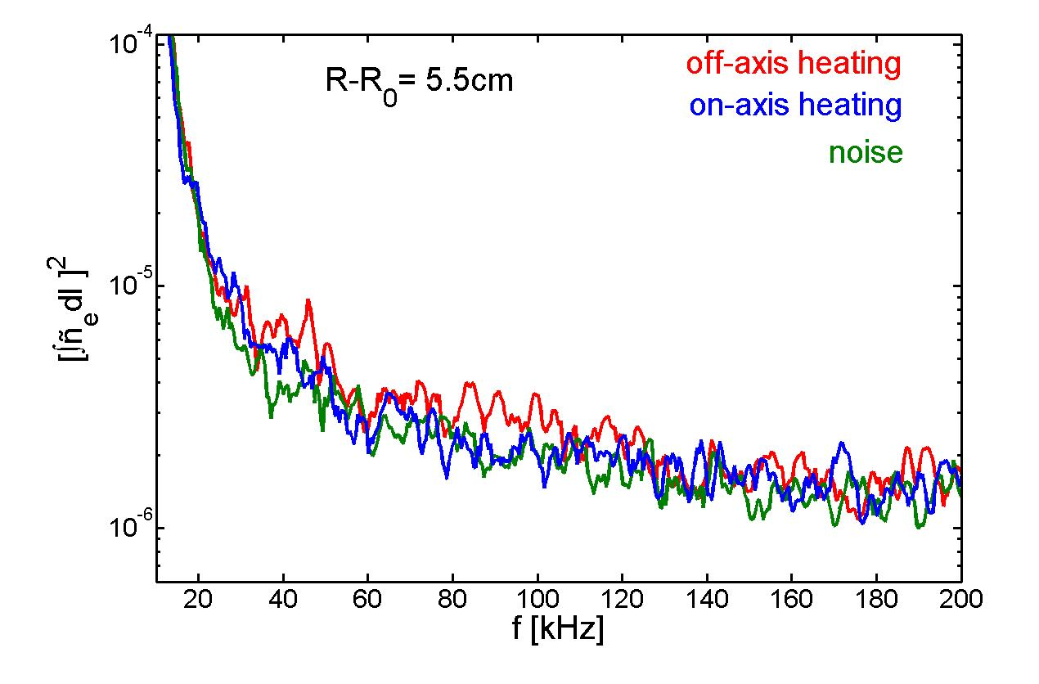
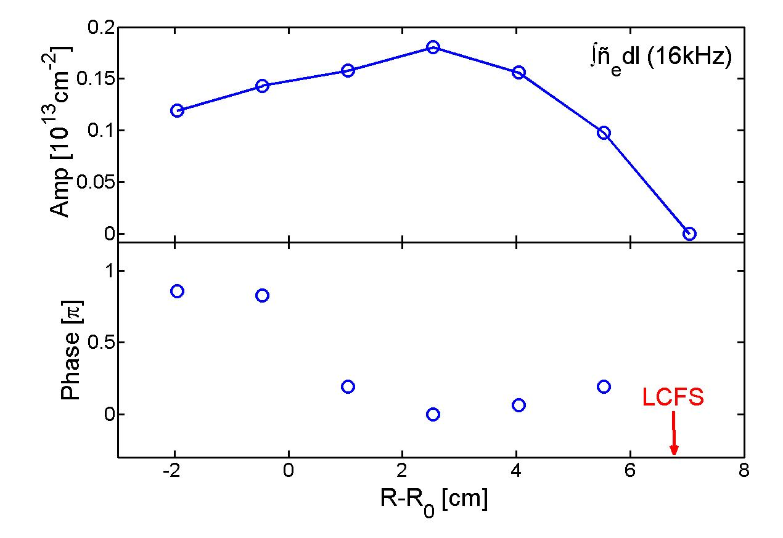
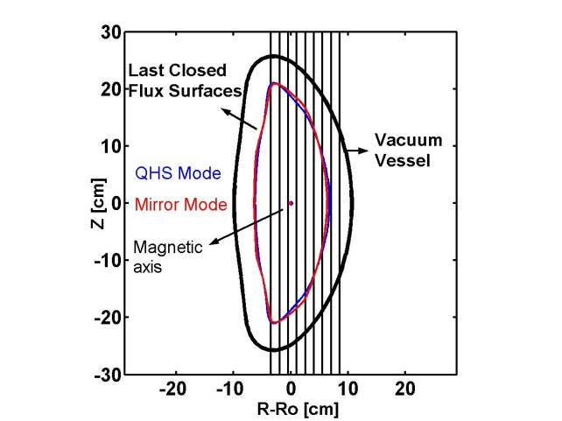
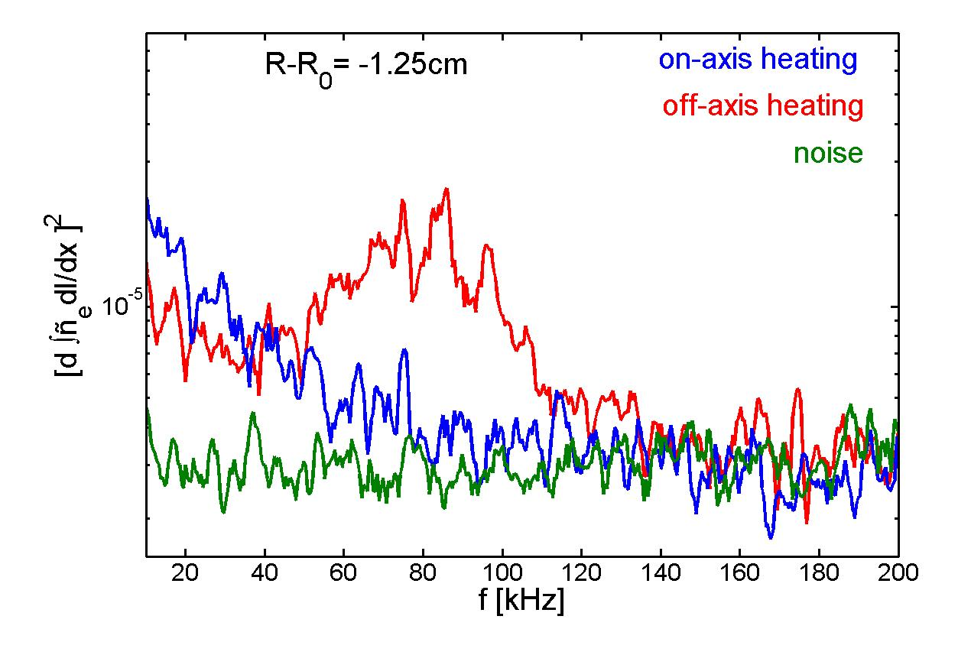
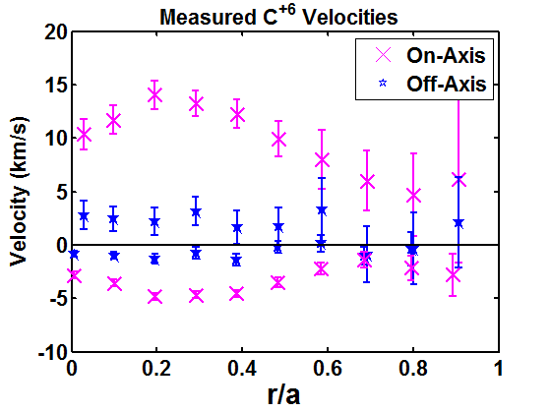
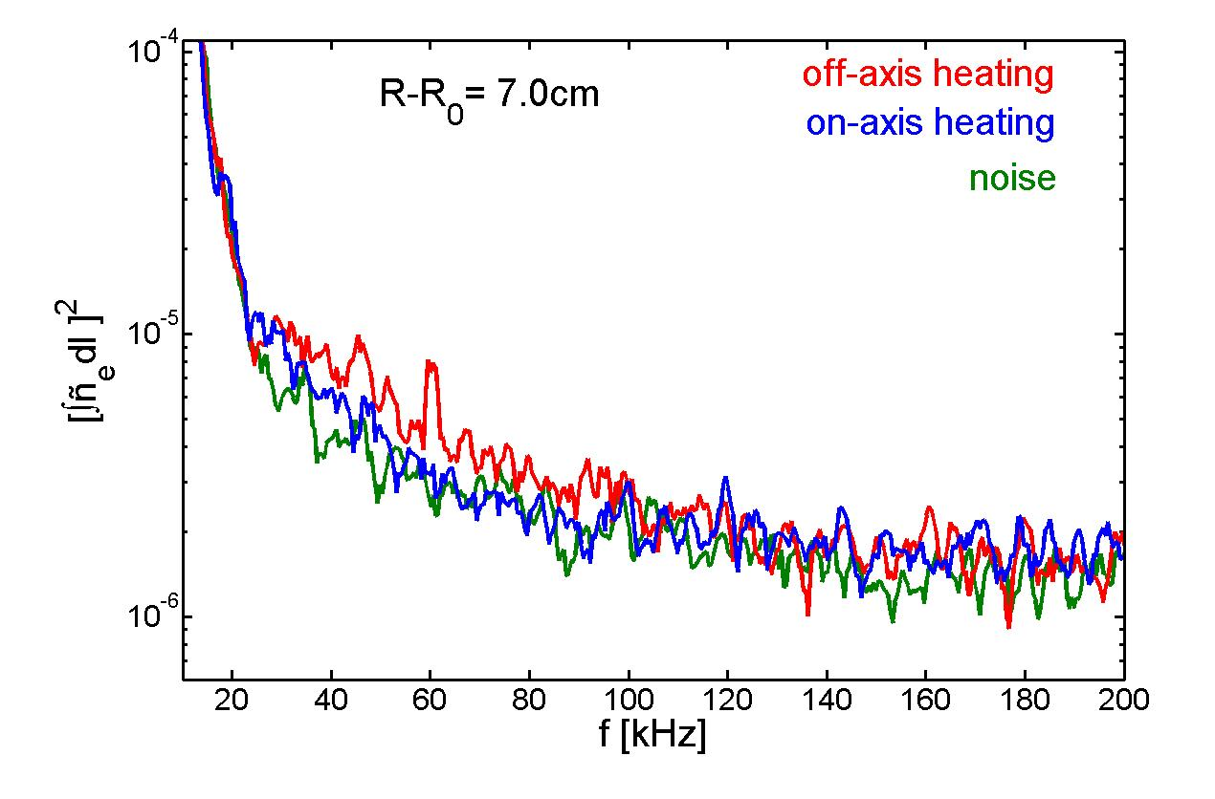
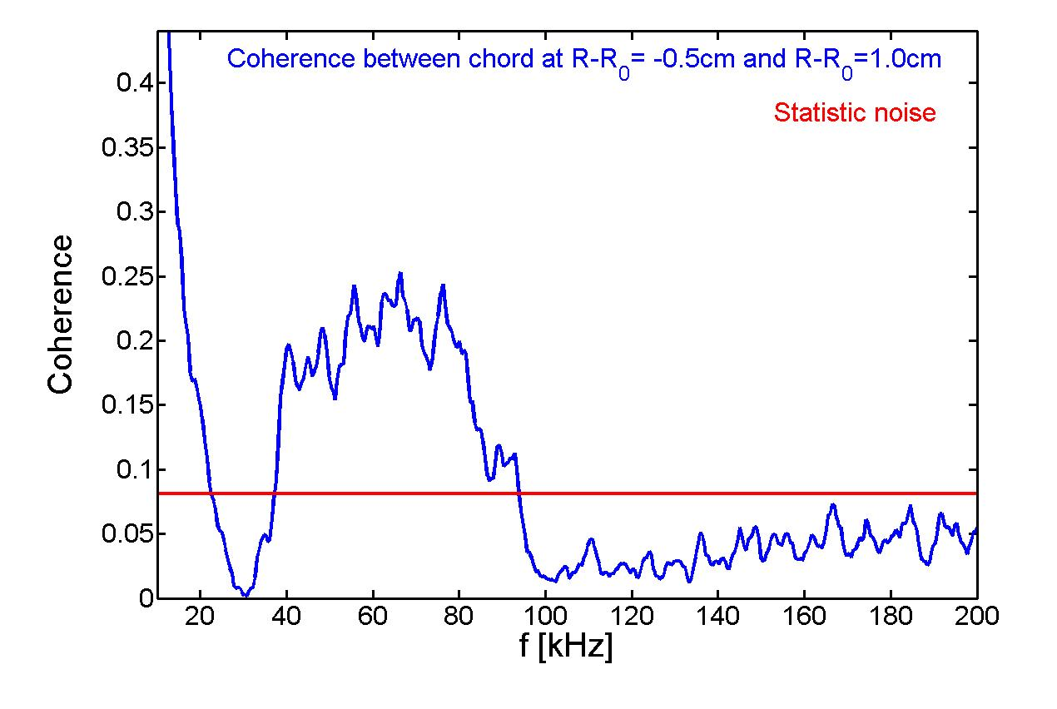
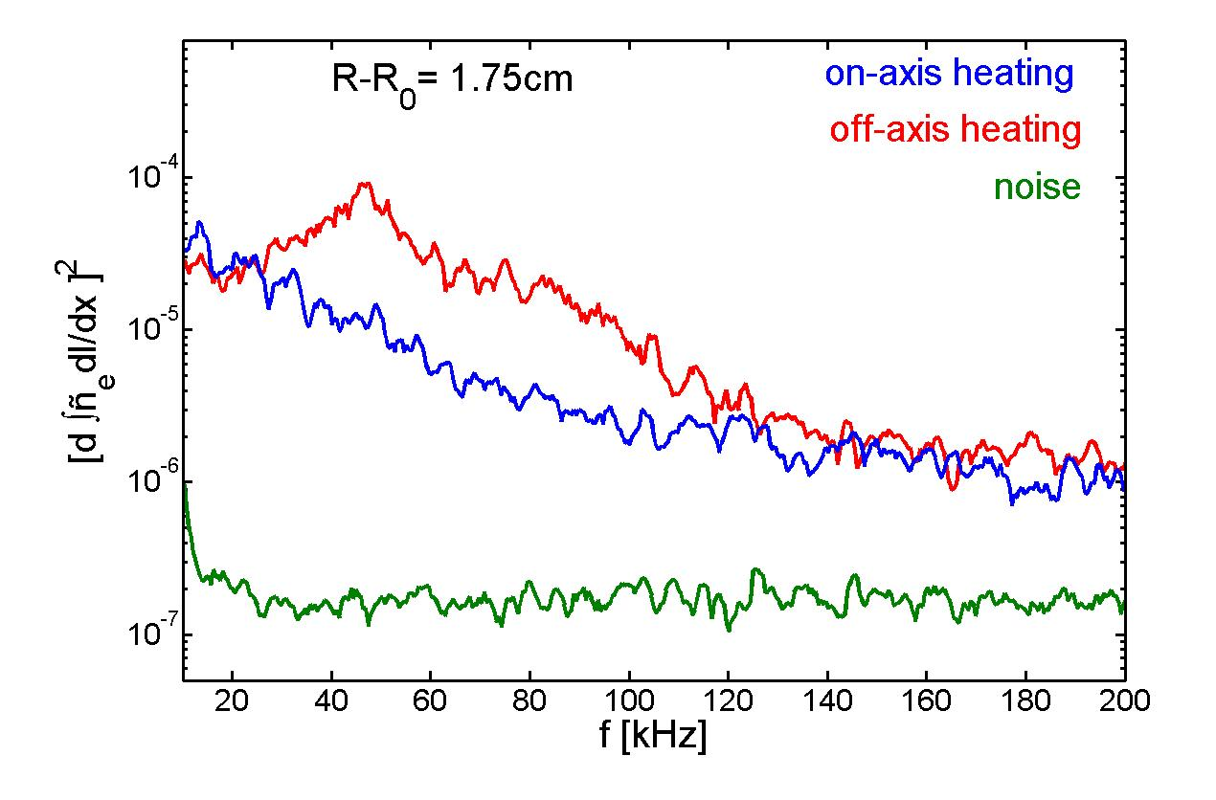
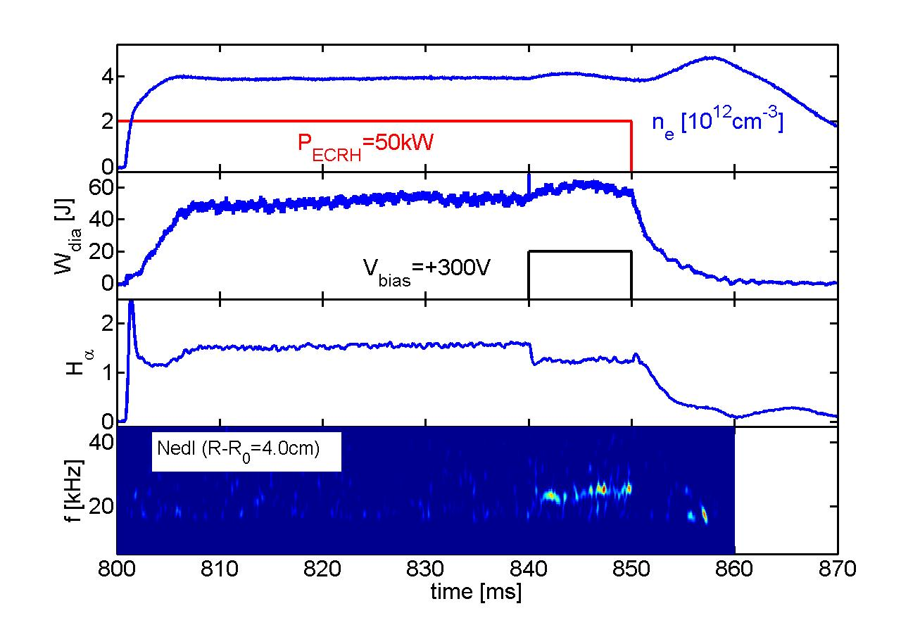
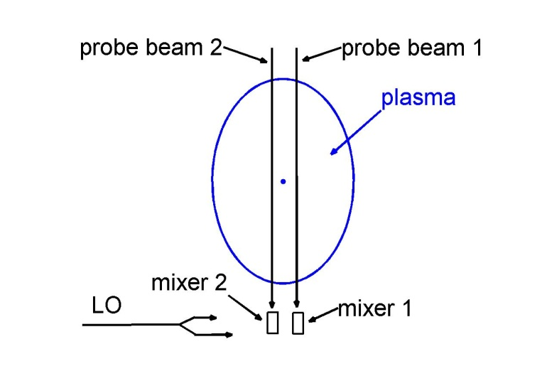
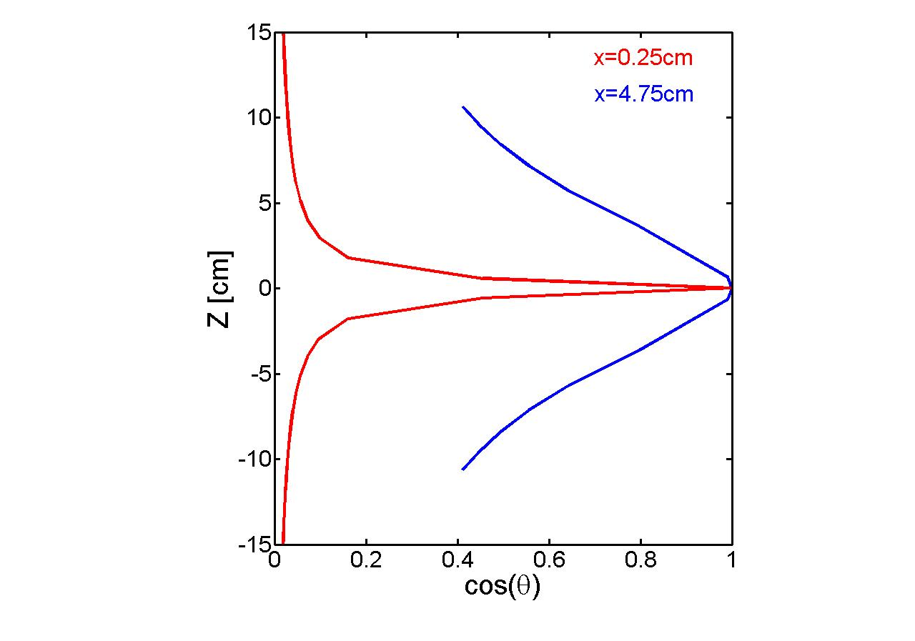
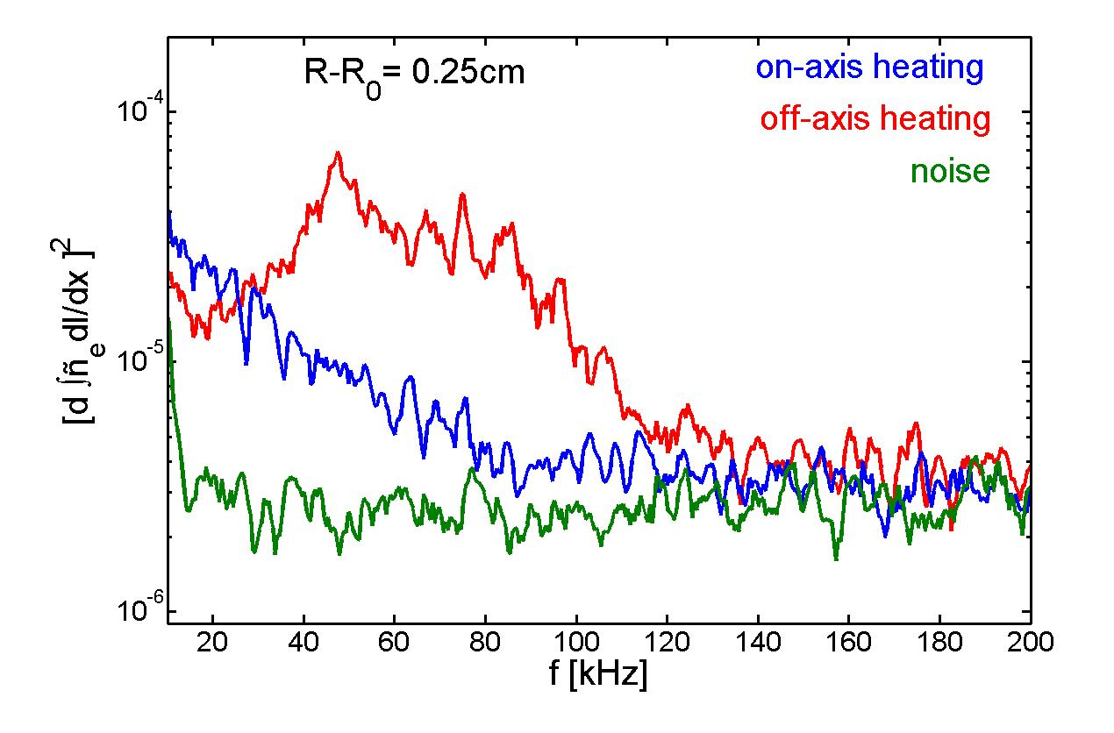
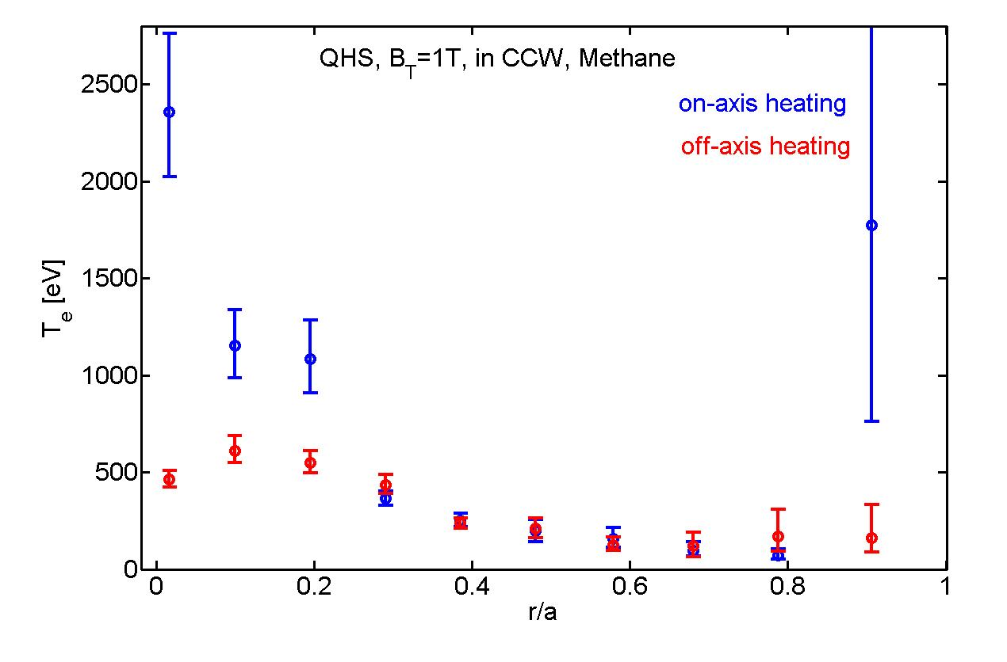
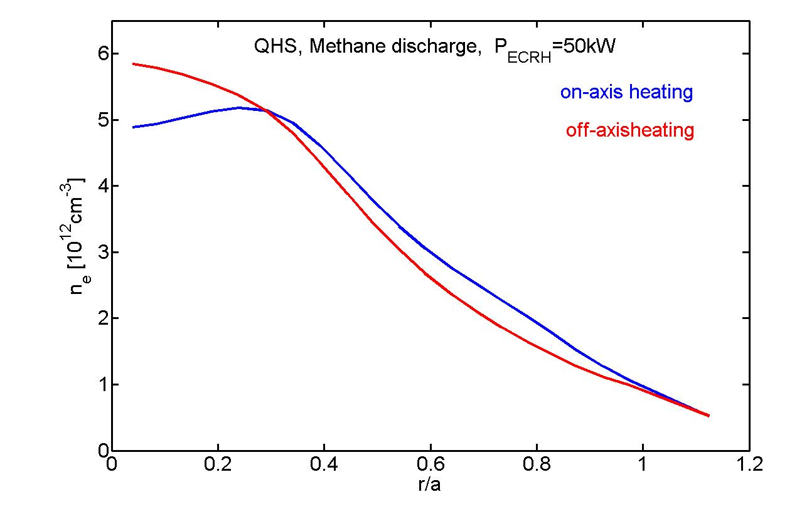
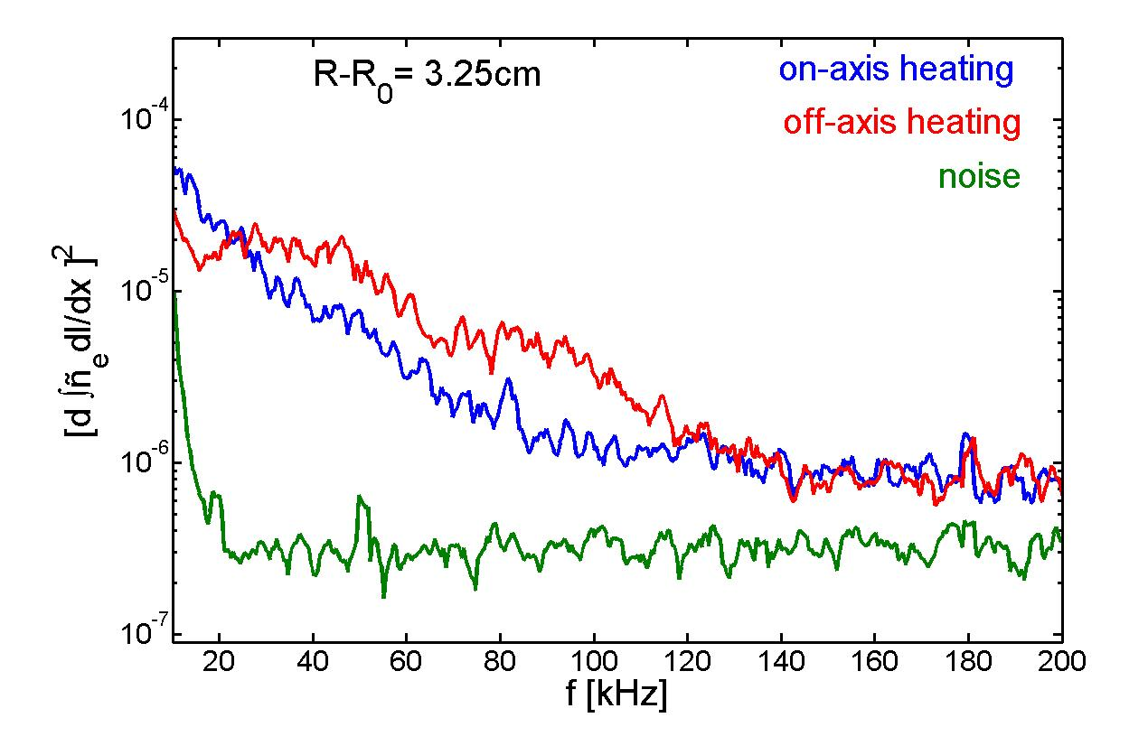
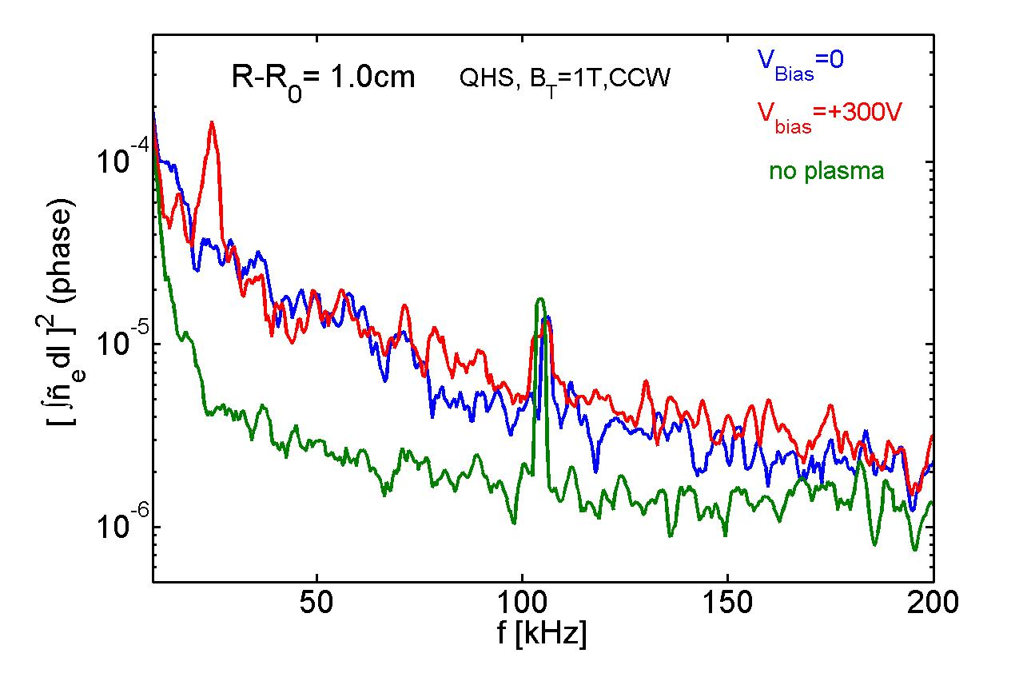
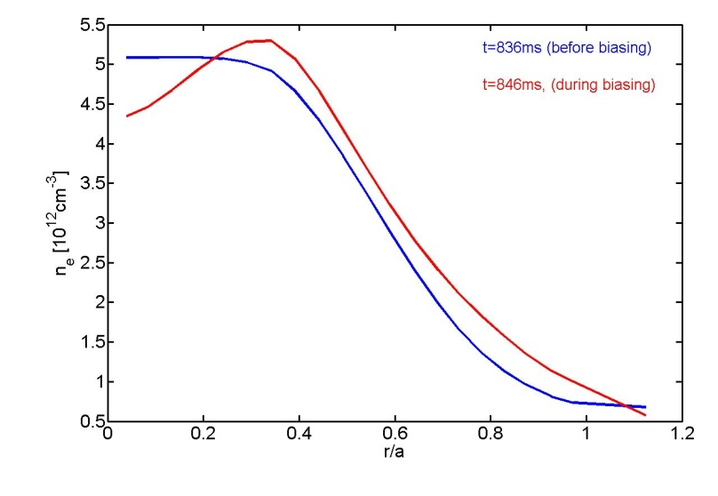
Core Density Fluctuation Measurements by Interferometry in the HSX Stellarator
C. Deng , D.L. Brower, University of California, Los Angeles,
D.T. Anderson, F.S.B. Anderson, A. Briesemeister, K. Likin, J. Lore, J. Schmitt, J.N. Talmadge, R. Wilcox, K. Zhai, University of Wisconsin-Madison
Abstract
Results From Three Techniques
Coherent mode in QHS Plasma
Coherent mode in Mirror Plasma
The multichannel interferometer system on the HSX stellarator is optimized to measure electron density fluctuations by utilizing both phase and amplitude techniques Information on core and edge fluctuations can be realized by comparing chords at different locations or by use of the differential interferometry approach. Both coherent modes and broadband density fluctuations with frequency up to 250 kHz are measured. For quasi-helically symmetric plasmas with B_{T}=1.0 T, significant changes (both amplitude and frequency) in the turbulent density fluctuation spectrum are observed when heating location changes from on-axis to high field side. Density fluctuation amplitude and frequency decrease with increasing of ECRH power (Te). Changes in fluctuations will be compared with measurements of plasma flow (by CHERS) as well as electron density and temperature profile modifications. When HSX is operated without quasi-helical symmetry at B_{T}=1T and n_{e}= 4x10¹² cm⁻³, a coherent electrostatic mode at 28 kHz is observed. Fluctuation sensitivity to changes of heating location and ECRH power were not observed for these plasmas.
Coherent and Broad Band Fluctuation Measured by Far-Forward Scattering
Interferometer and Far-Forward Scattering Show Similar Results
Density Fluctuations from Differential Interferometry Measurement
Coherent mode (density fluctuation) is observed for slightly inboard heating
Magnetic fluctuations observed on some Mirnov coils
ECE signals reduced when coherent mode present
No change in n_{e}(r)
B_{T}=1T in CCW direction
Coherent mode observed in Mirror Plasma for B_{T}=1 T (ccw)
Mode observed in density, not in magnetic signals
Density window for mode is narrow: (3.8-4.5)* 10¹² cm⁻³
Decrease in ECE emission suggests decrease in energetic electron confinement
Plasma Conditions:
B_{T}=1T, Counter Clockwise, QHS
Main Field Current I_{B}=10891A
n_{e}=4x10¹²cm⁻³ , P_{ECRH}=50kW
Scattering measurements
R-R_{o}=1.0 cm
1. Broadband fluctuations
2. Coherent mode at 16 kHz (stronger on neg. side)
3. Coherent mode observed on magnetic coils
Far-Forward Scattering
Interferometry
Provides measure of
density gradient fluctuations
Directly measures phase
difference between
adjacent chords
[R-Ro: +1 and -0.5 cm]:
Coherence between two chords
Differences in coherent mode for Mirror and QHS configurations:
Mirror: density fluctuation only; QHS: both density and magnetic fluctuation
Mirror: sensitive to equilibrium density; QHS is not
Mirror: sensitive to direction of B field [cw or ccw]; QHS is not
Mirror: not sensitive to I_{B} (heating location); QHS case is very sensitive to I_{B}
Lower noise level and core localization for differential interferometer measurement
Frequency Spectrum of Density Fluctuations
HSX – Quasi-Helically Symmetry Stellarator
Density Fluctuations Increase with off-axis Heating (QHS plasma, Bt=1T in CCW)
Density fluctuations
Density gradient
fluctuations
Frequency Spectrum
No Significant Change in Density Profile
HSX Provides Access to Configurations With and Without Symmetry
Plasma Parameter Time Traces
Significant change in density fluctuations with heating location for central chords
No change in density fluctuations with heating location for edge chord chords
QHS: helical axis of symmetry in |B|
Mirror: quasi-helical symmetry broken by adding a mirror field
Plasma Parameters
major radius: 1.2 m
minor radius: 0.15 m
magnetic field: 1 T;
ECRH: 28 GHz ,
<150 kW
pulse length: < 50 ms
on axis heating:
I_{B}=11000A
off axis heating:
I_{B}=10600A
Red→|B|>1.0 T
Blue→|B|<1.0 T
No changes for broad band fluctuations
coherent mode was observed for slightly inboard heating
Amplitude and Phase
QHS
Mirror
mode amplitude is higher on high field side
π phase shift observed across magnetic axis (m is odd)
mode not observed on external magnetic coils
Input ECH power are similar, but significantly lower stored energy for off-axis heated plasma. Measured density fluctuations are of larger amplitude and at higher frequency for off-axis heating.
Amplitude and Phase of the Coherent Mode
Amplitude
QHS: helical bands of constant |B|
Mirror: helical bands are broken
Density mode amplitude peaked near plasma edge
Density shows π phase shift across magnetic axis; m is odd
Weak Magnetic fluctuations, external coils suggest m=1
Phase
Interferometry System
Core localized measurement of Density gradient fluctuations shows large increase in amplitude for off-axis heating
Summary and Future Plans
Measurement Techniques
Flux Surface and Chord Positions
1. Interferometry, Differential Interferometry and Far-forward Scattering are used to measure density fluctuations in HSX
- line-integrated measurements, some spatial information
available by comparing chords
- differential interferometry is used to obtain core localized
measurements
2. Both coherent modes and broadband fluctuations are observed
3. For QHS plasma
- Significant changes (amplitude and frequency) of fluctuations
are observed when heating location changes from on-axis
heating to HFS heating
- Density fluctuation amplitude and frequency decrease with
of electron temperature
- core density fluctuations increase and confinement degrades
with off-axis heating
- coherent mode observed on density and magnetic when
heating slightly off-axis
4. Mirror plasma:
- Coherent mode observed on density fluctuation signal only,
- mode not sensitive to ECRH location
Future work will focus on identification of fluctuations
1. Interferometry (phase measurement)
2. Far-Forward Collective scattering
(a) collective scattering within the
divergence of the beam
(b) amplitude measurement
3. Differential Inteferometry
Interferometer System:
1. 9 chords
2. 1 MHz bandwidth
3. 1.5 cm chord spacing, width
k⊥ < 2 cm⁻¹
Density fluctuations can be measured from information of:
Amplitude
Phase
Differential
Coherence between two adjacent central chords
Plasma flow reduced for Off-Axis Heating Case
Doppler shift (reduced) cannot account for higher frequency density fluctuations with off-axis ECRH
Coherent mode in biased QHS plasma with V_{bias}=+300V
Coherent mode observed in Biased QHS Plasma, and while broad band fluctuations did not change
Mode observed in both density, and magnetic signals
Localized Density Fluctuation Gradient Measurement
Electron Temperature and Density Profiles
(1) For density gradient and gradient fluctuations
[differential interferometry]
1) For equivalent ECRH power, off-axis heating
results in lower stored energy and lower core
temperature
2) Plasma flow is significantly reduced with
off-axis heating. Doppler shift cannot account
for change in frequency or amplitude of density
fluctuations
3) Increased core density fluctuations with off-axis
heating ; may act to degrade energy confinement
T_{e} (Thomson Scattering)
n_{e} (Interferometer)
Frequency Spectrum
Density Profile
(2) For density fluctuations (m=1) [standard interferometry]
Z
Very peaked Te profile flat or slightly hollow density profile (dTe/dr driven diffusion) negative density gradient reduction of density fluctuations
53rd Annual Meeting of the Division of Plasma Physics, November 14-18, 2011, Salt Lake City, Utah

