Slide 1
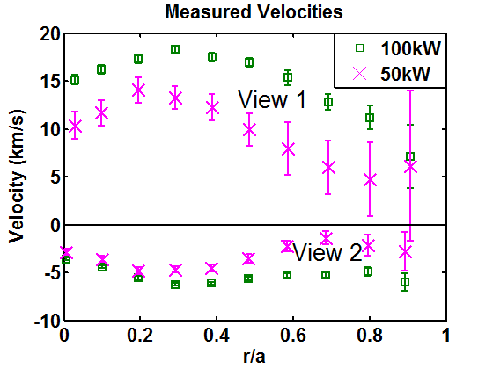
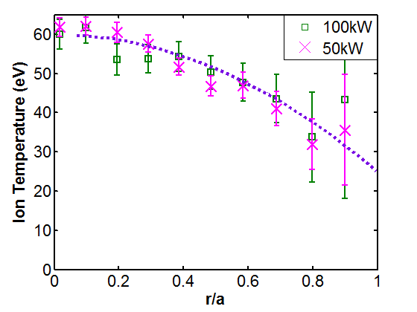
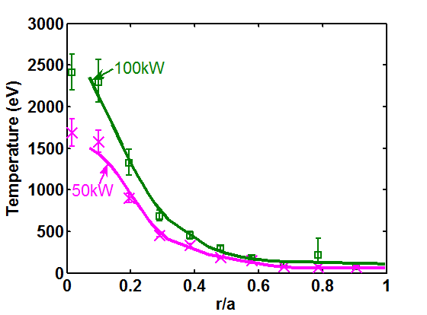
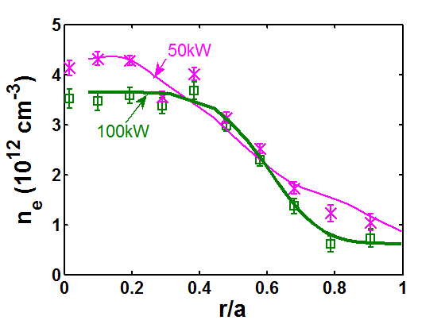
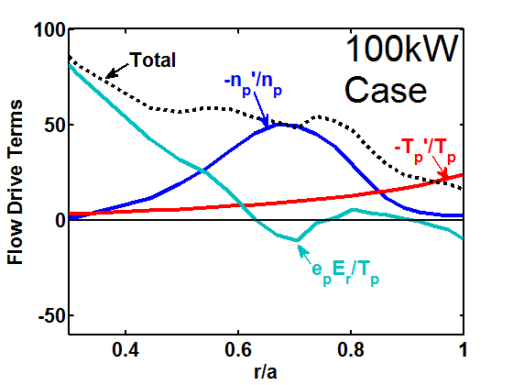
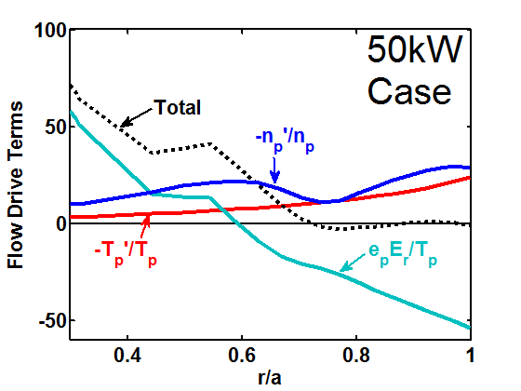
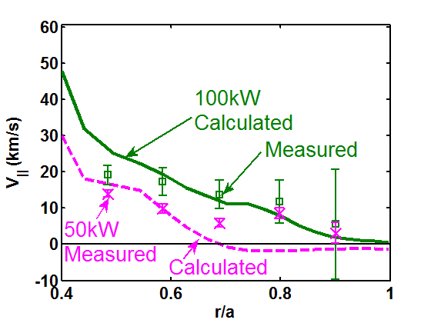
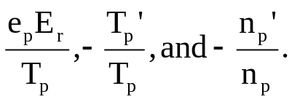
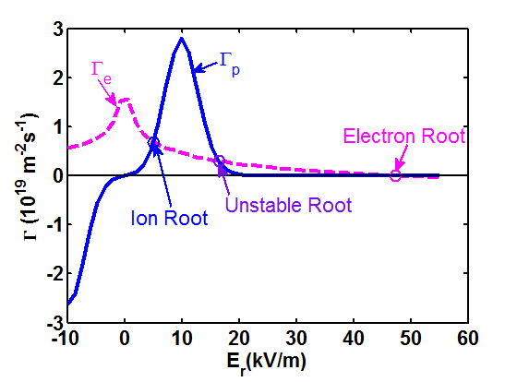
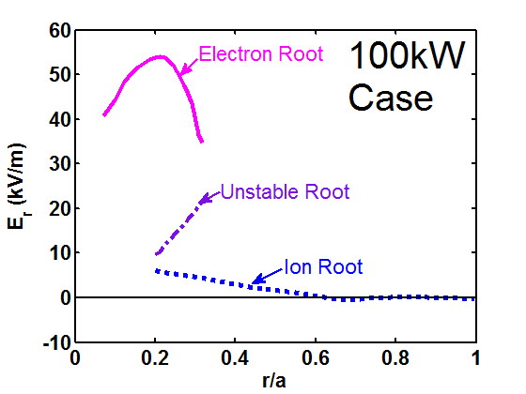
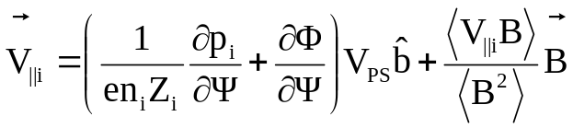
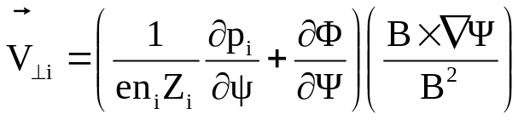
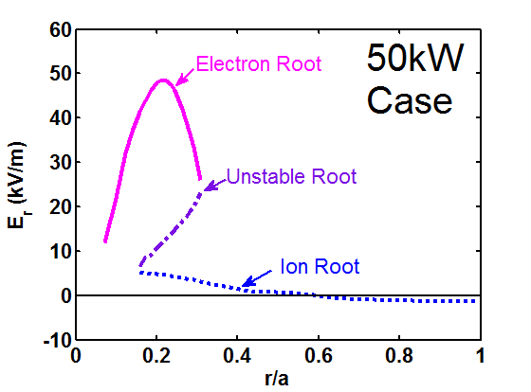
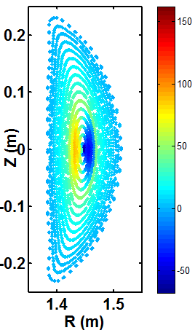
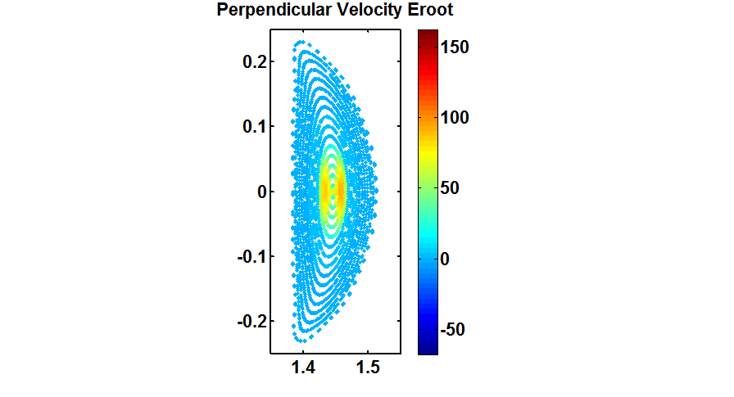
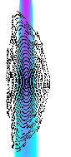
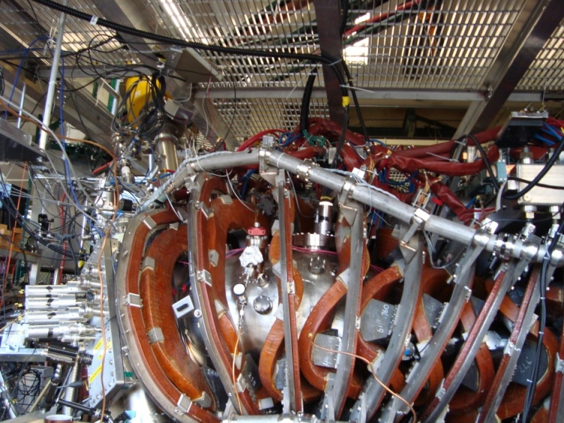
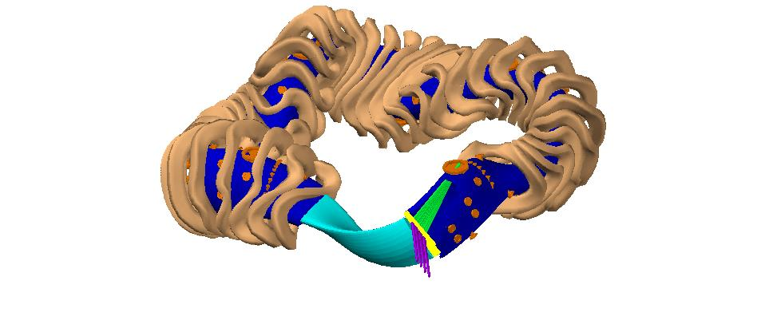
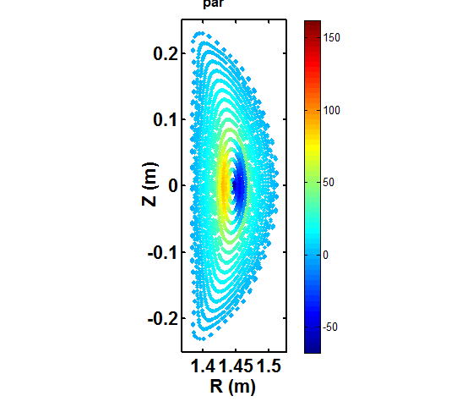
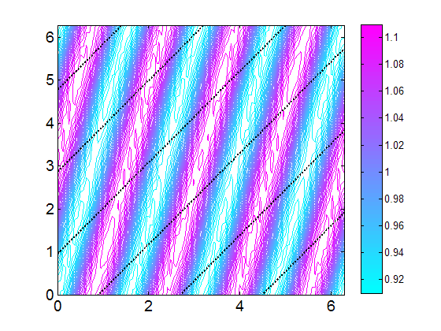
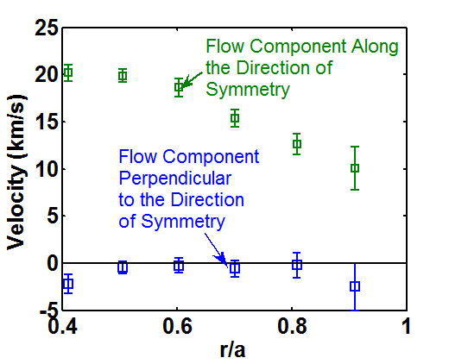
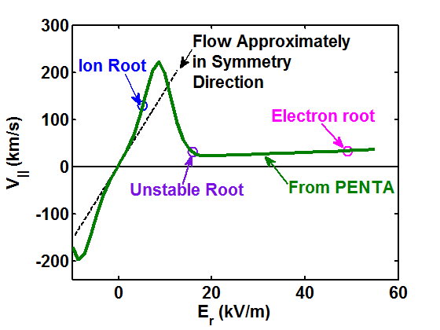
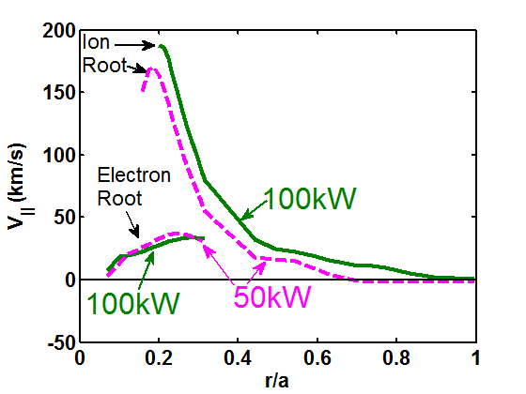





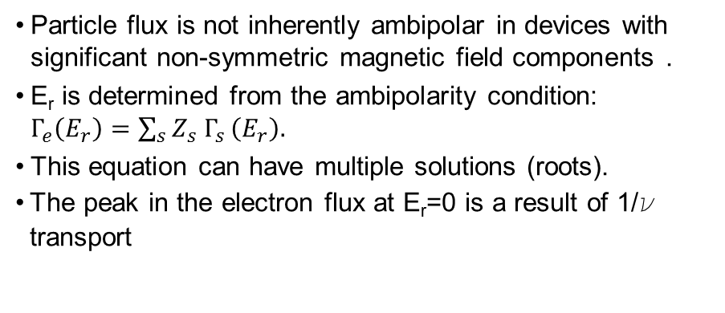


Measuring and Predicting the Flow Velocity in the HSX Stellarator
A. Briesemeister, K. Zhai, J. Radder, D.T. Anderson, F.S.B. Anderson, J.N. Talmadge
HSX Plasma Laboratory, Univ. of Wisconsin, Madison, USA
Overview
Flows Increase with ECRH
$∇$p Drives V|| for r/a>0.5
CHERS has been used to measure C⁺⁶ flow velocity, temperature and density.
The PENTA code has been used to calculate the neoclassical value of the radial electric field and parallel flow.
Ion flows are measured to increase with increasing electron heating power.
PENTA predicts an increase in E_{r} in the core and an increase in the pressure gradient driven flow in the outer half of the plasma for the higher power case.
The flow direction is measured and predicted to be predominantly along the helical direction of symmetry in the outer half of the plasma where flows are predicted to be predominantly driven by the pressure gradient.
Agreement is seen between measured and neoclassically predicted V|| in the outer half of the plasma
Flow direction and magnitude changes significantly within the core of the plasma, complicating interpretation of the CHERS measurements near the axis
Improvements to the CHERS views are planned
Ion Flows Increased
T_{i} was Similar
T_{e} Increased in the Core
$\text{∇}{\text{n}}_{\text{e}}$ Change Significantly
The Pressure Gradient Terms Are Significantly Larger Than E_{r} in the Outer Half of the Plasma
Reasonable Agreement seen Between Measured and Calculated V||
V|| for the protons is predicted to have a similar dependence on all the thermodynamic drive terms:
The measured ion flow velocity was significantly faster in the case where 100kW of electron cyclotron resonance heating (ECRH) was used.
All flows are intrinsic (no external momentum sources).
Ion temperatures did not measurably change.
The electron temperature and temperature gradient in the core of the plasma increased with ECRH
The density profile for the 100kW had a smaller gradient in the core, but a larger gradient near r/a=0.6
In the outer half of the plasma E_{r} is small and in some regions negative, which in the absence of the pressure gradient terms would drive a negative parallel flow.
Reasonable agreement is seen between the measured and calculated V|| when all terms are included.
E_{r} is Determined by the Ambipolarity Condition for Particle Flux
Flow Direction and Magnitude Predicted to Vary Significantly Near the Axis
Particle Flux At r/a=0.22
Electron root: Larger positive E_{r} associated with reduced neoclassical transport
Ion root: Smaller, sometimes negative E_{r} Unstable root: Not a stable solution
E_{r} Calculated Using PENTA
E_{r} Calculated Using PENTA
$${\text{V}}_{\text{⊥}}$$
Total V|| Predicted
Total Predicted
The magnitude of has a minima in the middle of the neutral beam
changes direction across the view/beam intersection volume measured by the CHERS views of the core.
New views are being developed to measure the Pfirsch-Schlüter flow to better resolve E_{r} in the core.
Neutral
Beam
Density
Charge Exchange Recombination Spectroscopy (CHERS)
V|| (km/s)
The magnitude of the plasma flow velocity components are plotted for the toroidal location where CHERS measurements are made.
Flows shown were calculated using profiles for the 100kW case.
The electron root was chosen in the multi root region
The total V|| is dominated by the Pfirsch-Schlüter component
$${\text{V}}_{\text{⊥}}$$
30keV 4Amp 4ms hydrogen diagnostic neutral beam
Two 0.75m Czerny-Turner spectrometers with EMCCDs
10 radial locations are viewed from two different directions.
Flows will not have a component in the radial direction, so the flow velocity vector is uniquely determine by the two velocity measurements
Neutral Beam
${\text{V}}_{\text{⊥}}$(km/s)
View 1
$${\text{V}}_{\text{⊥}}$$
View 1
Typical
Poloidal
View
Volume
View 2
Neutral Beam
Particle flux is not inherently ambipolar in devices with significant non-symmetric magnetic field components .
E_{r} is determined from the ambipolarity condition: $Γ_{e}\left(E_{r}\right)=\sum_{s}{Z_{s} Γ_{s}}\left(E_{r}\right).$
This equation can have multiple solutions (roots).
The peak in the electron flux at E_{r}=0 is a result of 1/ν transport
In both the 100kW and 50kW cases near the axis only an electron root is predicted, from r/a~0.2 to r/a~3 multiple roots are predicted, for the outer half of the plasma only the ion root is predicted.
E_{r} is predicted to be slightly lower in the 50kW case for most locations in the plasma
View 2
Beam atoms charge exchange with plasma ions, causing spatially localized photon emission.
The Doppler shift, Doppler broadening and strength of the emission are used to calculate velocity, temperature and density respectively.
A series of shots are taken with the magnetic field in the clockwise direction and then the counter clockwise direction in order to reverse the flow. This essentially doubles the measured Doppler shift and eliminates uncertainty in the position of the unshifted wavelength.
  For typical HSX ion temperatures (~50eV) the ion-ion collision times are short. (τ_{E}^{C+6/p}~3.0ms and τ_{E}^{p/C+6}~40ms) Proton temperatures should be similar to the measured C⁺⁶ temperatures.
Reduced Flow Damping Along the Helical Direction of Symmetry Leads to Parallel Flow
HSX was optimized to have a direction of symmetry in its magnetic field strength. This has been predicted and measured to cause reduced flow damping in the n=4, m=1 helical direction [5].
|B| and Velocity in HSX
Measured Flows Are Predominantly in the Helical Direction of Symmetry
The Relationship Between V|| and E_{r} calculated for r/a=0.22
V|| Calculated Using PENTA
References
For large perpendicular flow drives, such as the electron root radial electric field, ions which caused the plasma viscosity are de-trapped and parallel flow will be reduced
θ_{Boozer}
V┴
PENTA Calculations
V
V||
D.A. Spong, Phys. Plasmas 12, 056114 (2005).
J. Lore, Phys. Plasmas 17 056101 (2010).
Hirshman et al., Phys. Fluids 29, 2951 (1986).
van Rij et al., Phys. Fluids B 1, 563 (1989).
S.P. Gerhardt et al., Phys. Plasmas 12, 05116 (2005).
The PENTA code [1][2] is used to calculate neoclassical particle fluxes, radial electric field, and parallel flow velocities.
Monoenergetic transport coefficients are calculated using the Drift Kinetic Equation Solver (DKES).
DKES [3][4] uses a non-momentum conserving collision operator, which was previously assumed to be sufficiently accurate for calculations in stellarators, which do not posses a direction of symmetry.
PENTA can reintroduce the effects of momentum conservation, making the calculations applicable to devices with a variety of levels of symmetry in their magnetic field structure.
PENTA can also include the effects of multiple ion species.
B
ζ_{Boozer}
For both the 100kW and the 50kW cases a small V|| is predicted near the core as a result of the large electron root E_{r}
The peak flows are larger than the ion thermal velocity, no experimental evidence of supra-thermal flows has been found
For small values of E_{r} parallel flows will arise that cause the total flow direction to be along the direction of symmetry, on average.
In the outer half of the plasma, where E_{r} is predicted to be small, the direction is along direction of symmetry.
$${\text{V}}_{\text{⊥}}\text{∝}{\text{−}\frac{\text{r}}{\text{R}}\text{V}}_{\text{||}}\left(\text{ι}\text{−4}\right)$$
When the total flow will move approximately along the symmetry direction.
For small values of E_{r} PENTA predicts flows will move in the direction of symmetry.
Thanks to MST for loaning us the neutral beam.

