Slide 1
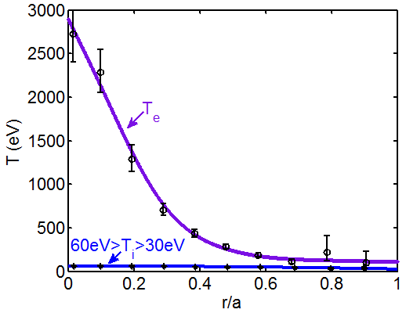
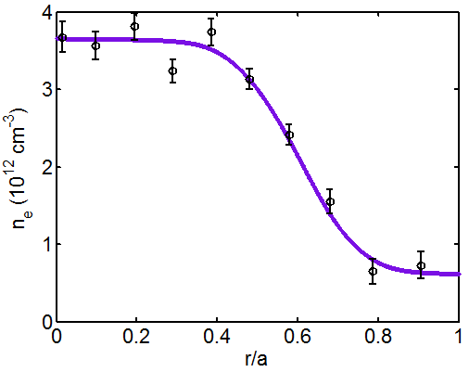
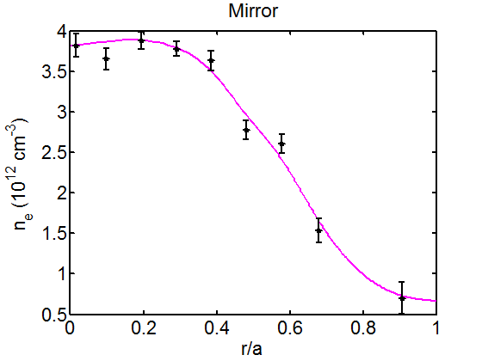
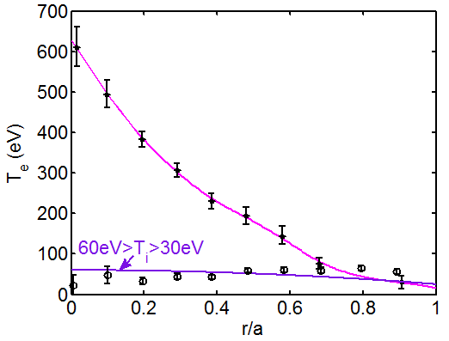
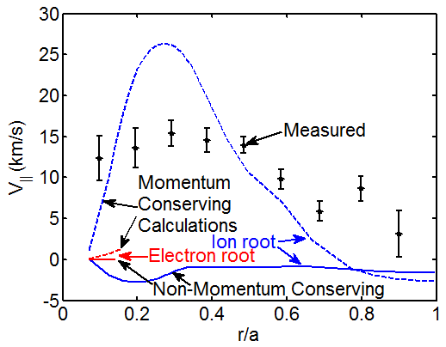
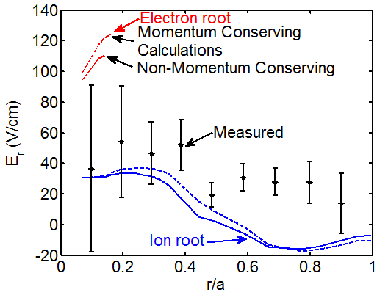
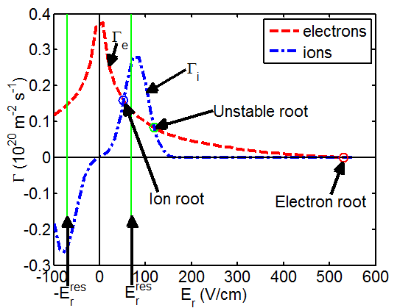
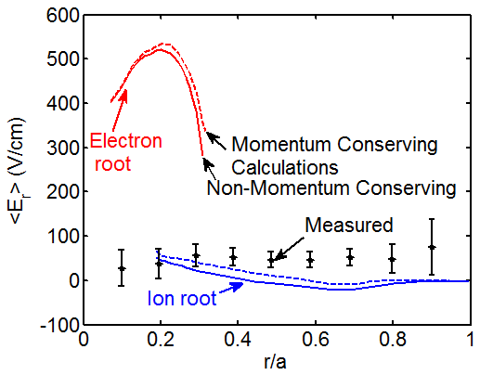
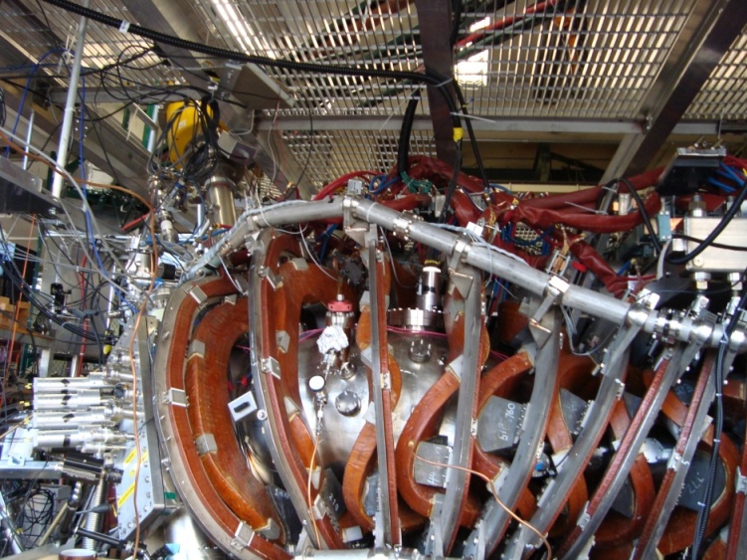
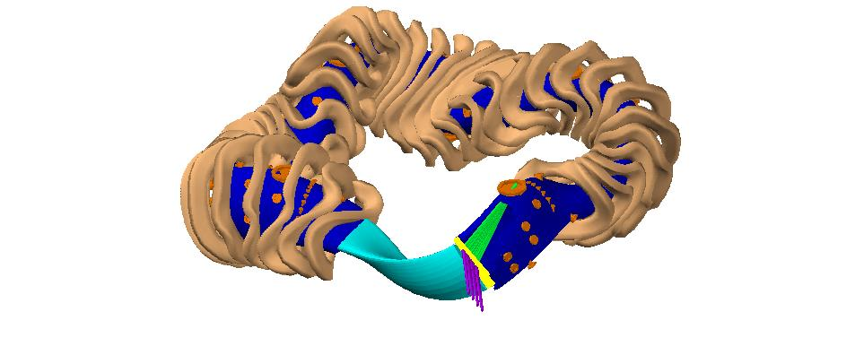
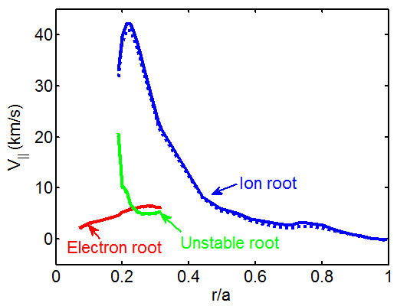
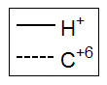
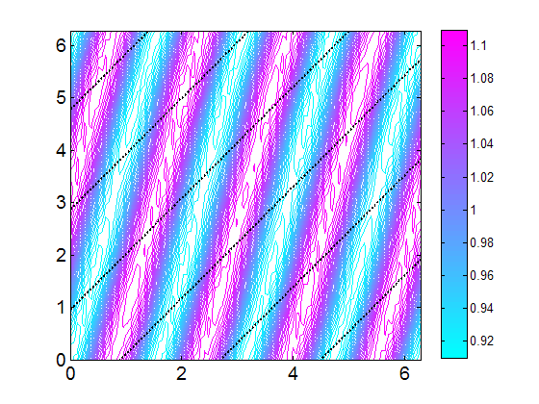
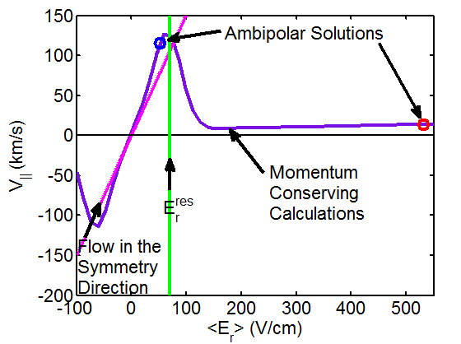
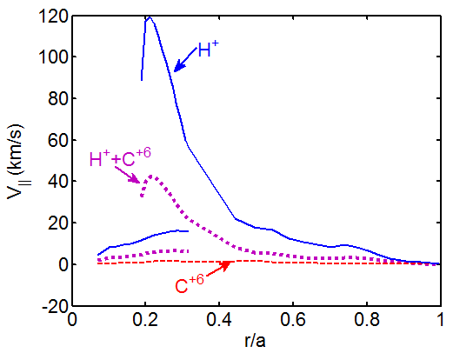
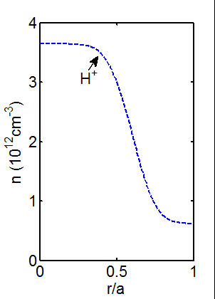
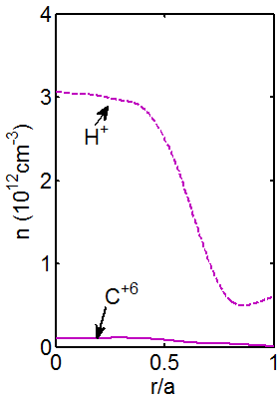
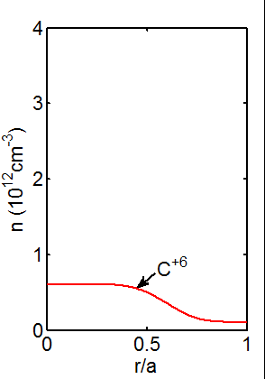
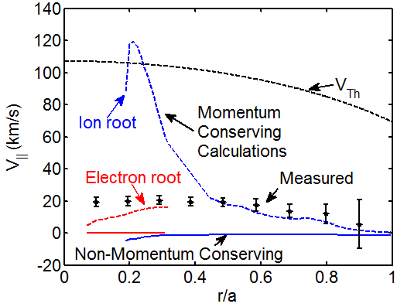
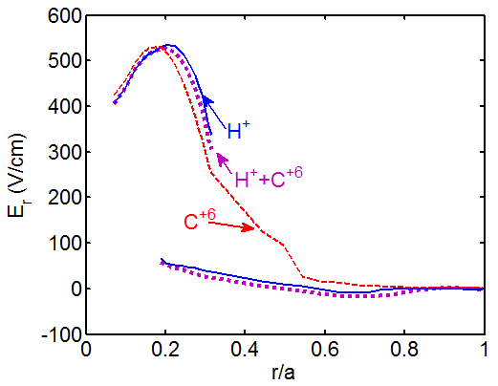
Measurement of Flows in the HSX Stellarator Demonstrating the Importance of Momentum-Conservation in Neoclassical Flow Modeling
A. Briesemeister, J. Lore, K. Zhai, D.T. Anderson, F.S.B. Anderson, J.N. Talmadge
HSX Plasma Laboratory, Univ. of Wisconsin, Madison, USA
Overview
Calculated and Measured V|| and E_{r}
Non-Symmetric Magnetic Field Effects
CHERS has been used to measure C⁺⁶ flow velocity, temperature and density.
The PENTA code has been used to calculate the radial electric field (E_{r}) and the ion flow in the direction of the magnetic field (V||)
Calculations performed using the non-momentum conserving collision operator under-predict V|| by an order of magnitude in both the quasi-helically symmetric magnetic configuration and the configuration with significant symmetry breaking magnetic field components
Momentum conserving calculations predict that protons and impurity ions will have approximately the same V||.
The calculated magnitude of V|| is sensitive to impurity content.
Neither the large E_{r} predicted for the electron root solution, nor the large parallel flows predicted for the ion root solution were measured in the plasma core. In this region the helical particle resonance complicates calculations and the relatively large neutral beam size reduces spatial resolution. Plans are in progress to address these issues.
Electron temperature and density were measured using Thomson scattering.
Ion temperature was measured using CHERS.
B_{o}=1T and 100kW on-axis O-mode ECRH was used for the case shown.
The ions are not heated directly. T_{i}<<T_{e}
HSX’s average major radius =1.2m and average minor radius=12cm.
The optimized quasi-helically symmetric magnetic configuration was used for results shown in this section.
Plasma Temperatures and Density
Non-symmetric components were intentionally added to the magnetic field structure.
This is known as the “mirror” configuration. The dominant components added have a poloidal mode number m=0, they therefore do not introduce additional particle resonances.
This type of perturbation has been experimentally shown [6] to increase the damping of induced plasma flows in HSX.
Plasma Temperatures and Density
The measured flow agrees reasonably well with the calculations which include momentum conservation and are much larger than flows predicted by non-momentum conserving calculations.
General agreement is seen between the measurements and the values calculated for the ion root which is predicted to exist across the entire plasma.
50kW on-axis O-Mode ECRH was used, B_{o}=1T
Parallel Flow in the “Mirror” Configuration
E_{r} in the “Mirror” Configuration
E_{r} Calculated by Enforcing Ambipolar Transport
Calculated Particle Flux
Particle flux (Γ_{s}) is not inherently ambipolar in devices with significant non-symmetric magnetic field components.
The radial electric field can be determined by enforcing ambipolar particle transport. (Γ_{e}=Γ_{i})
The electrons are in the long mean free path regime so Γ_{e} has a maximum at E_{r}=0.
Multiple solutions (roots) are calculated near r/a~0.3 as a result of a maximum in the ion flux cause by helical resonance between the radial electric field and the ion thermal motion along the field lines, which causes large radial drifts. [5]
m and n are the poloidal and toroidal mode numbers of the magnetic field component causing the resonance. V_{Tha} is the thermal velocity of the resonating species. B_{ϴ} is the poloidal magnetic field.
In HSX the m=1, n=4 component of the magnetic field causes the dominant resonance.
The three roots are known as electron, ion and unstable. The unstable root cannot exist as any perturbation from that solution would drive the E_{r} towards one of the stable roots.
Neglecting momentum conservation does not significantly alter the calculated value of E_{r}.
Radial Electric Field Profile
Impurity Effects
Charge Exchange Recombination Spectroscopy (CHERS)
30keV 4Amp 4ms hydrogen diagnostic neutral beam
Two 0.75m Czerny-Turner spectrometers with EMCCDs
10 radial locations are viewed from two different directions.
Flows will not have a component in the radial direction, so the flow velocity vector is uniquely
Neutral Beam
View 1
In all other sections of this poster the calculations shown were performed including only H⁺ ions. In this section calculations are performed with C⁺⁶, H⁺ and a mix for comparison.
View 1
Parallel Flow is Related to E_{r} by Viscosity
Without momentum conservation different species are predicted to move at significantly different speeds and in some cases in opposite directions.
More massive ions will resonate at lower values of E_{r} which significantly alters their viscosity.
Changing the ion content of the plasma will also change the collisionality.
When the effects of momentum conservation are included in the calculations all ion species are predicted to have approximately the same parallel velocity for typical HSX plasma parameters.
CHERS measurements are made using C⁺⁶.
C⁺⁶ and H⁺ will have the same V||
View 2
Neutral Beam
HSX is a quasi-helically symmetric device. HSX’s optimized configuration has a helical direction of approximately constant magnetic field strength.
Reduced flow damping has been predicted and measured [6] along HSX’s helical direction of symmetry.
For small E_{r} (< E_{r} ^{res}) PENTA predicts parallel flow which causes the intrinsic flow to move in the helical direction of symmetry will arise as a result of viscosity.
Large values of E_{r} will reduce particle trapping and therefore viscosity. Small V|| values are predicted at large E_{r}
|B| and Velocity in HSX
V|| is Non-linearly Related to E_{r}
View 2
θ_{Boozer}
V┴
determine by the two velocity measurements
V
Beam atoms charge exchange with plasma ions, causing spatially localized photon emission.
The Doppler shift, Doppler broadening and strength of the emission are used to calculate velocity, temperature and density respectively.
A series of shots are taken with the magnetic field in the clockwise direction and then the counter clockwise direction in order to reverse the flow. This essentially doubles the measured Doppler shift and eliminates uncertainty in the position of the unshifted wavelength.
The radial electric field (E_{r}) is calculated from the measured flow velocities and pressure gradient using radial force balance:
V||
Calculations performed including only H⁺ showed a significantly higher parallel flow velocity than the other two cases.
A C⁺⁶ density consistent with that measured by CHERS was included in the mixed case. The calculated velocity for this case was slightly lower than the measured velocity for r/a>0.5.
A multi-root region was not predicted when all the ions were assumed to be C⁺⁶. The predicted E_{r} profiles were otherwise similar for all the cases.
Calculations Using Different Ions
Carbonization was used to condition the walls for the cases shown. Carbon was the dominant impurity, but may not have been fully ionized throughout the plasma.
B
Ion Density Profiles
ζ_{Boozer}
Non-Momentum Conserving Calculations Under-Predict V||
A non-momentum conserving collision operator is typically used in flow calculations in stellarators with large flow damping in all directions.
Non-momentum conserving calculations predict V||>~1km/s while CHERS measurements show V||>~10km/s.
Agreement is seen between measured velocities and PENTA calculations which include the effects of momentum conservation in the outer half of the plasma.
In the region where multiple roots are predicted the measured V|| agrees better with the electron root solution, while the measured E_{r} agrees with the ion root solution.
E_{r} measurements are complicated in this region by relatively poor spatial resolution.
PENTA calculations may also be inaccurate when E_{r}~E_{r}^{res}.
Parallel Flow Profile
References
PENTA Calculations
The PENTA code [1][2] was used to calculate neoclassical particle fluxes, radial electric field, and parallel flow velocities.
Monoenergetic transport coefficients were calculated using the Drift Kinetic Equation Solver (DKES).
DKES [3][4] uses a non-momentum conserving collision operator, which was previously assumed to be sufficiently accurate for calculations in stellarators, which do not posses a direction of symmetry.
PENTA can reintroduce the effects of momentum conservation, making the calculations applicable to devices with a variety of levels of symmetry in their magnetic field structure.
PENTA can also include the effects of multiple ion species.
H⁺
D.A. Spong, Phys. Plasmas 12, 056114 (2005).
J. Lore, Phys. Plasmas 17 056101 (2010).
Hirshman et al., Phys. Fluids 29, 2951 (1986).
van Rij et al., Phys. Fluids B 1, 563 (1989).
M. Yokoyama et al., Nuclear Fusion 35, 153 (1995)
S.P. Gerhardt et al., Phys. Plasmas 12, 05116 (2005).
Thanks to MST for loaning us the neutral beam.

