Slide 1
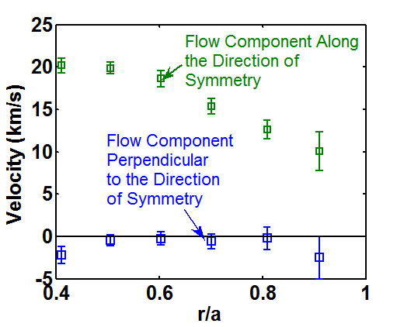
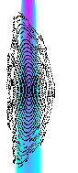
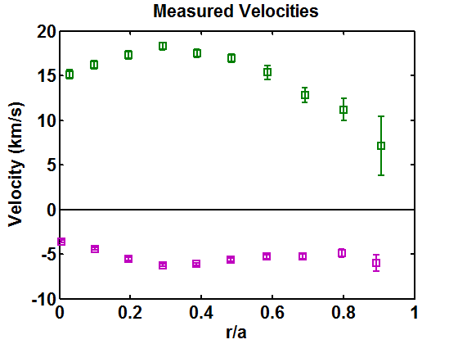
Flows Move Primarily Along the Helical Direction of Symmetry
Velocity Along and Across the Symmetry Direction
Neutral Beam
Velocity Measured By Each View
“Toroidal” Views
Typical
Poloidal
View
Volume
“Poloidal” Views
Geometric factors are used to relate the measured velocities to the average flow in the symmetry and cross symmetry directions within the view
Near the axis the flow direction change significantly across the beam/view volume

Slide 2
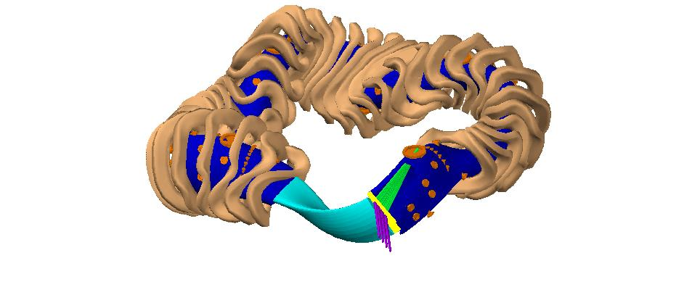
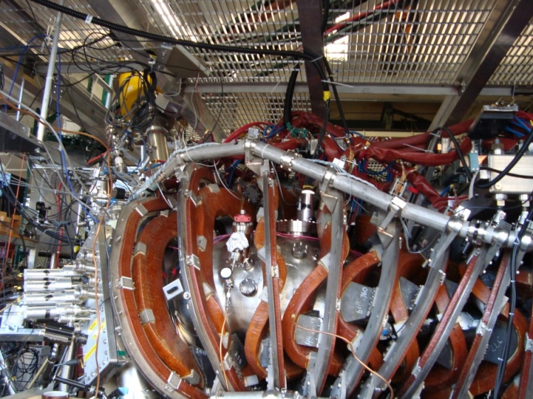
Charge Exchange Recombination Spectroscopy (CHERS) On HSX
Neutral Beam
Neutral
Beam
Density
“Toroidal”
Views
“Toroidal”
Views
“Poloidal”
Views
Neutral Beam
“Poloidal”
Views
30keV, 4Amp, 3ms hydrogen neutral beam is fired radially
C⁺⁶ ions charge exchange with the neutral beam
529nm light from the C⁺⁵ ions is collected
Two 0.75m imaging Czerny-Turner spectrometers with electron multiplying ccds image the spectra
Frames integrated for 5ms are taken before, during and after the beam fires

Slide 3
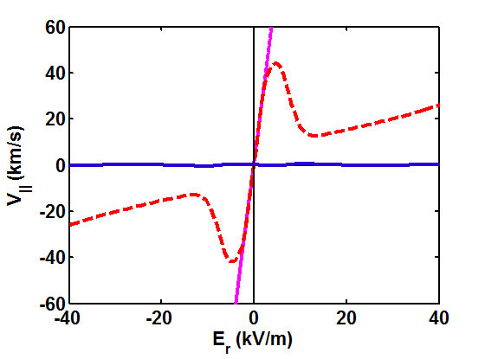
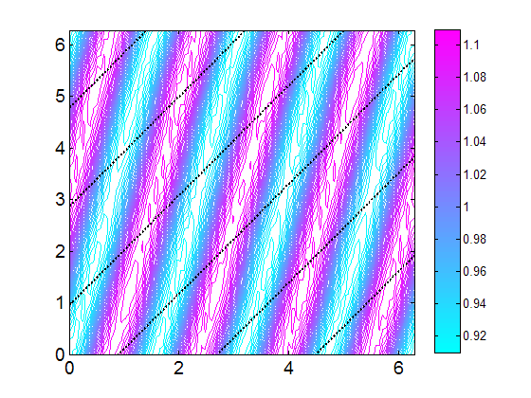

V|| is Determined by and Viscosity
|B| and Velocity in HSX
Helical Flow
PENTA
V┴
θ_{Boozer}
V
V||
DKES
B
ζ_{Boozer}
DKES predicts ~0 V|| for all values of E_{r} because it does not account for momentum conservation in collisions

Slide 4
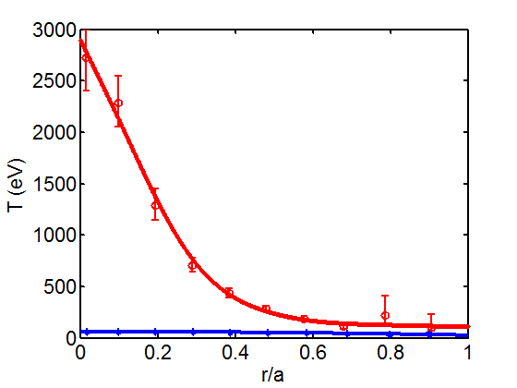
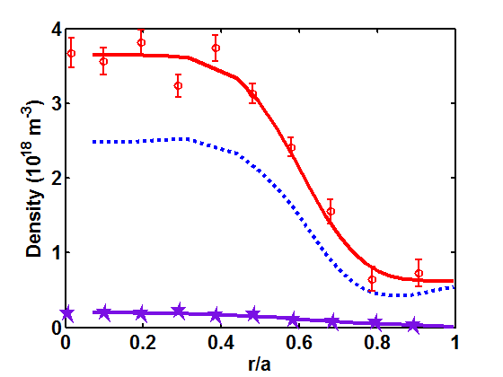
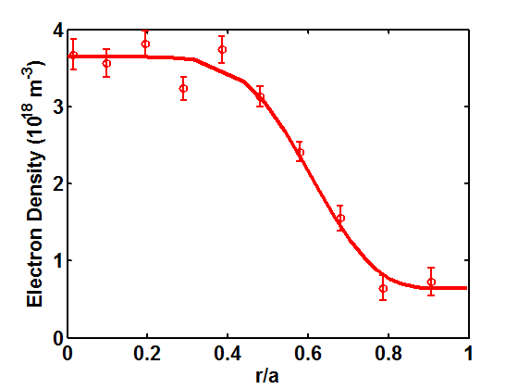
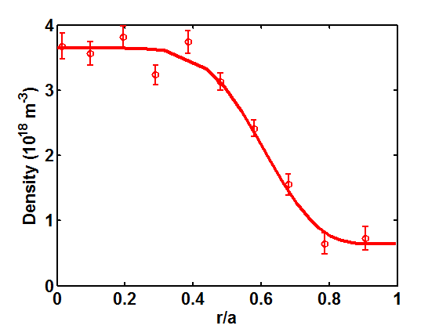
The Measured Density and Temperature Profiles Input to PENTA
n_{e}
T_{e}
n_{H+}
60eV>T_{C+6}>30eV
T_{H+}=T_{C+6}
n_{C+6}
T_{e} and n_{e} measured using Thomson Scattering
Ions are collisional and have the same temperature and V||

Slide 5
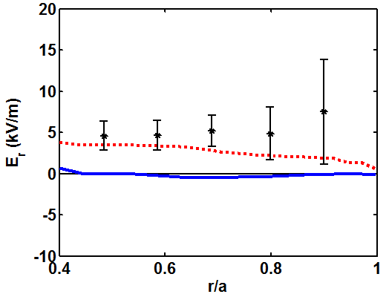
Agreement Seen Between Measured E_{r} and The PENTA Value
Measured and Calculated E_{r}
Measured
PENTA
DKES
PENTA predicts a small positive E_{r} at the edge
Differences between the E_{r} predicted by PENTA and DKES become significant when there are multiple ion species in the calculations

Slide 6
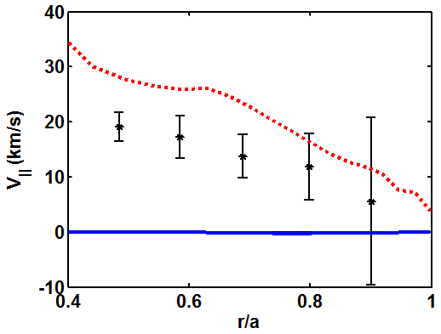
Flows Predicted PENTA, Including Momentum Conservation Show better Agreement
Measured and Calculated V||
PENTA
Measured
DKES
DKES under-predicts V|| by more than an order of magnitude
Better agreement is seen with the PENTA code which accounts for momentum conservation

Slide 7
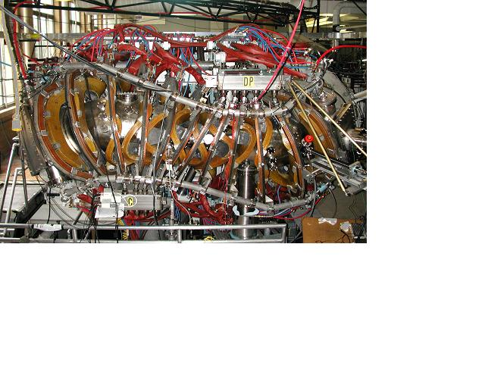
Measurement and Modeling of Large Helical Flows in the HSX Stellarator
Alexis Briesemeister
HSX Plasma Laboratory
Electrical & Computer Engineering, UW-Madison
54th Annual Meeting of the APS-DPP, Providence, Rhode Island October 31, 2012

Slide 8
Motivation
Quasi-symmetry allows large intrinsic flows in stellarators, which typically have large flow damping
  HSX was optimized for quasi-helical symmetry
Flows improve plasma confinement and stability
  Using neutral beams to drive flows is impractical for larger devices, intrinsic flows become important
This is the first test of the PENTA code which can calculate intrinsic flows in devices with any level of symmetry
  Non-symmetric fields can increase flow drive, but damp plasma rotation

Slide 9
Outline
The quasi-symmetric HSX stellarator
  Charge exchange recombination spectroscopy (CHERS) used to measure flow speed and direction
  Flows move in the helical direction with speed 20km/s
PENTA code is used to calculate neoclassical transport, E_{r} and parallel flow
  The ambipolar constraint determines E_{r} in configurations with significant non-symmetric field components
  Includes momentum conservation and multiple ion species
Measured and predicted flows agree only when momentum conservation is accounted for

Slide 10
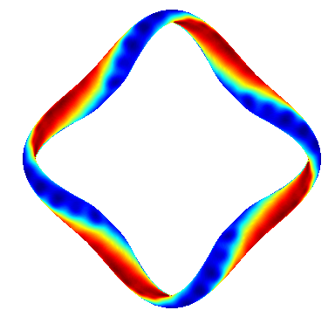
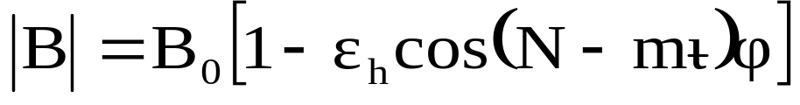
The Quasi-Helically Symmetric HSX Stellarator
Quasihelical symmetry (QHS) reduces neoclassical transport [Canik PRL, 2007] and flow damping in the helical direction [Gerhardt PRL, 2005]
QHS
<R> | 1.2 m
<a> | 0.12 m
ι | 1.05 →1.12
B₀ | 1.0 T
ECRH 28 GHz | 100 kW
<n_{e}> | ≤ 6 × 10¹² cm⁻³
T_{e} | 0.5 to 2.5 keV
T_{i} | 30 to 60 eV
N=4, m=1
ι ≈ 1
ι_{eff} = |N-mι| ≈ 3
no external momentum source, all flows shown are intrinsic

Slide 11
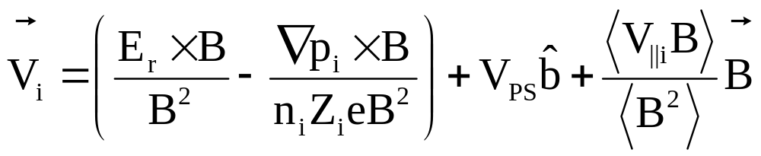
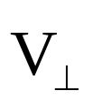

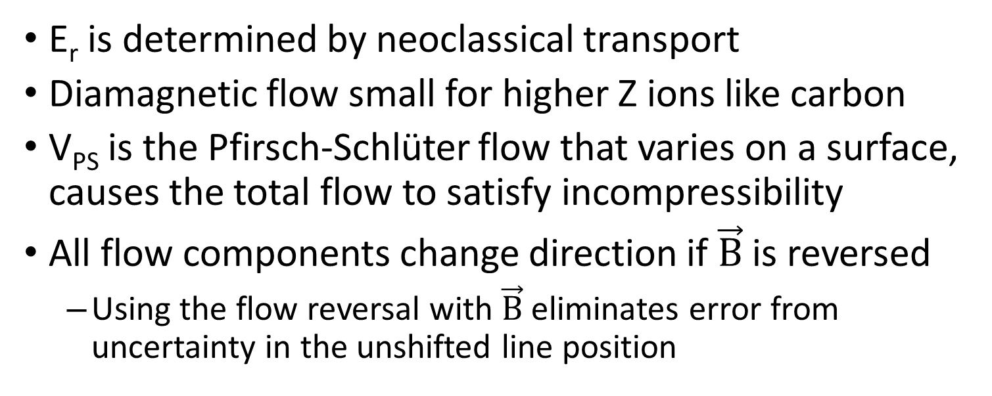
The Total Flow has Perpendicular and Parallel Components
E_{r} is determined by neoclassical transport
Diamagnetic flow small for higher Z ions like carbon
V_{PS} is the Pfirsch-Schlüter flow that varies on a surface, causes the total flow to satisfy incompressibility
All flow components change direction if is reversed
  Using the flow reversal with eliminates error from uncertainty in the unshifted line position

Slide 12
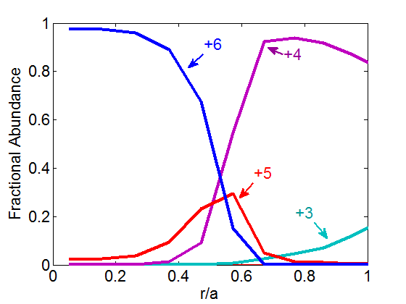
Coronal Equilibrium Used to Find Abundance of Other Carbon Ionization States
Electron impact ionization, recombination, and charge exchange are included [ADAS: Summers (2004) ]
No measurement of all ionizations states is currently available
Carbon to hydrogen ratio taken to be 1 to 4, methane

Slide 13
Neoclassical Particle Flux and Flows are Calculated using the PENTA Code
The DKES (Drift Kinetic Equation Solver) code [Hirshman PoF 1986] is used to find the mono-energetic diffusion coefficients
  Uses a non-momentum conserving collision operator
  Developed for conventional stellarators with large flow damping
The PENTA code[Spong PoP 2005] corrects the mono-energetic diffusion coefficients from DKES for momentum exchange
  This correction makes PENTA valid for devices with any level of symmetry from ideal tokamaks to conventional stellarators
  Can include multiple ion species

Slide 14
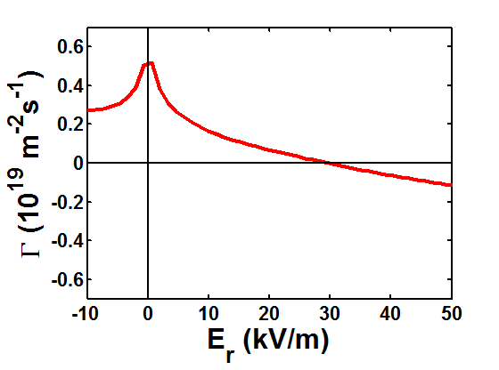
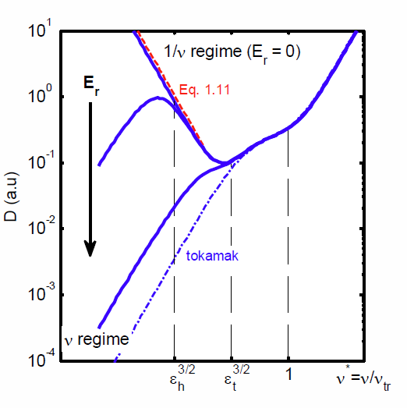
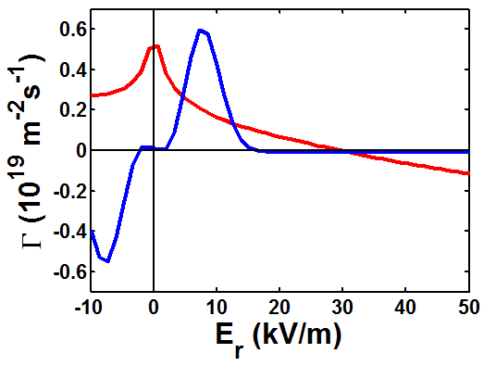
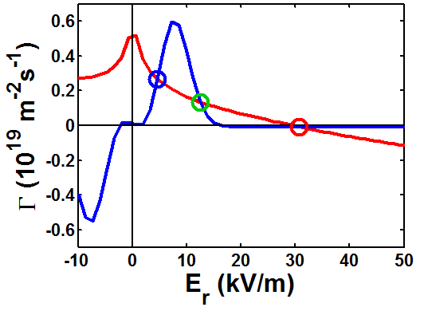
Electron’s Are in the 1/nu Regime In The Core
Particle Flux
Particle Diffusion
Γ_{e}
The hotter electrons are in the 1/n regime
Their flux peaks at E_{r}=0
[Lore Thesis 2010]

Slide 15
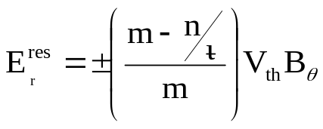
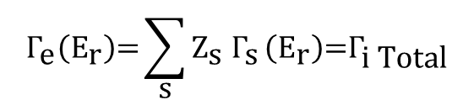
Multiple Roots are Predicted As a Result of the Helical Proton Resonance
Particle Flux
E_{r} is found by enforcing ambipolarity
Multiple roots of the ambipolarity condition are predicted in the core because of a peak in the Γ_{H+} near the helical proton resonance
Γ_{e}
Γ_{i Total}
$${\text{Γ}}_{\text{e}}\left({\text{E}}_{\text{r}}\right)\text{=}\sum_{\text{s}}{{\text{Z}}_{\text{s}} {\text{Γ}}_{\text{s}}}\left({\text{E}}_{\text{r}}\right)\text{=}{\text{Γ}}_{\text{i} \text{Total}}$$

Slide 16
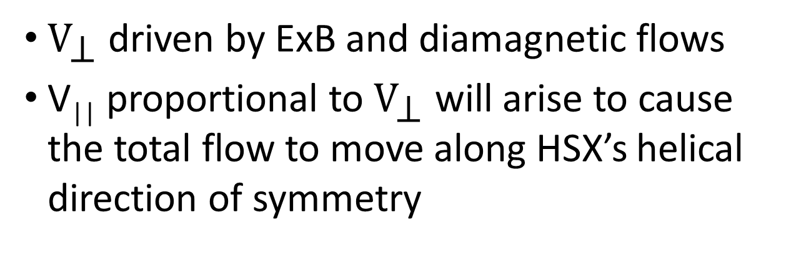
V|| is Determined by and Viscosity
|B| and Velocity in HSX
V┴
θ_{Boozer}
V
V||
B
ζ_{Boozer}
${\text{V}}_{\text{⊥}}$ driven by ExB and diamagnetic flows
V|| proportional to ${\text{V}}_{\text{⊥}}$ will arise to cause the total flow to move along HSX’s helical direction of symmetry

Slide 17
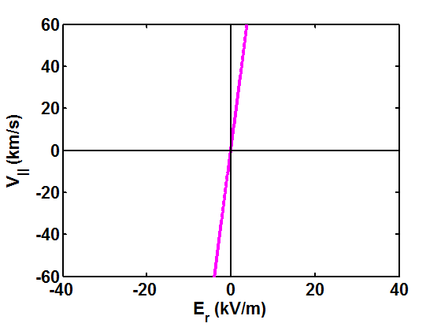
V|| is Determined by and Viscosity
|B| and Velocity in HSX
Helical Flow
V┴
θ_{Boozer}
V
V||
B
ζ_{Boozer}
With all else held constant, V|| should increase linearly with E_{r} to cause the to total flow to move along the helical direction of symmetry

Slide 18
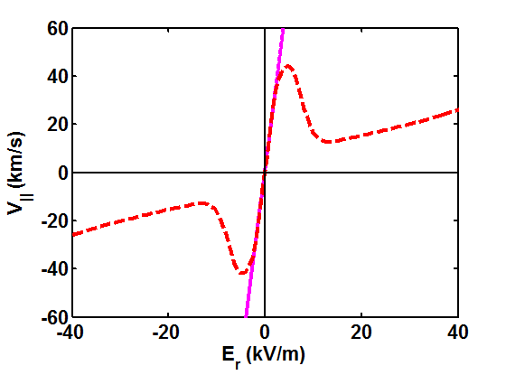
V|| is Determined by and Viscosity
|B| and Velocity in HSX
Helical Flow
PENTA
V┴
θ_{Boozer}
V
V||
B
ζ_{Boozer}
For small (ion root) values of E_{r} PENTA predicts the protons will move in the direction of symmetry
Large values of E_{r} detrap the particles responsible for the plasma viscosity, reducing V||

Slide 19
Conclusion
The intrinsic plasma flow follows HSX’s helical direction of symmetry
Reasonable agreement between the measured and calculated flow is only seen when the effects of momentum conservation are included in the calculation
PENTA successfully predicts flows in a system that is largely symmetric

Slide 20
Multiple Roots are Predicted As a Result of the Helical Proton Resonance
Particle Flux
E_{r} is found by enforcing ambipolarity
Multiple roots of the ambipolarity condition are predicted because of a peak in the Γ_{H+} near the helical proton resonance
Γ_{e}
Γ_{i Total}
$${\text{Γ}}_{\text{e}}\left({\text{E}}_{\text{r}}\right)\text{=}\sum_{\text{s}}{{\text{Z}}_{\text{s}} {\text{Γ}}_{\text{s}}}\left({\text{E}}_{\text{r}}\right)\text{=}{\text{Γ}}_{\text{i} \text{Total}}$$

Slide 21
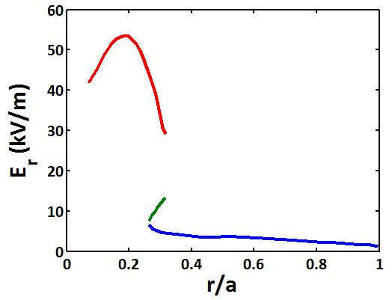
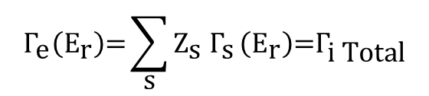
Multiple Roots are Predicted As a Result of the Helical Proton Resonance
Particle Flux
Calculated E_{r} Profile
Γ_{e}
Γ_{i Total}
Electron root
Unstable root
Ion root
$${\text{Γ}}_{\text{e}}\left({\text{E}}_{\text{r}}\right)\text{=}\sum_{\text{s}}{{\text{Z}}_{\text{s}} {\text{Γ}}_{\text{s}}}\left({\text{E}}_{\text{r}}\right)\text{=}{\text{Γ}}_{\text{i} \text{Total}}$$
Electron root: Larger positive E_{r} associated with reduced neoclassical transport
Ion root: Smaller, sometimes negative E_{r}
Unstable root: Not a stable solution

Slide 22
PENTA Accounts for Momentum Conservation
HSX’s quasi-helical symmetry allows large flows to develop
The DKES (Drift Kinetic Equation Solver) code uses a non-momentum conserving collision operator
The parallel momentum conserving moments method techniques developed by Sugama and Nishimura[PoP 2002], and Maasberg, Beidler, and Turkin [PoP 2009] and Taguchi[Phys. Fluids 1992] were implemented by Spong and Lore in the PENTA code [Spong 2005] to correct the DKES coefficients
These techniques are valid for devices with any level of effective ripple, from tokamaks to conventional stellarators

Slide 23
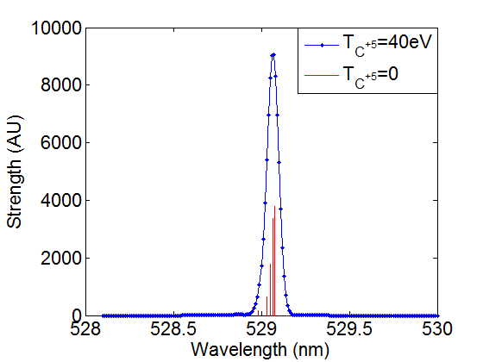


Atomic Data and Field Reversal Used To Find Density, Temperature and Velocity
Fine Structure Broadening Comparable to Thermal Broadening
Thermal motion of the ion causes Doppler broadening of the spectral line
Doppler shift is determined by flow velocity along the viewing direction
$Δλ=\frac{529nm∗Velocity}{c}$~0.04nm
The charge exchange cross section used to find the C⁺⁶ density and the fine structure of the line used to correct the line width is taken from the Atomic Data Analysis Structure ADAS [Summers 2004]
Reversing the magnetic field reverses the flows, doubling the measured Doppler shift
Spectral calibration performed each shot to account for instrumental drift using a Neon lamp

Slide 24
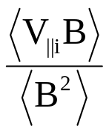
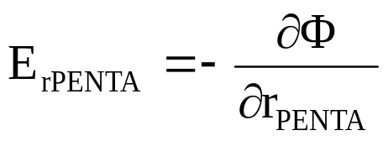
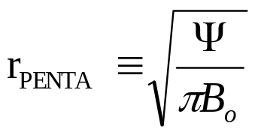
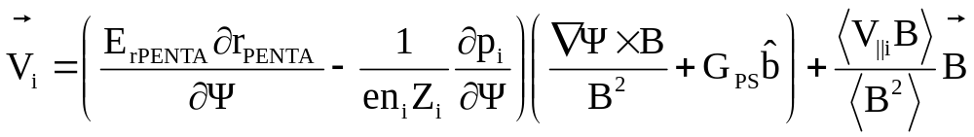
Local Flow Velocity Can Be Calculated from PENTA Profiles and Magnetic Geometry
PENTA calculates : and
where
The local flow is calculated on a grid of points throughout the beam/view intersection volumes:
G_{ps} =geometry factor for the Pfirsch-Schlüter flow
The calculated neutral beam density is used to create a weighted average of the velocity that would be “seen” by each view

Slide 25
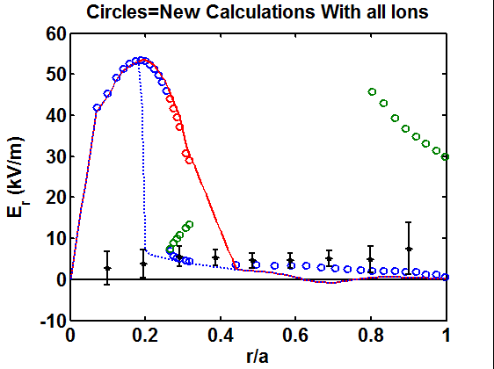
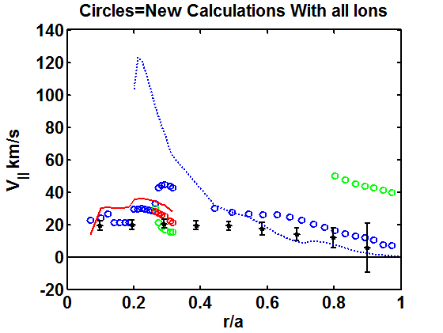
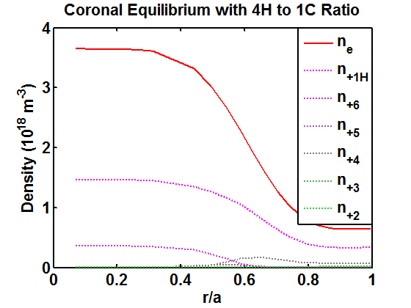
Including All Ions
Lines are old calculations with just protons and C⁺⁶

Slide 26
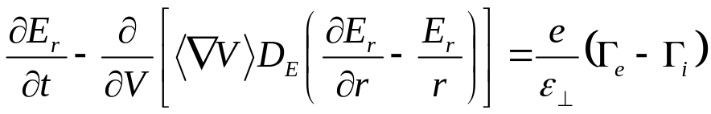
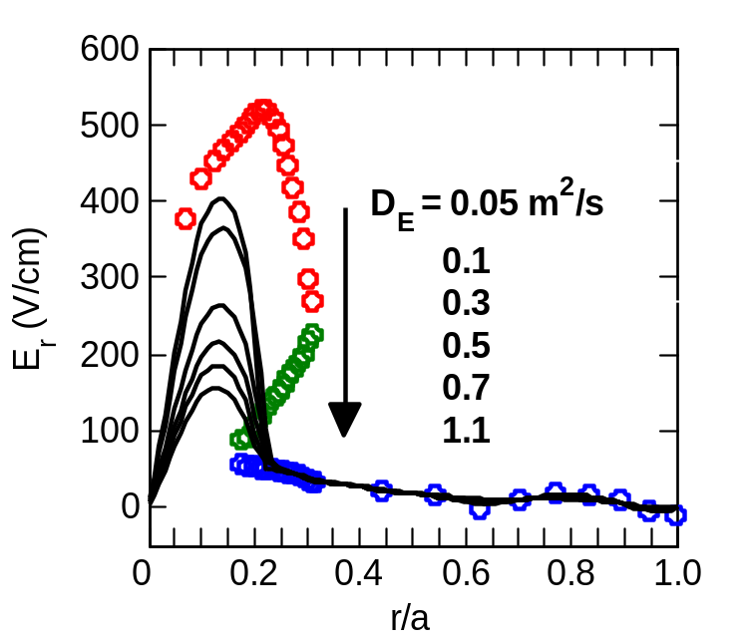
Solving the Diffusion Equation for E_{r}
I stole this from J. Lore’s Dissertation, Do we now have a better calculation for D_{E}?
The radial electric field profile can be determined by solving a diffusion equation¹
D_{E} (related to perpendicular viscosity) is generally not known²
  Solutions for different D_{E} show a region of strong E_{r} shear at r/a~0.25
1) Shaing (1984), Maassberg et al (1993). 2) Hastings (1985, 1986)

Slide 27
In the Core Flow Direction Changes Across the Beam/View Intersection Volumes
The CHERS system can only measure a weighted average of the local plasma flow within each beam/view intersection volume
The measured flows are much smaller (~20km/s) than the flows predicted by PENTA (~50 to 100km/s) in the core
A synthetic diagnostic was developed to better understand the relationship between E_{r} and V|| predicted by PENTA and the velocities seen by each view

Slide 28
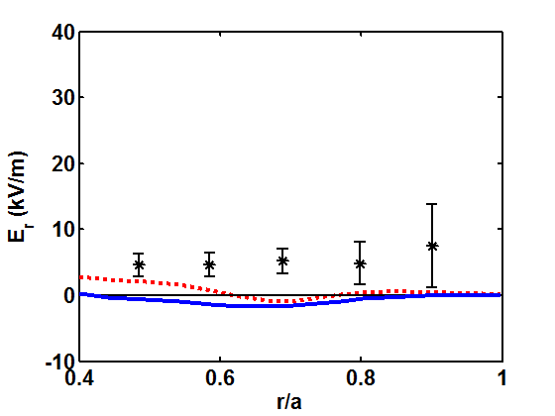
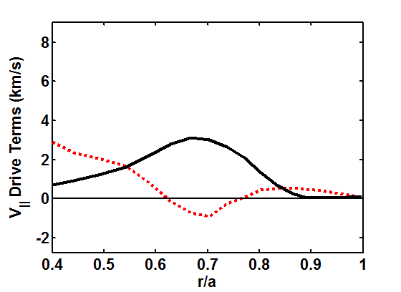
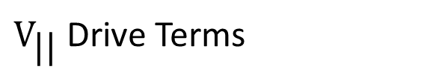
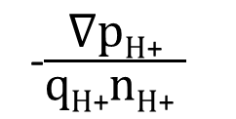
DKES and PENTA Predict Low E_{r} for r/a>0.5, Total Flow Determined by Diamagnetic Flow
E_{r} measured by CHERS is ~5kV/m larger than the predicted E_{r} profile in the outer half of the plasma
E_{r} larger than the calculated values were also measured using probes [See Poster R. Wilcox on Thursday]
The predicted V|| does not change direction in the regions where E_{r} is negative because of the positive diamagnetic flow
Measured and Calculated E_{r}
${\text{V}}_{\text{||}}$ Drive Terms
-$\frac{\text{∇}\text{p}\text{H}\text{+}}{\text{q}\text{H}\text{+}\text{n}\text{H}\text{+} }$
Measured
PENTA
DKES
E_{r}

Slide 29
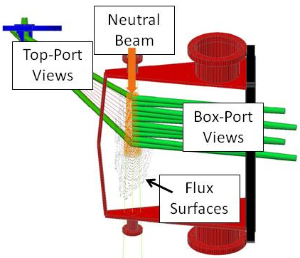
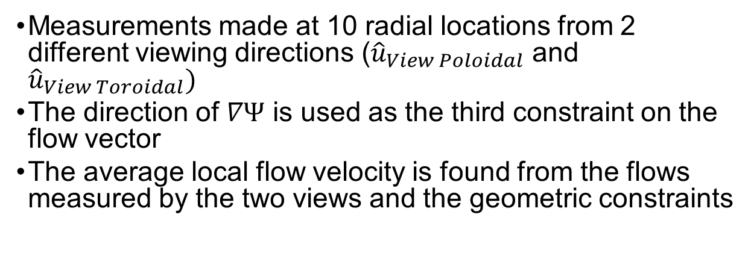
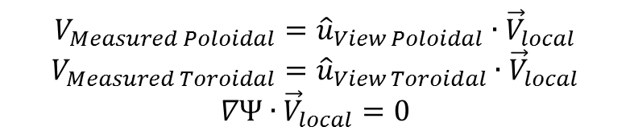
Two Viewing Angles Needed To Find Flow Direction
Three Constraints Used to Determine the Local Flow Speed and Direction:
“Toroidal”
Views
$$V_{Measured Poloidal}={\hat{u}}_{View Poloidal}∙{\vec{V}}_{local}$$
$$V_{Measured Toroidal}={\hat{u}}_{View Toroidal}∙{\vec{V}}_{local}$$
$$∇Ψ∙{\vec{V}}_{local}=0$$
“Poloidal”
Views
Measurements made at 10 radial locations from 2 different viewing directions (${\hat{u}}_{View Poloidal}$ and ${\hat{u}}_{View Toroidal})$
The direction of $∇Ψ$ is used as the third constraint on the flow vector
The average local flow velocity is found from the flows measured by the two views and the geometric constraints

Slide 30
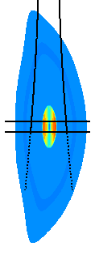
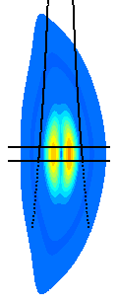





The Flow Perpendicular to the Magnetic Field Changes Speed and Direction in View Volume
$${\text{V}}_{\text{⊥}} Ion Root$$
$${\text{V}}_{\text{⊥}} Electron Root$$
Flow
Direction
${\text{V}}_{\text{⊥}}$changes direction and magnitude within the beam/view intersection volumes
The radial extent of the region predicted to have large ${\text{V}}_{\text{⊥}}$ will depend on which root exists in the multi-root region
km/s
View
Neutral
beam width
Ion root chosen in multi-root region
Electron root
chosen in multi-root region

Slide 31





The Flow Along the Magnetic Field is Dominated by the Pfirsch-Schlüter Flow For Electron Root E_{r}
$${\text{V}}_{||} Ion Root$$
In the multi-root region the smaller, ion root, E_{r} produces a larger net V||
When the electron root is chosen the Pfirsch-Schlüter flow, which changes direction across the “toroidal” views dominates the total V||
$${\text{V}}_{\text{||}}Electron Root$$
Flow
Direction
km/s
View
Ion root chosen in multi-root region
Neutral
beam width
Electron root
chosen in multi-root region

Slide 32


Synthetic Diagnostic Shows Flows Predicted by PENTA Larger Than Measured Flows for r/a<0.5
Velocity Seen By
“Poloidal” Views
Velocity Seen By
“Toroidal” Views
Measured
Ion root
Electron root
The velocity that would have been measured by each view for a given profile is calculated using the synthetic diagnostic
In the core the measured velocity is more than 20km/s less than that predicted by PENTA when either the electron or ion root is chosen where both are predicted
V_{thH+}~100km/s; V_{thC+6}~30km/s

Slide 33

Neoclassical Fluxes Are Not Intrinsically Ambi-Polar in Non-Symmetric Configurations
Neoclassical electron and ion fluxes are non-linear independent functions of radial electric field
Turbulent fluxes are assumed to be ambipolar
In steady state the radial electric field is determined by enforcing ambipolarity
$$Γ_{e}\left(E_{r}\right)=\sum_{s}{Z_{s} Γ_{s}}\left(E_{r}\right)$$

Slide 34
Motivation
Flows improve plasma confinement and stability by
  Healing vacuum islands in stellarators
  Stabilizing resistive wall and tearing modes
Using neutral beams to drive flows is impractical for larger devices, intrinsic flows become important
Non-symmetric magnetic field components damp flows, but can in some cases increase flow drive
  Symmetry breaking terms are being added to tokamaks
  Non-symmetric fields in stellarators determine E_{r}, but damp large flows
  HSX’s direction of symmetry allows for large flows

